Slide 1
COMD
Graphic Design
Internship
Akeem Dillard
COMD
4900

Slide 2
Outline
Where did I work ?
Projects
Work Place Culture
What did I learn
Tips for designers

Slide 3
Where Did I Intern?

Slide 4
Prestone Press
Long Island City , NY
Prestone Press Is Ranked 145th largest printing company In the United States
Prestone Press won 2015-2017 HP Inkspiration Award

Slide 5
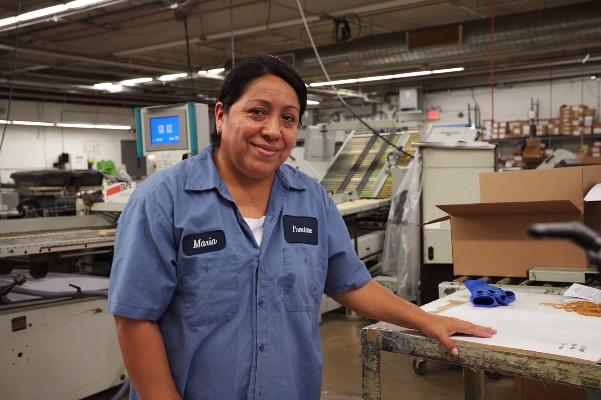
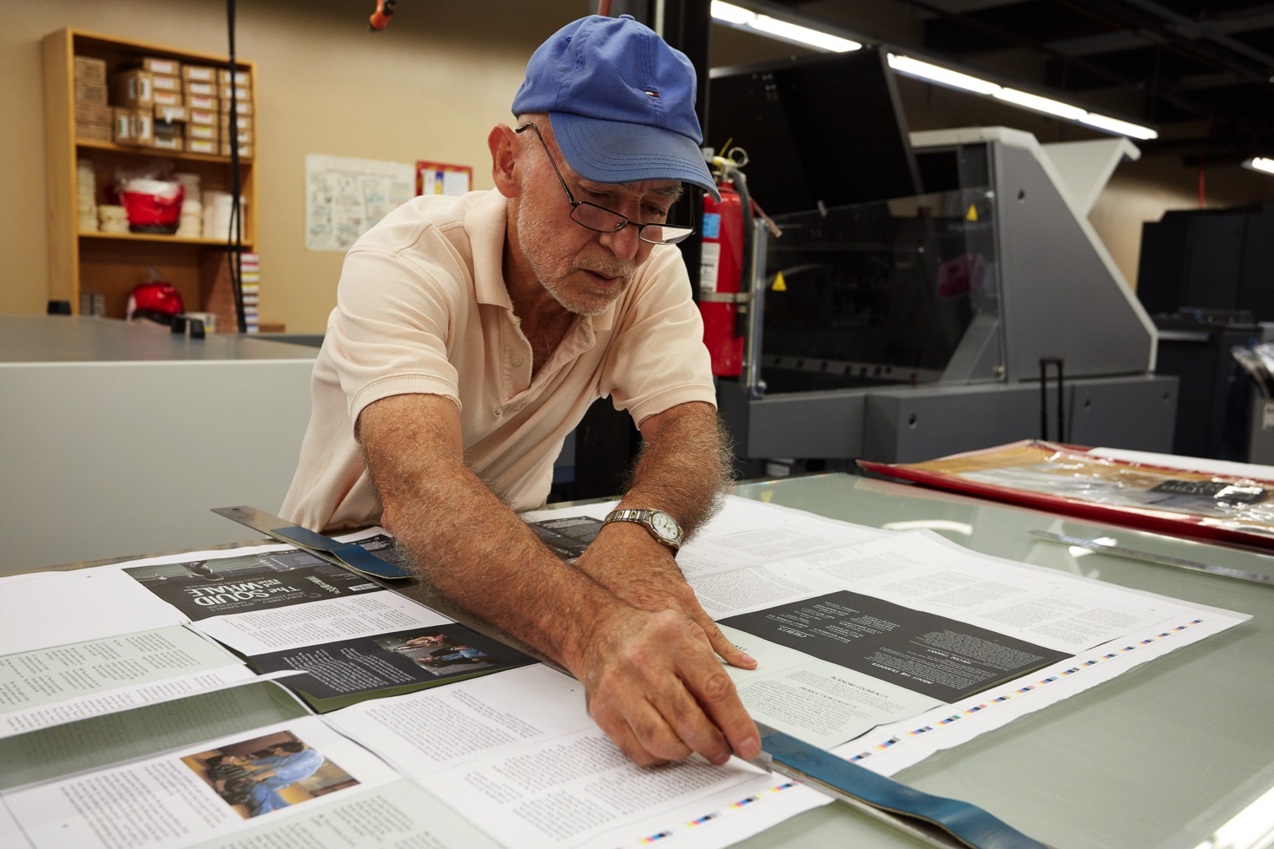
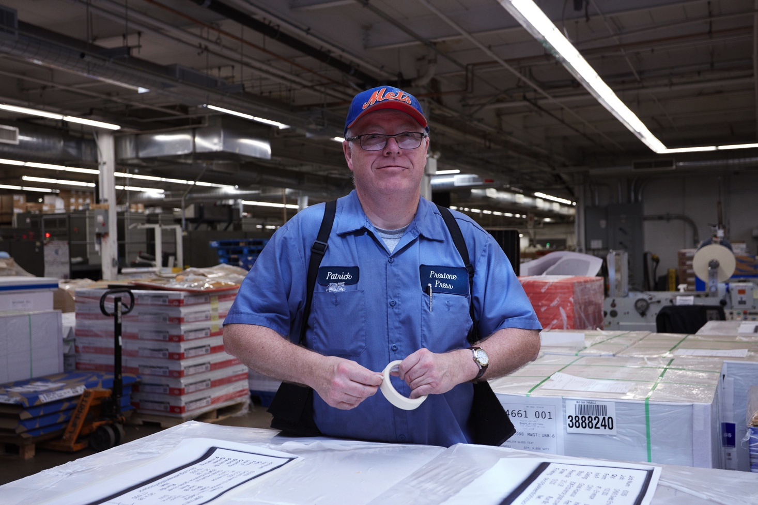
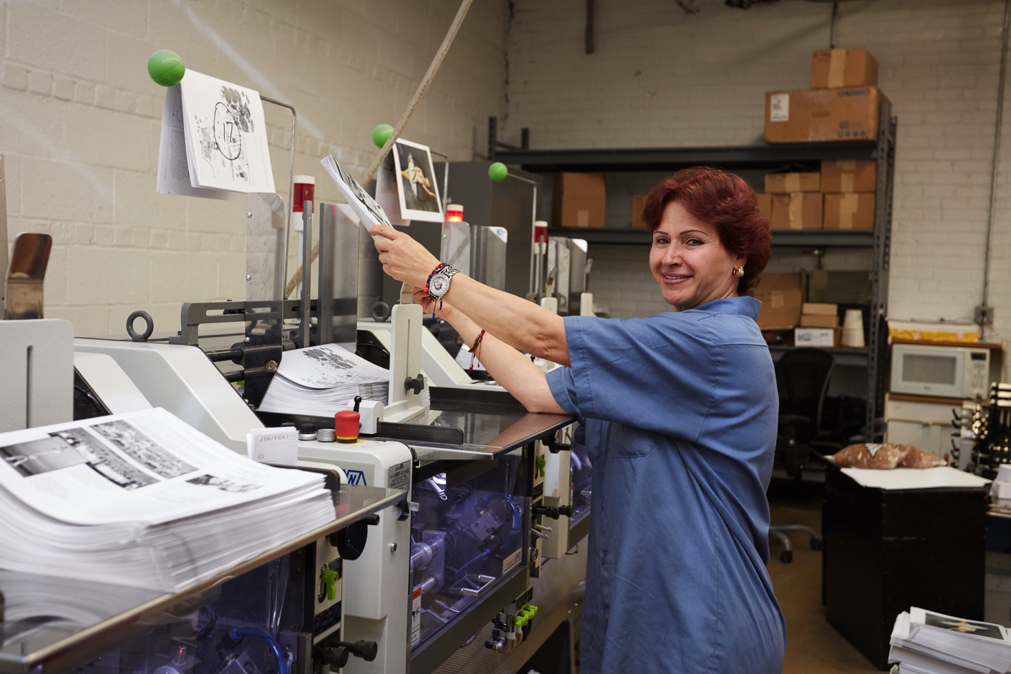

Slide 6
Work Place Culture

Slide 7
Workplace Culture
Positive
Quite
Relaxed
Modern
Friendly
Drive engagement

Slide 8
Projects
Direct Mail
Graphic Designs
Client Press Check
Advertisement
Digital Print

Slide 9
Direct Mail
Direct-mail advertising is that it is highly targeted
highly measurable, according to the U.S. Postal Service
Individualized
Cost Effective
Highly Flexible

Slide 10
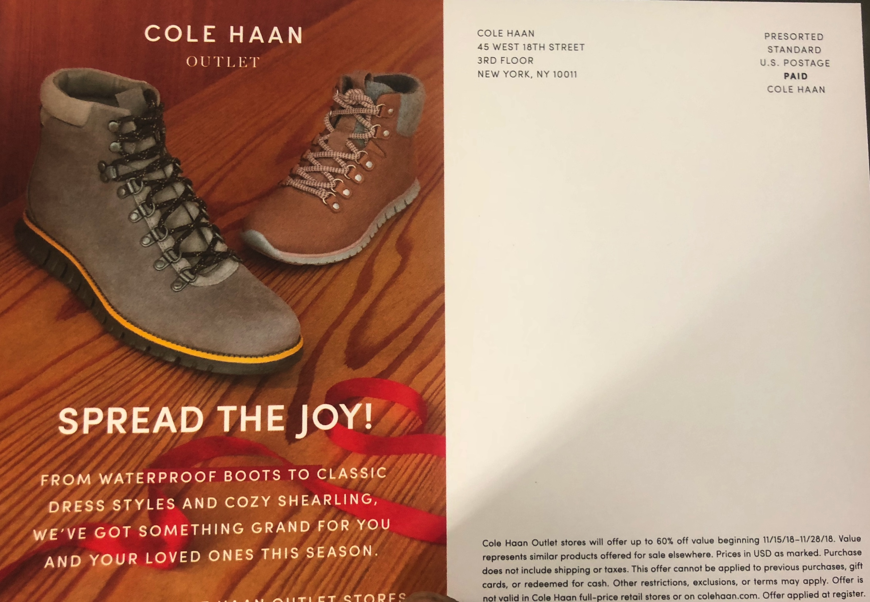
Cole Hann Direct Mail Print

Slide 11
Print Production
Worked with HP 10 Color Press Printer
Rena Soft Envelope Printer
Mcolor Software
Client Press Check
PDF Samples

Slide 12
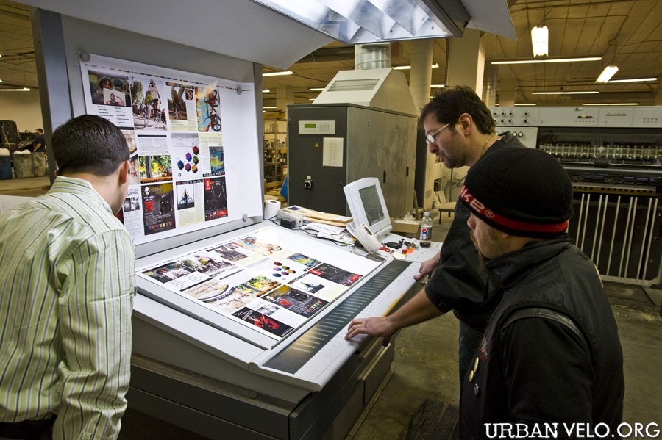
Client Press Check

Slide 13
Other Work
Color Corrected file
Assisted Senior designer with designs
Printed 1,000 Post card Direct Mail for Kings College & Cole Hann
Printed 1,000 Envelope Design

Slide 15
What I learned
Print Production
Design Process
Ask questions
Its Plenty to learn
Self doubt is ok
Be patient
Trust the process

Slide 16
Tips For Designer's
Get Organized
Set Your Priorities
Over Estimate
Network Like Crazy
Be Passionate
Enjoy Your Work
Be & Stay Creative

Slide 17
THANK YOU…

