Slide 1
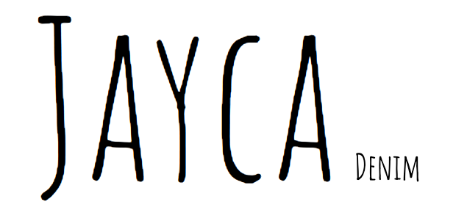

Slide 2
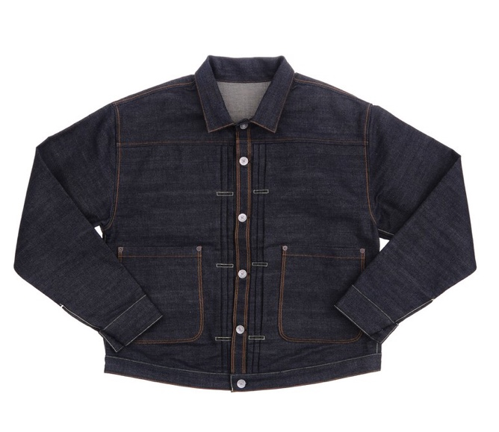
Denim jacket trends and history

Slide 3
Denim History
Levi Strauss
Invented first denim jacket known as a trucker in 1880
1980’s
Denim jacket becomes oversized with boxy and a comfortable fit
Denim becomes an Icon
In 1955, James Dean made denim jacket popular wig captured rebel without a cause style
2000-
Denim continues to be a staple piece everchanging In the market

Slide 4
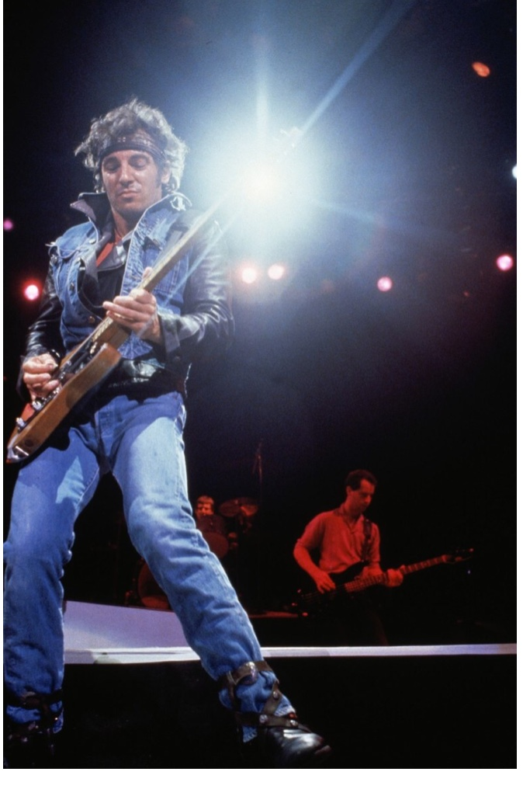
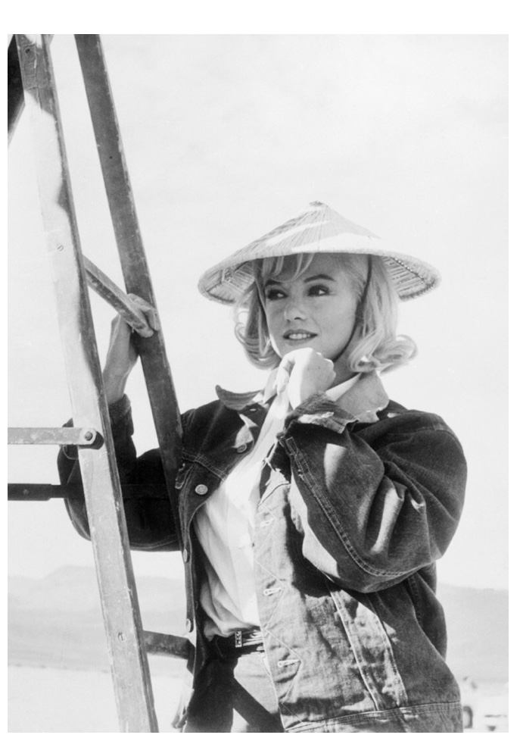
Trends
There are several trends today that showcase many varieties of the denim jacket
Some of these trends are distressed,colored neon,appliqué and tie dye
The first denim jacket was created 1880 by Levi Strauss. It was created for railroad workers and was then popularly known as the trucker jacket

Slide 5
Adapting to Changes in the market
Denim has been categorized into mass market, standard and premium
Customers demand cost effective denim in addition to comfort is boosting the market
The denim market is expected to reach $79,211 million by 2023 due to the large transformation of asian retail clothing
Growing e-commerce industry and expansion of organized retail is driving the market globally.
Men category in the denim market hold the largest share because men across the globe wear denim more the other for work-wear, party-wear, and casual-wear
Rising disposable income of people
Expanding bases of the working class population
Denim jacket market is also growing with the rise in overall disposable income and greater affordability of popular denim brands such as H&M, Old Navy, ASOS, and Zara

Slide 6
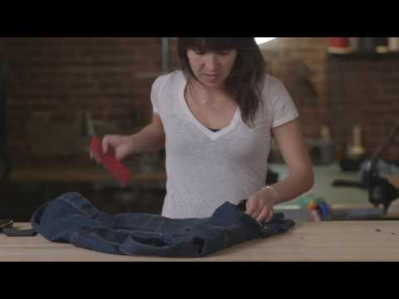
What is distressed ?
https://youtu.be/NwParuvKWLQ

Slide 7
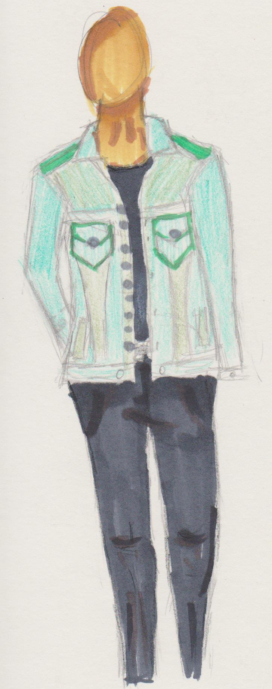
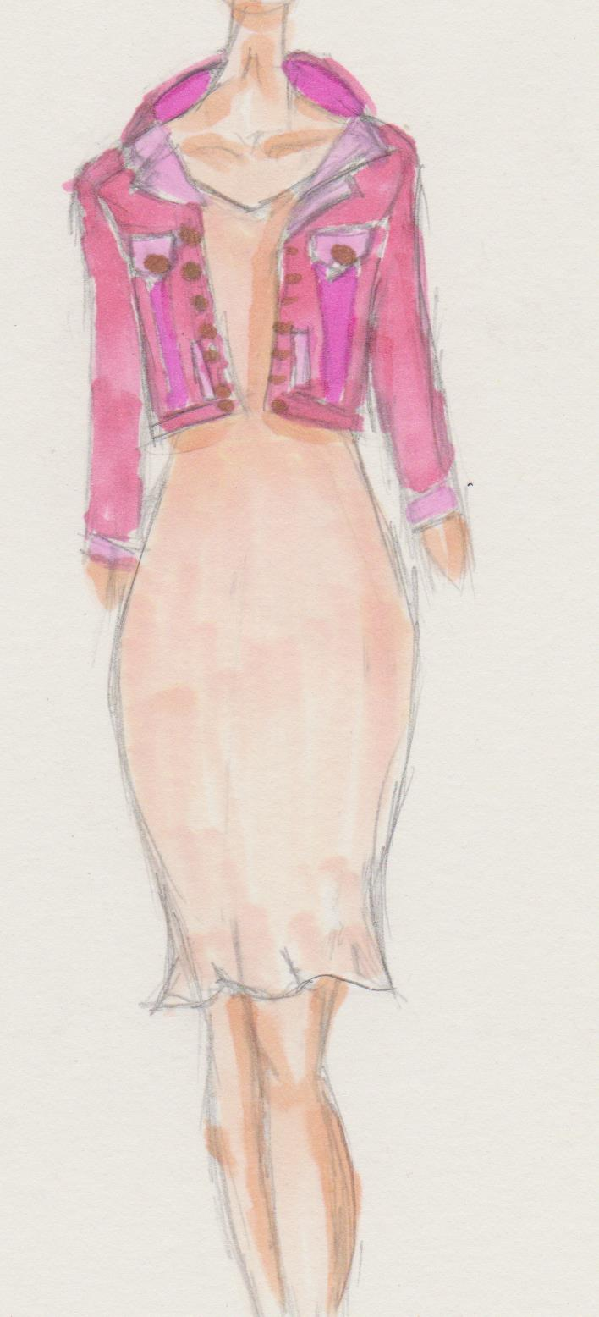
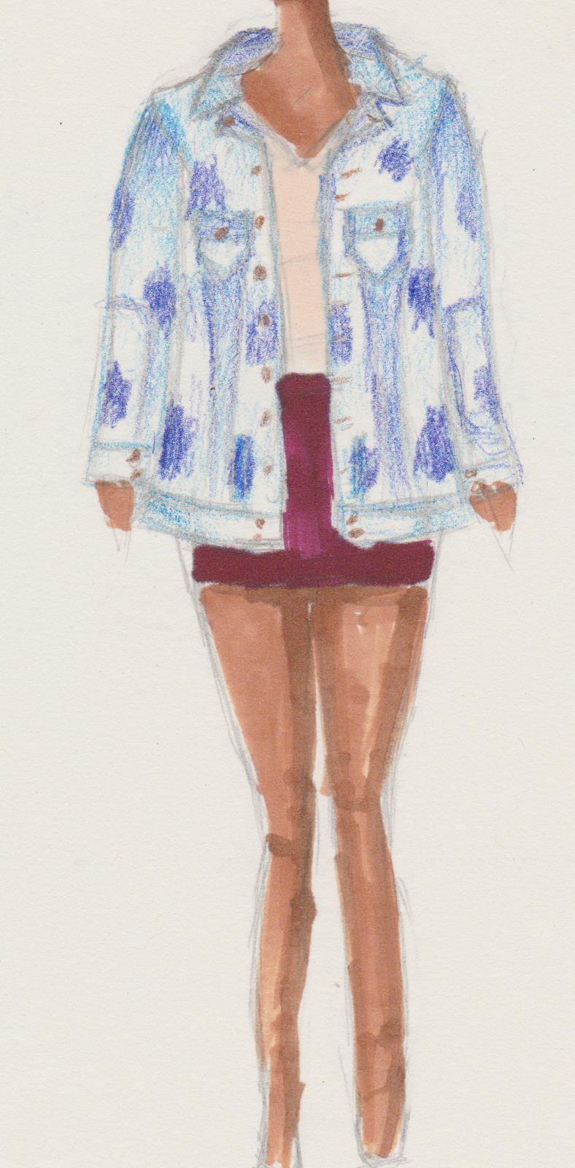
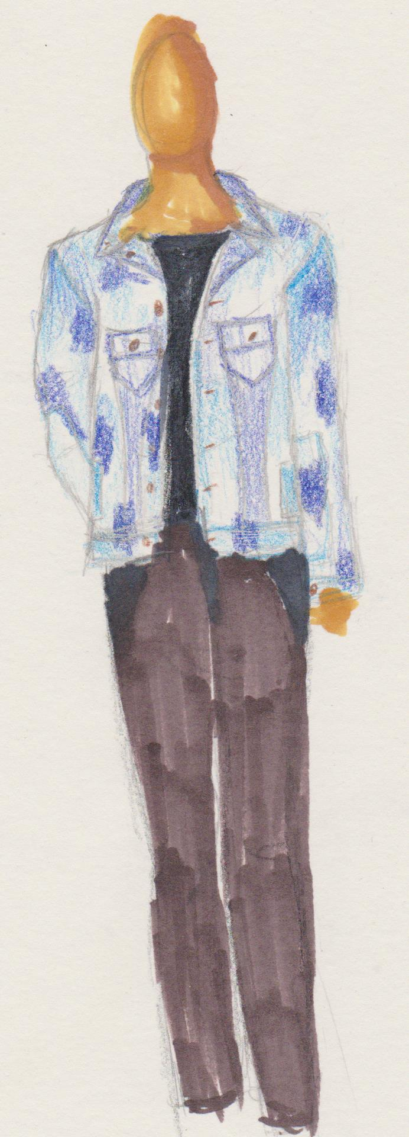
Acid Wash Oversize
Color/Neon

Slide 8
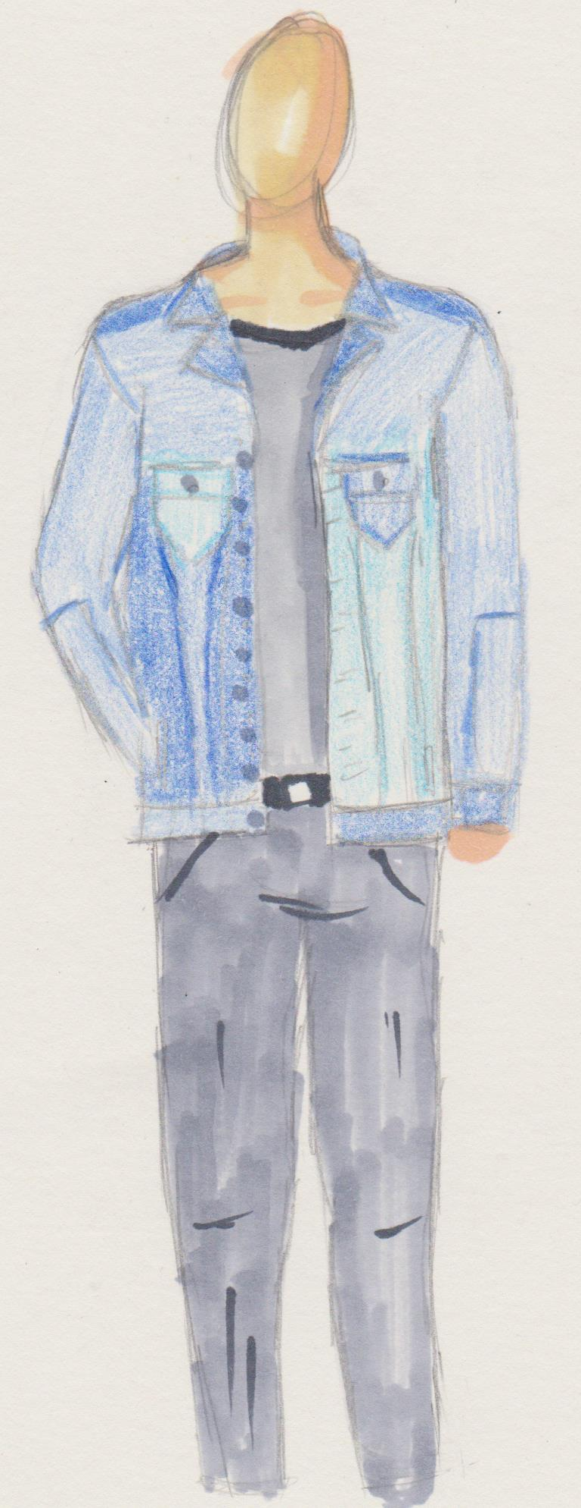
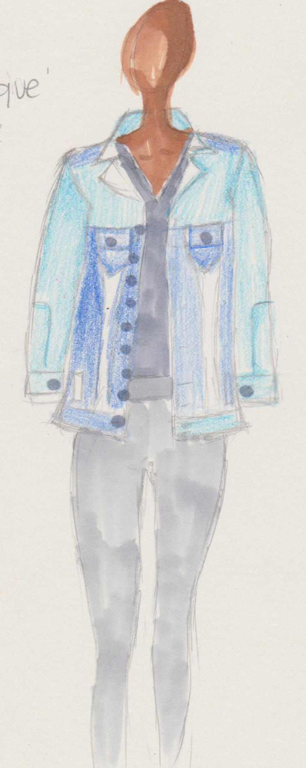
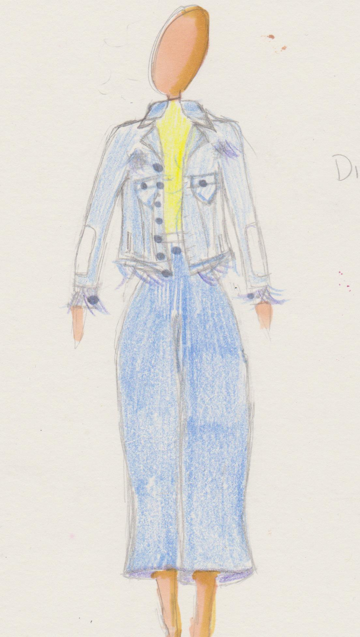
Distressed regular fit
Patches Oversize

Slide 9
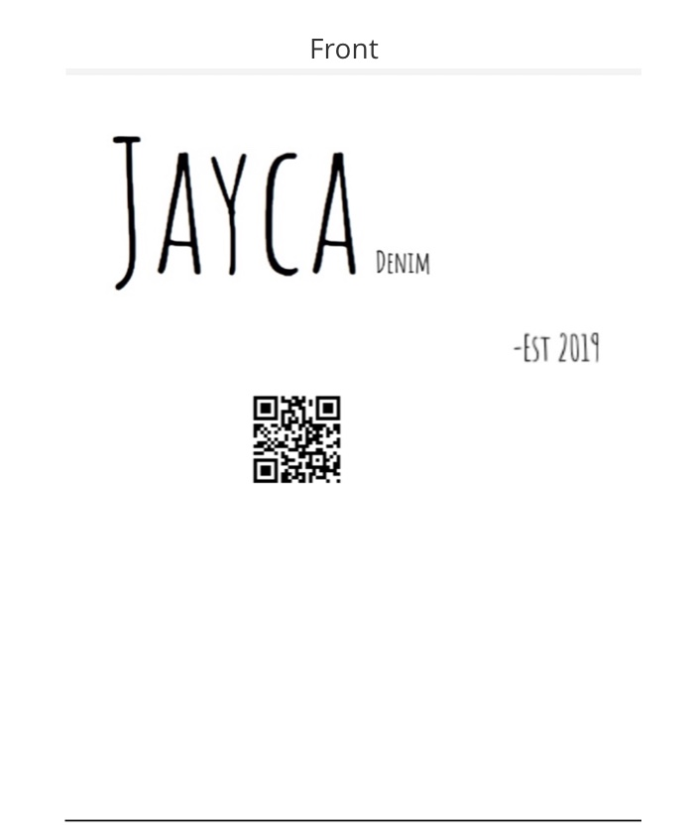
Global scanning tag that can link and identify products to website and social media. Scanning it also tells material information and care instructions

Slide 10
Shopping the Mkt
STORE | MATERIAL | COLOR/ACCENTS | FIT | RETAIL PRICE
ZARA | 100% COTTON | NEON GREEN | CROPPED | $49.90
TOPSHOP | 100% COTTON | DISTRESSED/MIDSTONE | OVERSIZED | $95.00
A&F | 100% COTTON | PATCHED/LIGHT WASH | TRUE TO SIZE | $140
LEVIS | 100% Cotton | GREY/DISTRESSED | Regular fit | $98
AE | 99% Cotton, 1% Elastane | ACID WASH | STANDARD FIT | $89.95

Slide 11
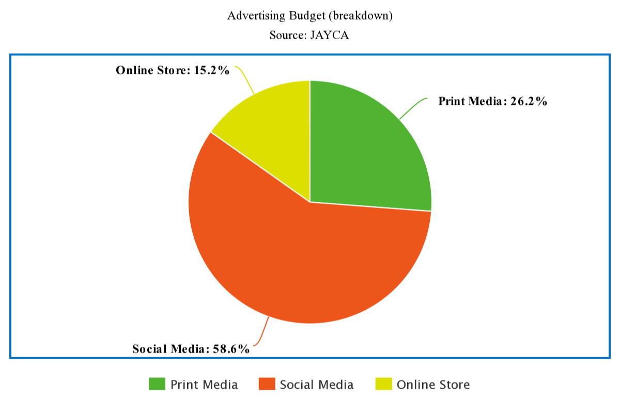
Advertising Budget
Medium: | Cost:
Print Media | $603,988
Social Media | $1,350,000
Online Store | $350,000
Total Cost: | $2,303,988

Slide 12
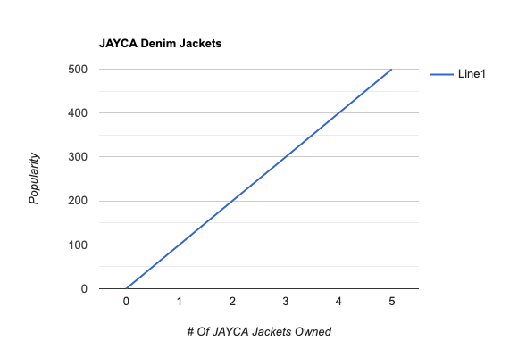

Slide 13
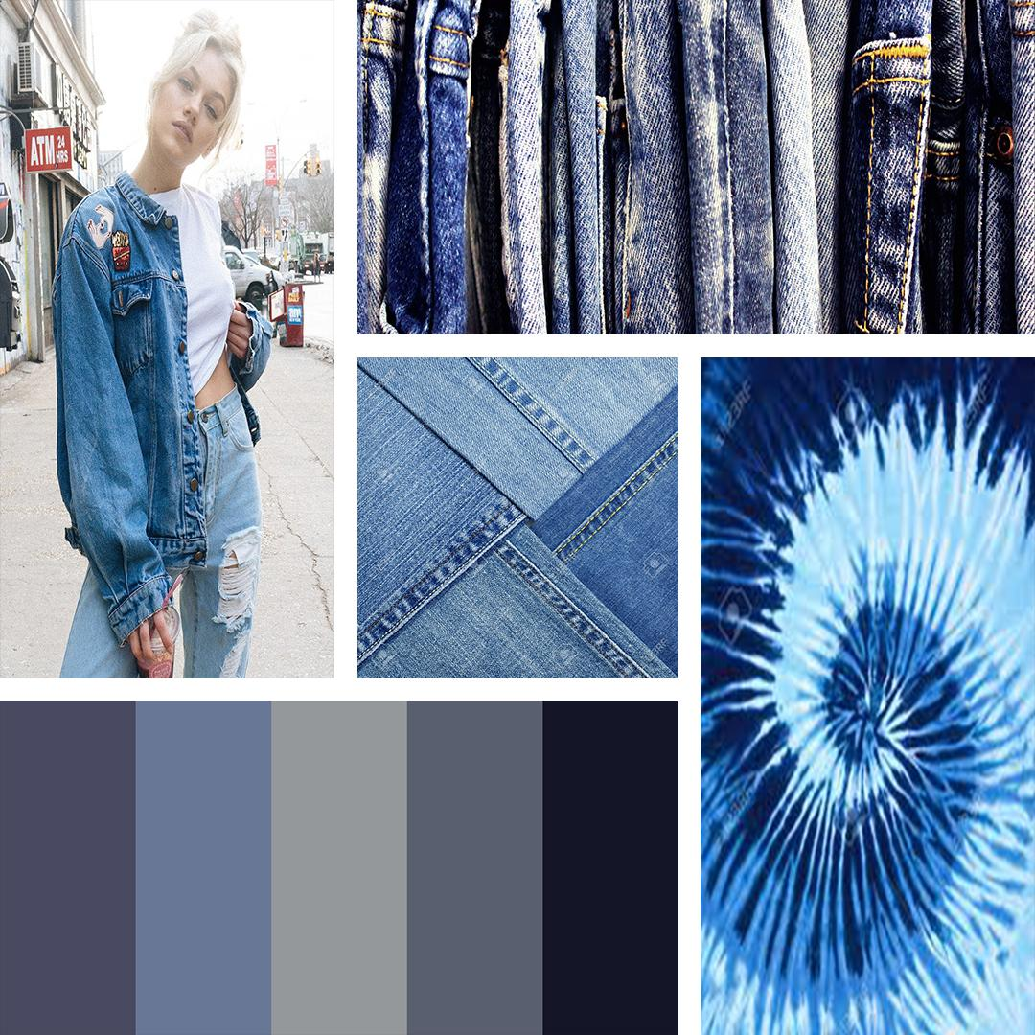
MOO

Slide 14
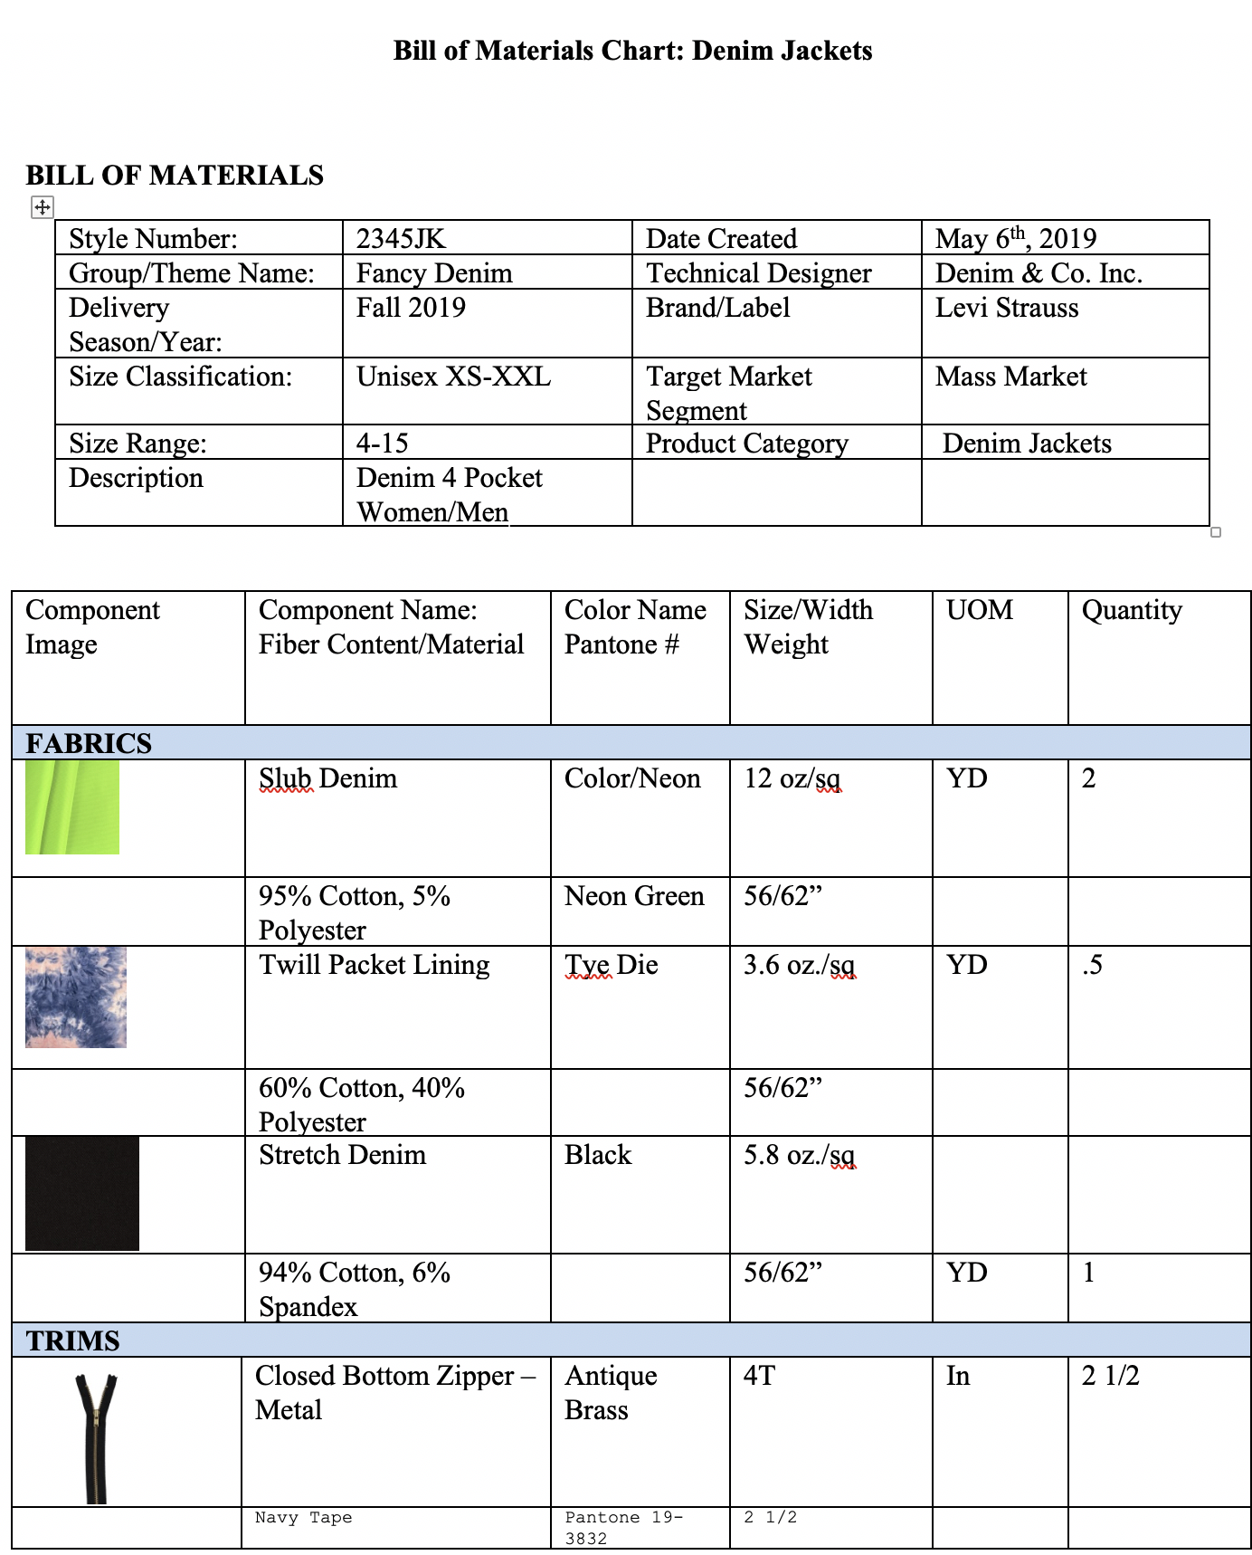
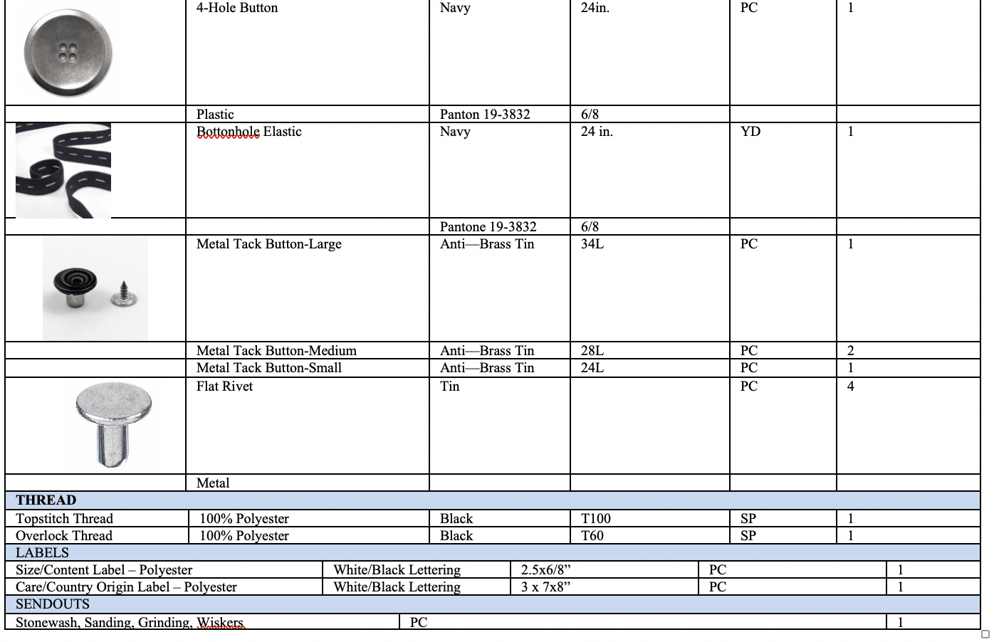

Slide 15
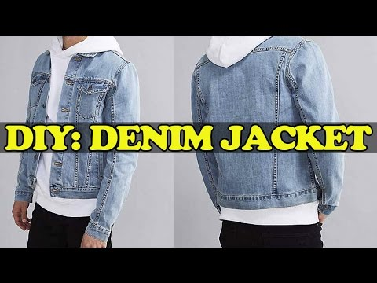
DIY DENIM JACKET VIDEO
https://www.youtube.com/watch?v=lDg3W7gPG3Y

Slide 16
