Slide 1
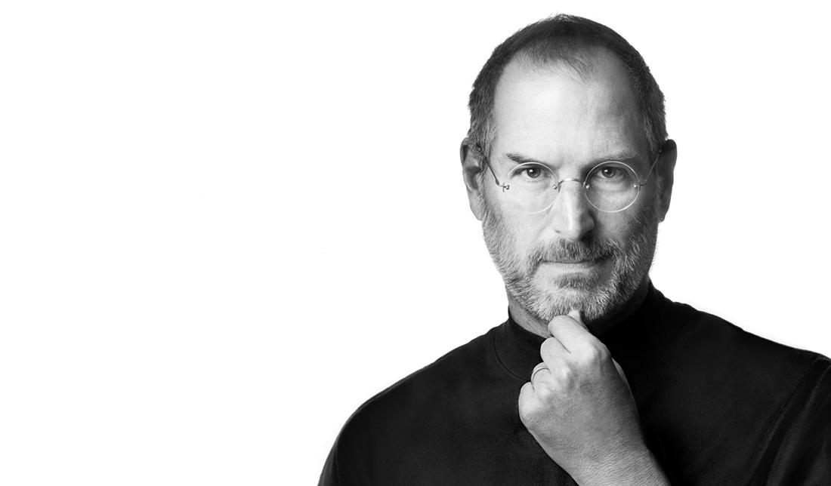
Steven Jobs
By: Alberto Caicedo

Slide 2

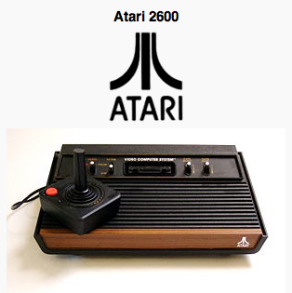
The Bibliography
An American entrepreneur, marketer, and inventor and cofounder and CEO of Apple Inc.
Born in San Francisco, California in February 24, 1955 to two university graduates, Joanne Shieble and John Jandali, who placed him for adoption. Until he was adopted by Clara and Paul Jobs.
In Reed College in Portland, Oregon, he dropped out six months later, and dropped in on creative classes, like Calligraphy, that suited his interests.
In 1974, Jobs took a position as a video game designer with Atari
He traveled to spiritual enlightenment to India and experimented on psychedelic drugs.

Slide 3

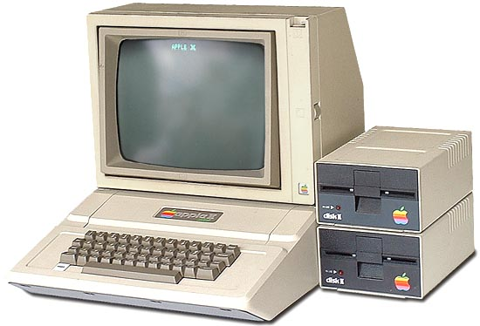
The Beginning of an era
In 1976, Steven Jobs, at the age of 21, he and his best friend Wozniak started Apple Computers at his family’s garage. Not to mention he sold his Volkswagen bus and Wozniak sold his beloved calculator to pursue their goal.
The first industry was not successful at first. They make machines smaller, heavier and cheaper to everyday consumers. Three years later, they introduced to Apple’s second model, Apple II and the market value stake up to 1.2 billion dollars on the first day of trade.

Slide 4
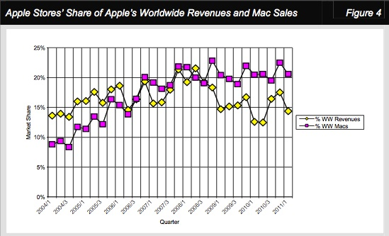
The Turmoil
Several products of the Apple Inc. had suffered design flaws and low consumer disappointments.
IBM had surpass Apple’s sales and Apple had to compete.
In 1984, Apple had worked Macintosh by marketing the computer but it was not compatible to IBM
In 1985, Jobs was resigned as Apple’s CEO and began a new hardware and software Company called NeXT.

Slide 5

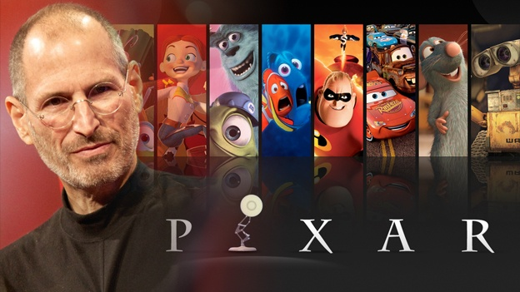
Out of the Darkness
The following years Jobs had purchased a company from George Lucas and later became Pixar Animation Studios.
Jobs had invested 50 million dollars into the company
Many popular movies were produced: Toy Story, Finding Nemo, and The Incredibles and the film skyrocketed to 4 billion dollars.
In 2006, Walt Disney merged the company to Pixar and made Steven Jobs, Disney’s largest shareholder.

Slide 6

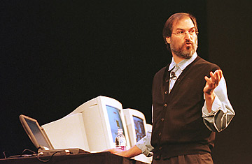
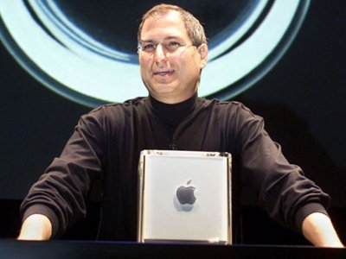
Out of the Darkness II
The company, NeXT had made many attempts to sell the operating systems to mainstream America.
In 1997, Apple brought the company NeXT for 429 million dollars and Jobs return back to the company has CEO of Apple.
New management team altered stock options and a self imposed annual salary of $1 a year
Once he came back, he put the company back on track and invented new technology such as the iMac and other popular brands

Slide 7
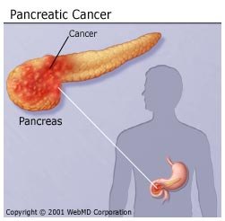
Disturbing news
In 2003, Jobs discovered he had neuroendocrine tumor. A operable form of pancreatic cancer.
For nine months, he was operated but he postponed the operation making everyone including the Apple directors nervous.
In 2004, the pancreatic tumor was removed, but Jobs cares little about his health.
In October 5, 2011, Steven Jobs had passed away in Palo Alto at the age of 56 years old.

Slide 8
The Achievement
Steven Jobs was the fifth most powerful person in the industry world that sold and manufacture Apple products to the consumers.
He pushed boundaries to his company to produce a computer that is available for everyone.
Consumer technology advanced at an incredible rate over the past decade thanks to the contributions of Apple under Steven Jobs
He showed a lot of interest in technology as a young boy, and with his motivation, he created the most successful company known as Apple.

Slide 9

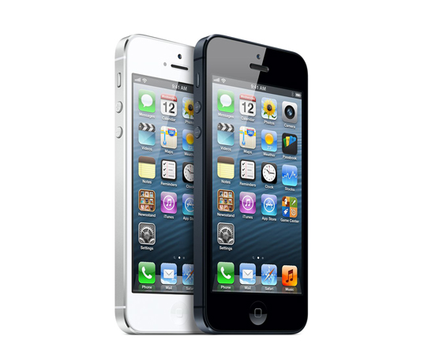
Why was Steve Jobs so important?
Steven Jobs had created the first commercial personal computer and it brought affordable computers to every consumers.
He inspires not only in his friends but to the designers and workers at Apple and other companies to push boundaries in which the style of the computer was not invented.
He revolutionized technologies by creating the iPod, and iMac and many successful media, phone, and musical devices.
He founded Pixar and created the 3d media movies in the world.

Slide 10
“Your time is limited, so don’t waste it living someone else’s life. Don’t be trapped by dogma which is living with the results of other people’s thinking. Don’t let the noise of others’ opinions drown out your own inner voice. And most important, have the courage to follow your heart and intuition. They somehow already know what you truly want to become. Everything else is secondary.”
- Steven Jobs

Slide 11
Steven Jobs
February 5 1955 – October 5, 2011

