Slide 1
Avoiding Plagiarism & Documenting Sources
WILSON SHERWIN AND DREW FLEMING
WRITING FELLOWS AT CITY TECH
Notes:
WS

Slide 2
In this workshop we will cover:
Understanding Plagiarism
Documenting Sources
Paraphrasing

Slide 3
Intellectual challenges in American academic writing (Stolley, Karl, Brizee, Allen, and Paiz, Joshua M., 2013: Directly from Purdue OWL)
Build on the work of previous researchers | BUT | Write something new and original
Rely on experts' and authorities' opinions | BUT | Improve upon and/or disagree with those same opinions
Give credit to previous researchers | BUT | Make your own significant contribution
Use the “jargon” of your discipline. | BUT | Use your own words and your own voice

Slide 4
Plagiarism Quiz

Slide 5
What is plagiarism?
“Plagiarism is the act of presenting another person’s ideas, research, or writings as your own. Examples of plagiarism include:
Copying another person’s actual words or images without the use of quotation marks and footnotes attributing the words to their source.
Presenting another person’s ideas or theories in your own words without acknowledging the source.
Failing to acknowledge collaborators on homework and laboratory assignments.
Internet plagiarism, including submitting downloaded term papers or parts of term papers, paraphrasing or copying information from the internet without citing the source, or ‘cutting and pasting’ from various sources without proper attribution.”
-NYCCT statement on academic integrity

Slide 6
Why does plagiarism occur?
Time management
Lack of self-confidence
Bad paraphrasing
Improper citations

Slide 7
What is paraphrasing?
Paraphrasing is rewriting a sentence or series of sentences in your own words.
Example (From Purdue OWL, 2012)
Original Text:
“Students frequently overuse direct quotation in taking notes, and as a result they overuse quotations in the final [research] paper. Probably only about 10% of your final manuscript should appear as directly quoted matter. Therefore, you should strive to limit the amount of exact transcribing of source materials while taking notes.” Lester, James D. Writing Research Papers. 2nd ed. (1976): 46-47.
Paraphrase:
In research papers students often quote excessively, failing to keep quoted material down to a desirable level. Since the problem usually originates during note taking, it is essential to minimize the material recorded verbatim (Lester 46-47).
https://owl.english.purdue.edu/owl/resource/563/02/

Slide 8
6 Steps to Effective Paraphrasing (Purdue OWL, 2010) - https://owl.english.purdue.edu/owl/resource/619/1/
Reread the original passage until you fully understand it.
Write your version without looking at the original.
Include a few words below your paraphrase to remind you later how you envision using this material.
Check your version with the original to make sure that your paraphrase accurately expresses all the essential information in a new form.
Use quotation marks to identify any unique phrase you have borrowed from the original.
Cite your original source using proper formatting.

Slide 9
Paraphrase Exercise
Imagine you want to use the following information to support an argument you are making in a paper. Paraphrase it, and include an in-text citation:
Of the more than 1000 bicycling deaths each year, three-fourths are caused by head injuries. Half of those killed are school-age children. One study concluded that wearing a bike helmet can reduce the risk of head injury by 85 percent. In an accident, a bike helmet absorbs the shock and cushions the head.
Excerpt from "Bike Helmets: Unused Lifesavers," Consumer Reports (May 1990): 348.

Slide 10
Documenting Sources
Know the preferred citation style for the class
MLA is the preferred style for liberal arts and humanities
APA is the preferred style for the social sciences
Many academic disciplines have their own style, so always ask your professor
PRO TIP: Don’t bother memorizing details of each style!!
Bookmark this instead: https://owl.english.purdue.edu/owl/

Slide 11
MLA Format
Example of In-Text Citation:
“Along these lines, revisionists have stressed continuing popular Episcopalianism after disestablishment and recast the demographic explosion of evangelicalism as a firmly early to mid-nineteenth century story” (Heyrman 18–20).
Works Cited:
Heyrman, Christine. Southern Cross: The Beginnings of the Bible Belt. Chapel Hill, NC: University of North Carolina Press, 1997. Print.

Slide 12
APA Format
In-Text Citation
“Along these lines, revisionists have stressed continuing popular Episcopalianism after disestablishment and recast the demographic explosion of evangelicalism as a firmly early to mid-nineteenth century story” (Heyrman, 1997, pp. 18–20).
Reference Page
Heyrman, C. (1997). Southern Cross: The Beginnings of the Bible Belt. Chapel Hill, NC: University of North Carolina Press.

Slide 13
How do I Document My Sources?
Citations in the body of the paper
In-text citations
Footnotes/endnotes
Documentation at the end of the paper
Bibliography
Works Cited
References

Slide 14
Work Cited v. Bibliography
Works Cited
A works cited page consists of sources that you DIRECTLY cite in your paper.
All secondary sources which you quote from or paraphrase MUST be included in your works cited.
Bibliography
A bibliography page consists of sources that you DIRECTLY cite in your paper along with any and all works you consulted in your project.
Even if you did not cite the item or paraphrase it in your paper, you should include it.

Slide 15
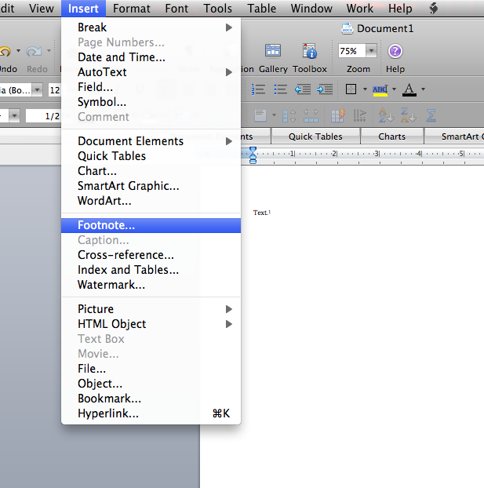
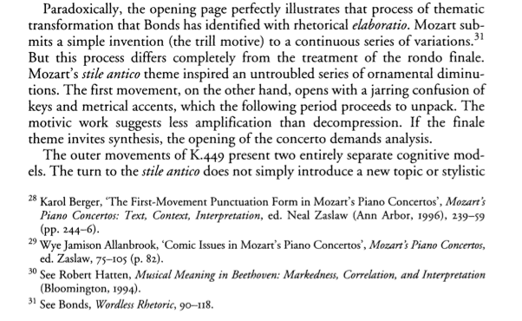
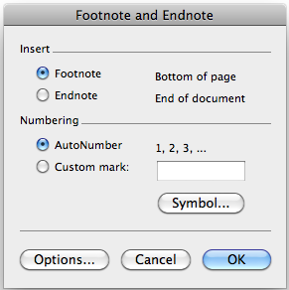
Footnotes/Endnotes
Footnotes and endnotes are used in the Chicago Manual style of citation.
They are intended to be less intrusive to the flow of a paper’s prose than in-text citations.
A footnote/endnote has two parts:
Note Reference Mark—the number or other symbol inserted in the body of the paper indicating cited material.
Note Text—the source information appearing at the bottom of the page or end of the paper.
Footnotes and endnotes should be entered using the References tab or the Insert dropdown menu in Microsoft Word.

Slide 16
Contact
Wilson Sherwin:
wilsonsherwin@gmail.com
Drew Fleming:
jfleming@gradcenter.cuny.edu

