Slide 1
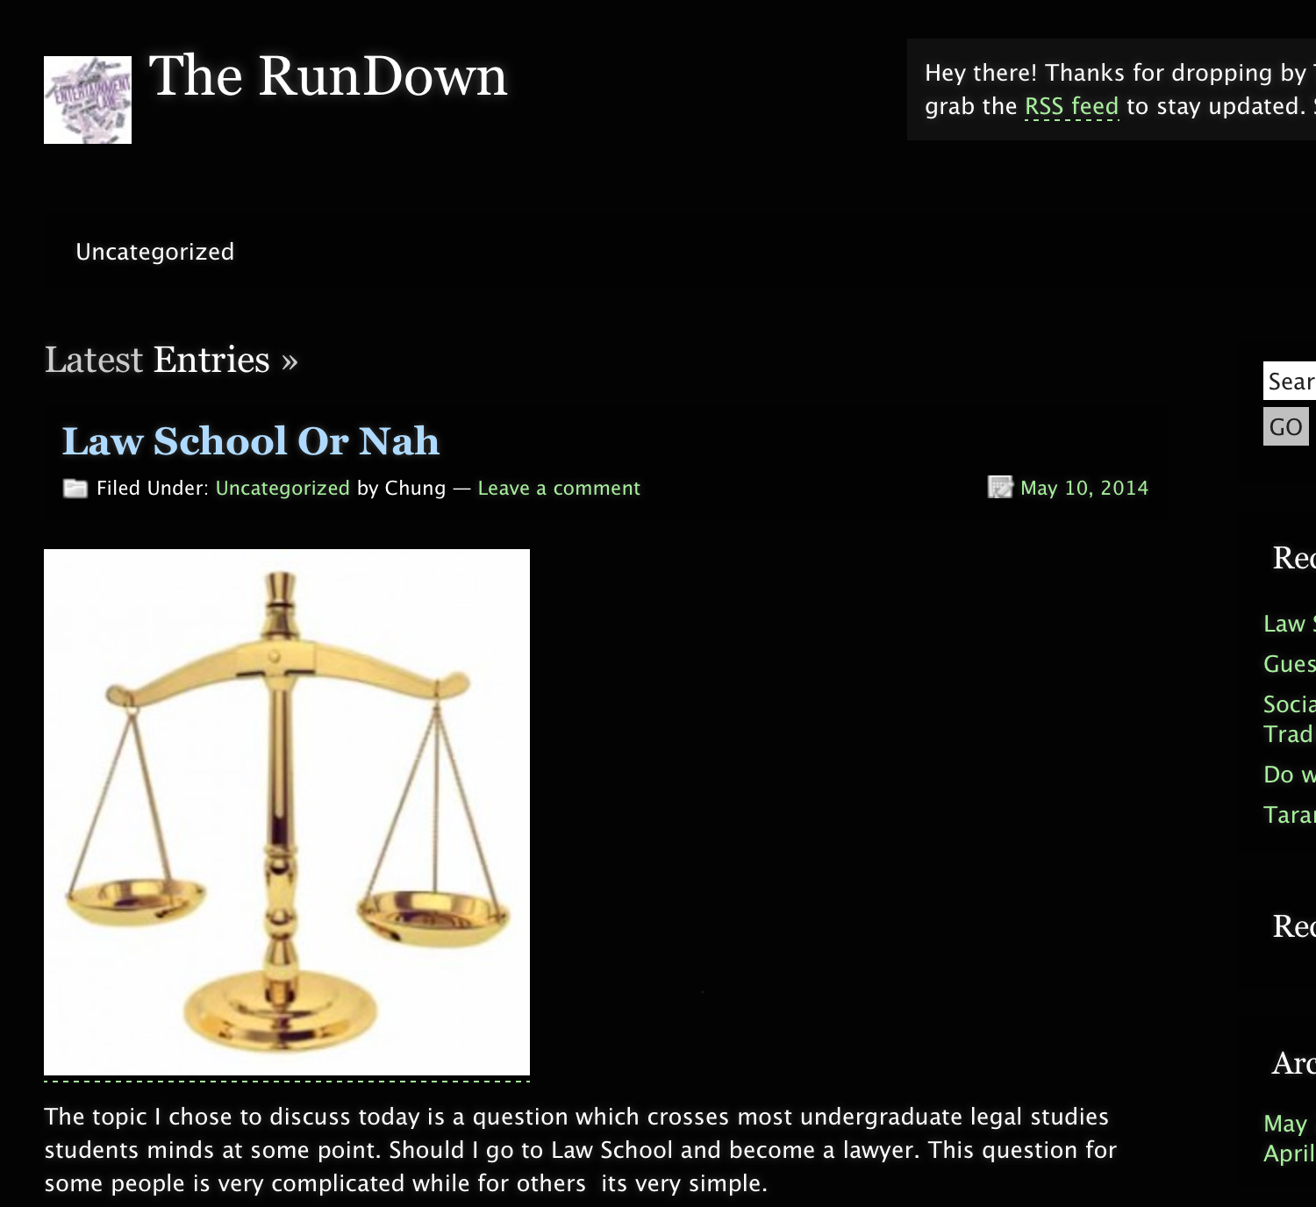
The RunDown
http://openlab.citytech.cuny.edu/abovethelaw/

Slide 2
The RunDown
Bio
Michael Chung is the creator and visionary behind The RunDown. Chung is a Brooklyn native who is majoring in Legal Studies at City Tech. He finds that the best discussions comes from random and fun conversations amongst friends, co-workers etc. With experience in both the legal and entertainment field Chung wants to use this blog as a way to express his thoughts with respect to both fields.

Slide 3
The RunDown
Mission Statement
The Mission of my blog is to express my thoughts in a relatable manner. Readers will be informed about legal matters that made big headlines in entrainment industry. This blog will consist of my opinions and views on the topics that I choose to post.

Slide 4
The RunDown
A typical post on The RunDown contains usual a topic regarding someone in the entertainment field having legal troubles and me giving my opinion on that subject with an Image attached.

Slide 5
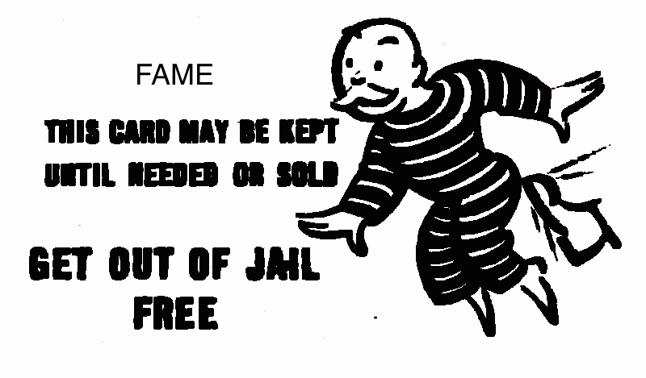
The RunDown
Series Post
There is a three part blog series on The Rundown entitled “Stay Out Of Trouble”. This series was inspired by celebrities who have gotten in trouble with the law and given a “Get out of jail card” but continues to get in trouble with the law and jeopardize their career.

Slide 6
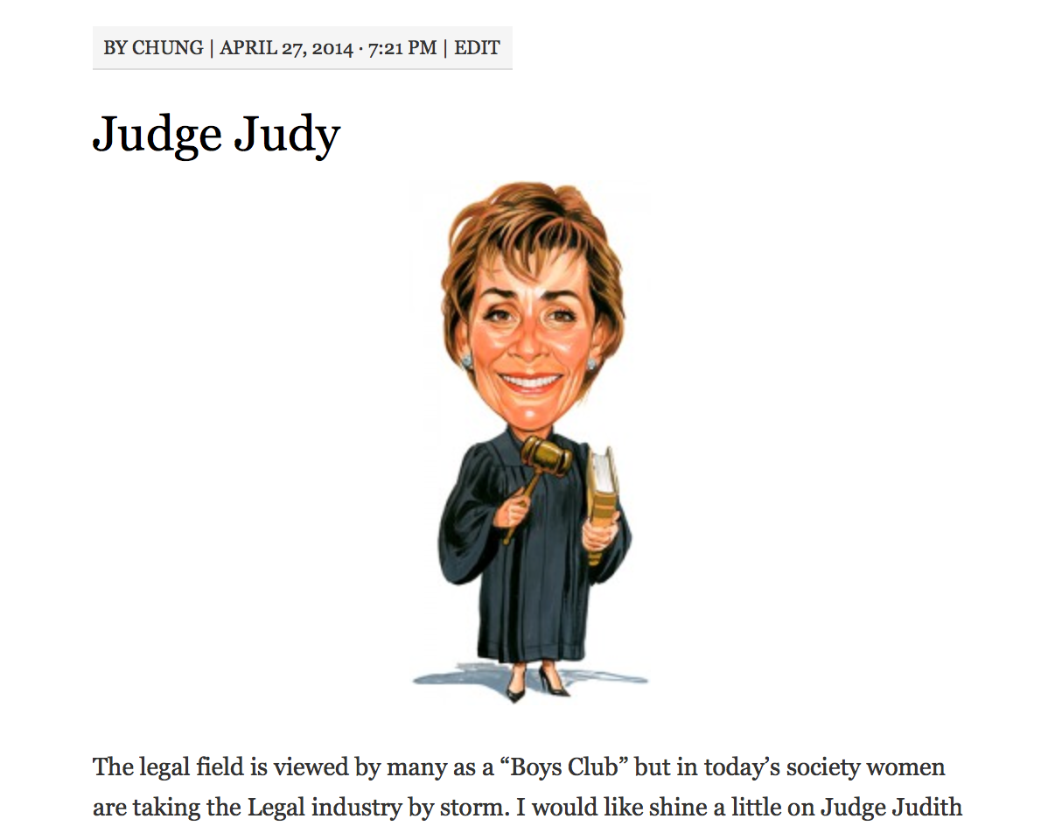
The RunDown
I made a guest post on Laura’s Law History Blog. In this post I payed homage to Judy Judge.
Laura’ Blog is a very informative blog that has a unique way of explaining topics regarding history in the legal field. To check her blog out follow the link below
openlab.citytech.cuny.edu/lawandhistory/

Slide 7
The RunDown
Even though this blog is in it development stage You should read The RoundDown because it is a simple and cool blog for those interested in reading about Law & Entertainment.
Thank you for your time.

