Slide 1
Coney Island then & now

Slide 2
https://kapwi.ng/w/BFuAUK1j

Slide 3
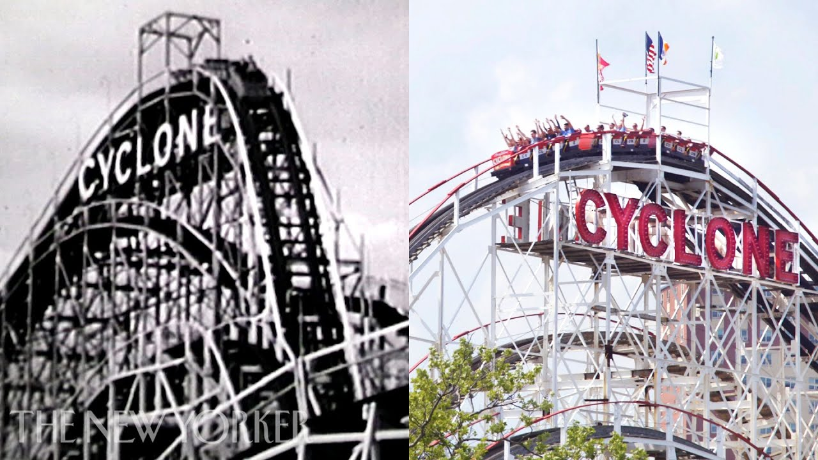

Slide 4
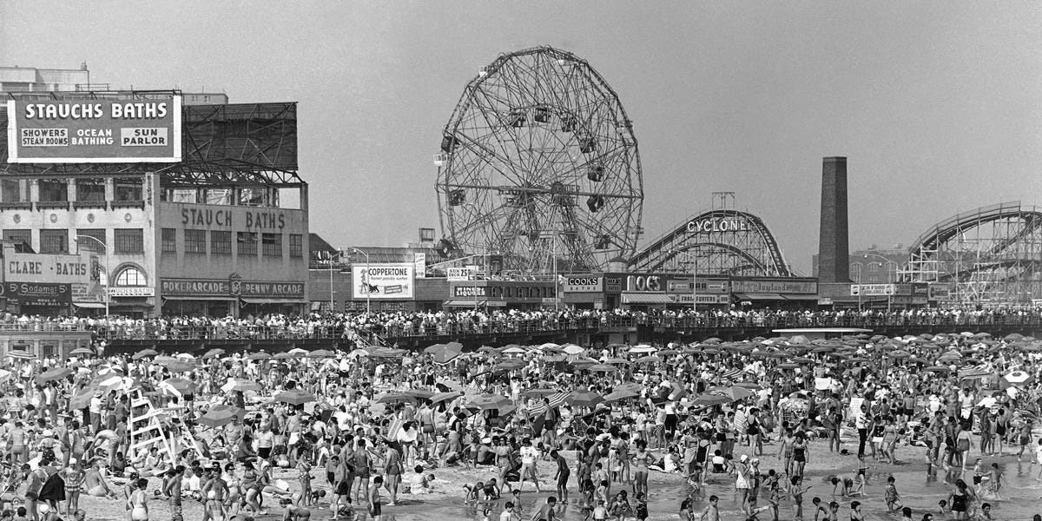

Slide 6
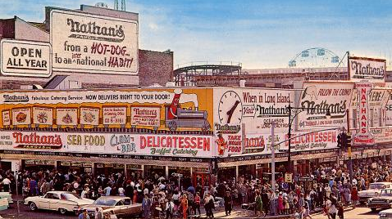

Slide 7
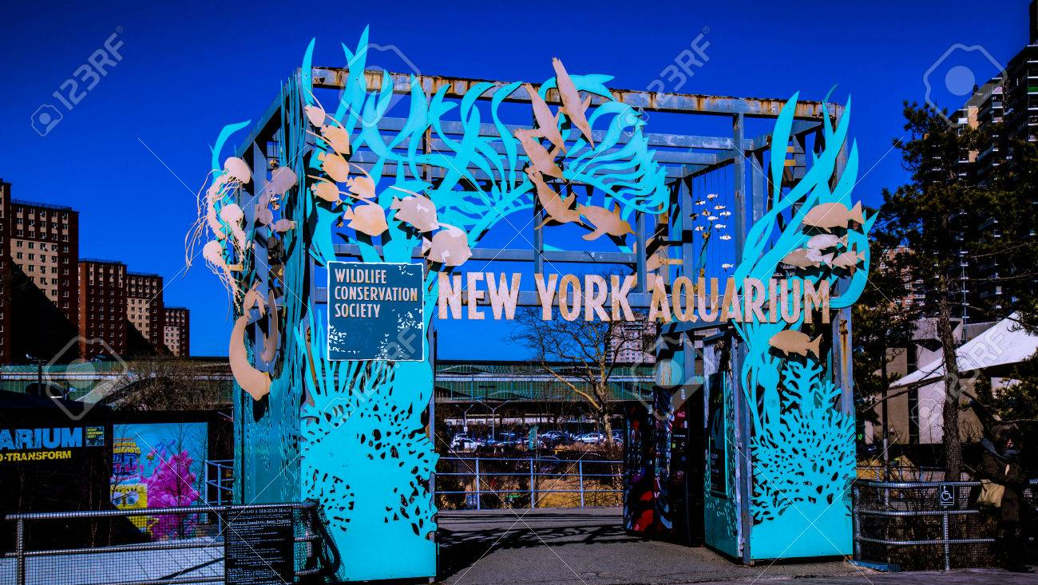

Slide 8
