Slide 1

ENG 1121
English Composition 2
Objectives
Intro to Antigone
Discuss the characters of the play

Slide 2
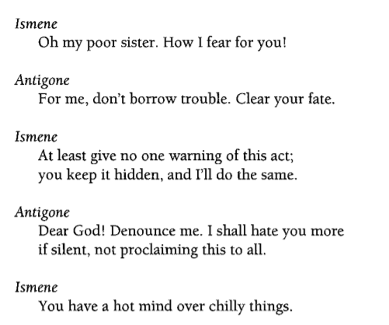
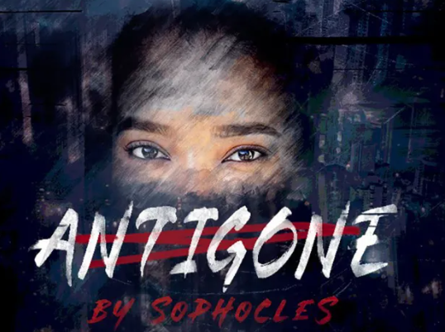
What’s the main conflict?

Slide 3

The play’s the thing!
A professor of mine once said that plays aren’t meant to be read in silence—they’re meant to be read out loud!
Do you agree or disagree? Why?
Do we have at least two volunteers to read part of the scene between Antigone and Ismene?

Slide 4
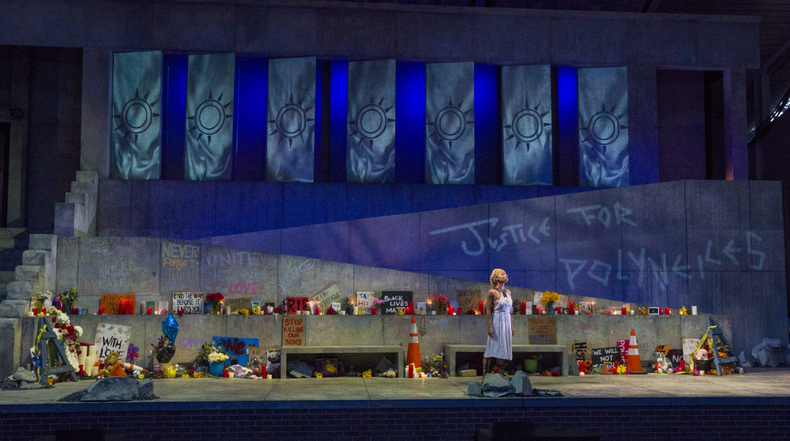
Digging Deeper into the Play’s Characters
In the next 30 minutes, write a Post titled Full Name, Characters of Antigone and saved under the category Unit 2 Work. The post should have two paragraphs that include the following:
Paragraph 1: Reread the first 100 lines (pages 1-5) of the play and write some adjectives that come to mind describing the two sisters (Antigone and Ismene). With these characteristics in mind, what actors would you cast in the role of Antigone and Ismene if this were a movie? Why?
Paragraph 2: Reread Creon’s monologue (pp. 6-8), Creon’s interactions with the guard (pp. 8-13), and the section between Antigone and Creon after she is brought before him (pp.13-21) in order to gain a sense of Creon’s character. If Creon lived in today’s world, on which social media platform would his monologue appear? Why would he use this platform? What traits does he have that would make him choose this platform? Using the conventions of the platform, rewrite a section of the monologue in modern language.

Slide 5
Digging Deeper into the Play’s Characters
Let’s talk about what you’ve discovered about Antigone, Ismene, and Creon!

Slide 6
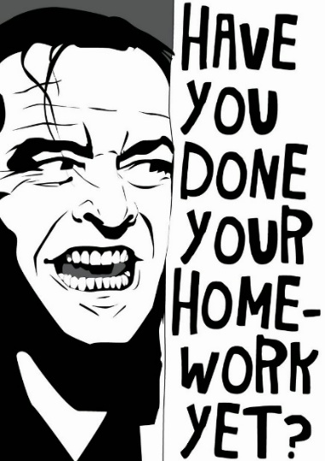
Homework
Before class on Wednesday, READ & WRITE:
Read Sophocles, Antigone (pp. 22-45)
  Again, be sure to read it before class!
Write a Post titled Full Name, Did Antigone engage in civil disobedience? and save it under the category Unit 2 Work that includes the following (at least 100 words):
  A definition for the term “civil disobedience,” and explain whether or not you think Antigone is engaged in an act of civil disobedience.
  We’ll discuss this in class, so complete this post before we meet!
We’ll also talk about how Antigone is linked to our Annotated Bibliography!

