Slide 1

ENG 1121
English Composition 2
Objectives
Practice quoting from AOC’s speech
Decide if you’re writing a speech or a letter
Brainstorm about your project

Slide 2

Alexandria Ocasio-Cortez
What’s AOC’s discourse community?
What issue is she discussing in her speech?
Who is her audience?

Slide 3
Quoting AOC
We’re going to practice creating “quote sandwiches” with AOC’s speech!

Slide 4
Step-by-Step Guide
I found this quote: “[W]hat I do have issue with is using women, wives, and daughters as shields and excuses for poor behavior.”
  Note this is verbatim to what is in the text, so I use quotation marks around the phrase, and that I don’t quote everything.
To create a quote sandwich, I need to have an introductory phrase. For example: In her speech, Alexandria Ocasio-Cortez states…
  Note that by mentioning her name, I’ve cited the source!
To complete the sandwich, I need to have an explanation. For example: This statement refers to the moment when Representative Yoho used the fact that he was a husband and a father to deny his behavior towards Ocasio-Cortez on the steps of the Capitol building.
  Note that the explanation is longer than the quote itself!

Slide 5
Quoting AOC
Here’s the final product:
In her speech, Alexandria Ocasio-Cortez states “what I do have issue with is using women, wives, and daughters as shields and excuses for poor behavior.” This statement refers to the moment when Representative Yoho used the fact that he was a husband and a father to deny his behavior towards Ocasio-Cortez on the steps of the Capitol building.

Slide 6
Quoting AOC
I could also do this:
“[W]hat I do have issue with is using women, wives, and daughters as shields and excuses for poor behavior,” Alexandria Ocasio-Cortez states in her speech. This statement refers to the moment when Representative Yoho used the fact that he was a husband and a father to deny his behavior towards Ocasio-Cortez on the steps of the Capitol building.
Either way, the sandwich still has the same elements!

Slide 7
Quoting AOC
Spend about 5 minutes locating a quote.
I’ve put a better transcript of the speech in the Course Profile.
Then spend about 10 minutes creating a quote sandwich.
Don’t worry, I’ll post the slide that explains what to do in a moment…
When time’s up, I’m going to put you into a breakroom to share what you have with a group.
Even if you aren’t finished, share what you have!

Slide 8
Quote Sandwich Review
I found this quote: “[W]hat I do have issue with is using women, wives, and daughters as shields and excuses for poor behavior.”
  Note this is verbatim to what is in the text, so I use quotation marks around the phrase, and that I don’t quote everything.
To create a quote sandwich, I need to have an introductory phrase. For example: In her speech, Alexandria Ocasio-Cortez states…
  Note that by mentioning her name, I’ve cited the source!
To complete the sandwich, I need to have an explanation. For example: This statement refers to the moment when Representative Yoho used the fact that he was a husband and a father to deny his behavior towards Ocasio-Cortez on the steps of the Capitol building.
  Note that the explanation is longer than the quote itself!

Slide 9
Quoting AOC
I’m going to put you into a breakroom to share what you have with a group.
Even if you aren’t finished, share what you have!
Do quick peer reviews of the quote sandwiches:
Does it have an introduction?
Does it use proper punctuation?
Does it have an explanation?

Slide 10
Pick a Model & Organize Your Ideas
Hopefully by now you’ve decided whether you’re writing a speech or a letter.
Now, review the relevant models. If you are writing a speech, review Young, A.O.C., and Douglass. If you are writing a letter look at the text by Wollstonecraft.
Imagine you have met someone who is outside your discourse community. You want to convince them of the importance of the issue you’ve identified.
Set a timer and spend 20 uninterrupted minutes writing what you would say about your issue or problem. (This is a free write, so you don’t have to worry about perfect grammar or complete sentences–just get your ideas down!)
Include all the details you can think of related to this issue or problem:
  Who is affected and how?
  What are some of the effects of this problem? Give examples.
  Also include other important and relevant information to help someone on the outside of your discourse community see and understand the problem.
  Who are the people with power who could help to create change?

Slide 11
Pick a Model & Organize Your Ideas
After twenty minutes, read through and decide what information seems useful and worth using in the letter or speech you will be writing. Also, think about how you will lay out your argument; for example, in what order will you deliver the information?
The above activities are for you to keep and reflect on as you work towards the Unit Assignment (in other words, do not submit the above).
Instead, you will write a Post (approx. 300 words). Title it Full Name, Letter or Speech? In your post, please share the following:
  Write a few sentences explaining which model you are choosing (the letter or speech) and why. How do you think this specific genre will help you to make your argument?
  Create either an outline or a summary organizing your thoughts. This outline or summary should state your main point and how you will make your argument.
  This assignment is due by 11:59 PM on Friday, October 1.

Slide 12
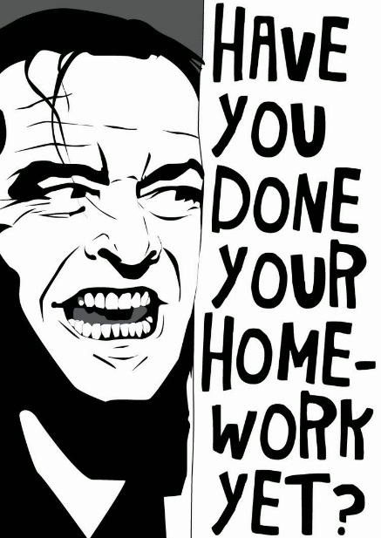
Homework
If you haven’t responded to Monday’s Discussion Question or completed the Frederick Douglass post yet—do them today!
Write a Post (approx. 300 words). Title it Full Name, Letter or Speech? Post it under Introductory Work. In your post, please share the following: Write a few sentences explaining which model you are choosing (the letter or speech) and why. How do you think this specific genre will help you to make your argument?
Create either an outline or a summary organizing your thoughts. This outline or summary should state your main point and how you will make your argument.
This assignment is due by 11:59 PM on Friday, October 1.
Coming up: Peer review of your first draft letter or speech on Wednesday! Specific instructions will be announced on Friday’s Announcement and Agenda!

