Slide 1
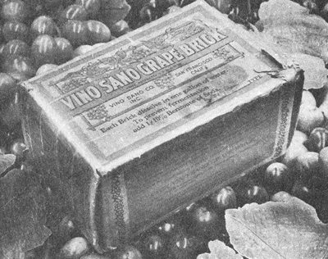
Wines of North America
Prof. Karen Goodlad, CSW
HMGT 2402, Spring 2018
New York city college of technology, cuny

Slide 2
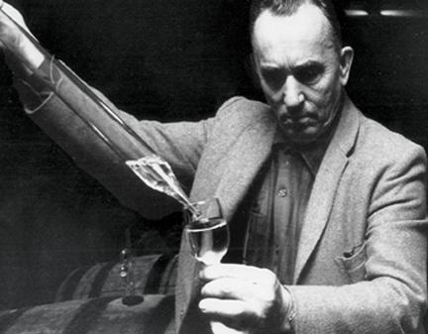
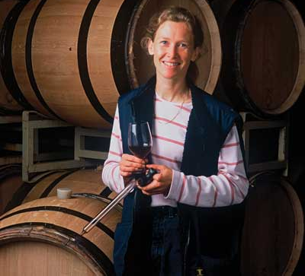
Objectives
Discuss legal and ethical issues in regard to the sale and service of alcoholic beverages
Identify geographical regions for wine production in the US
Identify fermented, brewed and distilled beverages
Image from: https://grapecollective.com/articles/dr-konstantin-frank-the-innovative-finger-lakes-winery

Slide 3
Terms to Know
Prohibition
Control State, Three Tier State
On Premise, off Premise
Distributor
ATF, TTB
AVA
Factors that affect the taste of wine for New York, Oregon and Washington

Slide 4
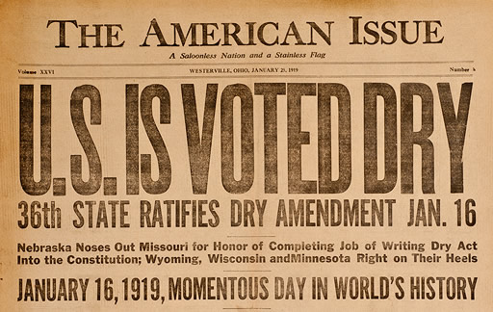
Identify the issues that lead to prohibition
Learn more about Prohibition: http://www.history.com/news/10-things-you-should-know-about-prohibition
Notes:
18th Amendment started prohibition, 21 repealed prohibition.
500 gallons per head of house
1st “dry” area or county was in Maine in 1846, still some dry laws are in effect today.
Women’s suffrage
World war I
Public drunkeness

Slide 5
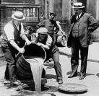
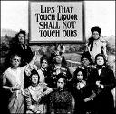
Introduction: Prohibition
The manufacture, sale & transportation of intoxicating liquors was prohibited in the United States from 1920-1933.
Notes:
Exception
home production and use
Prescriptions
Religious

Slide 6
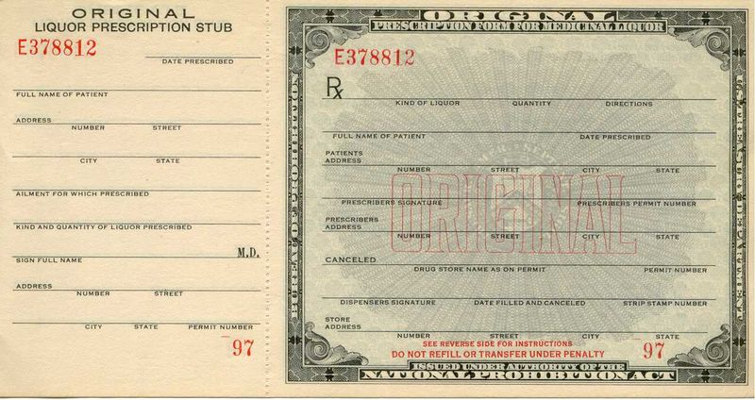
Introduction: Prohibition

Slide 7
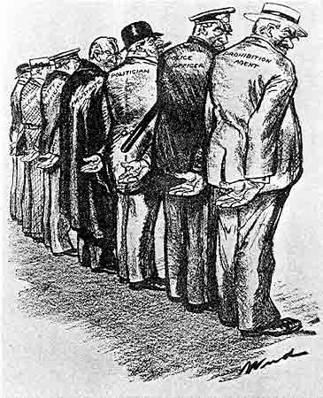
Prohibition: The Reality

Slide 8
Prohibition: The Reality
Grape varieties changed
Shipped grapes and “bricks” to end user
Wineries closed
  No R&D
  No Market
Drinking continued
  No money to enforce law
  Speak Easies
  Organized Crime
  Increase alcohol poisoning deaths
Church attendance increased
Medical prescriptions increased

Slide 9
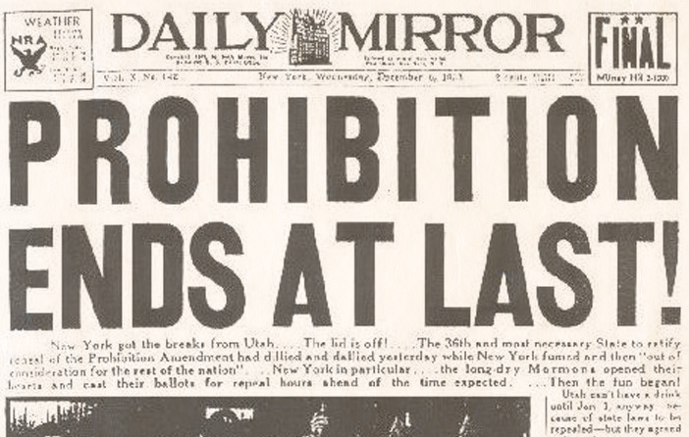
Prohibition: The End of the Nobel Experiment
What lead to the end of Prohibition?
Notes:
States now had control, Mississippi did not repeal Prohibition rules until 1966

Slide 10
Prohibition: The End of the Nobel Experiment
Depression
Drought
Continued
Consumption
State by state
control
Not until the 1970’s did wine consumption reach pre-prohibition levels of ~1.5 gallons per capita
Notes:
States now had control, Mississippi did not repeal Prohibition rules until 1966

Slide 11
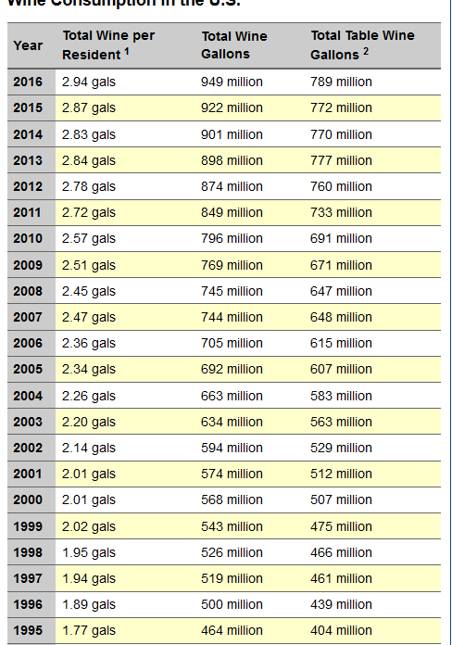
US Consumption of Wine 1995-2016
What trend do you notice?
What do you belive is diving the trends?
What do the trends mean to you?
What do the trends mean to restaurateurs and F&B managers?
Why was 2008 less than 2007?
Source: http://www.wineinstitute.org/resources/statistics/article86
Notes:
The Prominence and Quality of Wine in North America Has grown Significantly in the Last Three Decades
According to Adams Beverage the rise is attributed to:
Per Capital, Americans Drank 2.5 Gallons of Wine in 2009
US is the #1 wine market in the world with 211.9 million cases sold in 2011, up 5.6% (Wine Institute Trends Article)
We are eating out more and ordering wine more as a result
"Critter" labels made wine seem more accessible in the early to mid 2000’s, those people have stayed loyal to wine
The impact of positive health news related to wine has had a continuing impact
We are entertaining at home more

Slide 12
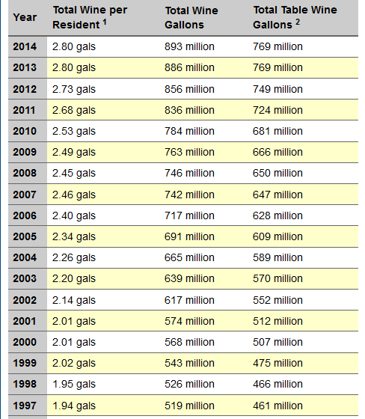
US Consumption of Wine 1997-2014
What trend do you notice?
What is diving the trends?
What do the trends mean to you?
What do the trends mean to restaurateurs and F&B managers?
Why was 2008 less than 2007?
Source: http://www.wineinstitute.org/resources/statistics/article86
Notes:
The Prominence and Quality of Wine in North America Has grown Significantly in the Last Three Decades
According to Adams Beverage the rise is attributed to:
Per Capital, Americans Drank 2.5 Gallons of Wine in 2009
US is the #1 wine market in the world with 211.9 million cases sold in 2011, up 5.6% (Wine Institute Trends Article)
We are eating out more and ordering wine more as a result
"Critter" labels made wine seem more accessible in the early to mid 2000’s, those people have stayed loyal to wine
The impact of positive health news related to wine has had a continuing impact
We are entertaining at home more

Slide 13
Wine Laws
Alcohol and Tobacco Tax and Trade Bureau (TTB)
  Formerly known as the Bureau of Alcohol, Tobacco and Firearms (BATF)
American Viticultural Area (AVA)
  Geographically defined growing area
  Petition BATF
  Describe what makes the region different
    Soil, climate, microclimate, history, watertable, elevation…
  1st AVA Augusta, Missouri, 1980
  As of October 2010 197 AVAs recorded in 35 different states
Notes:
AVA does not govern grape varieties vine training, yield, wine style. Label does not have to say AVA

Slide 14
Wine Laws
Varietal Name
  Wine must be 75% from the named variety
  In Oregon it is 90% (Cabernet Sauvignon is 75%)
Place Name
  State 75%
    Exception: CA, WA, OR = 100%
  County 75%
  AVA 85% (Washington State 100%)
Vintage
  95% from that harvest
Health Warning
Sulfite Warning

Slide 15
Sales: Federal Laws=State Controls
Control States
Three Tier States
On Premise:
  Restaurants, Clubs, Hotels
Off Premise:
  Wine Shops, Grocery Stores, Costco
Notes:
Shelf talkers
neckers

Slide 16
Sales: Three Tier System
Winery/Importer → → →
Distributor → → →
Retailer → → →
Consumer
Direct Shipment & On Line Movement…
FOR MORE INFO...
Who Ships Where?
Notes:
Direct Shipments are an Issue of interstate commerce and antitrust laws

Slide 17
Responsible Alcohol Sales
Check ID
Recognize the signs of intoxication
Decline service to those visibly intoxicated
Train all FOH employees
Ensure all bartenders and managers are certified in a responsible beverage service program
  TiPS (Training for Intervention Procedures)
  NRAEF ServSafe Alcohol

Slide 18
Responsible Alcohol Sales, Employment
On Premise 18 years:
  Handle, dispense & receive payment for alcoholic beverages
Off Premise 16 years:
  Handle, record & receive payment for alcoholic products with direct supervision
Off Premise 18 years:
  Handle, record & receive payment for alcoholic beverages
FOR MORE INFO...
NY State Handbook for Retail
Notes:
Responsible Alcohol Sales
On Premise 18 years:
Handle, dispense & receive payment for alcoholic beverages
Off Premise 16 years:
Handle, record & receive payment for beer products
Off Premise 18 years:
Handle, record & receive payment for alcoholic beverages

Slide 19
How to read an American Wine Label
Brand Name
Grape Variety
Vintage
Location
  AVA and/or county and/or state
Percentage of Alcohol
Bottle Size
Legal Notifications
  sulfites, government warning, producer name and address,
For more information: https://www.ttb.gov/pdf/brochures/p51901.pdf

Slide 20
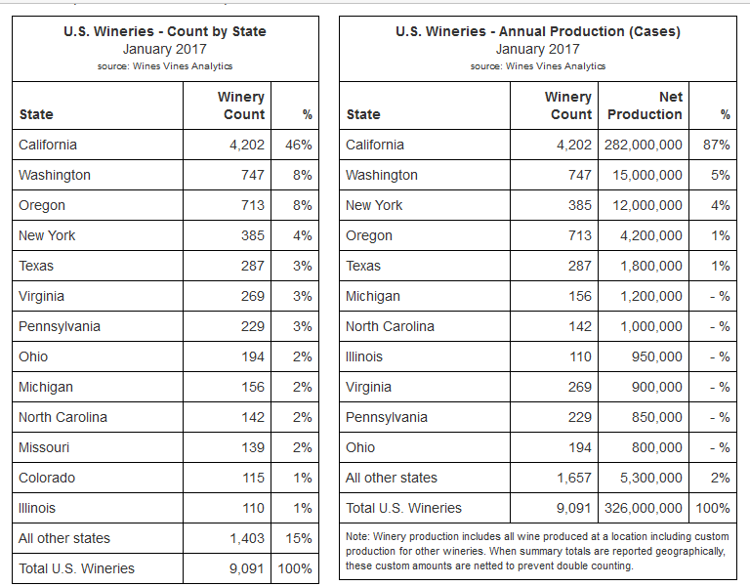
Source: https://www.winesandvines.com/template.cfm?section=widc&widcDomain=wineries

Slide 21
New York State
3rd Largest Wine Producing State (2017)
  10 AVAs, 385 Wineries (2017) [230 Wineries as of 2010]
Climate
  Cool, Danger of Frost in Spring & Fall
  Moderating Effects of Large Bodies of Water Create Micro Climates
Grape Varieties
  Vitis Vinifera and Vitis Labrusca and Hybrid
Who is Dr. Konstantine Frank ?
For More Info: Uncork New York
Notes:
Dr. Konstantine Frank 1st commercial wine maker
Farm act of 1976: Encouraged fine wine production through tax incentives and less restrictive distribution rules.
species

Slide 22
NYS AVAs
Lake Erie AVA
Niagara Escarpment AVA
Finger Lakes AVA
  Cayuga Lake AVA and Seneca Lake AVA
Hudson River AVA
North Fork, Long Island AVA
Hamptons, Long Island AVA
Long Island AVA
Champlain Valley of NY AVA
Learn More about New York Wine : https://www.newyorkwines.org/Media/Default/documents/2014NYWCR.pdf
Notes:
Lake Erie:Largest in terms of Grape acreage, Wine, Juice and Jelly, Lake Affect Snows (insulation against freezing temperatures)
Finger Lakes: Largest Wine Producing Region in NY (1/2 states wineries) Mostly shale under shallow top soil. Many lakes, keep temp moderate, rolling hills angle vineyard to sun Chardonnay and Riesling, Seyval Blanc and Vignoles, Pinot Nior and Cab Franc
Seneca Lake: deepest of 11 finger lakes, does not freeze, best known for Riesling.
Cayuga Lake: water creates a 1 month longer growing season that finger lakes Slate an Shale Deposits(wine have mineral and crispness)
Hudson River Regions: Hudson River provides moderating climate Oldest vineyards and wineries in America, Concord Grapes, complex soils from glacier deposits
North Fork, LI: sandy soil, 1-3 week longer growing season then south shore once Potato Farms, Cabernet and Merlot
Hamptons, LI:

Slide 23
Oregon
Think Pinot Noir
Most Farm Using Sustainable & Environmentally Friendly Practices
18 AVAs
Climate
  Maritime
Dominant Grape Varieties
  Pinot Noir, Pinot Gris, Chardonnay
Notes:
Dundee Hills:
In the autumn of 1964, a young graduate of the famed viticulture and enology program at UC Davis named David Lett gathered 3000 vine cuttings from various California vineyards and just after Christmas headed north to Oregon.
Rain in spring frost in fall
4th largest producer
Pinot Noir and Pinot Gris
Estate = grown with in 5 miles of winery
90% of varietal on label
No generic terms

Slide 24
Oregon’s AVAs
Columbia Valley AVA (W & O)
Walla Walla Valley AVA (W & O)
Willamette Valley AVA
  largest, 75% of production
Chehalem Mountains
Umpqua Valley AVA
Dundee Hills AVA
Rogue Valley AVA
Applegate AVA
Notes:
Williamette Valley: High Quality Pinot Noir
Umpaqua Valley: Various soil types and elevation. Grapes
Rogue Valley: Just north of CA. Grapes: Chardonnay, Cab. Sauv.
Applegate Valley: within Rogue Valley high elevations, warm dry. Grapes: Pinot Noir, Chardonnay, Syrah

Slide 25
Washington
Washington Wine Commission
  100% from AVA, 100% variety on label
  No additives to change color, flavor, aroma
  Reserve: 3000 cases or 10% of total wine production
  No generic labeling
13 AVAs
Stimson Lane = ~2/3 of WA state production:
  Chateau St. Michelle (important sparkling wine producer), Columbia Crest
  Partnership with Antinori (famous for Super Tuscans) growing Sangiovese and Cabernet for blending
Notes:
Yakima Valley Parallels Northern Bordeaux
99% of Washington’s vineyards are east of the Cascade mts.

Slide 26
Washington
Cascade Mountains
  West significant Rainfall, more moderate temperatures
  East less rainfall, warmer days, cooler nights
    100º days → 40º nights
    irrigation is necessary
  Long daylight hours
Dominant Grape Varieties
  Chardonnay, Cabernet Sauvignon, Merlot, Riesling, Syrah
Notes:
Crisp, stainless steel fermentation/aging to support the fruity nature of vitis-vinefera
White: Riesling, Semillion, Sauvignon Blanc some chard in oak
Red: Merlot and Cabernet, oak aging some syrah
Summer day light hours are 17.5

Slide 27
Selection of Washington AVAs
Columbia Valley AVA (W & O)
  6 Sub Appellations as of 10/10
Walla Walla Valley AVA (W & O)
  Sub Appellation of Columbia Valley AVA
  Less than ½ % of total vineyards
Yakima Valley AVA
  Sub Appellation of Columbia Valley AVA
  40% of Washington’s vineyards
Red Mountain AVA
  Sub Appellation of Columbia Valley AVA
  One of the Smallest Appellation
Horse Heaven Hills AVA
Notes:
Columbia Valley: 10.5 million acres, largest region 60% (99% of vitis vinifera) of total wine in Washington
Controversy because of size, some land not plantable, no distinct continuous growing area, arid almost desert like, needs irrigation
Yakima Valley: with in Columbia Valley, Yakima River-Rattlesnake Hills, Cooler than rest of Columbia Valley
Red Valley: broad slopes mineral deposits, full southern exposure
Walla Walla Valley: significant for rain fall with in the arid climate with in Columbia Valley glacial silt loam, Cab, Merlot, Riesling, Gewurztraminer
Puget Sound: WET, WET, WET 25 wineries in AVA

Slide 28
Comparison of Washington & Oregon
Washington | Oregon
East Cascade Mts. | West Cascade Mts.
Irrigation | No Irrigation
Continental | Maritime
2021 Hours of Sunshine and More Heat Good for Thick Skin Varietal | 1660 Hours of Sunshine Better for Thin Skin Varietals
24% Chardonnay 22%Cabernet Sauvignon 21% Merlot 23% Other (Trend Toward Sangiovese) | 53% Pinot Noir 13% Pinot Gris 9% Chardonnay 25% Other
747 Wineries (as of 2017) | 713Wineries (as of 2017)

Slide 29
Sales: Sommelier
(suh-mal-'yAy), or wine steward, is a trained and knowledgeable wine professional, commonly working in fine restaurants, who specializes in all facets of wine service. The role is more specialized and informed than that of a wine waiter.
Court of Master Sommeliers
Master of Wine
Certified Wine Educator
Wine and Spirits Education Trust (SWET)
Notes:
As of 2013, 129 MS in US
MS, 4 levels 25-30% pass the advanced 10% pass the MS exam
As of 2013 there are 30 in the US and 297 Masters of Wine, living in 23 different countries, 87 are female.

Slide 30
Service: Decanting
Why we Decant
  Aeration
  Bring to proper temp
  Remove sediment
  Season glass
Mise en Place
  Decanter
  Corkscrew
  Candle/Matches
  Coaster
  Waiters Side Towel
  Glasses/Wine!!!

Slide 31
Importance of Temperature
Sparkling Wine: 41°-45°
Dry Whites and Rose’s: 44°-54°
Light-bodied Reds: 50°-55°
Medium to Full Bodied Reds: 55°-65°
Sweet Wines, Not Port: 45°-50°

Slide 32
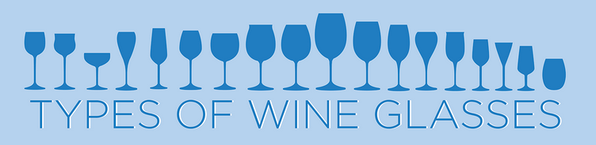

Slide 33
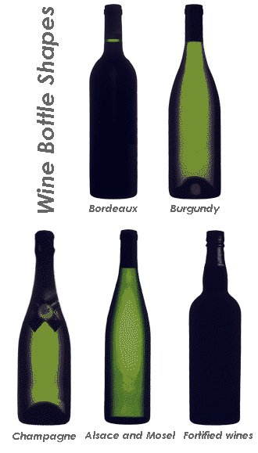
What does the shape of the bottle tell us about what is in the bottle?
A Lot…

Slide 34
Storage
Why have caves always been used for wine storage?
  55°F, no temperature fluctuations
  75% humidity
  Dark
  No vibrations
  Store on side with label face up

Slide 35
Alternative Packaging and Sales
Screw Caps
Three-Liter Boxes (Bag in a Box)
Cans
TetraPak
Single-Serve Packages (175ml)
Lighter Weight Bottles
Vending Machines and Bottle Refill Pumps
Interactive Wine Service
FOR MORE INFO...
Notes:
According to The Nielsen Company data, between July 2004 and May 2007, the 187ml category as a whole has grown by 33 percent by case volume, nearly triple the 12 percent growth rate of the overall market in the same timeframe.
Champagne producers are looking to lighten the bottle, not easy as a bottle of champagne contains 3Xs the pressure of a car tire.

