Slide 1



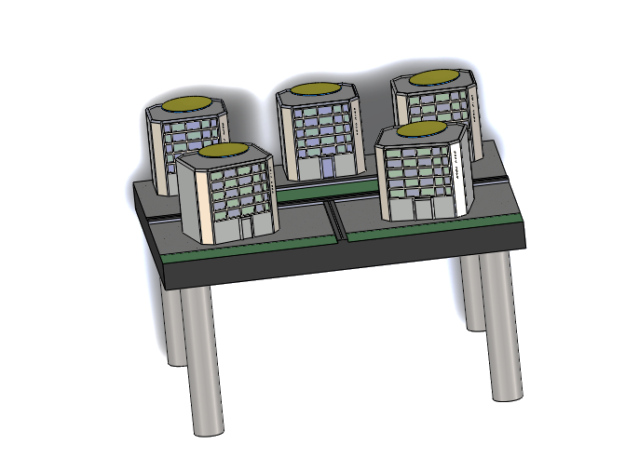
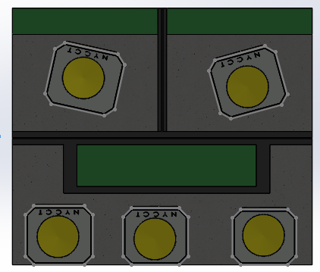
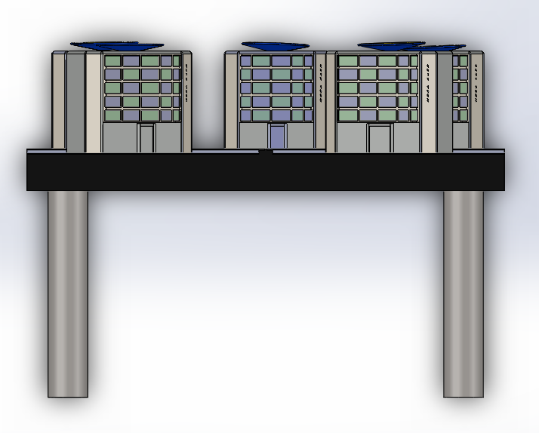
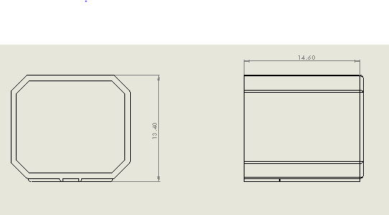
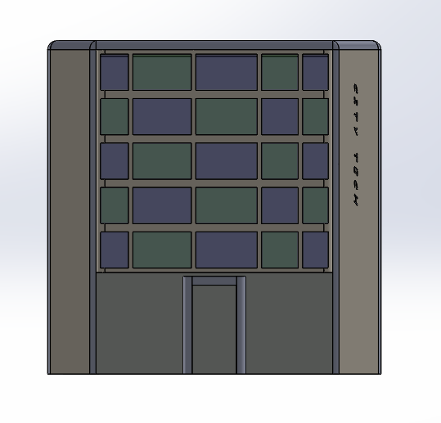
CULINARY DISPLAY
Student: MICKAIL, WILSON, Advisor: Prof. Masato R. Nakamura,
Department of Mechanical Engineering Technology and Industrial Design Technology
New York City College of Technology (City Tech), City University of New York (CUNY), Brooklyn, NY
INTRODUCTION
Design and Create a food display to present different dishes
Must be:
Portable: compact, lightweight
Presentable: appropriate, catch hold of the audience
DESIGN
New York city inspired the culinary display. This exposition is made up of five buildings, and on the roof of each, a dish would be an exhibit.
Materials: Glass
Aluminum
Top View
Front View
Dimension
Building Front View

