Slide 1
Serving Tray
Diego Alvarado
IND 2410

Slide 2
Introduction
In this project we were given a specific target; to create a unique type of display for the culinary department.
This is were our imagination and capabilities come in place, where we create a presentation worthy piece in collaboration with the culinary department.
A very unique creation would help chief with a display for the Olympics coming up.

Slide 3
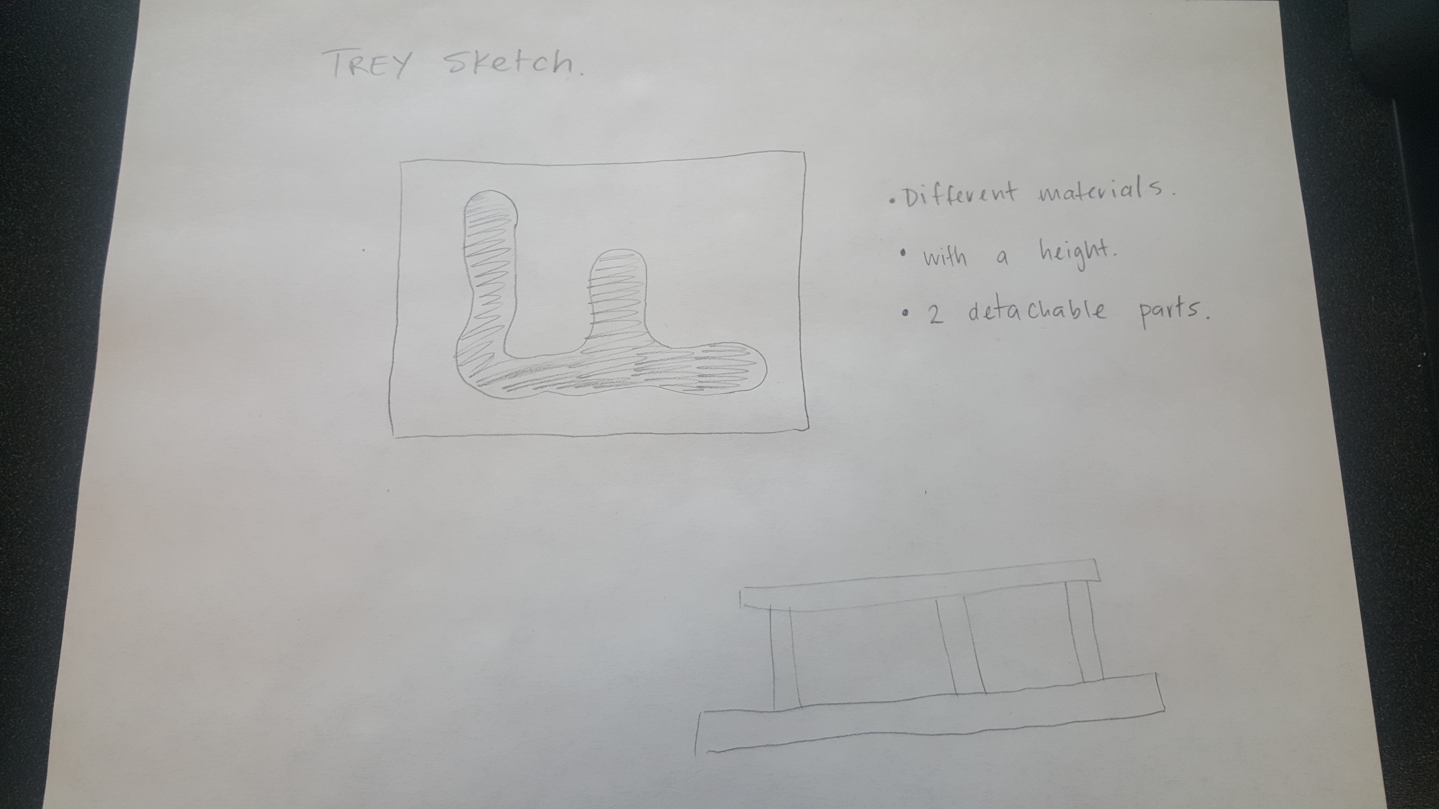
Sketches

Slide 4
Tray information
The piece will use aluminum as the bottom piece material(not making it heavy to take overseas). While the top piece could be transparent glass for display purposes.
The tray has a very unique design just like a path, given the chief a choice to use this path as he pleases. Ex. Serving entrees and small dishes building it up till the end of the path where the main dish could be served.
The tray has two pieces that come out making it easy to transport from place to place.

Slide 5
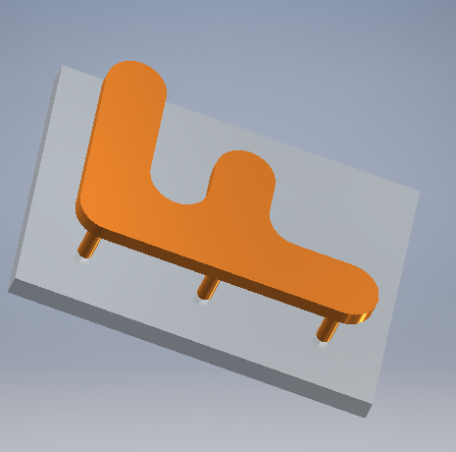
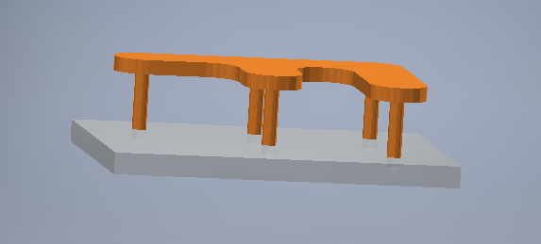
3d model of the trey
The height of the piece is 4 in.

Slide 6

Continued

Slide 7
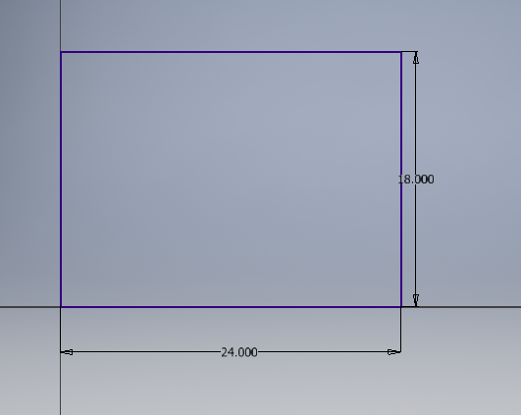
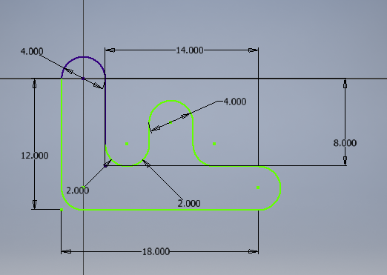
Dimensions of the trey (Inches)
Bottom piece.
Top piece.

