Slide 1

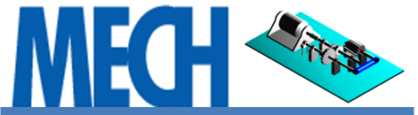

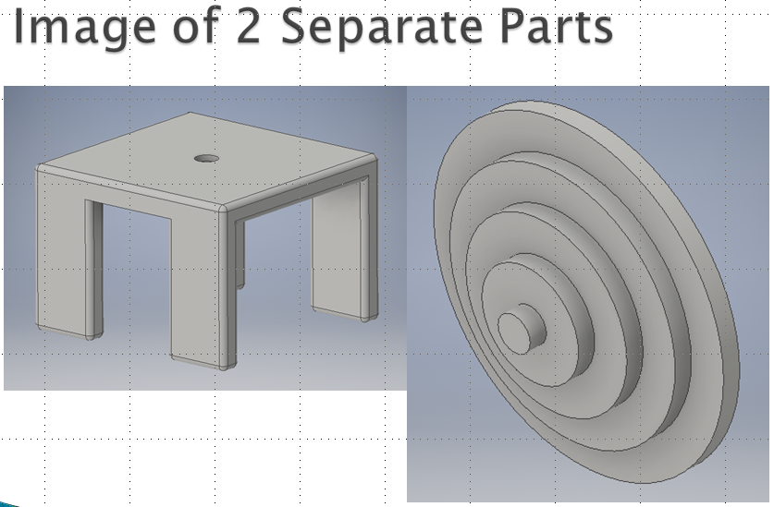
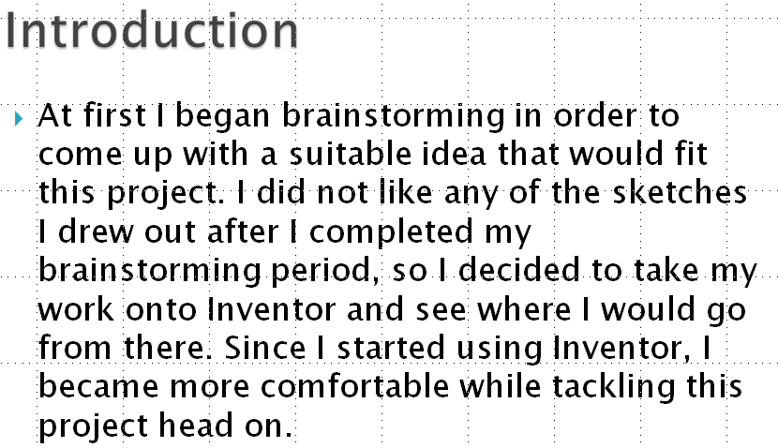
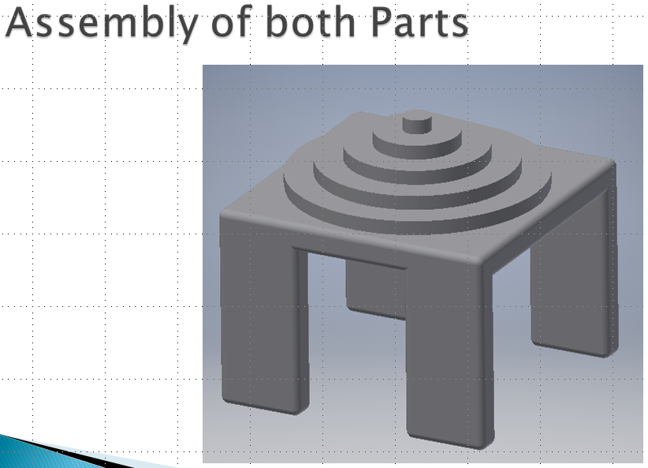
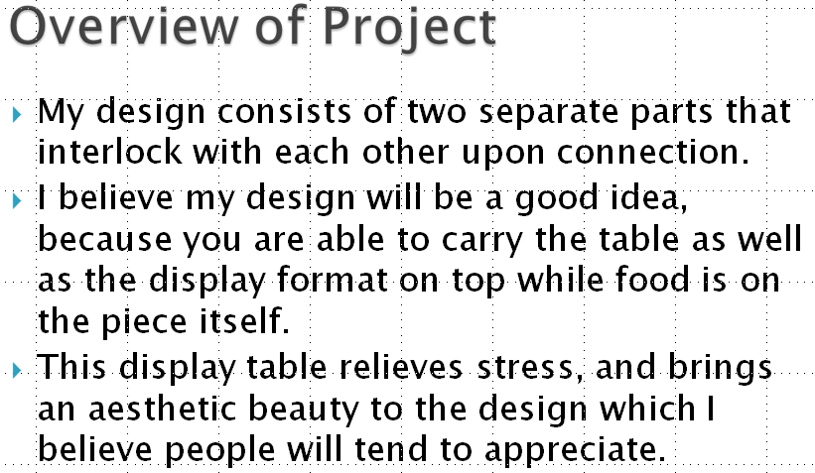
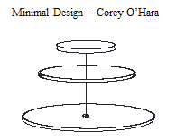
IND 2410 Industrial Design II
Project Name: Culinary Display Design
Instructor and Course Coordinator: Prof. Masato R. Nakamura
Department of Mechanical Engineering Technology
New York City College of Technology (City Tech), City University of New York (CUNY), Brooklyn, NY

