Slide 1
Culinary Art Display
Victor Soto

Slide 2
Purpose
Create a display for the Chefs that are going to be attending the Culinary Olympics this year in Germany.
The requirements for this competition from part of the Chefs are that the display has to be easy to assemble, transportable, durable and lightweight.
The display needs to be able to fit the different food course that are going to be displayed.

Slide 3
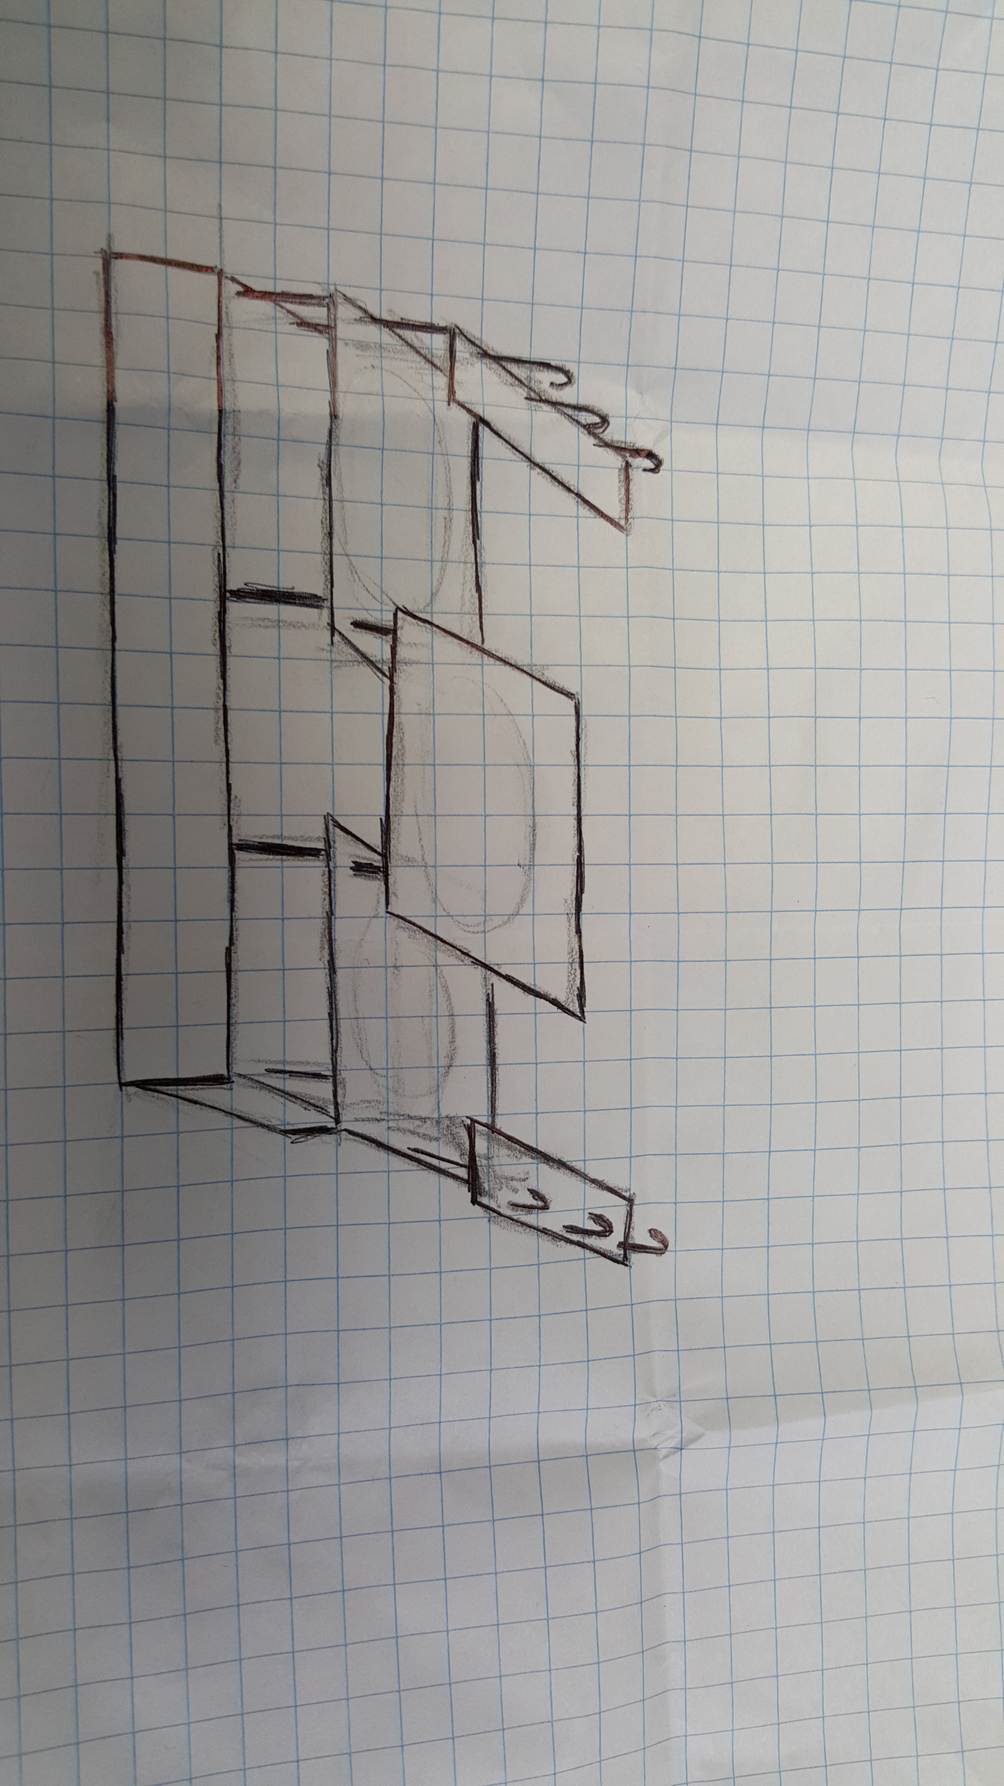
Sketch

Slide 4
Description of the display
The concept is based on the tool box since this equipment carry all the tools needed for its users, it is transportable, everything fits in one place, lightweight and they tend to be durable depending of its user.
The Food Box can be made out of plastic or wood since both materials are going to hold the load apply to each of its parts, and this materials are lightweight.
All the parts in the display fits perfectly inside the box.

Slide 5
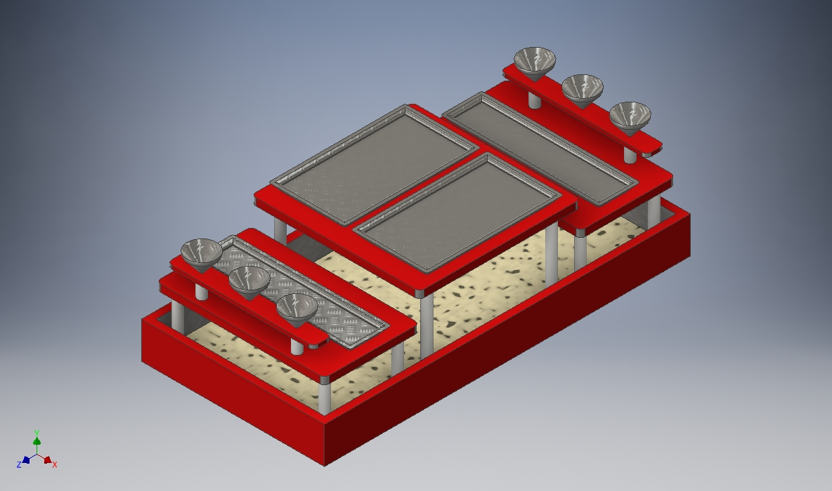
3D Model

Slide 6
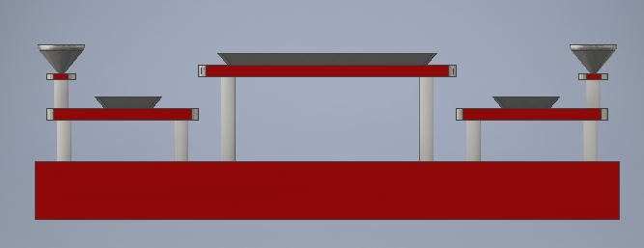
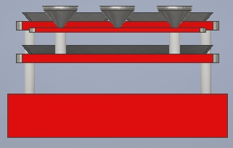
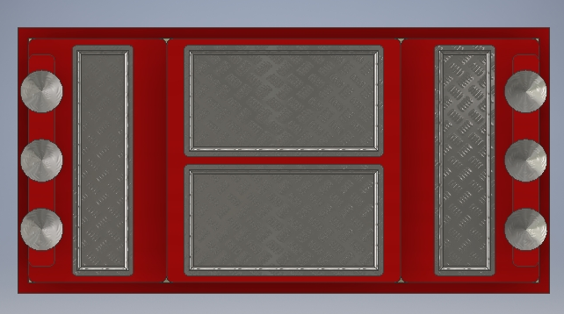
Additional Views

Slide 7
3D Model Features
Plates for each course (Appetizer, Main Dish, etc…)
Cups
Three surfaces to placed the food.
The rods that hold the surfaces.
The box in which all the parts fit

