Slide 1
Lotus Display bowl
Design by Ezra Stabler

Slide 2
Design Focus
After studying existing culinary displays, I found that most of them utilized a relatively simple and elegant dishes, without any moving parts.
I decided to design a presentation bowl that stayed in line with this trend

Slide 3
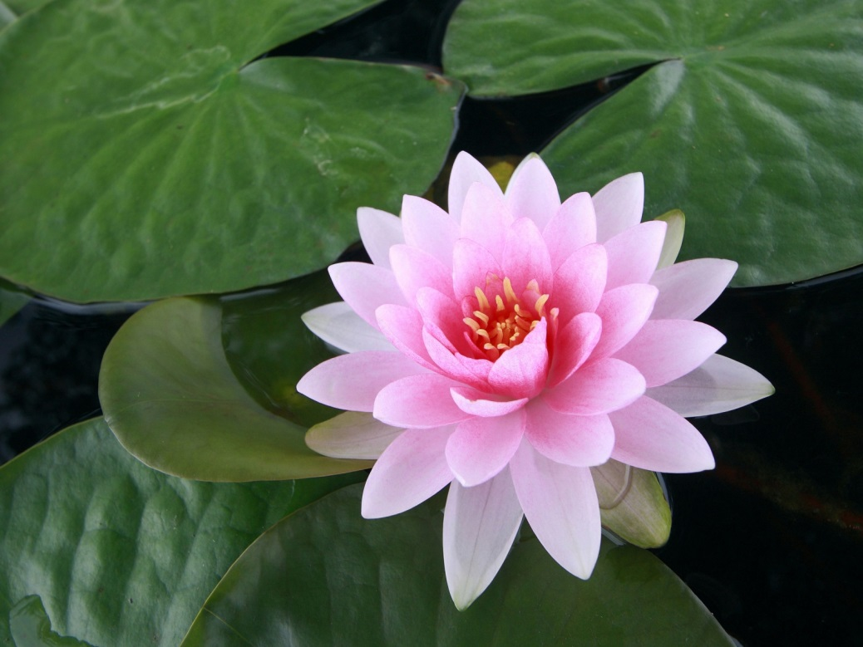
Design Inspiration
I look inspiration from nature, and looked at the Lotus Flower while formulating my design

Slide 4
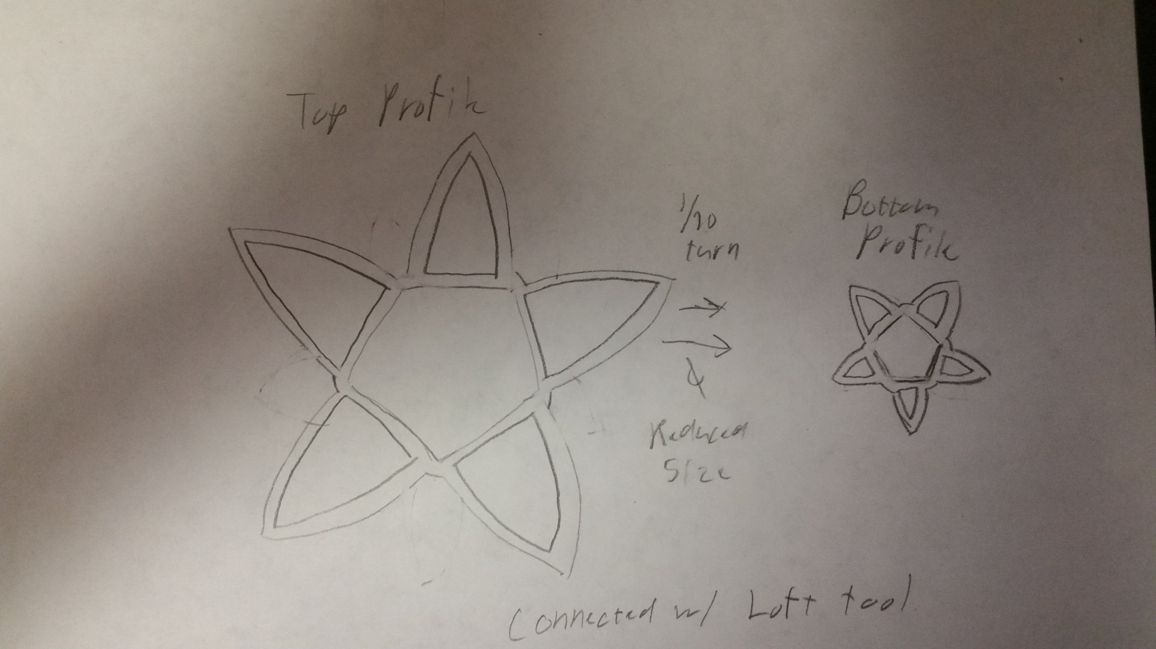
Preliminary Sketch

Slide 5
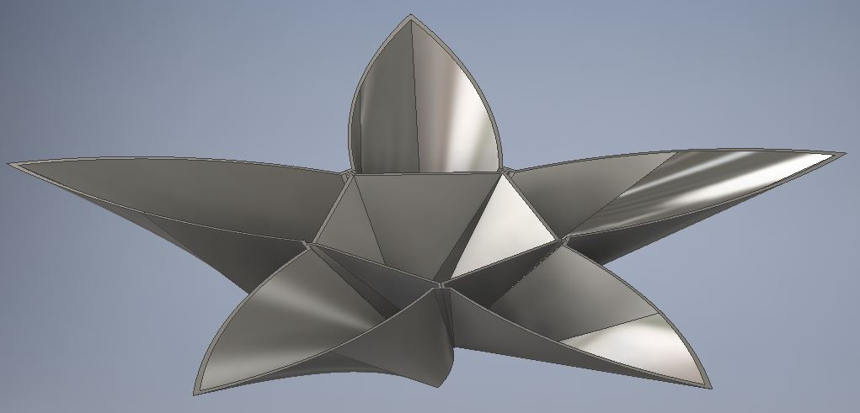
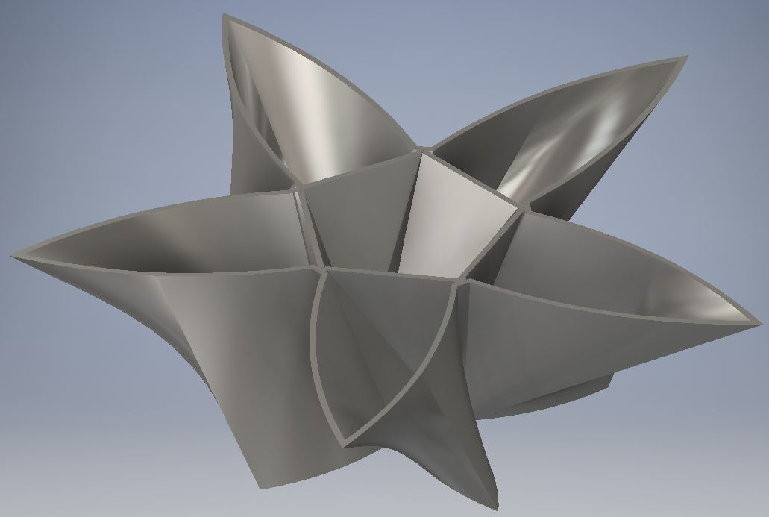
Final Designs

