Slide 1
Display Table
By: Marko Cibic

Slide 2
Introduction
At first I began brainstorming in order to come up with a suitable idea that would fit this project. I did not like any of the sketches I drew out after I completed my brainstorming period, so I decided to take my work onto Inventor and see where I would go from there. Since I started using Inventor, I became more comfortable while tackling this project head on.

Slide 3
Overview of Project
My design consists of two separate parts that interlock with each other upon connection.
I believe my design will be a good idea, because you are able to carry the table as well as the display format on top while food is on the piece itself.
This display table relieves stress, and brings an aesthetic beauty to the design which I believe people will tend to appreciate.

Slide 4
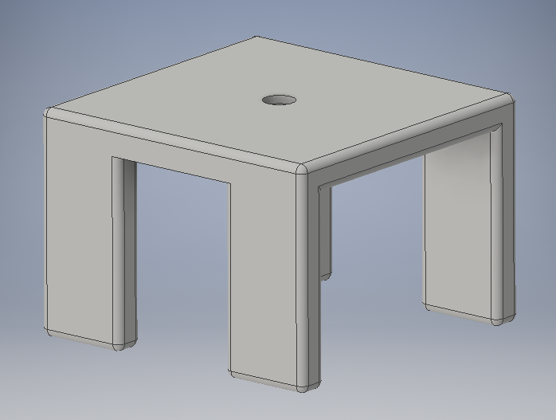
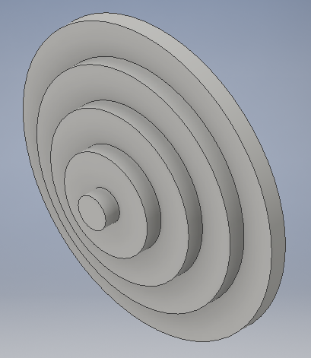
Image of 2 Separate Parts

Slide 5
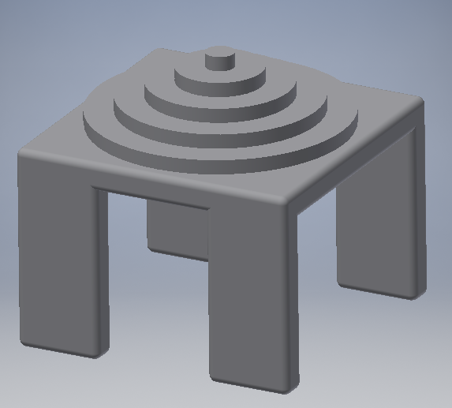
Assembly of both Parts

