Slide 1
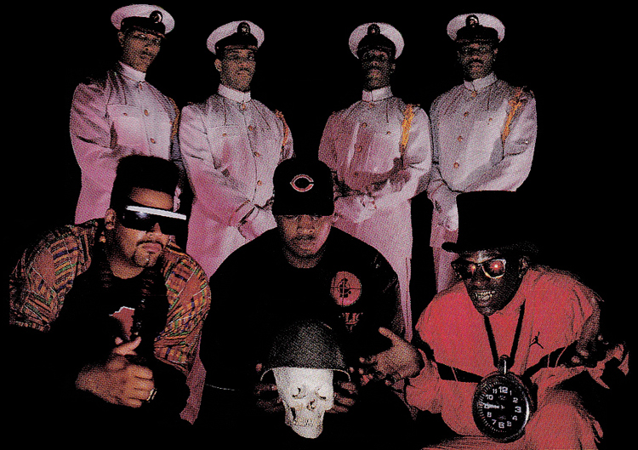
Enshrine These nineties
A blog by Jason Kahn

Slide 2
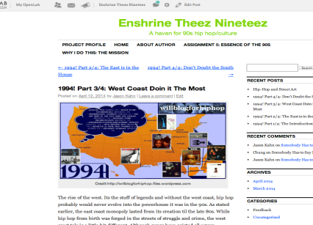
jkahn193@gmail.com
http://www.pinterest.com/4thaskrilla/
rapgenius.com /AQUAPHREESH193
“Its like you were born in the wrong time period” my best friend once told me and he was right. Sometimes people often ask me “What do you know about the 90s?”, as if I’m not supposed to know anything due to my age. If there are people that dress up in Victorian era clothing and scholars that obsess over societies like Rome, then what's wrong with being 90s obsessed? I’m currently pursing a B-tech degree in graphic communication and design here at City Tech and If i could major in 90s hip hop I would, but that’s not a program here.
I have also been religiously listening to and learning about 90s hip hop for the past eight years. Although I still listen to many other genres of music like house, r&b, and techno, 90s hip hop is my passion and expertise. I welcome everyone to this blog and feel free to comment and share any 90s hip hop related info.

Slide 3
Typical Posts
A TYPICAL POST ON MY Blog basically is to inform and analyze with an occasional pinch of wittiness.
Since there is so much to this culture, its very easy to overlook some of the more obscure albums and artists.
My four part blog series was an opportunity to reveal so of these artists and albums.

Slide 4
Mission Statement
Much like those that love other genres of music, the focus of this blog is to unite all people that share the same love and serious passion for 90s hip-hop and 90s urban culture. Its also for people that are largely uninterested in the hip hop of today and/or have grown tired of its lack of substance.
If people treasure these other decades of music, why shouldn't we treasure this one? Why shouldn't we reminisce on an era that so many claim to understand, but fail to dig deep enough to truly understand.

Slide 5
Blog series: 1994!
My blog series was a detailed insight into one of the most prosperous and influential years in hip hop.
Each part analyzed a different region, which were the East, west, and south. I also briefly discussed some of my favorite albums from each.
While the album selections are my opinions, they are all highly esteemed selections and are considered some of the best albums to be released during the 90s.
I also provided a little historical background leading up to 1994, so viewers can get a sense of what preceded these artists and their music.

Slide 6
Guest post: Street art & hip hop
I did a guest post on Marco’s blog which is about street art and its figures such as banksy, shepard fairey, and others.
This was very easy to connect to my topic since graffiti/street art is one of the five original elements of hip hop, the other four being Emcee-ing, DJ-ing, Breakdancing, and knowledge.
Most of the street artists and their work were born from the rebellion and grass roots nature of hip hop. This is why so many of them are not only die-hard hip hop fans, but some are also hip hop artists. They are active participants of this culture and have contributed a great deal to what made the 90s so special.
His link:
openlab.citytech.cuny.edu/anonymousartnyc/

Slide 7
blog Summary
Although this assignment was relatively fun, laziness was the main challenge that I faced. I thought that writing about something I love would motivate me, but I was only motivated early on and it soon wore off.
Nevertheless it was an enjoyable experience to write and share my opinions on something I know extensively. I might continue this blog in the future, but most likely on a new site with more options available.
openlab.citytech.cuny.edu/90sforevahandevah/

