Slide 1
The living laboratory
EDU 3640 – Computers in Education
Dr. Lieselle Trinidad
Assistant Professor
Career and Technology Teachers Education

Slide 2
Course Redesign
Course is a hands-on computing literacy course on how microcomputers can improve teaching and learning environments. Emphasis is placed on the process of planning, designing, and implementing pedagogical techniques that best facilitate student learning.
Topics include Word Processing, Spreadsheet & Database Management Systems. Interactive Multimedia Software, Internet Multimedia software, Internet Multimedia Software, Internet and World Wide Web.
This is a hybrid course which means it meets both face-to-face and online.
Other course information besides the syllabus was not available to me, therefore a complete redesign was required for he Fall 2014 semester.
Emphasis was put on expanding the course to include Diversity/Global learning as well as openLab & eportfolios
Notes:
This course is a hands on course showing the positive effect that computers can have for both a teacher and students. The unique thing about my department is that we are training teachers to be teachers so everything we do is not only beneficial for them as students, but also as models for them as teachers.
This is a hybrid course and only meets in person for about 6 sessions.
The course information from the previous instructor was unfortunately not available to me, so I had to redesign the entire course. In this revision, emphasis was put on making the diversity and global learning more apparent throughout the curriculum as well as incorporating the openLab and eportfolios

Slide 3
General Education SLOs
Global/Multicultural Orientation
Demonstrate expanded cultural and global awareness
Discern multiple perspectives
Demonstrate proficiencies and capacities in dealing with a diverse society
Communicate across cultural and linguistic boundaries
Communication
Communicate in diverse settings and groups, using written (both reading and writing), oral (both speaking and listening), and visual means, and in more than one language.
Inquiry/Analysis
Derive meaning from experience, as well as gather information from observation.
Notes:
These are the general education SLOs, but as I focused on the diversity/global learning

Slide 4
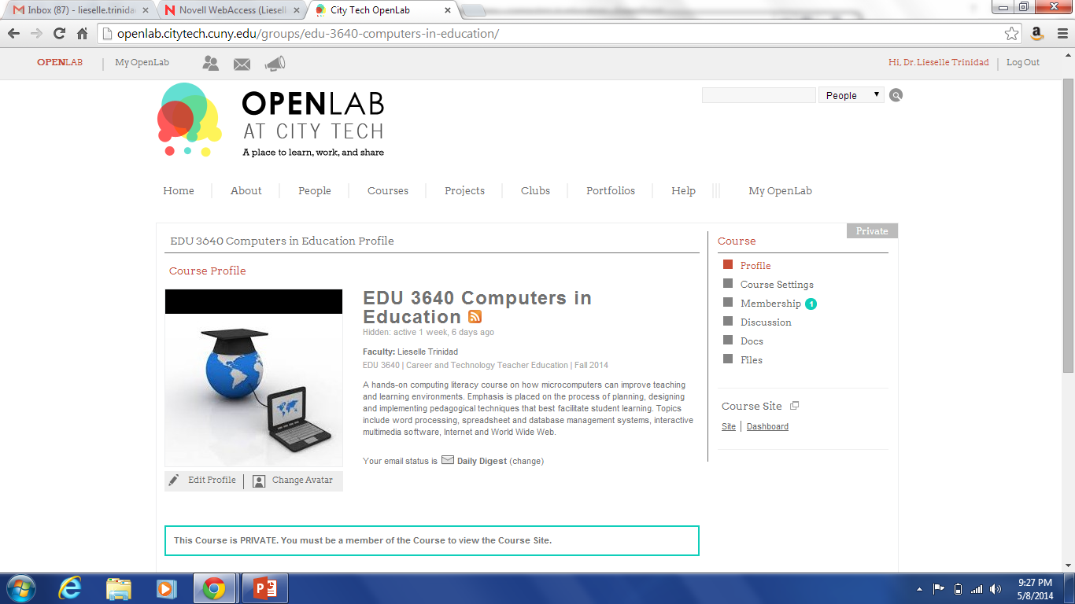
Notes:
And here is the OpenLab page…clearly empty, but ready to be filled with the student work in the Fall

Slide 5
Assignment description
The assignment will begin on the 3rd class meeting (week 3) after the students have chosen the topic for their final projects
Students will reflect and blog in eportfolio about why they chose their final project topic.
What was your inspiration or connection to the topic?
What do you hope your students will learn from the guide
As part of the assignment students will utilize the blog tool in the eportfolio to comment on each other’s work as well.
Free to use any articles, resources.
All resources must be cited in APA format
This assignment will repeat throughout the semester each time touching on different topics including
Why did I chose this field of study, and What do I have to offer the field?
Gender
Ethnicity
Economic class
Language
Sexuality
nationality
Notes:
The main assignments I chose to really incorporate the diversity/global learning through is a reflection/blog assignment that will scaffold throughout the semester introducing different topics surrounding the idea of diversity.
So this is a metacognition assignment and it start out with a non critical topic that also allows the students to get comfortable using OpenLab and having other students reading and commenting on their thoughts.

Slide 6
Assessment
Blog rubric:
If you receive a rating of less than a 3 you have the option to resubmit within one week of due date.
Rating | Characteristics
4 | Exceptional. The blog post is focused and coherently integrates examples with explanations or analysis. The post demonstrates awareness of its own limitations or implications, and it considers multiple perspectives when appropriate. The entry reflects in-depth engagement with the topic.
3 | Satisfactory. The blog post is reasonably focused, and explanations or analysis are mostly based on examples or other evidence. Fewer connections are made between ideas, and though new insights are offered, they are not fully developed. The post reflects moderate engagement with the topic.
2 | Underdeveloped. The blog post is mostly description or summary, without consideration of alternative perspectives, and few connections are made between ideas. The post reflects passing engagement with the topic.
1 | Limited. The blog post is unfocused, or simply rehashes previous comments, and displays no evidence of student engagement with the topic.
0 | No Credit. The blog post is missing or consists of one or two disconnected sentences.
Notes:
This is the rubric I will be using to assess the assignments, but as I mentioned earlier I am teaching future teachers so these rubrics are important in assessing their development of the content, but also as a model for them to use in their classrooms.

Slide 7
Inspirations
Open pedagogy game
Wiki update with two groups via checkers/family feud method
Each team contributes building on previous
Olympic experience
New course – 3 professors
Historical and political, tourism and hospitality, athletic equipment and structures
Painting game
Collaborative painting
Communication and collaboration are one of the most important skills in life
Notes:
Finally I just wanted to mention 3 things that I was inspired by this semester:
Was the open pedagogy assignment where as a team we created a game where the class is divided into two teams and each team at a time contributes to an online resource (such as Wikipedia) on a topic assigned by the instructor. Each contribution will require references.
The Olympic experience where Sean, Claire and myself designed a course that we would like to take if we were students. We designed a course where the three of us would teach a two semester capstone course. The course would cover topics spanning history, politics, sociological, tourism, hospitality, athletic equipment, structures, etc…There is just so much you can discuss surrounding the experience, and we still hope to find a way to develop that course.
Finally I really enjoyed the painting game and the emphasis on communication and collaboration because those are such important skills for anyone to develop no matter what your field is.

Slide 10
Learning Goals
Learning Outcomes
After taking this class, the student will be able to… | This will be demonstrated by...
Evaluate appropriate uses of educational technology and social media
Critically analyze issues related to educational technology and social media
Select appropriate uses of technology consistent with educational objectives and standards
Plan ways to use technology appropriately and effectively in teaching and learning environments
Utilize various software applications and the internet in the classroom
Demonstrate proficiencies and capacities in dealing with a diverse societies

