Slide 1
Living Lab 4th Year Fellows Presentation
John McCullough
ENT 4410 – Technical Direction
http://openlab.citytech.cuny.edu/techdirectionsp2014/

Slide 2
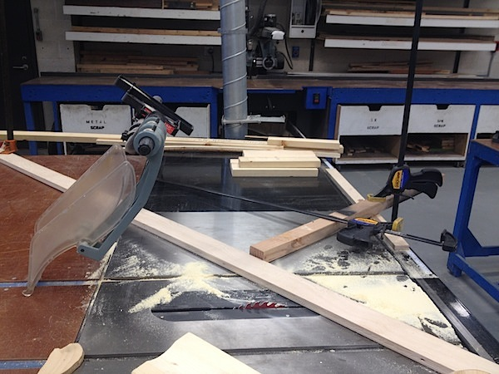
ENT 4410 – Technical Direction
Notes:
Runs in spring semester of even-numbered years (at the moments)
Photo from a student demo of a manufacturing technique – cutting cove moulding on a table saw

Slide 3
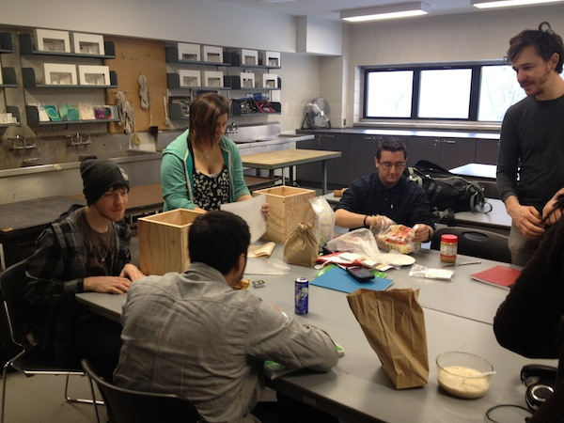
Fabrication track capstone course
Students learn to build, plan, budget, implement scenery projects
Combines skills from Theatrical CAD, Project Management and Scene Design classes
Notes:
Photo from presentation day: Problem 1 - PBJ

Slide 4
Old Version
Traditional Lecture-style course
Homework and projects were very rigidly structured
Notes:
Low attendance
High rate of late arrivals
Perceived lack of student engagement
incomplete/missing assignments
not a lot of engagement in class discussions

Slide 5
Revised Version
Inquiry-based
Problems are student-led
Use of Openlab for note-taking, communication, and learning portfolios
Notes:
Inquiry-based: the instructor or tutor presents and ‘ill-structured’ problem to the class, which requires independent research, testing, and study to solve. The students choose what solutions to attempt and what research to do. The instructor asks guided questions to help them on their way. The focus is to get students to think about what they know and how they know it.
Each day one of the students “volunteers” to take notes and post to openlab.
Each student is asked to produce a learning portfolio for the class
Seems to have improved engagement
better attendance and on-time arrival
fewer incomplete and missing assignments

Slide 6
Sample Assignment - Portfolio
Notes:
The portfolio project asks students to present their work and think about it in three ways:
description; analysis; and application

Slide 7
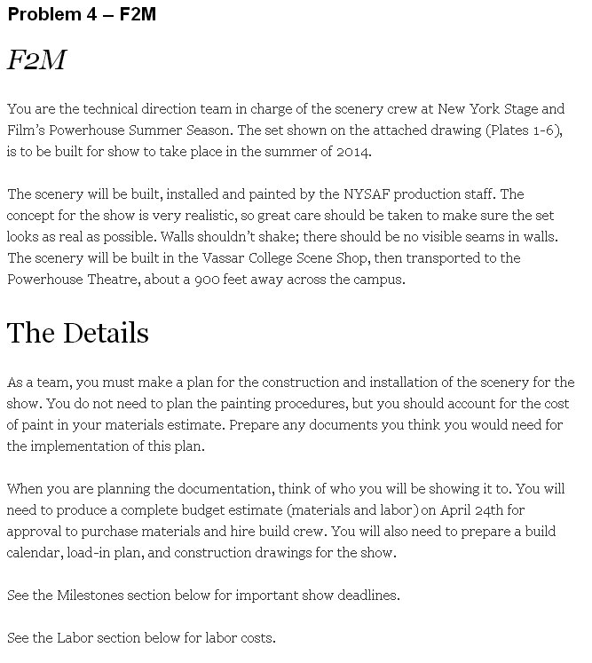
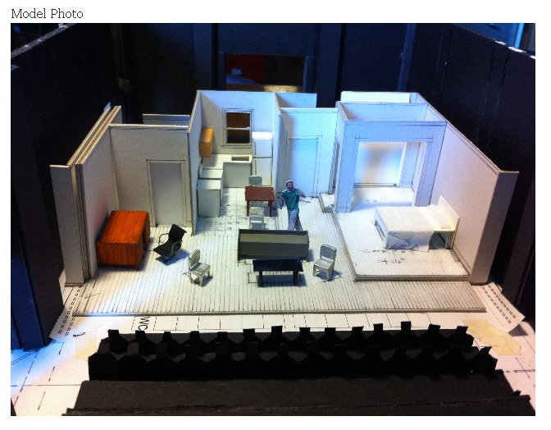
Sample Assignment – Problem 4
Notes:
Models a real-world example – work in a team to determine how to build a set for a play, meeting budgetary, time, and artistic needs of the show
Working in a team
Oral, written and graphic presentation of information
Using creativity to solve problems

Slide 8
Selected Bibliography
Gress, Jeffrey M. "A Problem-Based Learning Approach to Stagecraft." Theatre Design & Technology Fall (2013): 16-23.
Savery, John R. "Overview of Problem-based Learning: Deﬁnitions and Distinctions." Interdisciplinary Journal of Problem-based Learning 1.1 (2006): 9-20. Print.
Hmelo-Silver, Cindy E., and Howard S. Barrows. "Goals and Strategies of a Problem-based Learning Facilitator." Interdisciplinary Journal of Problem-based Learning 1.1 (2006): 21-39. Print.
Steinwachs, B. "How to Facilitate a Debriefing." Simulation & Gaming 23.2 (1992): 186-95. Print.
Bain, Ken. What the Best College Teachers Do. Cambridge, MA: Harvard UP, 2004. Print.

