Slide 1
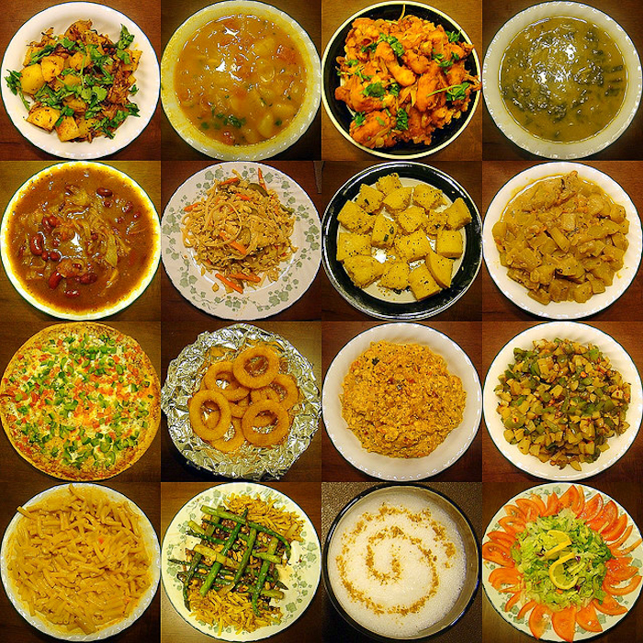
International Cuisine
Prof. Claire Stewart
Dept. of Hospitality Management
Food Exploration Exercise

Slide 2
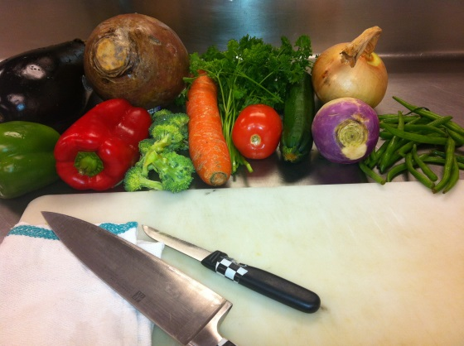
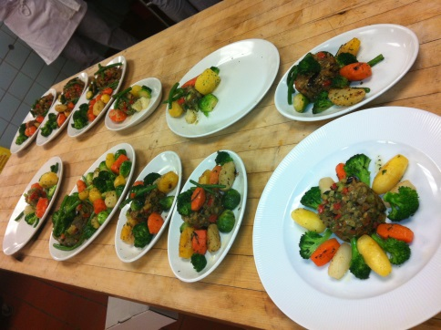
Former Task: Fall 2012 and Fall 2011
Food Journal- students were asked to post on Blackboard:
- unusual or special food experiences
- share photos of restaurant meals or items
cooked at home
-thoughts about favorite food memories
- new items tasted during the
semester

Slide 3
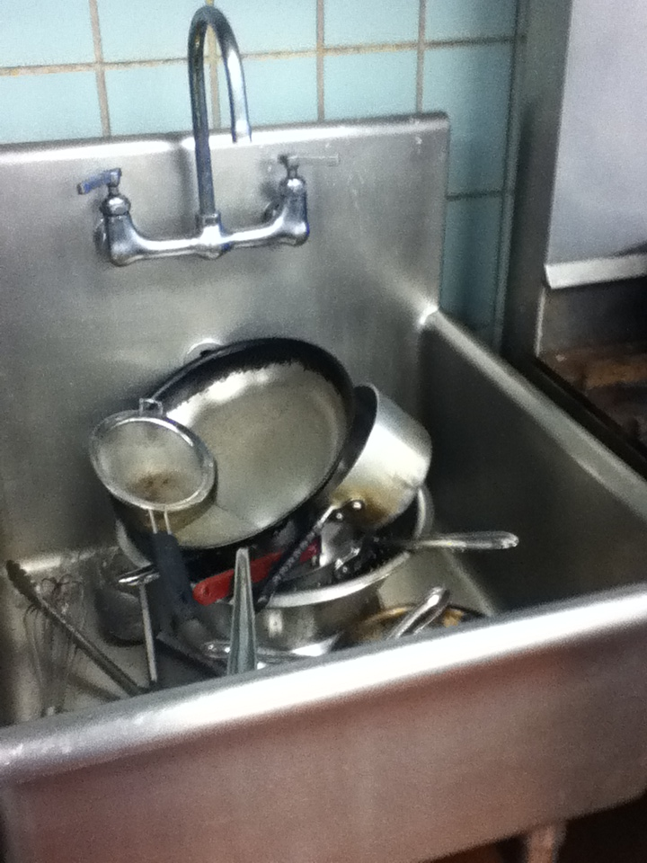
The problem with the assignment !
The students would not post regularly except for the faithful few (who already were doing well in the class).
Then when the assignment was close to coming due (week 13) the students began to frantically post. They somehow had many food “experiences” in week 12.
It was apparent their postings were not meaningful.
The low point was a photo of a sliced fruit plate from a banquet.
The problem was the assignment, Not the students. I know they post photos and comment about their food all the time on Facebook. They take pictures of their food constantly. They want to talk about food.

Slide 4
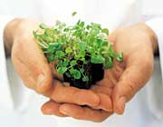
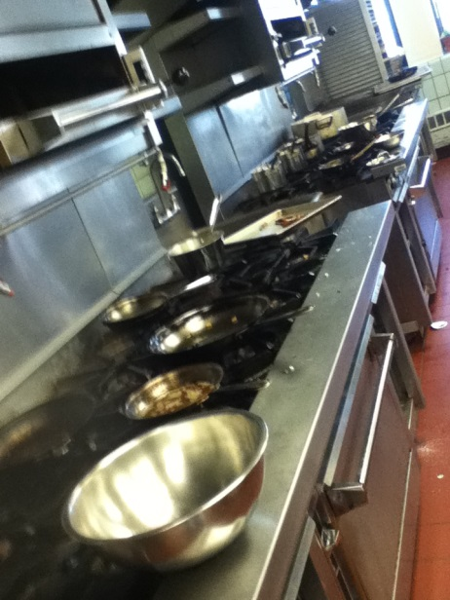
So, how could I change the assignment and get the students to “buy in?”
I know students constantly share YouTube videos about food
I know many students are immigrants or first generation Americans. Their interest is piqued when a food reminds them of “home” and they are able to see the likenesses and differences of various ethnicities
I know students are fiercely committed to the week they are chef. It is their moment to shine
The likelihood of doing an assignment based
on this week rather than random weeks
should increase the success of assignment

Slide 5
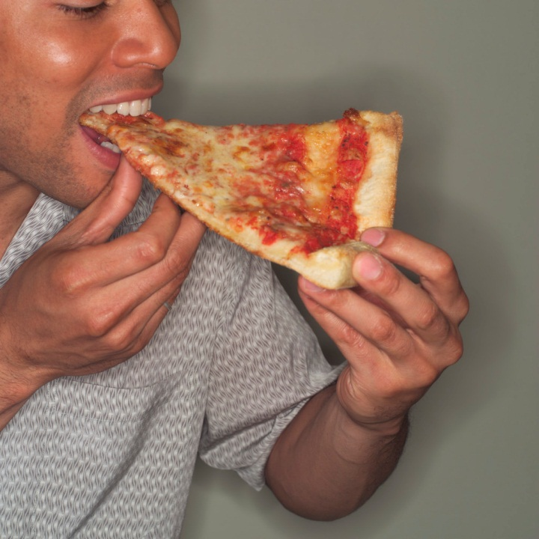
So now I will:
Narrow the focus onto the region in which they are chef. This
a. should increase participation
b. insure each region is represented on OpenLab rather than just “popular” food or regions from which many of the student body
derives

Slide 6

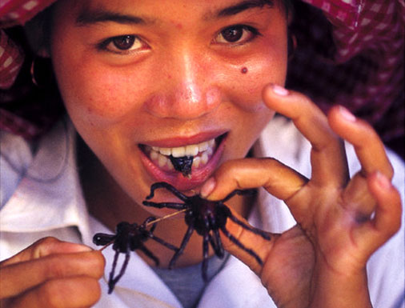
Personalize the Assignment
Insist that photos and videos for this part of the assignment are from students’ experience featuring themselves in the photo eating their food
This is to discourage the temptation to use
Wikipedia photos or to make
the assignment “general.”
This assignment is meant to
get students to try something
new and develop
their palate.

Slide 7
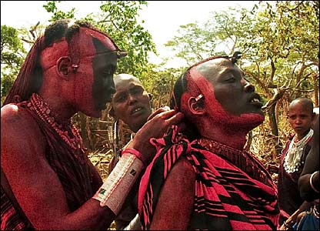
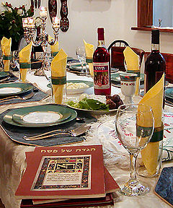
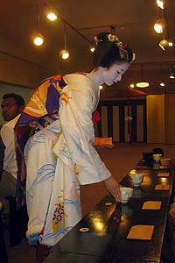
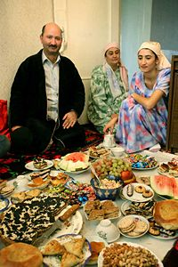
Broaden the assignment to include a cultural experience beyond food
Students will post photos and videos of various ceremonies and cultural traditions

Slide 8

Students will comment on posts
Because posts are tied to weekly chef responsibilities there should be ongoing
postings
This should address the frantic postings at the last minute just before the
assignment is due
This should help make the
assignment successful
I

Slide 9
General Education Student Learning Outcomes
Gen Ed Knowledge
a) Demonstrate understanding of international and regional foods through the production and consumption of various cuisines
b) Distinguish proper usage of culinary vocabulary
Gen Ed Knowledge and Skill
c) Analyze and produce international flavors through menu preparation

