Slide 1
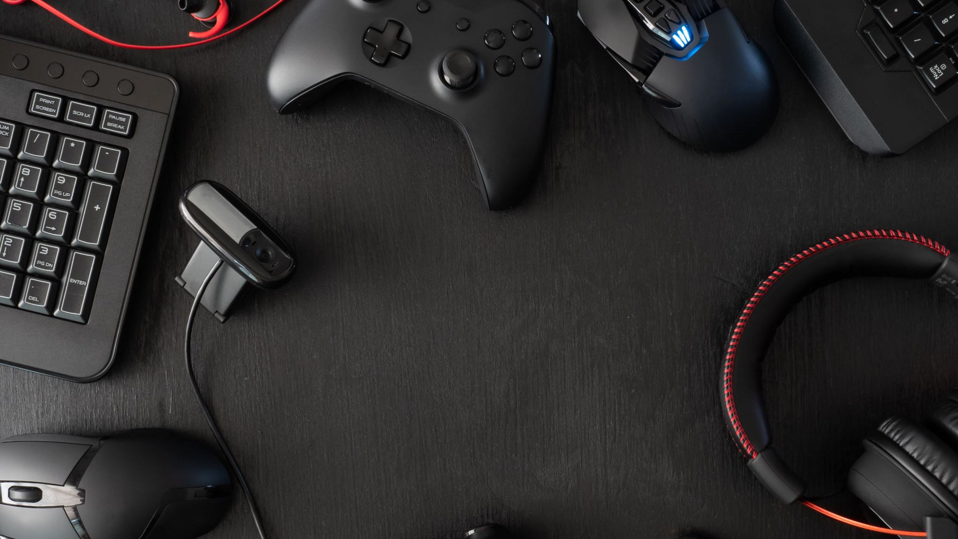
PlayStation 2
By PARMBIR SINGH

Slide 2
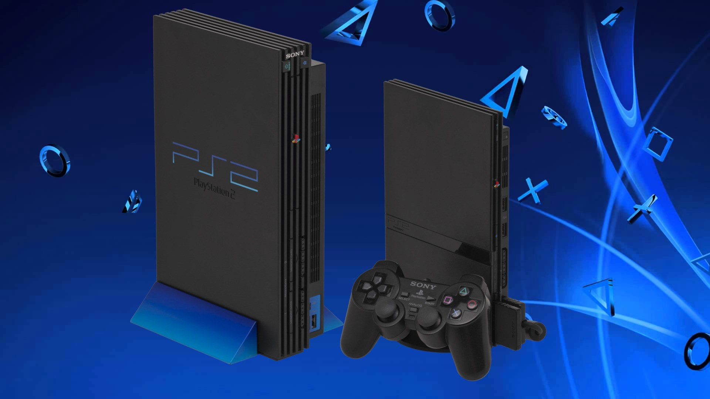
What is the PS2?
The PlayStation 2 is a multimedia home gaming console developed by Sony Interactive Entertainment. It first released in Japan on March 4th, 2000, then later releasing in North America on October 26th, 2000.
The PS2 have a built in DVD player was a major selling point to the consumers not interested in video games.
The PS2 also was backwards compatible with games from the original PlayStation console.

Slide 3
PS2 predecessors and successors
The PS2 predecessors was the original PlayStation also known as the PS1 on December 9th ,1994 in Japan and releasing 3months later In North America.
The Successor to PS2 was the PS3, which released on November 11th , 2006, and then releasing 6 days in North America.
The PlayStation 4 was released on November 15th , 2013 in North America and then two weeks later in Europe.
The PlayStation 5 was released on November 12th , 2020 in North America and then rest of the world a week later.

Slide 4
PS2 Technical Details
The PS2 was the first console to truly enable 3D graphics to shine. It opened up countless new possibilities to game designers and developers, and it did so before any of the other consoles of its generation.
The PS2’s DVD drive was a huge selling point early on, but it also allowed games to be bigger than ever before. Previously, large games had to span multiple disks, and the result was clunky at best.
Sources: https://www.lifewire.com/what-is-playstation-2-4684688

Slide 5
McLuhan Idea on video games
McLuhan argued that "Games are dramatic models of our psychological lives providing release of particular tensions. They are collective and popular art forms with strict conventions.”
Sources: https://www.degruyter.com/document/doi/10.4159/harvard.9780674422483.c2/html

Slide 6
Intended Consequences of PS2
One intended consequence of the PS2 is that it had online play through a dial up connection or a LAN connections. This allowed friends to play with each other multiplayer online games through the Ethernet connection.
Another Intended Consequences was durability and longevity. It had a lifespan of 13 years and had many new released of video games at that time.
The last intended consequence was third party support, it allowed for smaller game developers to make highly successful games and release on the PS2.

Slide 7
Unintended Consequence of the PS2
An unintended Consequence of the PS2 is that like many other gaming consoles throughout its history is aggressive behaviors among gamers towards people close with them and other gamers playing with them.
Another unintended consequence was health problems such as obesity, people who play games all day tend to not go outside or do exercise. They also eat junk food all day.
The last unintended consequence of the PS2 is that due to the major technological advancements made by the PS2, it made life span shorter for consoles released after the PS2.

Slide 8
PS2 Titles
The PlayStation 2 had many great video games profits as sales peaked in 2004 and declined in 2006 with the release of the PlayStation 3.
The Great PS2 video games titles include The Grand Theft Auto trilogy and with GTA San Andreas being the highest selling PS2 Game of all time. GTA 3 and GTA Vice city were in the top 6 for highest selling games in PS2 history.
The PS2 also had the Gran turismo Franchise which was also in the top 6.
This Photo by Unknown Author is licensed under CC BY-NC-ND

Slide 9
PS2 Reception
The PlayStation 2 was met with critical acclaim due to adding new technological advancements ahead when it initially released.
The PlayStation was also met with critical acclaim due to its gaming catalog and legendary title.
The slim version got praised Huge library of games; svelte design; built-in networking/modem ports and remote sensor; doubles as a CD/DVD player; free online gaming with select titles.
Many people believe this is the Greatest Console of all time. I also believe this statement.
Sources: https://www.cnet.com/reviews/sony-playstation-2-slim-review/

Slide 10
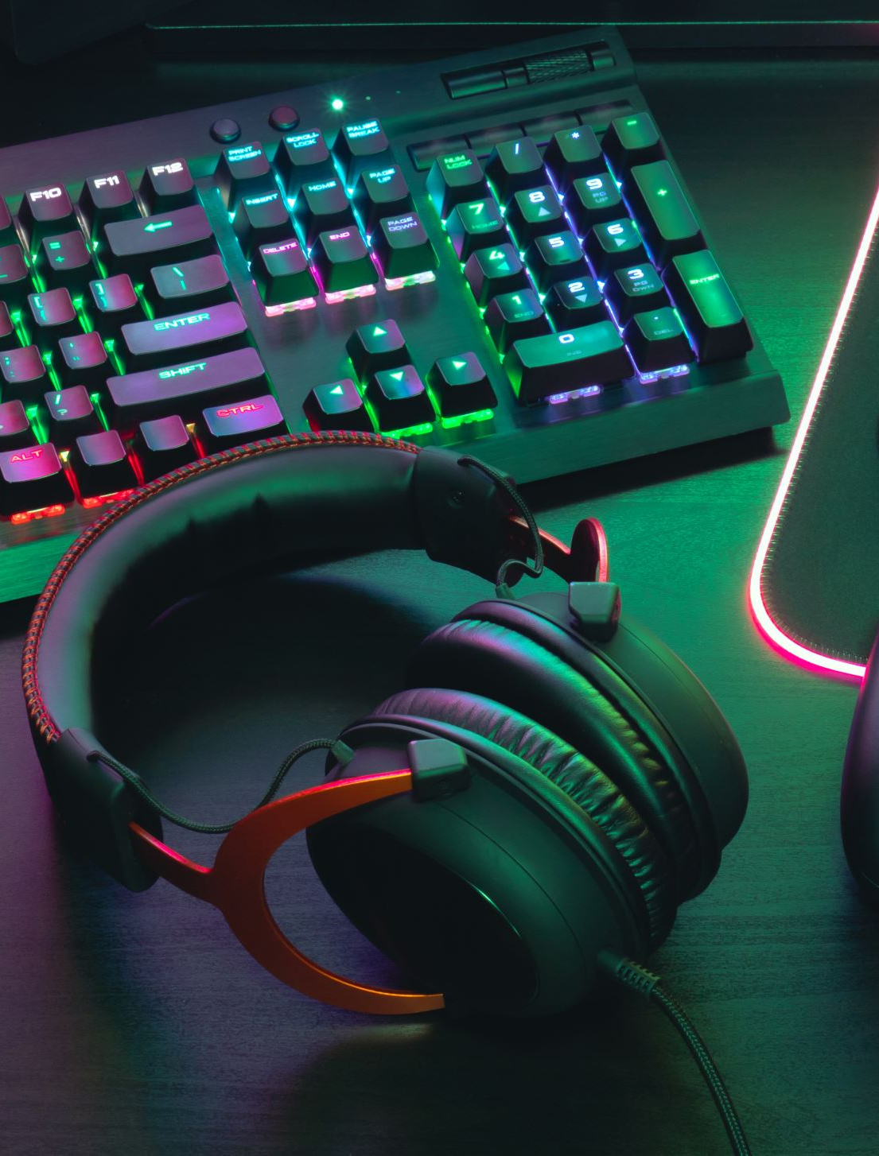
PS2 Sales
As of May 2023, Statista noted that the video game console PlayStation 2 (PS2) is still the best-selling video game device of all time with sales of 158.7 million units. PlayStation's closest competitor is Nintendo. With sales of 154.02 million units, the Nintendo DS overtook the PS2 in second place.
Sources: https://www.kompas.id/baca/english/2023/07/18/en-penjualan-playstation-2-masih-tertinggi-sepanjang-masa

Slide 11
THE END
This Photo by Unknown Author is licensed under CC BY-SA

