Slide 1
The Power Behind the Car
Sandy Fougeres
11/15/2022

Slide 2
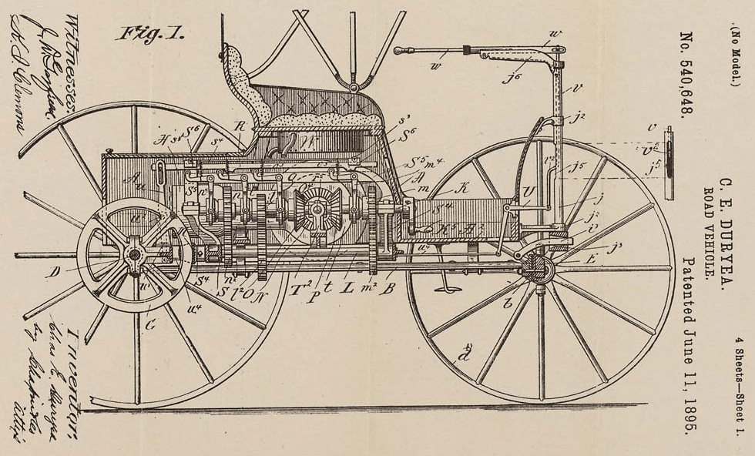
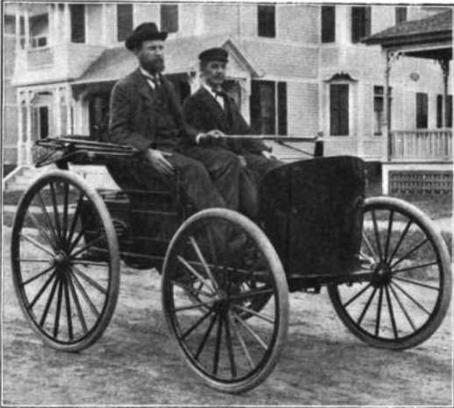
The Early History Behind the Car
In America, the car was invented in 1891 by Charles and Frank Duryea, who were inspired by Karl Benz. Brothers in the bicycle industry, they improved their earlier ideas creating the first gasoline powered automobile, which won the first recorded automobile race in America.
“Charles, the more loquacious brother, took the idea of mass-producing horseless carriages to Erwin Markham, a Springfield financier, in January 1892. Markham invested $1,000 in return for 10 percent of any profits…Frank Duryea, the more skilled mechanic, went to work. His initial efforts produced a gasoline-powered, one-cylinder buggy with a drive belt and no neutral gear” (Brown, 1996).

Slide 3
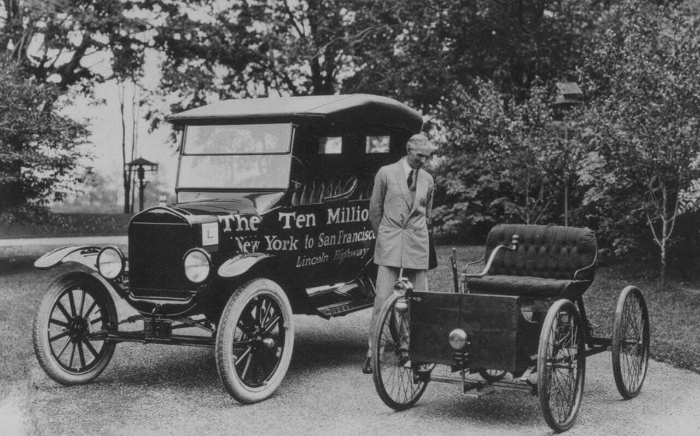
The Mass Production
Henry Ford, the American businessman, created the Model T car in 1908.
The Model T, was an affordable car that Ford mass produced. Ford’s innovation behind the moving assembly line supported the car industry worldwide.
“By the early 1920s more than half of the registered automobiles in the world were Fords. More than 15,000,000 Model Ts were built and sold” (“The Model T”, n.d).

Slide 4
The Intended Consequences
New way of traveling
New form of entertainment
Creation of new jobs and services
Creation of infrastructures such as roads, parking lots, express ways etc.
The relocating to suburbia

Slide 5
The Intended Consequences (cont.)
Traveling: People are able to travel cross country, for certain jobs, and for leisure etc. “Above all, the automobile was assuming a dominant role in popular recreation as more and more Americans incorporated it into their visions of recreation and leisure” (Blodgett, 2015).
Improved Infrastructure: “It is estimated that as much as one half of a modern American city’s land area is dedicated to streets and roads, parking lots, service stations, driveways, signals and traffic signs, automobile-oriented businesses, car dealerships, and more” (Frazer, 2019).

Slide 6
The Unintended Consequences
Car accidents/ Deaths
Weakened family ties
Air pollution
Traffic

Slide 7
The Unintended Consequences (cont.)
Car accidents became a new way of loss of life as cars became more prevalent. With more cars on the road, the chances of an accident increased. “It was widely recognized that the problem of motor vehicle accidents was directly related to the rise in the number of automobiles, since both accidents and motor vehicle registrations seemed to be increasing at geometric rates” (Brownell, 1972).
Air Pollution: “Vehicle pollutants harm our health and contain greenhouse gases that cause climate change” (Forster, n.d).

Slide 8
Improvements
Over the years, the car has improved in design, speed, safety, etc. Advanced technology have also become a part of cars and has enhanced the experience of driving. However, though there are changes made, there are still intended and unintended consequences with these advancements.

Slide 9
Resources
Frazer, J. (2019, August 6). The Reshaping Of City Cores That Were Designed For Cars. Forbes, https://www.forbes.com/sites/johnfrazer1/2019/08/06/the-reshaping-of-city-cores-that-were-designed-for-cars/?sh=5a2549e21e46
Blodgett, P. J. (2015, August 15). How Americans Fell in Love With Taking Road Trips. Time, https://time.com/3998949/road-trip-history/
The Model T. (n.d). Ford, https://corporate.ford.com/articles/history/the-model-t.html#:~:text=More%20than%2015%2C000%2C000%20Model%20T's,old%2C%20its%20legacy%20is%20timeless.
Forster, M. (n.d). Reducing Air Pollution from Cars. Department of Ecology State of Washington, https://ecology.wa.gov/Issues-and-local-projects/Education-training/What-you-can-do/Reducing-car-pollution#:~:text=Vehicle%20pollutants%20harm%20our%20health,hydrocarbons%2C%20benzene%2C%20and%20formaldehyde.
Brownell, B. A. (1972). A Symbol of Modernity: Attitudes Toward the Automobile in Southern Cities in the 1920s. The Johns Hopkins University Press, American Quarterly, https://www.jstor.org/stable/2711913
Brown, W. (1996, July 10). America’s Auto Industry Geared Up a Century Ago. The Washington Post, https://www.washingtonpost.com/archive/1996/07/10/americas-auto-industry-geared-up-a-century-ago/4cbae9ab-136a-4c70-8890-992a50681ac4/

Slide 10
Thank You!

