Slide 1
Streaming Services
Tiana Beatty

Slide 2
What is a streaming service?
A streaming service or streaming media is “is multimedia that is delivered and consumed in a continuous manner from a source, with little or no intermediate storage in network elements. Streaming refers to the delivery method of content, rather than the content itself.”
The term "streaming media" can apply to media other than video and audio, such as live closed captioning, ticker tape, and real-time text, which are all considered "streaming text".
Streaming is most popularized through entertainment platforms such as movies, tv shows, sports, and music.
Notes:
https://en.wikipedia.org/wiki/Streaming_media

Slide 3
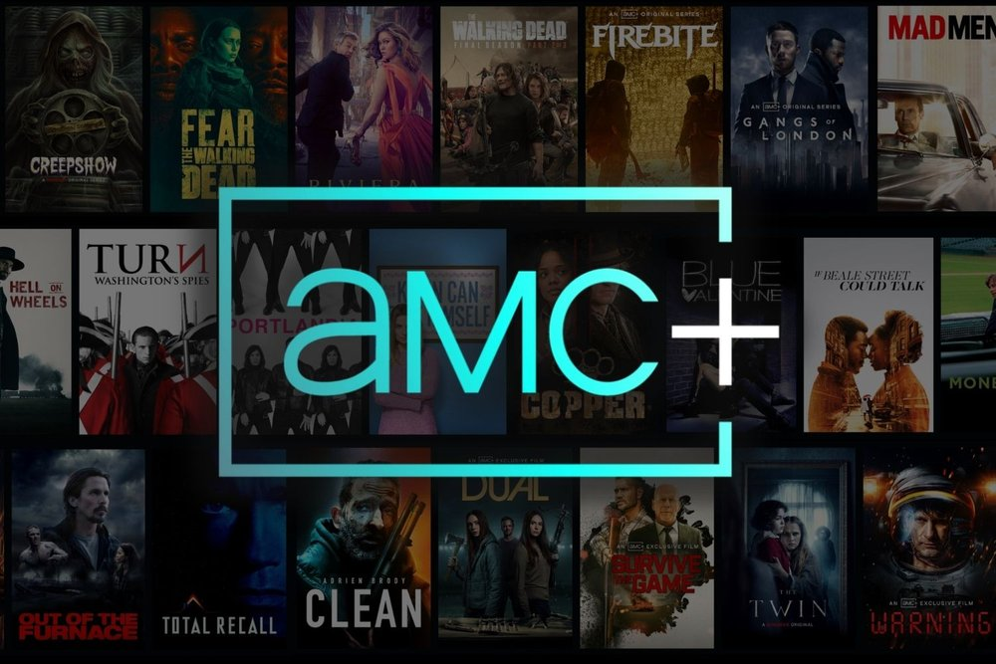
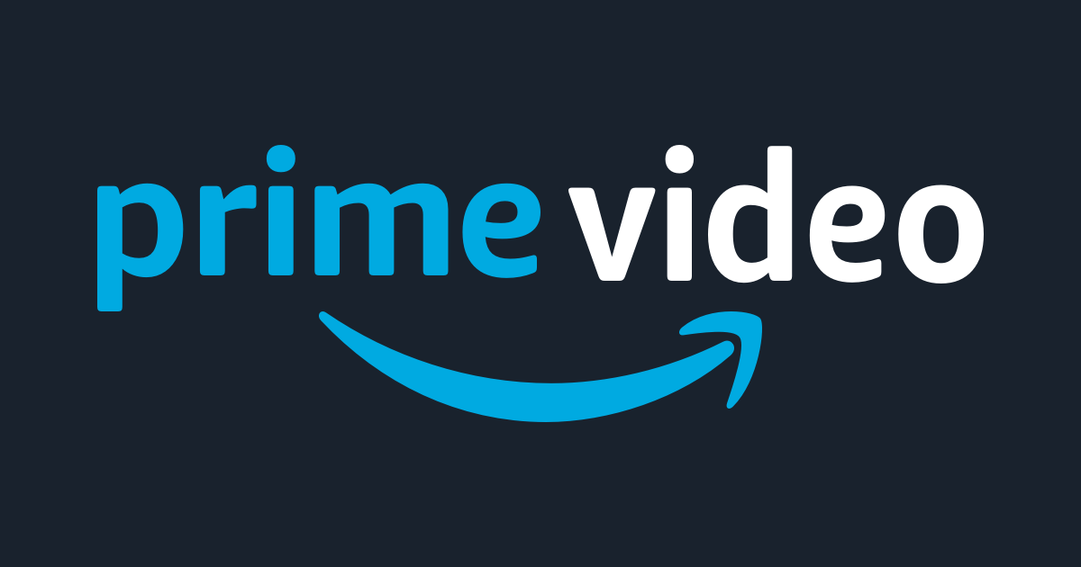
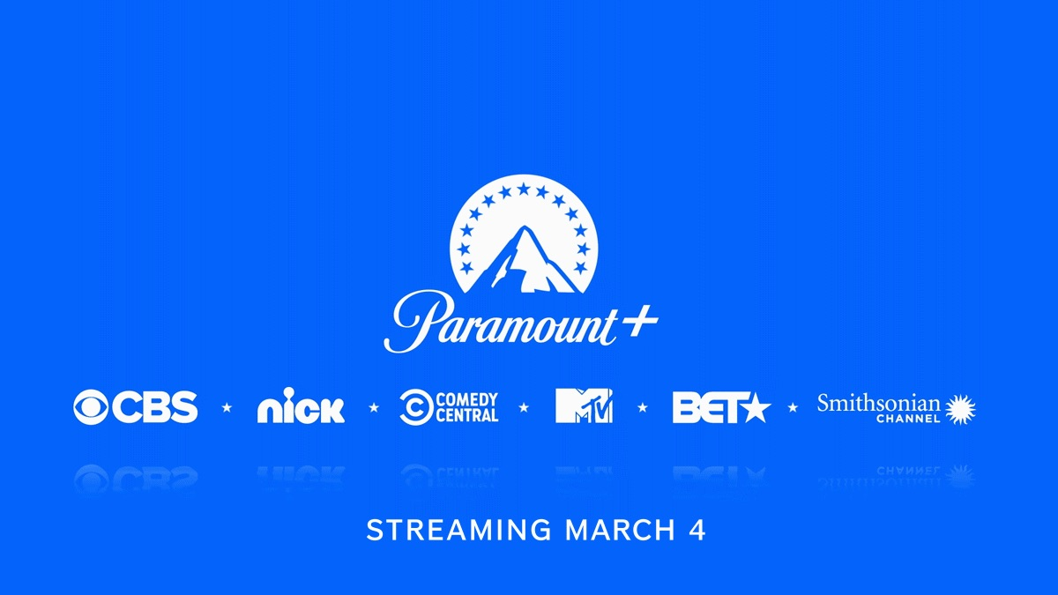
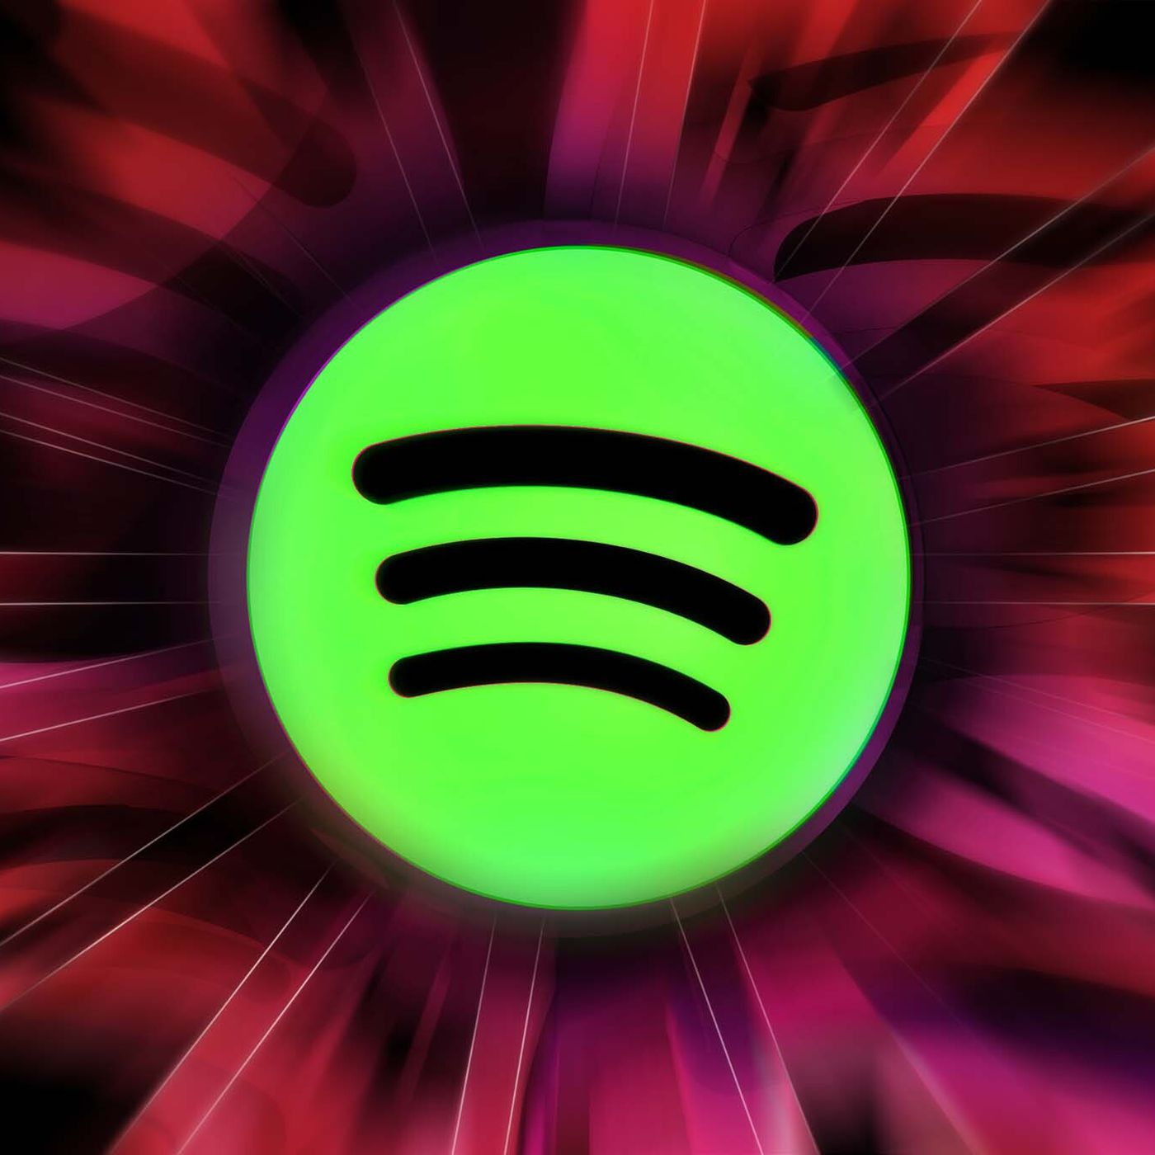
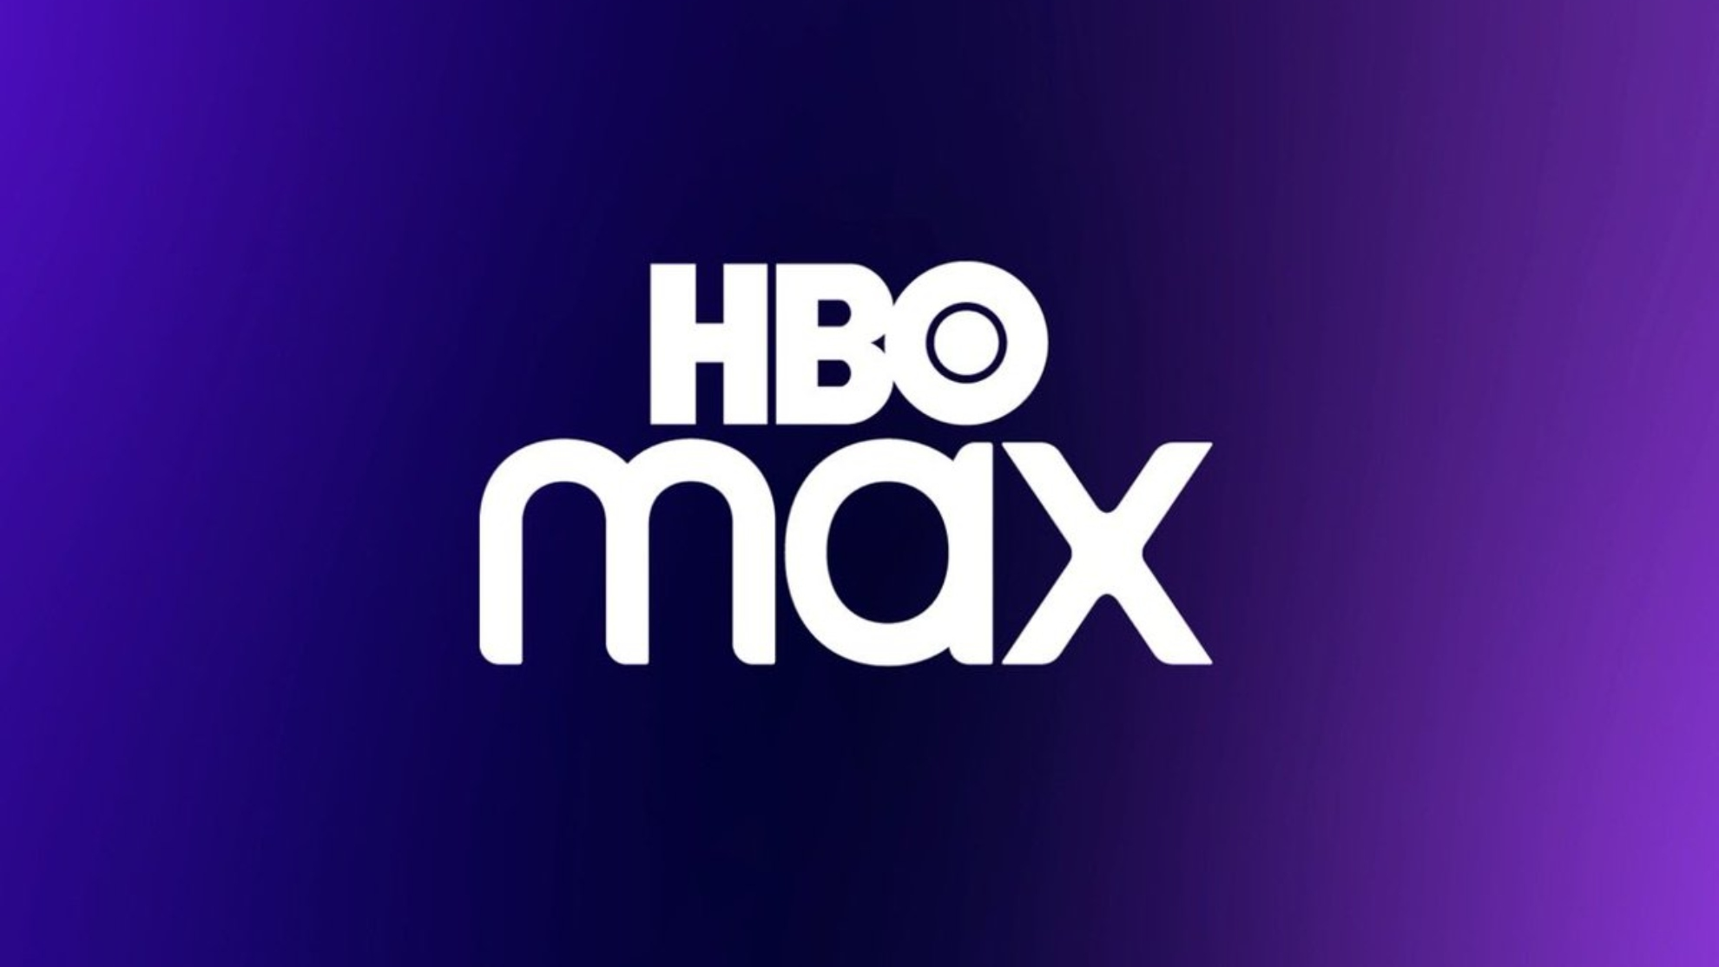
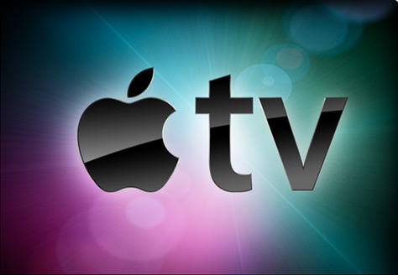
Examples of Streaming Services

Slide 4
Pros & Cons (Intended & Unintended Consequences)
Pros (Intended Consequences)
Cons (Unintended Consequences)
Streaming is immediate.
No advertisements or commercials
Catching up on past, current, and upcoming movies and tv shows
Streaming services cost money
Binge-watching and social isolation
Reliable internet connection

Slide 5
Pro: Streaming is Immediate
Streaming services provide immediate content no matter how big or small the file is.
Using a streaming service doesn’t require storage space; only the app that’s downloaded onto the device you’re watching or where you’re listening to the content on.
You can access the same or multiple shows on many device, like computers, TV/smart TVs, and cellphones, for streaming services. All is needed is downloaded app and login information.
Streaming provides convenience. Streaming gives the user the ability to watch whatever and whenever he/she wants. There is no commitment to scheduling compared to cable TV.
Streaming services introduces new and additional channels that viewers may have not been aware of.
Notes:
https://www.businessinsider.com/guides/streaming/what-is-streaming
https://toughnickel.com/frugal-living/Does-Cutting-the-Cord-Save-you-Money-It-Depends

Slide 6
Pro: Catching Up on Past, Current, and Upcoming Movies, TV Shows, & Music
Streaming services offer a variety of different genres and ranges for every person invested into a streaming service.
Viewers and listeners can choose what they want to watch no matter how old the content is. For example, someone can watch a movie that came out in 1999 without experiencing poor quality.
“Streaming on-demand apps open a whole other universe of options.”
Because streaming services can offer a wide range of different options, viewers and listeners can easily find new favorites or discover old ones.
Notes:
https://www.finehomesandliving.com/featured/top-5-advantages-of-tv-streaming-service/article_0a7d7b52-cbc3-11ec-a386-271492cd74dd.html
https://www.cabletv.com/blog/cable-vs-streaming

Slide 7
Pro: No Advisements or Commercials
Compared to cable-TV, most streaming services stop the usage of ads. This can create a productive, uninterrupted, and seamless viewing experience.
“You can watch your favorite shows and movies without having to sit through any interruptions. This is great news for those of us who hate being forced to watch commercials, and it's also great news for those of us who appreciate being able to control our own media consumption. No ads means that we can choose to watch what we want, when we want, and how we want. This is the way that streaming services are supposed to be.
Ads interrupts the viewing experience and when there are ads, the viewers can’t enjoy the content that’s in front of them.
Notes:
https://www.ict-pulse.com/2018/07/on-demand-streaming-traditional-tv-pros-cons/
https://www.finehomesandliving.com/featured/top-5-advantages-of-tv-streaming-service/article_0a7d7b52-cbc3-11ec-a386-271492cd74dd.html

Slide 8
Con: Streaming Services Cost Money
Most streaming services costs money and can range from $5.99 to $80.99 depending on the services you want provided.
Because streaming services are charging viewers and listeners, depending on the purchased plan; access to the streaming service can be limited.
HBO-Max charges $9.99/month for basic streaming and $14.99/month for ad-free streaming
Hulu charges $6.99/month with ad-supported content and $75.99/month with Hulu ad-free and live TV with Disney+ and ESPN.
Promotions and free trials reel in a new viewers and listeners.
Notes:
https://www.moneygeek.com/financial-planning/resources/best-streaming-services-on-a-budget/#deciding-on-streaming-services

Slide 9
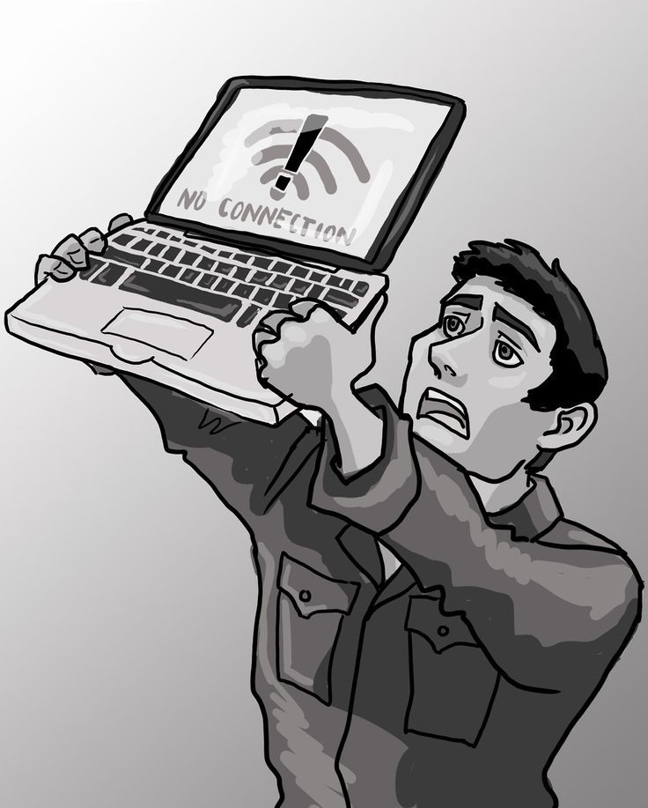
Con: WIFI/Internet Connection
Accessing streaming services causes for a reliable and fast WIFI/internet connection.
This normally isn’t a problem for most, but some areas can have limited connections which can cause buffers and lags when someone is streaming their content. Waiting time can be last from minutes to hours.
Notes:
https://www.businessinsider.com/guides/streaming/what-is-streaming
https://www.finder.com.au/pay-tv-vs-streaming

Slide 10
Con: Binge-Watching & Social Isolation
Binge-watching is the continuous watching of a TV show for a long period of time.
“Binge-watching affects the quality of your sleep and your sleep patterns. You may keep convincing yourself that this will be the last episode you watch for the night, and then find yourself still watching hours later.”
Binge watching leads to social isolation as the watcher losses time as they are watching the show of their choice. Because of the time, they are losing they can ignore other areas of life that need to be prioritized like work, school, family, and friends.
Notes:
https://www.thesundaily.my/style-life/pros-and-cons-of-binge-watching-shows-NX8734492

Slide 11
References
https://en.wikipedia.org/wiki/Streaming_media
https://www.thesundaily.my/style-life/pros-and-cons-of-binge-watching-shows-NX8734492
https://www.businessinsider.com/guides/streaming/what-is-streaming
https://www.finder.com.au/pay-tv-vs-streaming
https://www.moneygeek.com/financial-planning/resources/best-streaming-services-on-a-budget/#deciding-on-streaming-services
https://www.ict-pulse.com/2018/07/on-demand-streaming-traditional-tv-pros-cons/
https://www.finehomesandliving.com/featured/top-5-advantages-of-tv-streaming-service/article_0a7d7b52-cbc3-11ec-a386-271492cd74dd.html
https://www.cabletv.com/blog/cable-vs-streaming
https://toughnickel.com/frugal-living/Does-Cutting-the-Cord-Save-you-Money-It-Depends

