Slide 1
Welcome to
Dr. Carrie Halls class

Slide 2
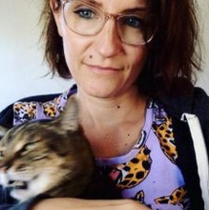
Dr. Carrie Hall
English 1121

Slide 3
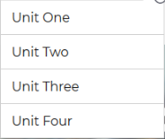
A class of Projects
Personnel Experience
-
Nicholas
Four to be exact…ish

Slide 4
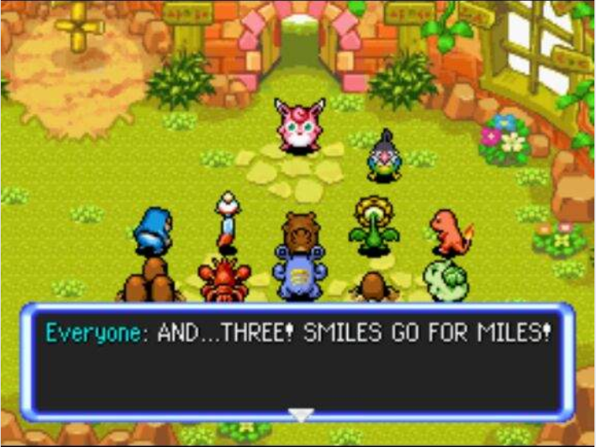
What you Enjoy
This class is meant to help you improve, and it’s hard to let a class do something if you hate it. So when trying to decide a topic for a project, make sure you are slightly passionate and that you know its something you will enjoy writing about.

Slide 5
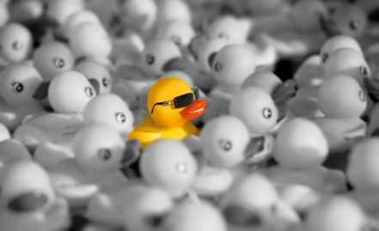
Personal Experience - Giuseppe
First of all, with this class you have to be yourself don’t try to imitate someone. This is how you show a professor who really are, and don’t be scared Prof. Hall will not eat you

Slide 6
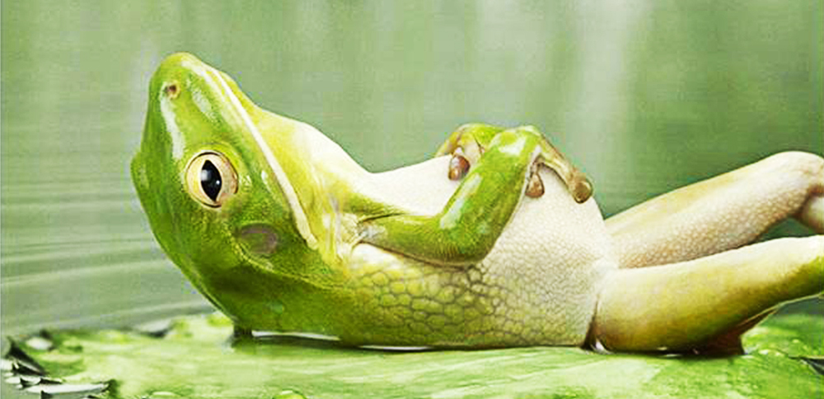
Stay Calm and Improve
Has the time has come to and end what I can tell to you guys the next students is that the class is very chill and the assignments are not difficult, but in some of them you’ll have to research articles or documents just because the assignments is like that.
I think that this class will help you be a better writer since what many of the assignments will be on what you think about something.

Slide 7
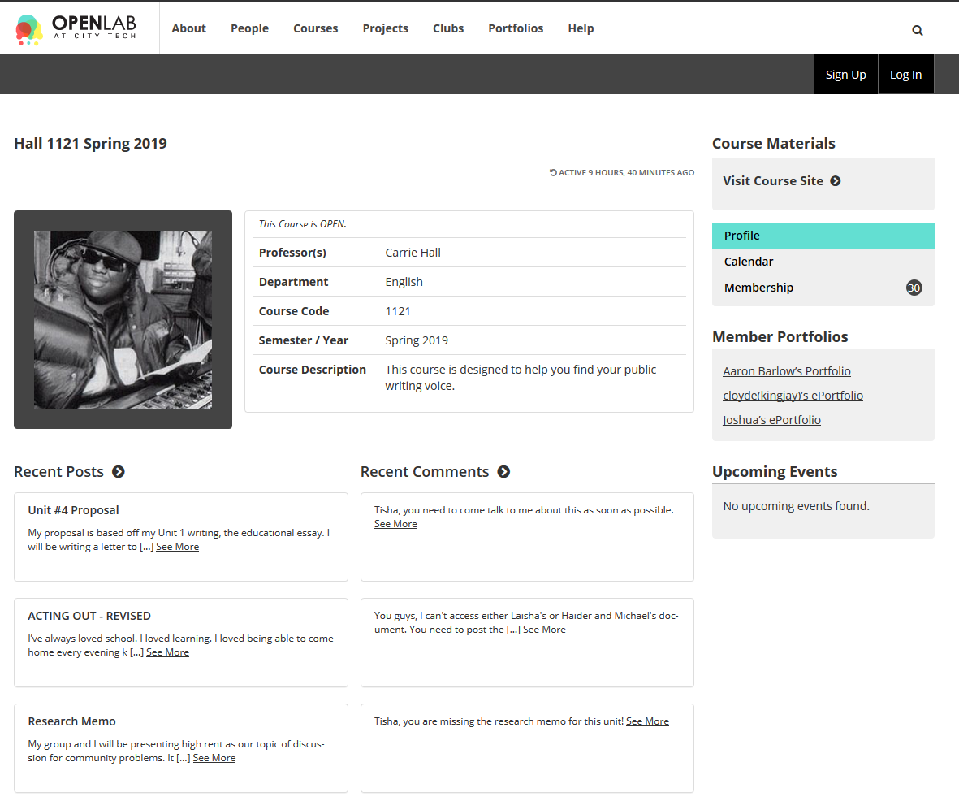
OpenLab
Oh and one last thing, if you don’t know how to use OpenLab, start practicing with it because that is where you’ll post every assignment!

Slide 8
Personal Experience - Latrell
Collaboration
In this class, you should expect a lot of collaboration, which will push your teamwork and collaborative skills farther forward.

Slide 9
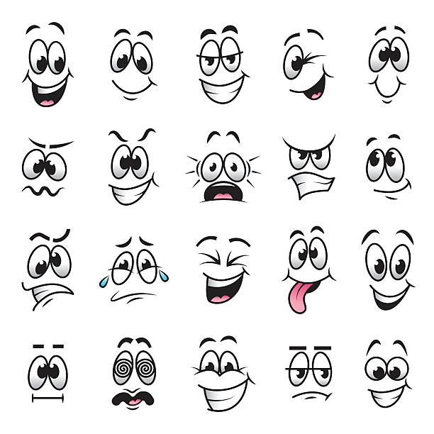
Expression
I’d say that you should be very confident about expressing your ideas, as this is very much a class where your own ideas will be at the forefront of your work. You won’t be given a layout of how you should present your ideas, and how to write your essays, because you’ll be choosing those things yourself. This english class puts a lot more emphasis on self-expression and the unique ways of thinking and learning that everyone has.

Slide 10
Effort
There won’t be an abundance homework assignments, instead, there will be assignments per unit. You should use that as an advantage to put in more time and work into the assignments to make them as complete and polished as you can make it!

