Slide 1
Understanding Unit 2:
The Reflective Annotated Bibliography
“Good Trouble”
Caroline Chamberlin Hellman

Slide 2
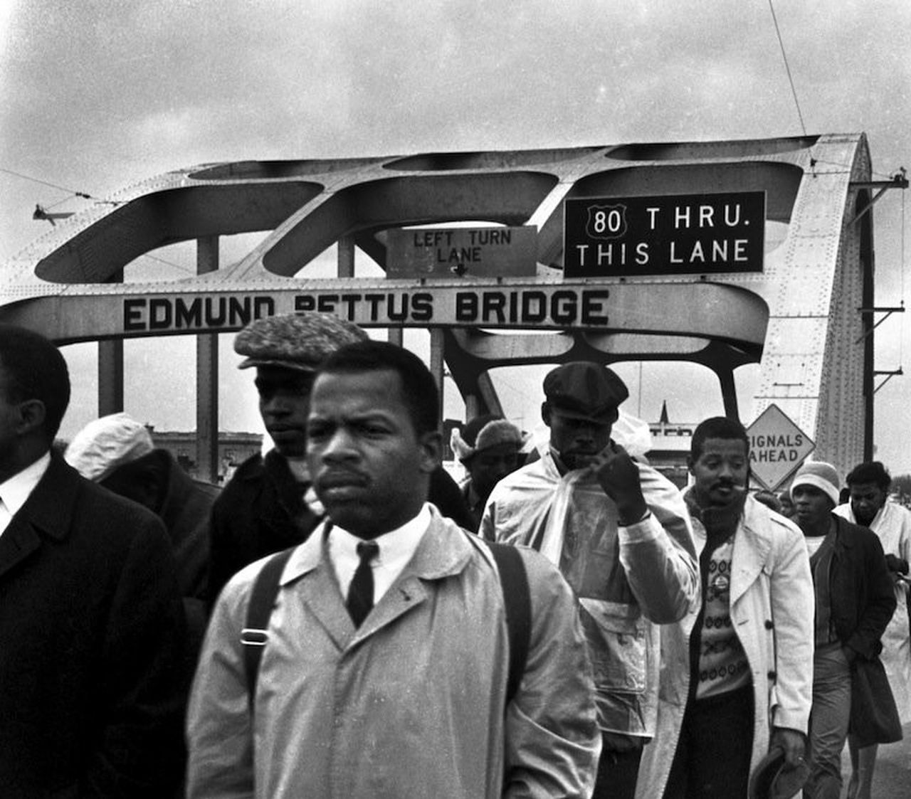
Congressman John Lewis (1940-2020)
Civil rights leader
Helped organize the 1963 March on Washington
Chairman of the Student Nonviolent Coordinating Committee (SNCC) 1963-1966
Led 1st Selma to Montgomery March across Edmund Pettus Bridge, Alabama, March 1965. State troopers and police attacked peaceful marchers, including John Lewis.
    NAACP:
      “If Federal troops are not made available to protect the rights of Negroes, then the American people are faced with terrible alternatives. Like the citizens of Nazi-occupied France, Negroes must either submit to the heels of their oppressors or they must organize underground to protect themselves from the oppression of Governor Wallace and his storm troopers.”
    State-sponsored violence led to Voting Rights Act

Slide 3
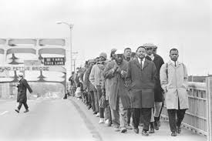
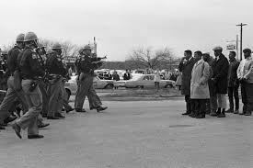

Slide 4
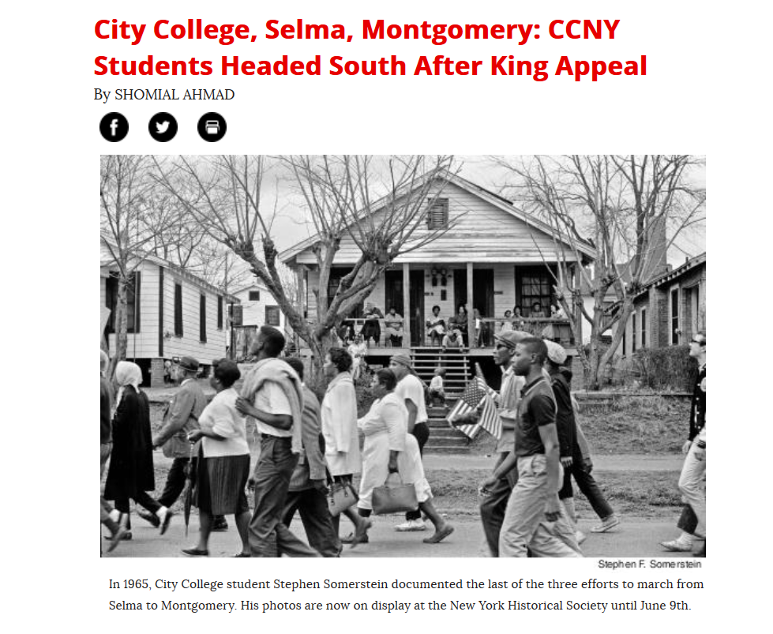

Slide 5
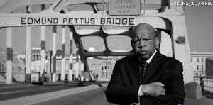
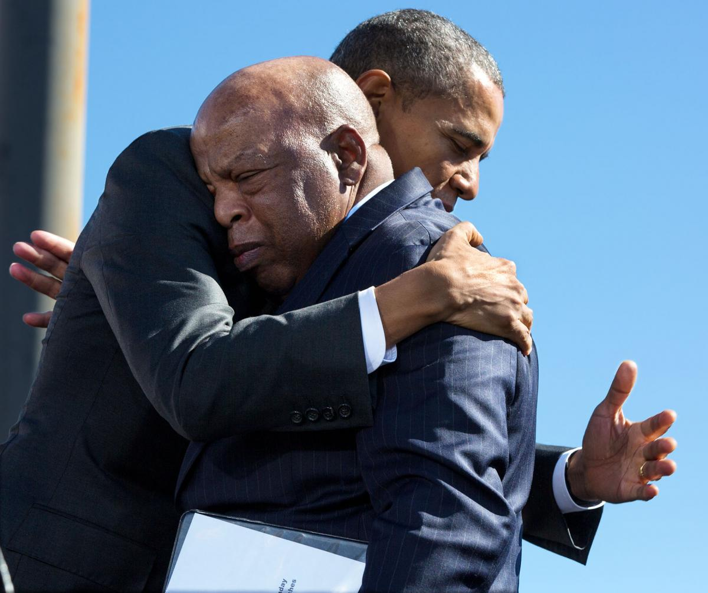
Congressman John Lewis
Served in United States House of Representatives, representing Georgia’s 5th Congressional District, 1987-2020
Upon Obama’s nomination for President: "If someone had told me this would be happening now, I would have told them they were crazy, out of their mind, they didn't know what they were talking about ... I just wish the others were around to see this day. ... To the people who were beaten, put in jail, were asked questions they could never answer to register to vote, it's amazing."

Slide 6
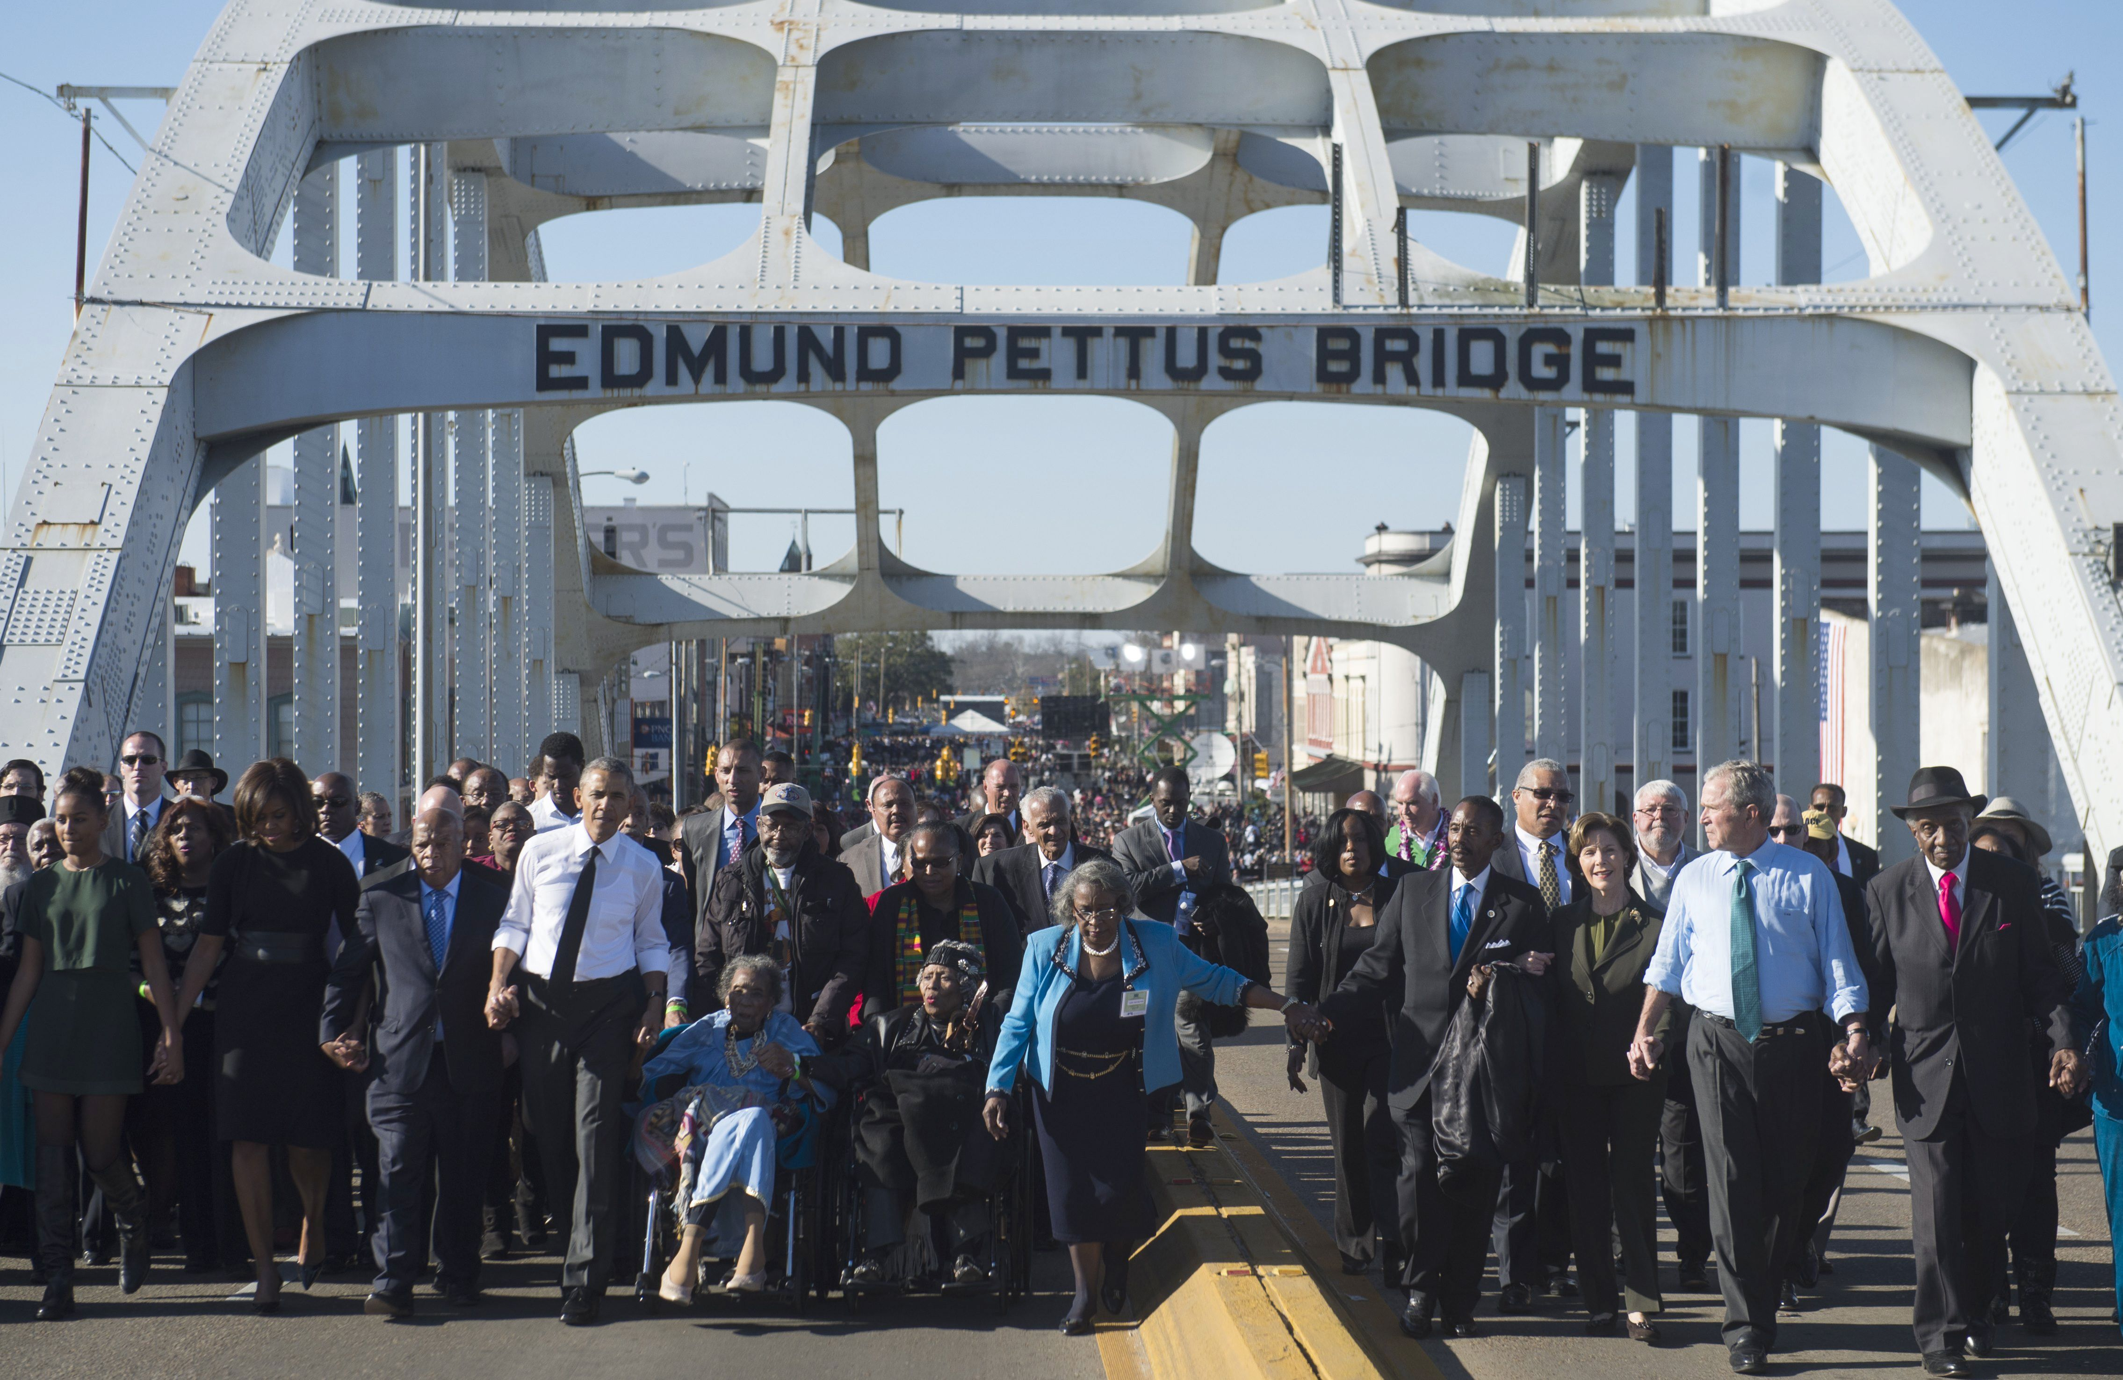
50th Anniversary of Bloody Sunday Selma March, 2015
Pictured:
To President Obama’s left: Amelia Boynton Robinson, 103. Voting rights activist and an organizer of the civil rights Marches

Slide 7

2019 Commencement Speech, CCNY, CUNY

Slide 8
Congressman Lewis’s advice: “You must find a way to get in the way. You must find a way to get in trouble, good trouble, necessary trouble. Use what you have … to help make our country and make our world a better place, where no one will be left out or left behind. … It is your time.”
What does Representative Lewis mean by “good trouble?”
For Unit 2, you will be writing about your own “good trouble,” evaluating and responding to the sources that already exist on this topic, and adding your own voice to the conversation.

Slide 9
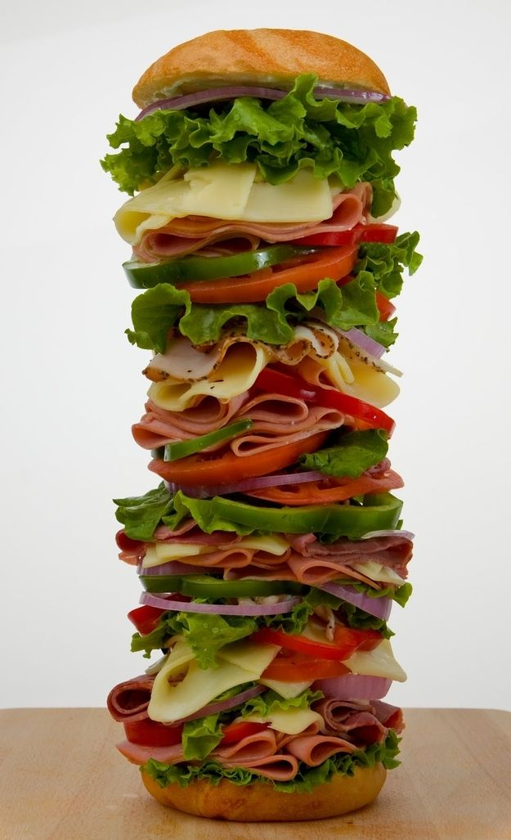
Once you narrow down a topic to investigate, you will want to compile a list of 3 sources in a variety of print and non-print genres: newspaper and journal articles, interviews, documentaries, songs, poems, government reports, etc. We will talk about genre awareness together.
A bibliography is a list of sources that one consults in a research process.
A Reflective Annotated Bibliography (RAB) includes more information about each source, including a summary, important quotes, rhetorical analysis, and response.
Think of the RAB as a giant quote sandwich (a party-size, 6 foot hero)!

Slide 10
RAB Components
Introduction (200-300 words)
  Introduce your topic and why it interests you, what you wish to find out more about
Alphabetical list of 3 sources, each with a bibliographic entry (200-300 words each)
  Summary of source content
  2-3 key quotes (include citation info) that are representative of major ideas (these do not count toward the word count total)
  Rhetorical analysis of the source (author’s writing style, genre, purpose/ intended audience, and credibility)
  Your reflection on the source, including your opinion on the content (here you distinguish your own ideas from those of the author/artist) and why you chose to include it
Conclusion (200-300 words)
  Reflect on the sources you have identified and brought together, and explain how your own thinking or approach to the topic has expanded or changed
  Address why this new knowledge is important
  Identify a potential audience for your ideas and consider which genre would be most appropriate to express them

Slide 11
Sample Topics (from previous students):
The Tulsa race massacre and how it was written about in different 1921 newspapers
Recent elements of gentrification in Flushing, Queens
Hong Kong youth protests
Binge-watching Netflix tv shows
The chopped cheese sandwich
LGBTQIA pride as seen in fashion
The different effects of high school disciplinary measures (detention, suspension, expulsion)
Street art (3 murals) in Brownsville, Brooklyn

Slide 12
Unit 2 Scaffolding Steps (Week 8)
What is your own “good trouble?” Write a paragraph in which you address:
  What is the topic that interests you? Why does it interest you?
  What do you already know about it? What do you hope to explore further and find out?
  [This paragraph will later become your RAB introduction]
2. I (your friendly neighborhood professor) will respond with feedback and suggestions about your proposal. We will work together to hone your research focus.
3. Begin researching your topic and possible sources. What are some possible sources you could consult (newspaper editorials, interviews, podcasts, songs, documentaries…).? Note: having a variety of genres, print and non-print, is important.
You have the option to include the two John Lewis texts (his NYT editorial and his CCNY Speech) as two of your sources.

Slide 13
Unit 2 Scaffolding Steps (Week 9)
Continue to work on your RAB draft.
  Assemble a list of 3 sources in alphabetical order, each with a bibliographic entry (~250 words each) that contains the following:
    Describe and summarize your source (5-6 sentences)
    Assess the writing style, genre, purpose/ intended audience, and credibility of the source. This is the rhetorical analysis. (3-4 sentences)
    Include 2-3 key quotes (with page citation if possible) that are representative of major ideas (these do not count toward the word count total)
    Respond to the source, with your own opinion on the content (here you distinguish your own ideas from those of the author/artist) and why you chose to include it in your bibliography. Here you could also include a response to some of the quotes you chose. (5-6 sentences)

Slide 14
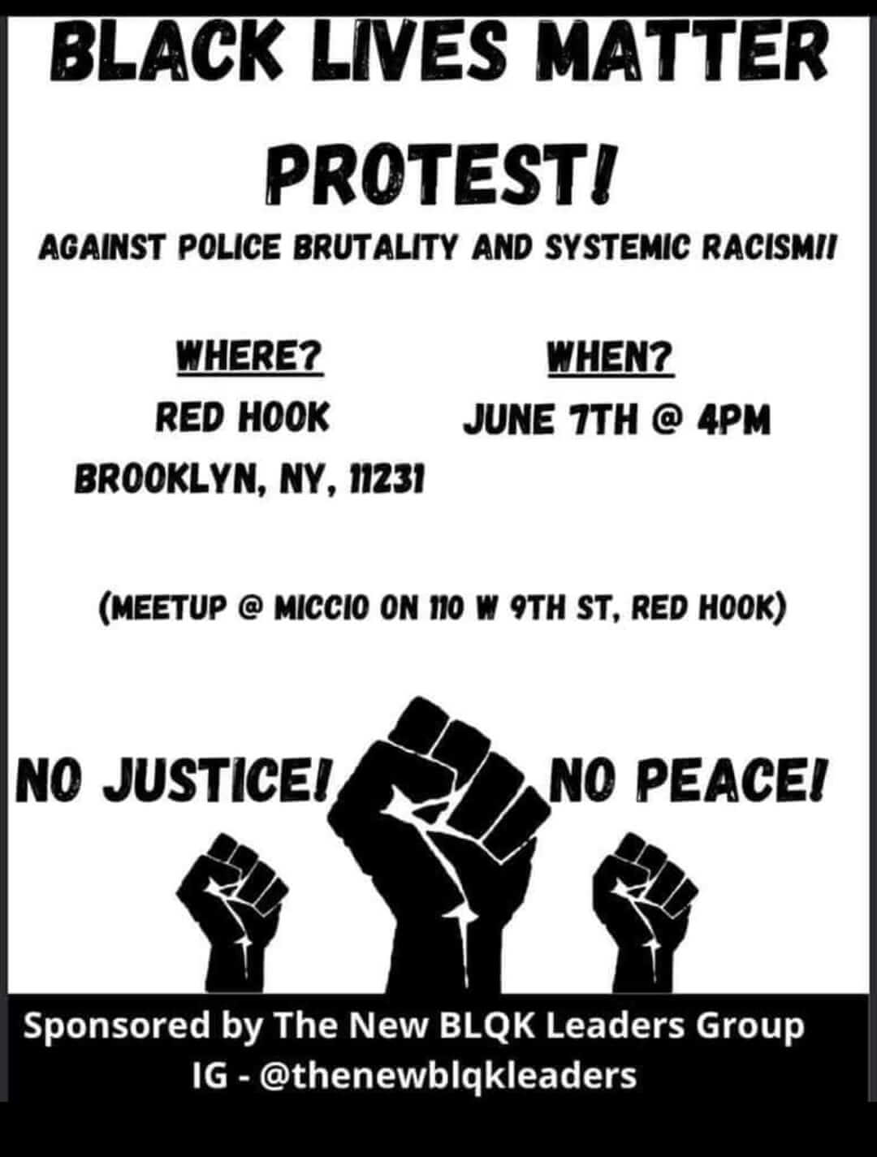
Unit 2 Scaffolding Steps (Week 10)
  At the top of the page, insert the introduction paragraph you wrote (topic description, explanation of your interest)
  Write your conclusion paragraph, reflecting on what you have learned, how this information could be assembled (genre?), and who’d be interested (audience)
  Review and proofread your entire draft.
  3. Upload your complete rough draft to our class Google Drive Unit 2 folder.

Slide 15

Unit 2 Scaffolding Steps (Week 11)
Use your draft feedback to revise your RAB.
Upload the final RAB to our class Google Drive Unit 2 folder.

