Slide 1
Putting the Pledge Into Practice:
Equitizing Classroom Policies & Practices
Dr. Alma Ramirez (alramirez@MSJC.EDU)
Interim Dean of Instruction, San Jacinto
Ryan Sullivan (RSULLIVAN@MSJC.edu)
Assistant Prof. of English, San Jacinto
A

Slide 2



Change can be scary.
It means more work, more time to invest, potential failure or mistakes, and a variety of other bad feelings.
However, our students deserve teachers who reflect, grow, change, and do whatever it takes to help them find the success that we have found.
Take a
Deep
Breath.
A

Slide 3


EQUITIZING CLASSROOM Policies and Procedures
R

Slide 4
A Few guiding Questions
Why do we assess students / give grades?
How do we accurately represent student knowledge while maintaining high expectations and rigorous standards?
How do we create equitable practices but not overwhelm ourselves and maintain clear boundaries?
How can we reimagine our policies and practices to avoid burnout?
R

Slide 5


Students Must negotiate Competing Priorities
We assume that prioritizing work and school are the obvious right answer based on our position—and as educators we place a high priority on education.
Students must negotiate choices between school and goods like money, time, jobs BUT also “ethical goods” like identity, community, family, and friends.
An advantaged student might choose between school and travel, or time hanging out with friends, or a hobby, but students from less privileged background must prioritize child care, sick family members, jobs, friendships and family bonds. Some of these enable them to go to school, so a choice between school and a friend who also helps watch kids is quite literally a no-win choice.
Our communities and our very identities are sometimes risked in this process, and as much as we need our communities-–they also need us.
From Moving Up without Losing Your Way by Jennifer Morton
A

Slide 6

When we create policies that try to force students to make what we think is a “good” or “better” decision, we are strengthening inequity by betraying the difficulty of negotiating competing priorities. We are also reproducing a system that greatly advantages those with more relative privilege.
From Moving Up without Losing Your Way by Jennifer Morton
A

Slide 7
Academic myths
Students just need to work harder. (Grit)
  No. We need to fix broken systems.
We are dumbing things down or making it easier. (Rigor)
  No. We need to challenge assumptions about success.
Students shouldn’t be so entitled when it comes to grades. (Growth Mindset)
  No. We have a system where failing has extreme consequences for them and sometimes their entire families.
Students don’t have the skills to be successful here/they aren’t college ready. (College Ready)
  No. Our systems have failed our students and we have an opportunity to help them.
A

Slide 8
What does it mean to be rigorous?
Faux Rigor
Prioritizing students meeting arbitrary timelines, deadlines, work loads, methods, doing all the “stuff,” and performing how we imagine good students perform
Having high expectations and expecting students to find their own way of meeting
A focus on the product of learning without recognition of the process
Comparing students to each other and ourselves and expecting them to perform in the same way
Ignoring student progress that happens outside of the boundaries we set
Meaningful Rigor:
Prioritizing student achievement and learning over our plans
Having high expectations with high support to achieve them
Focus on meaningful assessment as part of a learning process, not an end to that process
Meeting students’ individual needs
Encouraging progress and learning above all
Challenging our notions of what success looks like and constantly asking what is best for students
R

Slide 9
Living BIG: Boundaries, Integrity, and Generosity
“What boundaries do I need to put in place so I can work from a place of integrity and extend the most generous interpretations of the intentions, words, and actions of others?”
From Rising Strong and Dare to Lead, by Brené Brown
R

Slide 10
“What boundaries do I need to put in place so I can work from a place of integrity and extend the most generous interpretations of the intentions, words, and actions of others?”
Take an inventory of your needs:
  Example (accepting late work):
    Emailed assignments flood my box and get lost
    Loose late work gets lost in my chaotic mess of a bag
    I might get too many old assignments when I’m struggling to balance on time ones
Consider ways to set boundaries but be generous:
  Example (accepting late work):
    I will accept late work, but you must bring them to office hours or specific designated class time and show me in person.
    On time work will be prioritized and late work may receive less feedback and take longer to return.
    At a certain point / after a unit, we have to move on and I won’t be accepting more late work.
R

Slide 11
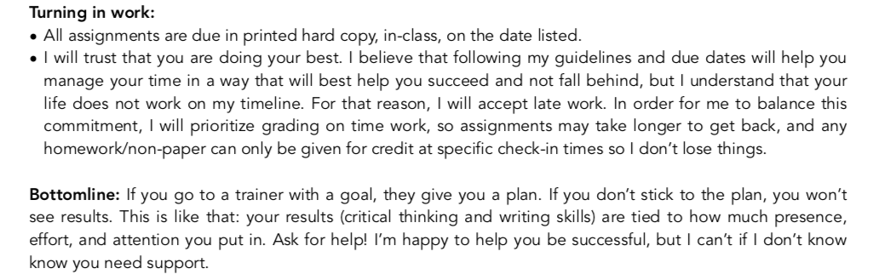
R

Slide 12
Living BIG: Boundaries, Integrity, and Generosity
"In addition to boundaries, an assumption of positive intent relies on the core belief that people are doing the best they can with what they’ve got, versus people are lazy, disengaged, and maybe even trying to piss us off on purpose. Sure, we’re all capable of change and growth, but assuming positive intent requires the belief that people are really trying in that moment.”
It is exhausting feeling like people around you don’t care, aren’t trying, or are disengaged and leads to burnout.
From Rising Strong and Dare to Lead, by Brené Brown
R

Slide 13
Why do we assess students with grades?
To accurately assess and communicate the areas a student has potential to grow in
To encourage growth, learning, and progress in order to meet expectations
To communicate to future colleges/employers a student’s skill level
A

Slide 14
3 Pillars of Equitable Grading
Acccurate
Bias Resistant
Grade based on student work, not timing
Motivational
Re-assess grade scales
Consider the purpose of grades
Avoid 0s/Minimum Grading
0-4 Scale
Re-assess weights and proportions
Grade based on content, not extra credit
Grade results, not methods
Self-assessment
Allow pre- and re-assessment
Create community of feedback
From Grading for Equity, by Joe Feldman
R

Slide 15
ACCURATE
Consider the purpose of grades: to accurately assess a student’s performance—not an accumulation of “stuff”
Re-assess weights and proportions: what messages/values are we communicating in our grade schema?
  Weight more heavily later in the class to allow for progress and improvement BUT avoid backloading work (don’t have a majority of the weight at the end, but also a majority of the work)
  Consider adjusting final grades to reflect progress and achievement.
Balance the grade scale by eliminating zeros for missing work (minimum grading) or using a GPA 0-4 Scale
R

Slide 16
Traditional Grade Scale
90-100 | A
80-89 | B
70-79 | C
60-69 | D
0-59 | F
Traditional Grade Scale – Complete
90-100 | A
80-89 | B
70-79 | C
60-69 | D
50-59 | F
40-49 | G
30-39 | H
20-29 | I
10-19 | J
0-9 | K
69% OF ASSIGNABLE GRADES ARE FAILING
R

Slide 17
STUDENT A
TEST 1 | 85% | B
TEST 2 | 85% | B
TEST 3 | 0% | F
Final Average | 57% | F
STUDENT A
TEST 1 | 85% | B
TEST 2 | 85% | B
TEST 3 | 0% | F
TEST 4 | 85% | B
TEST 5 | 85% | B
Final Average | 68% | D
R

Slide 18
STUDENT A
TEST 1 | 85% | B
TEST 2 | 85% | B
TEST 3 | 0% | F
TEST 4 | 85% | B
TEST 5 | 85% | B
Final Average | 68% | D
STUDENT A
TEST 1 | 85% | B
TEST 2 | 85% | B
TEST 3 | 50% | F
TEST 4 | 85% | B
TEST 5 | 85% | B
Final Average | 78% | C+
R

Slide 19
0-4 SCALE
4 | A
3 | B
2 | C
1 | D
0 | F
STUDENT A TRADITIONAL |  |  | MINIMUM GRADING |  | 0-4 SCALE
TEST 1 | 85% | B | 85% | B | 3
TEST 2 | 85% | B | 85% | B | 3
TEST 3 | 0% | F | 50% | F | 0
TEST 4 | 85% | B | 85% | B | 3
TEST 5 | 85% | B | 85% | B | 3
Final Average | 68% | D | 78% | C+ | 2.4 (C+)
NOTICE, THE 0-4 SCALE AND THE MINIMUM GRADING SCALE TURNED OUT THE SAME.
R

Slide 20
BIAS RESISTENT
Grade student work based on results, not timing (though, keep balance and be realistic)
  Students’ lives and learning processes don’t always fit our vision for them. Consider allowing more leniency for late work and encourage students to proactively ask for extensions.
Grade based on content, not extra credit
  Extra credit can be okay, but ask yourself: Will this support student growth and learning? How will this impact students in terms of time/money/transportation?
Grade results and honor the process instead of micromanaging methods
  There are many ways to learn. Are you supporting those, or forcing students to follow arbitrary methods (those that work for you, or those that you were taught)? Grades should assess a student’s ability, not be used to manage behaviors or teach soft skills (those matter--but that will be on the next slide).
  When students do things for points, they are more likely to see it as “doing X for the teacher” rather than understanding habits and learning tools.
A

Slide 21
Motivational
Give students a voice: Self-assessment
  Give students rubrics and ask them to reflect and self-assess. After, you can assess them and highlight areas of difference. This allows students a voice in the process, helps combat bias and blind spots, and helps students begin to better calibrate their assessments of themselves.
  Build in pre-tests and ways for students to assess their growth opportunities in advance. Tests and assignments should not try to trick or catch students, but be accurate representations of their progress.
Let students learn from mistakes: Allow re-assessment or pre-assessment (the learning is what matters, not the timeline)
  Allow students to learn from mistakes or retake/redo tests.
  Consider grouping test questions into knowledge areas, and allowing students to retake only knowledge areas they lacked proficiency in.
  Consider making re-assessment mandatory.
R

Slide 22
Don’t “Soft Skills” Matter? Yes!
Grades should be about assessing skills and knowledge.
Create a community of feedback: So-called ”soft skills” and how a student performs/interacts matters as well, but shouldn’t impact their grade. Instead of penalizing or managing behaviors and “soft skills” through grade reduction, offer feedback to students on “how to student”--including good learning habits, time management, and professionalism--throughout the course, and give individual feedback when students aren’t meeting your expectations.
Our goal as a community college is not to expect students to know how to be perfect college students day one. Our goal is to help support students understand best practices as they navigate the difficulties of having competing priorities.
  Example: You go to a restaurant. Do you pay at the table or pay at the front? Do you leave the dishes, or do you clean up? What if you should clean, but you see someone else not?
A

Slide 23
Deficit-minded Assumptions we make about students
If it isn’t worth points they won’t do it.
Everyone will turn in things late and no one will follow deadlines
Reassessing/late work isn’t fair to the students who do things on time. / Shouldn’t we treat all students equally?
We are lowering standards/rigor/dumbing down.

Slide 24
Deficit-minded Assumptions we make about students
If it isn’t worth points they won’t do it. / Students are lazy.
  If we emphasize the habits, skills, and transferable knowledge an assignment builds, they are more likely to do it based on intrinsic desire. Additionally, we must emphasize the value in the work and how it supports graded learning goals.
  Reframe: Students have competing priorities, and sometimes they struggle to balance them. I should show them why this work is valuable.

Slide 25
Deficit-minded Assumptions we make about students
Everyone will turn in things late and no one will follow deadlines
  Most instructors who try this find that this isn’t the case. Also, we should communicate that students our deadlines will help them manage their time and that consistently missing deadlines will make it more difficult to do all that they need to.
  Reframe: Students want to be successful but sometimes need help. I can set goals and strategies to succeed, but they need to make their own decisions.

Slide 26
Deficit-minded Assumptions we make about students
Reassessing/late work isn’t fair to the students who do things on time. / Shouldn’t we treat all students equally?
  Equity is about meeting students where they are. Fair is what each needs. All students matter but not all students deal with the same historical oppression, disadvantages, and barriers.
  Reframe: I will meet students where they are while maintaining the boundaries I need to be able to show up and not burn out.

Slide 27
Deficit-minded Assumptions we make about students
We are lowering standards/rigor/dumbing down.
  No. Having high expectations is important, but we must help students achieve them. High standards are about what is achieved, not about how we get there.
  Reframe: We have high expectations but students need different support in achieving them.

Slide 28
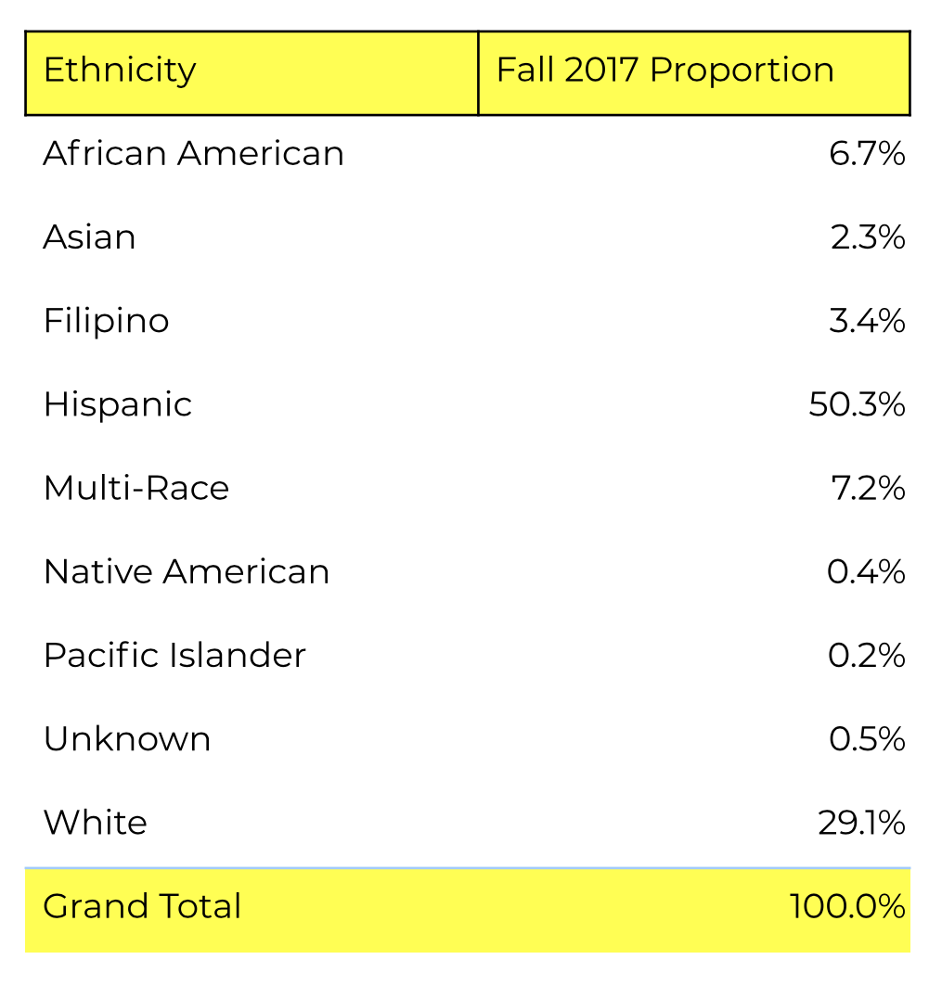
Does your course material reflect and affirm our students?
(see handout)
A

Slide 29
Decolonizing the classroom Questions
For whom do you design your curriculum? Who is your ideal, imagined student? What assumptions do you make about their backgrounds, culture, languages and schooling? What is your student demographic? Is there a difference between who you develop your curriculum for and who you are teaching?
Does your curriculum reflect its location: an HSI, in Southern California (see demographics)? To what extent does it draw on subjugated histories, voices, cultures and languages?
How does your teaching recognize and affirm the agency of Latinx, Black, Native American, and first-generation students? How does your teaching legitimate and respect their experiences and cultures? *Note, this is actively affirming.
A

