Slide 1
Purpose and Audience
In different genres
Professor Juanita But

Slide 2
Purpose
Genres
(text)
Writer
(and message)
audience

Slide 3
Some examples of text genres
Main Genres
Non-fiction (sub-genres)
Fiction/prose
Poetry
Drama
Non-fiction
Media
Essay
Memoir
Magazine/Newspaper article
Report
Textbook

Slide 4
Texts in different modes
Writing
Reading
Speaking
Viewing
Listening

Slide 5
writing + viewing

Slide 6
The first known mention of the bagel dates from 1610 in the community regulations of Krakow, Poland. The world’s biggest bagel factory is in Illinois. Still, no other food is so associated with New York as the “Jewish English muffin,” which spread from the Lower East Side in the early 20th century. “Pizza belongs to America now,” Josh Ozersky, a food writer, said, “but the bagel was always the undisputed property of New York.”
Tony Cenicola/The New York Times

Slide 7
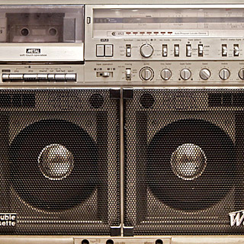
When bigger was better, the suitcase-size boom box was a necessity for big-city teenagers. In the 1980s, sales nationwide topped $20 million a year. In Spike Lee’s “Do the Right Thing,” Radio Raheem carried his everywhere, playing Public Enemy’s “Fight the Power.” By the ’90s, the battery-powered bass-heavy boxes equipped with radios and cassette players were supplanted by Walkmans and smaller devices, even as hip-hop and rap — born in New York City — came to dominate musical culture worldwide. Chang W. Lee/The New York Times

Slide 8
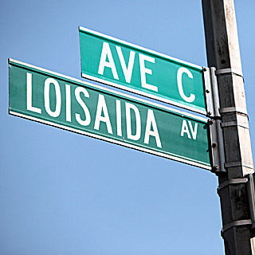
It was called the Lower East Side, the East Village, Alphabet City. But in Nuyorican, the local Latino vernacular, it is Loisaida. Popularized by the poet Bittman Rivas in 1974, the name became official when the city sanctioned Loisaida Avenue as another name for Avenue C in 1987. By 2000, a surge in immigration and higher birthrates nudged Hispanic New Yorkers past blacks as the city’s second-largest racial or ethnic group. Tony Cenicola/The New York Times

Slide 9
The context
“Inspired by “A History of the World in 100 Objects,” the British Museum’s BBC radio series and book, we recruited historians and museum curators to identify 50 objects that could embody the narrative of New York.”
From Sam Roberts, “A History of New York in 50 Objects” (2012)

Slide 10
What other objects represent new York city, to you?

Slide 11
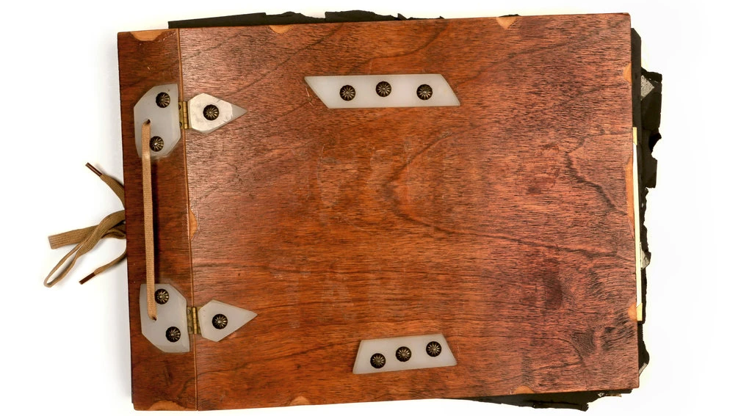

Slide 12
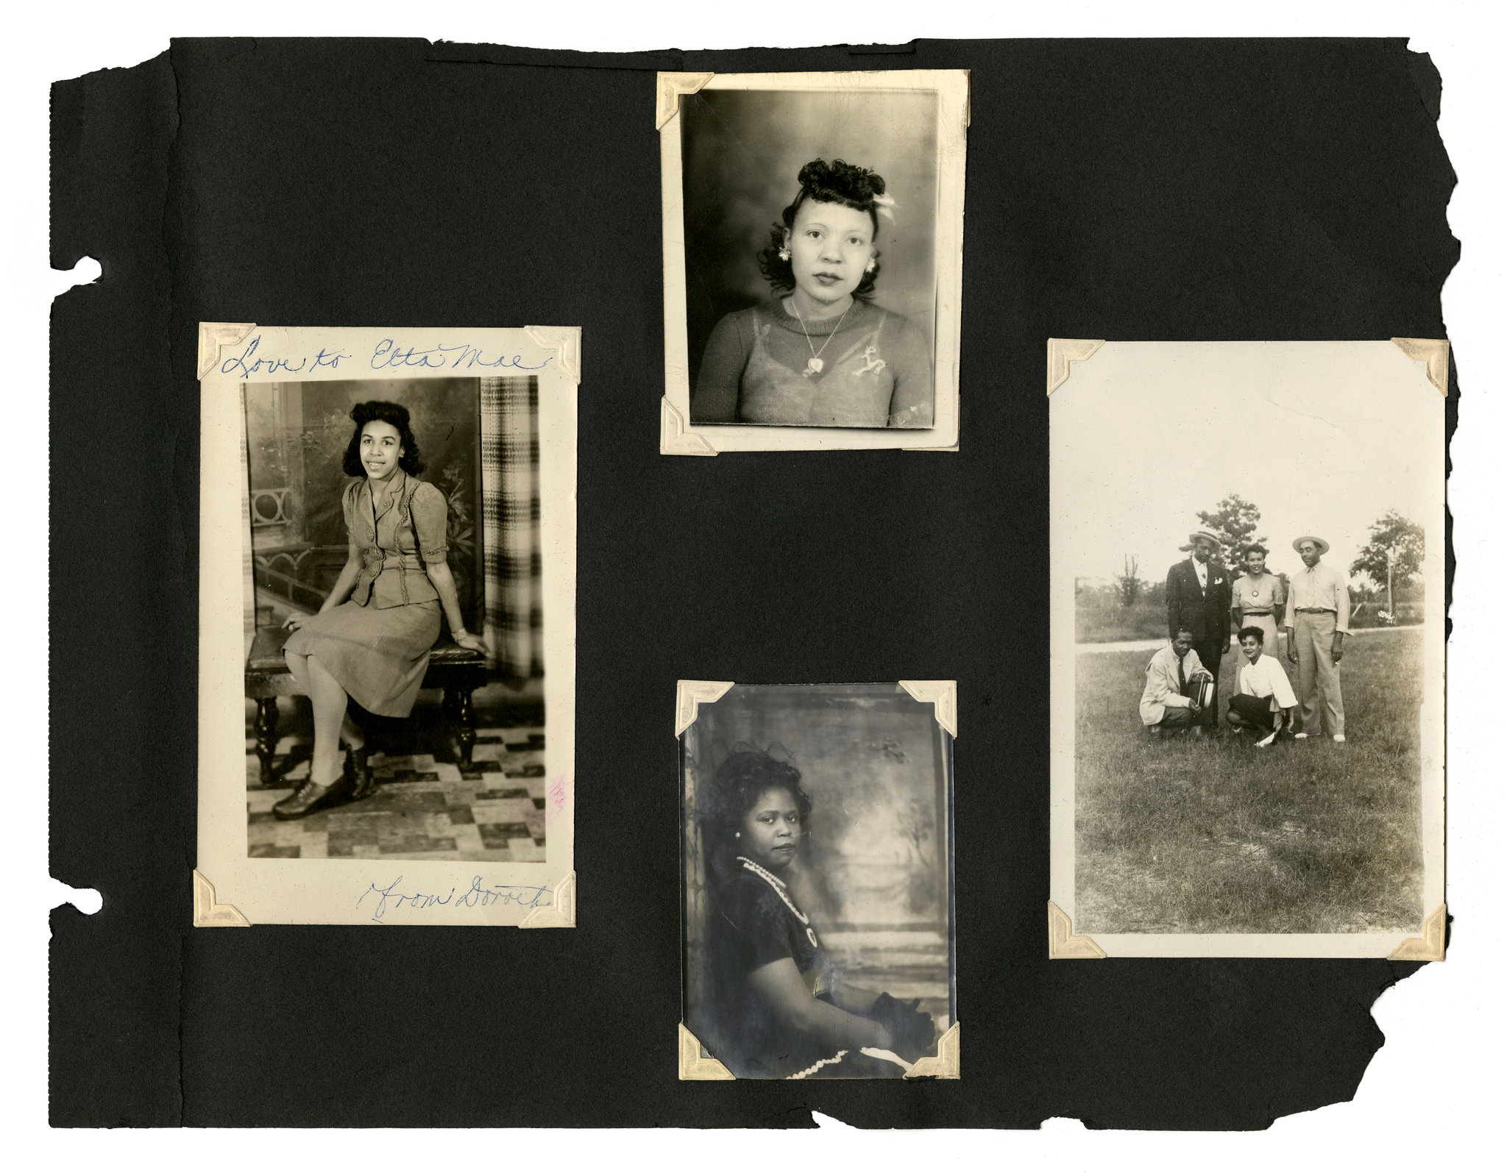

Slide 13
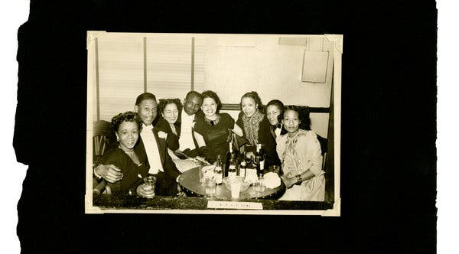

Slide 14
The context
“One night six years ago, on a quiet side street in Crown Heights, Brooklyn, I came across a photo album that had been put out with the trash. I lived around the corner, and I was walking home when I saw it sitting beneath a streetlamp on Lincoln Place.
It looked handmade, with a wooden cover bound with a shoelace. But it had been tied up with twine, like a bunch of old newspapers, and left atop a pile of recycling.
After hesitating a moment, I picked it up and took it home.”
From Anne Correal, “Love and Black Lives, in Pictures Found on a Brooklyn Street” (2017)

Slide 15
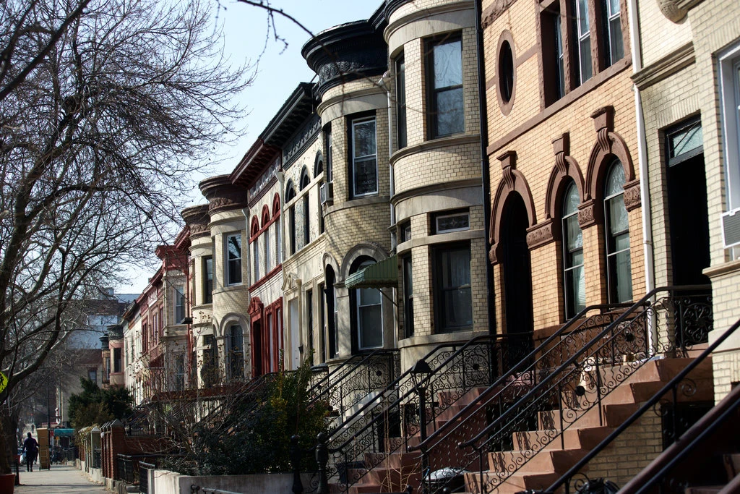
The Place
Lincoln Place in the Crown Heights section of Brooklyn. Credit...Benjamin Norman for The New York Times

Slide 16
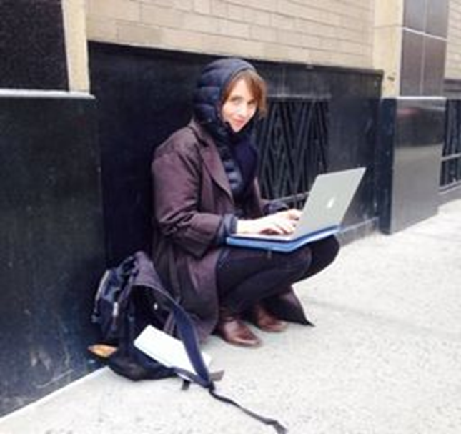
The author
Annie Correal covers immigration and immigrant communities in New York. Since joining The New York Times in 2013, she has contributed both breaking news and feature stories on topics from criminal justice to the opioid crisis. Her reporting has been featured on “The Daily“ podcast.
Ms. Correal is a native Spanish-speaker born in Colombia. She has documented New York City’s immigrant communities for more than a decade and has traveled to Mexico and to the American South to chronicle migration and migrant labor.

