Slide 1


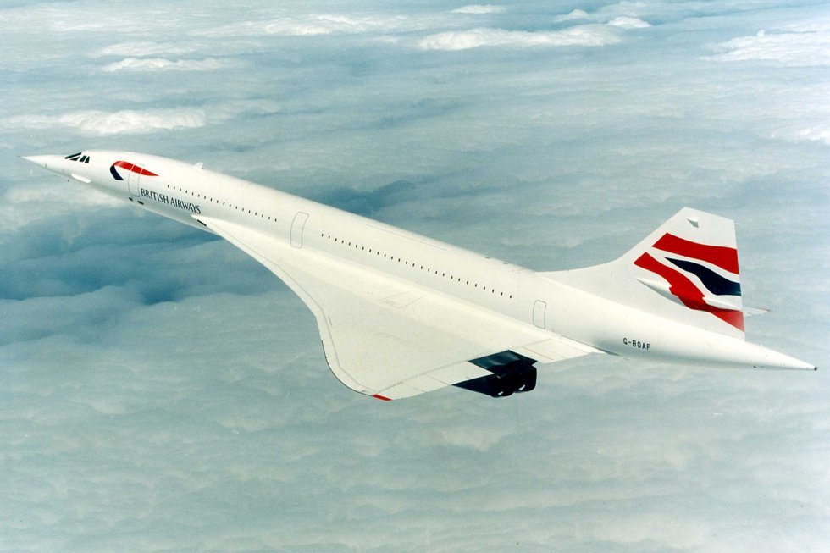
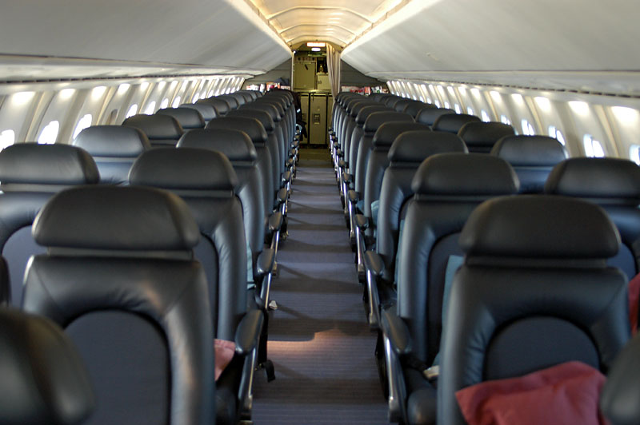
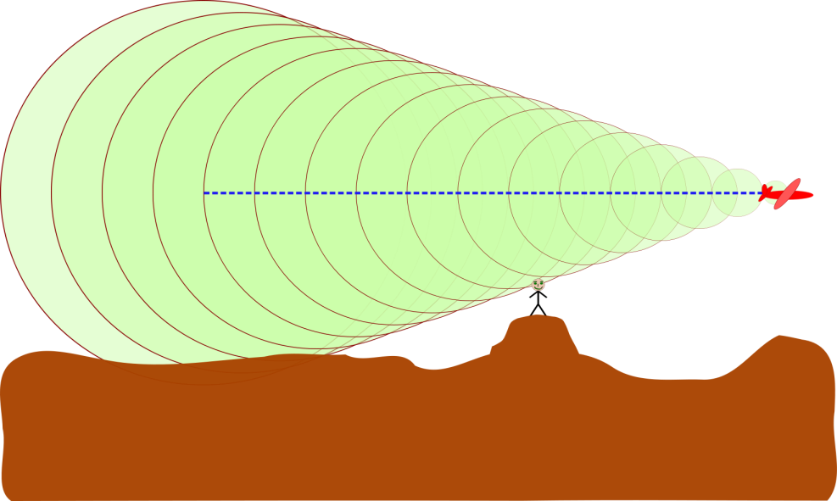
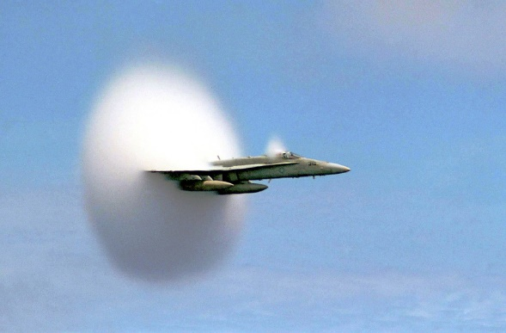
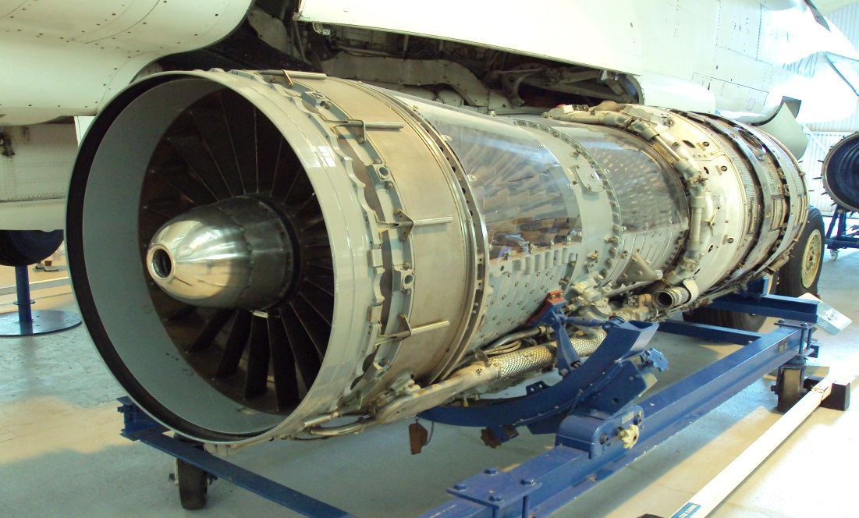
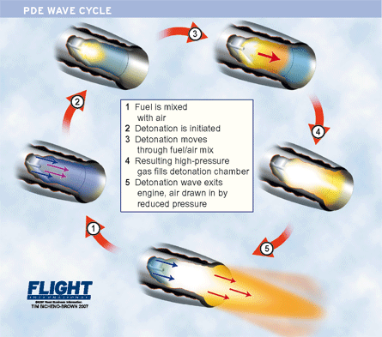
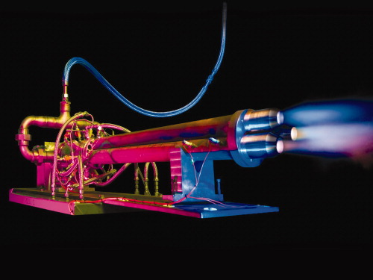
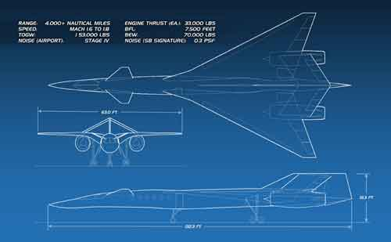
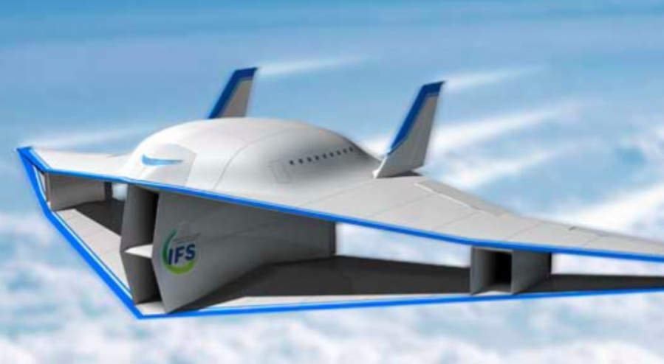
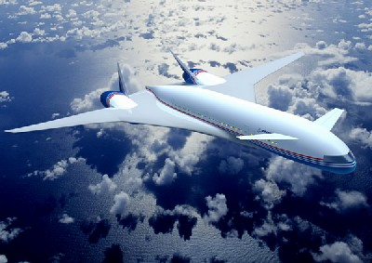
Industry-Academia Forum (IAF) 2014 International Student Industry Summit (ISIS2014)
Supersonic Transportation
Christopher Collado Mario Lalama Daniel Frederick
Background
Discussion
Production: 1969-2003
Cost: $38,474,400
Passengers: 90-120
Max Speed: Mach2.4
Cruise Speed: Mach2.2 Range: 4488 Miles
Bring in back to production
Address some issues with redesign the wings
Lower maintenance cost
Problems
Conclusion/Suggestions
High ticket cost
Engines consume large amounts of fuel
Conventional design limits capacity
Sonic boom limits
Fly over routes
Discontinued
High maintenance cost
High pitch sonic boom
By improving aerodynamics and using modern technology we can improve flight in a concord
Objectives
Bring in back to production
Address some issues with redesign the wings
Lower maintenance cost
References
http://commons.wikimedia.org/wiki/File:Pulse_Jet_Engine.PNG
http://cdn-www.airliners.net/aviation-photos/photos/8/3/9/1010938.jpg
http://baconcorde.tripod.com/id8.html
http://www.planetminecraft.com/project/plane-crash-survival-concord/

