Slide 1
The Medical Industry For Mechanical Engineering
By: Raymond Persaud, Simon Ho, Khaled Ahmed

Slide 2
Background
The medical industry has been a new frontier for the mechanical engineering field to provide new and improved medical equipment. Working with medical knowledge being provided by doctors input we are developing innovating products for the medical industry.
The Medical Industry is one of the most complex field for engineering in since its has to do reviewed not only by engineers but also doctors and the FDA for approval.

Slide 3
Problems
Financial Inefficiency of the medical system.
Billions of dollars are being wasted
Insurance malpractice, creating lots of debt and or one of the main reasons for the financial inefficiency

Slide 4
Objective
Increase the financial efficiencies within the medical industry with newer technology, safer methods of practice were cost the major factor for future decisions.
Improvement within the medical industry of products and services that are already being used.

Slide 5
Discussion
An engineer within the medical industry can bring a lot of new technologies to the field.
3D printers or stereo-lithography can be used to bring medical processes to a newer age. This can save them lots of money in terms of making prints of dental molds and other prosthetics, which would normally cost a lot more with previous methods.
Improve on the surgical robots which could help decrease malpractices of the doctors and in turn be less money lost in legal cases.

Slide 6
Conclusion
Engineers within the Medical Industry will bring forth the new age of how people are treated and healed. As history has shown, new technology has increased life expectancy of humans. Only a few centuries ago, living to the age of 50 was acceptable, in today’s standard we want 100. Who knows what the future will bring with better developed technologies. Some day we might live to 200.

Slide 7
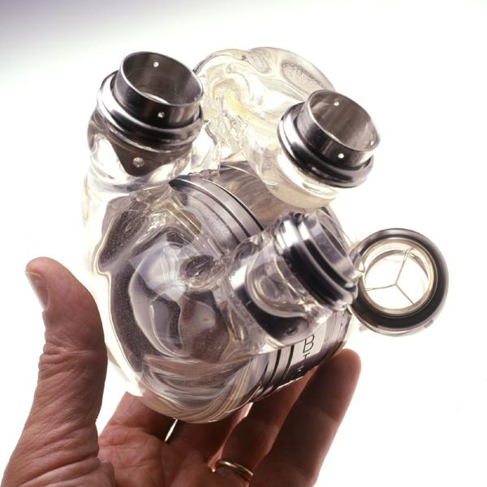
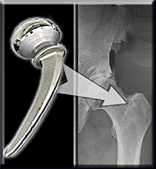
Engineered Kneecaps

Slide 8
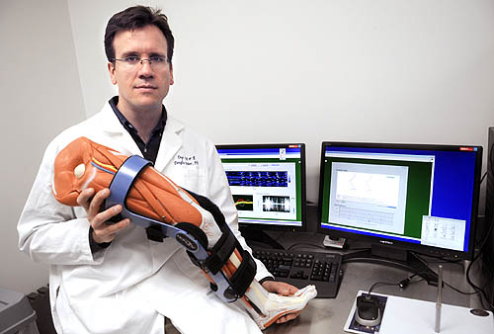
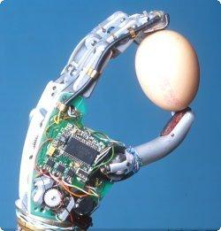
New Robotic Arm and Leg

Slide 9
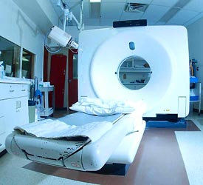
New MRI Equpiment

