Slide 1


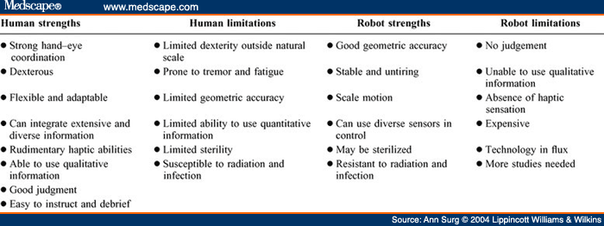
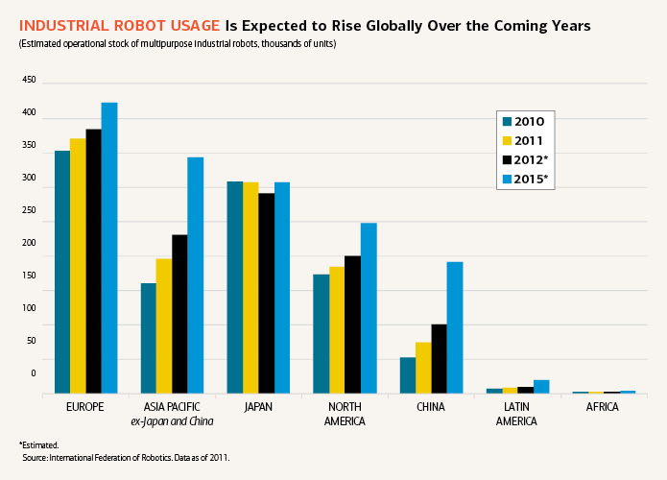
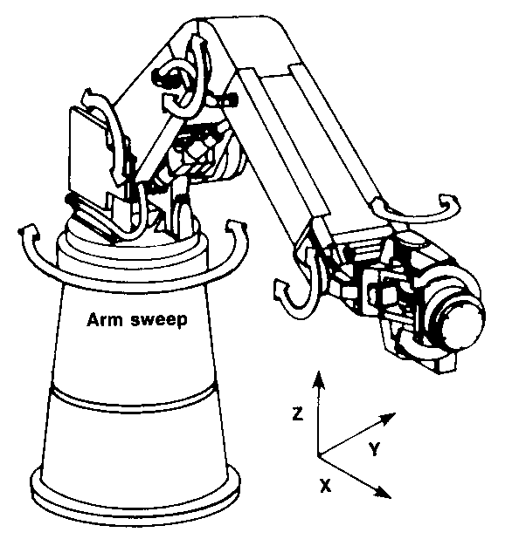
Robotics
Industry-Academia Forum (IAF) 2014 International Student Industry Summit (ISIS2014)
Kenny Bernadin, Kudesie Chunielal, Olivia Reed, Ricardo Clarke
Department of Mechanical Engineering Technology
New York City College of Technology
City College of New York
Brooklyn, NY
Introduction:
“Today’s manufacturing robots are big stiff, unsafe for people to be around, engineered to be precise and repeatable, not adaptable. Normal workers can’t touch them” – Heartland Robotics
Robotics is the branch of technology that deals with the design,, construction, and applications of robots. Robots are designed to carry out functions that humans cant do with speed and precision. There is currently a big market for robots due to their copious applications. So there is a huge need for solutions for the issues currently in robotics.
Current Issues:
Improper Material
Programing limits
Too many parts included when designing for manufacturing
No reusable energy/mass power usage
Limited degree of movement
Low implication of human features
http://www.ise.ncsu.edu
Objectives:
Discussion:
To build a robot using superior material and less of it.
To make it have its own power generator
Better programming to perform more tasks efficiently
To make more appealing to the human eye
Creating robots similar to human anatomy
More materials tested for durability and functionality
Should have more sensors, and expand processing capability
Make functional parts for user friendly
Power generator, solar powered
Less human maintenance
Introduce more hydraulics and degrees of freedom
Implement more human anatomy in designs
Conclusion:
We hope within the next 5-10 years the materials associated with robotics will get better as well as cheaper
Also by that time the technology will become more domesticated with companies all over the world
The advancements of this technology over the years will make robots overall easier to use
References:
http://goo.gl/udHrYy
Wikipedia.org
Medscape.com
http://www.ise.ncsu.edu
http://www.ifr.org

