Slide 1
Aero Industry
Christopher Collado
Mario Lalama
Daniel Frederick

Slide 2
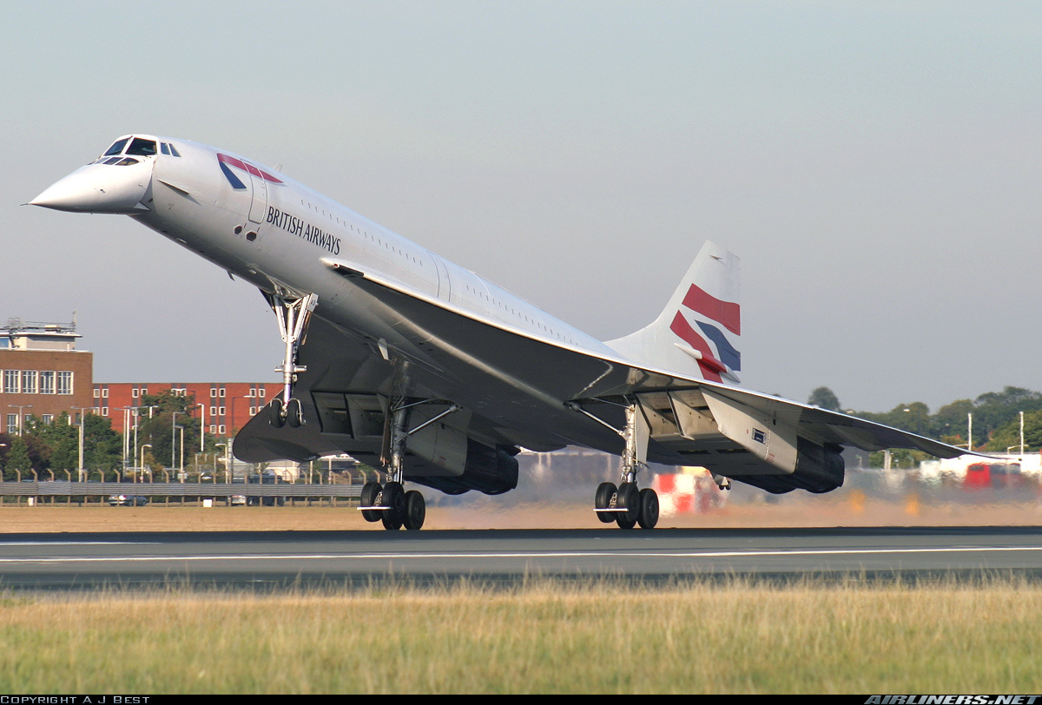
Background
Production 1969-2003
Cost £23 mill
92-120 passenger
Max Speed 2.4 Mach
Cruise Speed 2.2 Mach
Miles range 4488

Slide 3
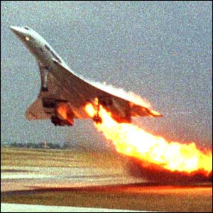
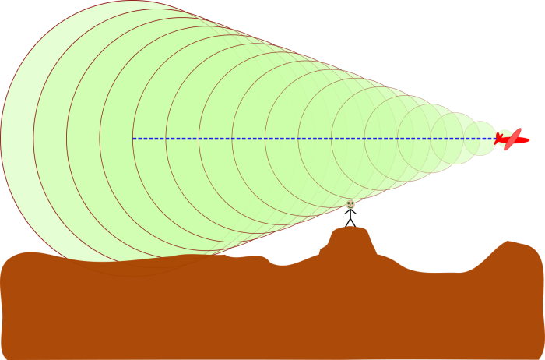
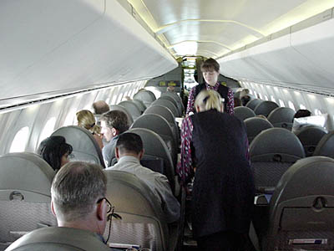
Problems
Discontinued
High maintenance cost
Small capacity /cargo
High pitch sonic boom

Slide 4
Objective
Bring in back to production
Address some issues with redesign the wings
Lower maintenance cost

Slide 5
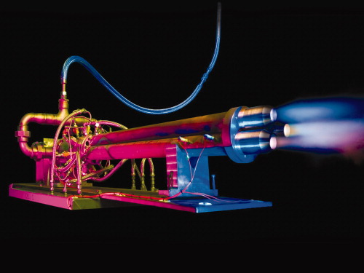
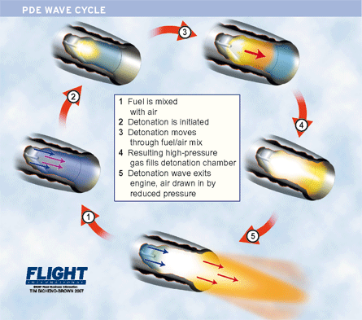
Discuss
Wing redesign for reduced noise
Reduce fuel consumption
Need for faster travel
Safety

Slide 6
Conclusion Reference
By improving aerodynamics and using modern technology we can improve flight in a concord
http://commons.wikimedia.org/wiki/File:Pulse_Jet_Engine.PNG
http://cdn-www.airliners.net/aviation-photos/photos/8/3/9/1010938.jpg
http://baconcorde.tripod.com/id8.html
http://www.planetminecraft.com/project/plane-crash-survival-concord/

