Slide 1
Esophageal Cancer
Group members
Hardy Ward
Scarla Colon
Nehe Bah
Dharam Bhagwandas
Jennifer Moreta
Adam Hernandez
Lariss Park
Wendy Rodriguez

Slide 2
Case information
75 year old patient with a history of breast cancer
  metastasized into her esophagus; causing for the removal and replacement of the esophagus.
  Ivor- Lewis Esophagectomy is the removal of the esophagus and part of the stomach.
    To allow swallowing and passage of food, part of the stomach and the small intestines are used to make a connection.

Slide 3
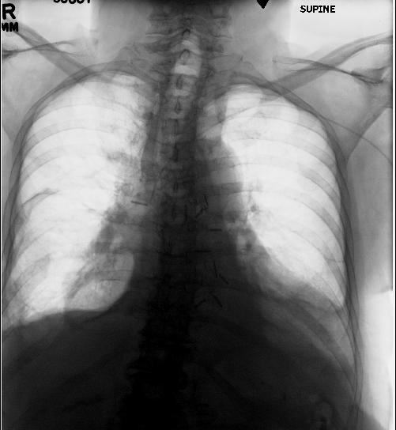
Surgical clips on mediastinum in order to raise part of stomach and small intestine for the replacement of the esophagus

