Slide 1

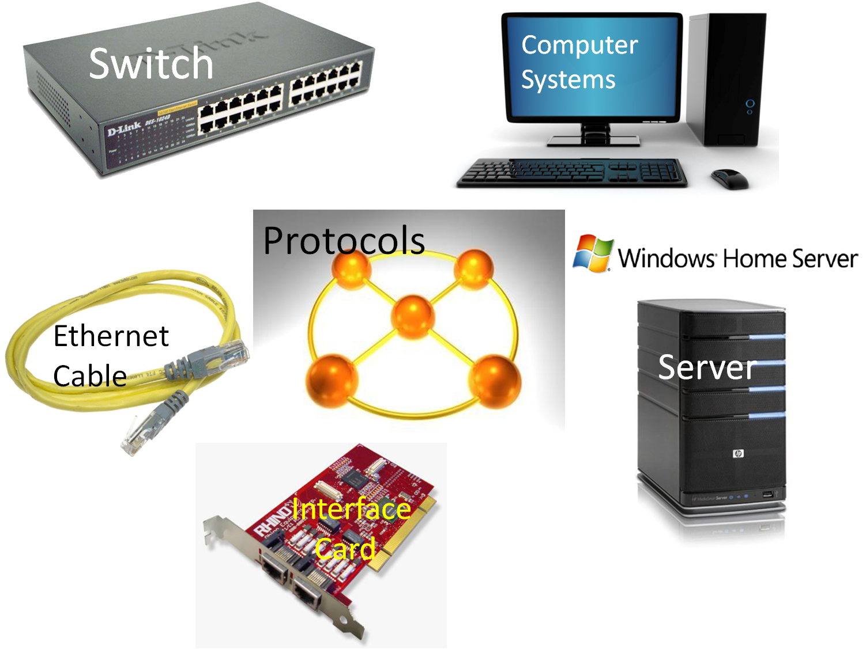
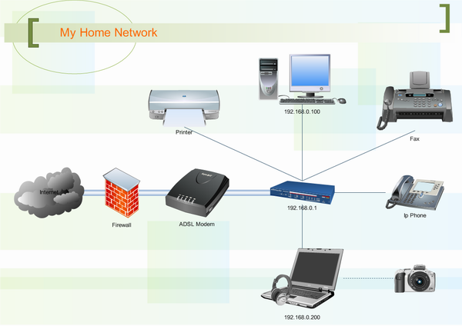
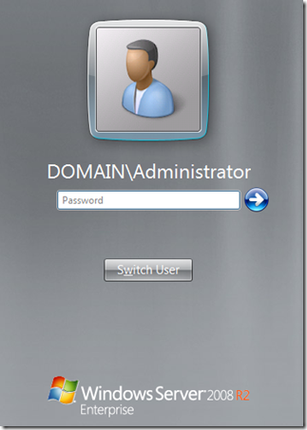
Implementing a Local Area Network/LAN
Shamsan Ahmed , Prof: Ossama Elhadary , New York City College of Technology (Computer Systems Technology)
Abstract:
Computer Network is a collection of two or more computers and other machines such as printers, modems or routers connected together to communicate with each other to exchange commands and share data and other resources. It is very important for any organization to have its own computer network so that workers can access remote programs and remote databases either from the same organization or from other public sources. This project recovers the process of building a local area network that consists of switches, servers, and
caballing instructions. As a result of this process we will have a fully operational network that provides the needed functionality for a small business needs. Consuming a computer network at someone’s business can save them money and make their business grow faster.
Literature review:
Local Area Network (LAN): A group of computers connected to each other in a localized area such as in an office, a school, or
a house.
LAN is used for sharing data such as database, files, programs, and emails, and for sharing resources such as printers, fax, or
storage device.
LAN Types: 1. Topology ( the geometric arraignment of devices on the network such
as a ring or a star) 2. Protocol (the rules and specifications on sending data) 3. Media (devices can be connected by cables or by
radio waves)
LAN can have from 2 to several hundred nodes(computers) that can be spread to about 300 meters away.
Experiments:
Install the wanted type of server to two machines that one of them will be the domain controller and the second one will be the standard account.
Install the necessity server roles such as ( Active Directory Domain Services, Domain Name Service DNS, and Dynamic Host Configuration Protocol DHCP) and the desired server roles such as (File Server, Application Server, and Web Server).
Link both machines together with a crossover Ethernet cable.
Attach both of those machines and the router to the switch.
From the switch we can now connect all the clients(users computers) and resources such as the printer or the fax using the UTP cable.
After the cabling process is done, everything should work properly.
Discussion:
LAN is the best way to manage and control more than 50 computers at one time.
LAN provides better security for the business because the server comes with built-in security.
LAN can save the business a lot of money when all workers are using the same resources they need in the job for example the printer or the internet access.
Media network type is be the best network architecture because nodes can be connected wirelessly.
Conclusion:
In this project I was able to implement a local area network that consists of two servers, a switch, and
two clients using a Microsoft Windows Server 2008.
In this network clients are sharing same data,
internet access, printer, and applications.
This kind of network is mostly used in a campus,
office building, and/or companies.
The result of this project indicate that, when
possible, using a “Media” local Area Network type is more preferable than any other network type. With Media Local Area Network, nodes can be connected to the switch physically or wirelessly making it even easier to share data and resources.
Windows Server 2008R2
http://www.hypervhd.com/windows-server-2008-64bit-f37/how-to-install-windows-server-2008-r2-x64-on-vmware-7-t1448.html
Local Area Network equipment (self-made picture)
Local Area Network/LAN Configuration
http://www.edrawsoft.com/Local-Area-Network.php
References:
1- Jonathan Hassell. (2008). Windows Server 2008: The Definitive Guide
O’Reilly Media
2- “What is Networking?” fcit.usf.edu. Florida Department of Education.1997
.Web.29 Apr.2012.
3- “Networking Basics - Key Concepts in Computer Networking.”
compnetworking.about.com. The New York Times Company.1996
.Web.29Apr.2012.
Special Thanks Go To:
Honors Scholars Program Director: Prof. Janet Liou –Mark
Honors Scholars Program Assistant: Ms. Laura Yuen-lau
Mentor: Prof: Elhadary Ossama
Department of Computer Systems Technology
© 2012 Microsoft Corporation

