Slide 1
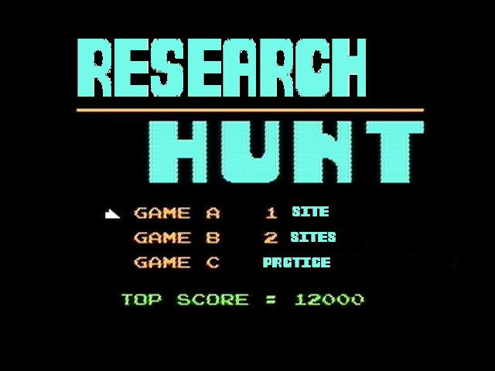

Slide 2
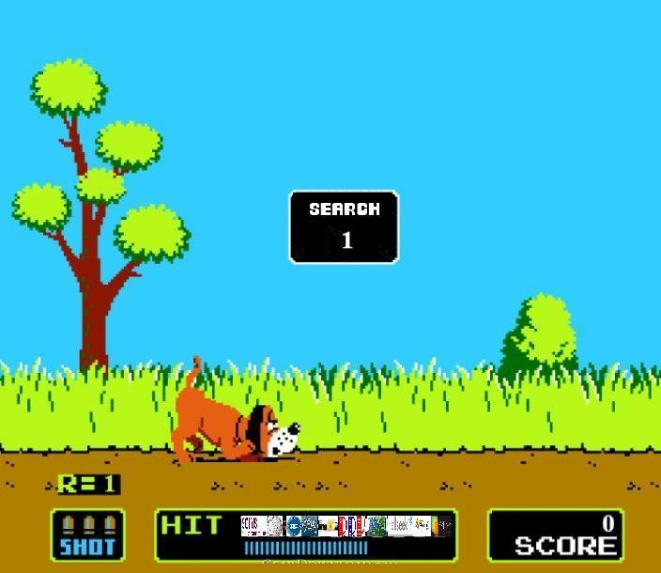

Slide 3
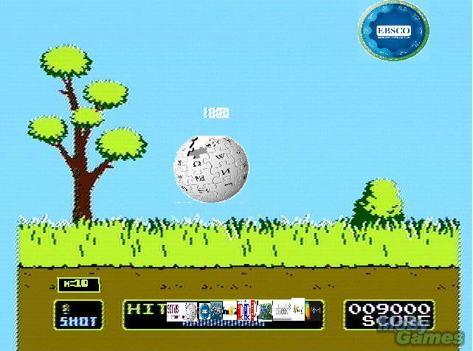
The Idea
To incorporate the classic game of Duck Hunt, created by Nintendo, with researching company logos such as Wikipedia and EBSCO.
As players shoot the logos, they obtain a certain amount of points for each targets hit and can earn more points by consecutively shooting targets without missing.

Slide 4
The purpose
The player receives accolades after completing a challenge and for each accolade that is obtained, a brief summary of the company honoring that accolade will be given. As in, the history and purpose of the company in society. This in turn, familiarize individuals with companies and the history behind each one while keeping them entertained with a simple shooter-game that most, if not all, people know.

Slide 5
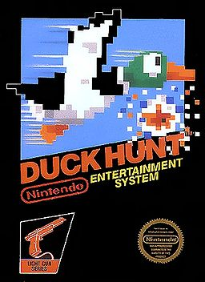
The history
Duck Hunt was created by Nintendo in 1984 for the original Nintendo Entertainment System.
It was one of first hunting video games and used a controller that imitated a gun.
Duck Hunt was the cause for the development of more hunting games and is the reason why hunting games are so popular today.

