Slide 1
HMGT 2402 Wine & Beverage Management
Prof. Karen Goodlad
Spring 2012
Introduction

Slide 2
Overview
Attendance
Semester Long Assigned Seating
Syllabus Review
Term Assignments
OpenLab
Lecture
Introduction to Alcoholic Beverages

Slide 3
History: The Beginning of Wine
3000BC Wine making from grapes Persia
Amphorae: Greek wine containers ~1400BC
Greeks spread grape growing/wine making
Dionysus: Greek God of Wine
Romans spread grape growing/wine making
Bacchus: Roman God of Wine
FOR MORE INFO AND MAPS...
http://www.museum.upenn.edu/new/exhibits/online_exhibits/wine/wineintro.html

Slide 4
Video Clips on the History of Wine
Watch:
Vintage: History of Wine Part 1 Origins
Vintage: History of Wine Part 2 Wine and Religion
Vintage: History of Wine Part 3 Wine in the Ancient World
Vintage: History of Wine Part 5 Wine in the Middle Ages

Slide 5
U.S. History
European settlers used the native vitis labrusca
The east has always been an important wine producing area until Prohibition
1st plantings in the Finger Lakes were in 1836
Now concentrated in NY and Virginia
1919-1933 Prohibition
Mid-1960’s focus of production shifts to quality, not sweetness

Slide 6
U.S. History: Recent Wine Consumption
1970’s saw the greatest increase
1980’s saw a great decline
1994-current greatest period of increase in since Prohibition
Increase in consumption expected for the future due to
increased awareness of health benefits
increased drinking age population
Increase in expendable income (still?)

Slide 7
What Happened in 2010
Trading up saw some improvements in wine.
Off Premise wine sales increased
Impact of wine blogs, Twitter and Facebook increased
World wide online wine tastings
US wineries as well as New Zealand, Chile & especially Argentina offered low-priced & well marketed wines, and continued to take share.
More consolidation on the wholesaler front & diversification on the part of suppliers.
“Millennials” increased their consumption of wine.
Notes:
We expect premium and super-premium wine sales to improve slightly in 2010 and even more in 2011.
will find it necessary to drop prices despite fears that it could damage brand value.
Consumers may not be quite ready to fork over the cash for $40+ spirits brands, but we expect those that deliver a strong brand message will see a turnaround towards the end of the year.
The Australian wine industry will continue searching for a united voice and solutions to its oversupply problem.
We don't expect a major brand acquisition, especially in the coming months, but may see some grabs for smaller players and brands. This could spell opportunity for some successful entrepreneurs.

Slide 8
What Happened in 2011
Younger wine consumers say “fun & contemporary looking” wine labels are important when choosing wines to drink at home
Social media has continued importance especially among 21-36 year olds
Argentina and New Zealand were the leaders in import growth
Millennials continued to increase wine consumption
U.S. consumed 291 million cases of wine
Source: Wine Enthusiast, February 1, 2012 http://www.winemag.com/Wine-Enthusiast-Magazine/Web-2012/Wines-2011-Report-Card/

Slide 10
Notes:
Core =1 a week –daily
Marginal = 2-3 times a month to 1 every 2-3 months

Slide 11
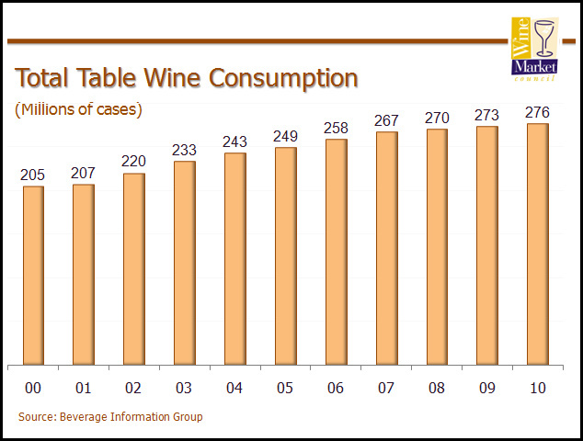
2011 Consumption 291
To learn more click: Wine Business Daily
Notes:
http://www.winebusiness.com/news/?go=getArticle&dataid=83196

Slide 12
It is a great time to be in the wine business!!
20% of American’s Drink 91% of all the wine consumed in the USA

Slide 13
Alcoholic Beverages
Wine
Beer
Spirits
Notes:
Wine: Fermented fruit juice
Beer:water, malted grains, hops + boil 1–3 hours add yeast
Spirits: a fermented liquid the is distilled

Slide 14
Fermentation
Sugar + Yeast =
Alcohol + Carbon dioxide + Heat

Slide 15
Distillation
The Process of Removing Alcohol From a Fermented Liquid
Place Fermented Liquid in a Copper Still
Heat Alcohol to 180°-190° F.
Cool the Vapor to a Condensed Liquid
Result = Double Alcohol
Repeat for Desired Result
For More Information:
http://www.cognac.fr/cognac/_en/1_annuaire/index.aspx?page=goodies#anim
Notes:
Water boils at 212 degrees
Pot Still
Column or Continuous or Coffey Still

Slide 16
Distilled Products (Spirits)
Brandy
Cognac, Armagnac, Calvados
Whiskey
Bourbon, Rye
Vodka
Gin
Rum
Liqueurs/Cordials
Amaretto, Bailey’s Irish Cream, Frangelico…
Notes:
Brandy: Distilled fruit wine that is aged in oak barrels
brandy (Cognac and Armagnac come from that specific area of France) made from grapes
Calvados made from apples
--10 gallons of wine are used to make1 gallon of brandy
Whisky (scotch) made from grain
Vodka: made from grains and/or potatoes and/or sugar beets, Processed to extract congeners
Rum made from sugarcane and molasses
Gin: made with a neutral grain spirit and distilled with juniper berries or other botanicals
Cordials & Liqueurs: Sugar added

Slide 17
The Grape
Vitis Vinifera
Most often used for wine making
Chardonnay, Cabernet Sauvignon, Merlot…
Thousands of additional varieties
Vitis Labrusca
Most often used as root stock
Concord, Delaware, Niagara, Catawba…
Components of a Grape
Skin: Aromatic characters, color, tannin,
Pulp: acids & minerals
Water: ~73%
Sugar: ~20%
Notes:
Vitis: genus of the plant meaning grape vine
Vinifera: species of vitis originating in Europe
Labrusca: species of vitis originating in Americas

Slide 18
Wine
Water 85-90%
Alcohol 9-14%
Glycerol ~1%
Acid ~.4%
Sugar ~.2%
Tannin ~.1%
Minerals ~.2%
Nitrogen, Vitamins
Notes:
Glycerol: viscuos liquid
Acid: balances sweetness, gives complexity
Sugar: dry wine has little sugar
Tannin: from pips, skin and stalk

Slide 19
Viticulture & Oenology
Viticulture
What happens in the vineyard/farm
Oenology (alt. spelling Enology)
Process of making wine after harvest of fruit (also known as vinification)

Slide 20
Terms to Remember
Prohibition
Fermentation
Distillation
Viticulture
Oenology
Vitis Vinifera, Vitis Labrusca
READ READ READ

