Slide 1
The Qwicky App
By: Arjenis, Blerta, Randy, & Christina

Slide 2
The Qwicky App?
The Qwicky App is a mobile app that can be downloaded directly into your smart phone via internet or Wi-Fi access which allows students and professors to communicate directly through CUNY First account
Linked with the student’s CUNY First account, instant updates are sent thru the app to the students involving their classes, emails, events, etc…

Slide 3
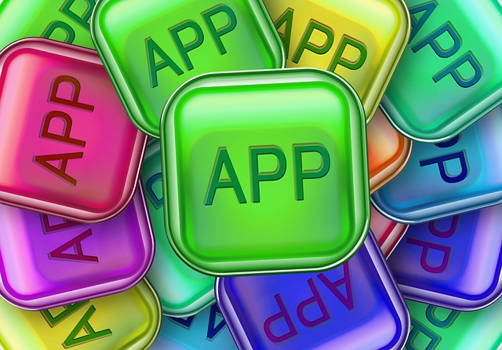
Mobile App

Slide 4
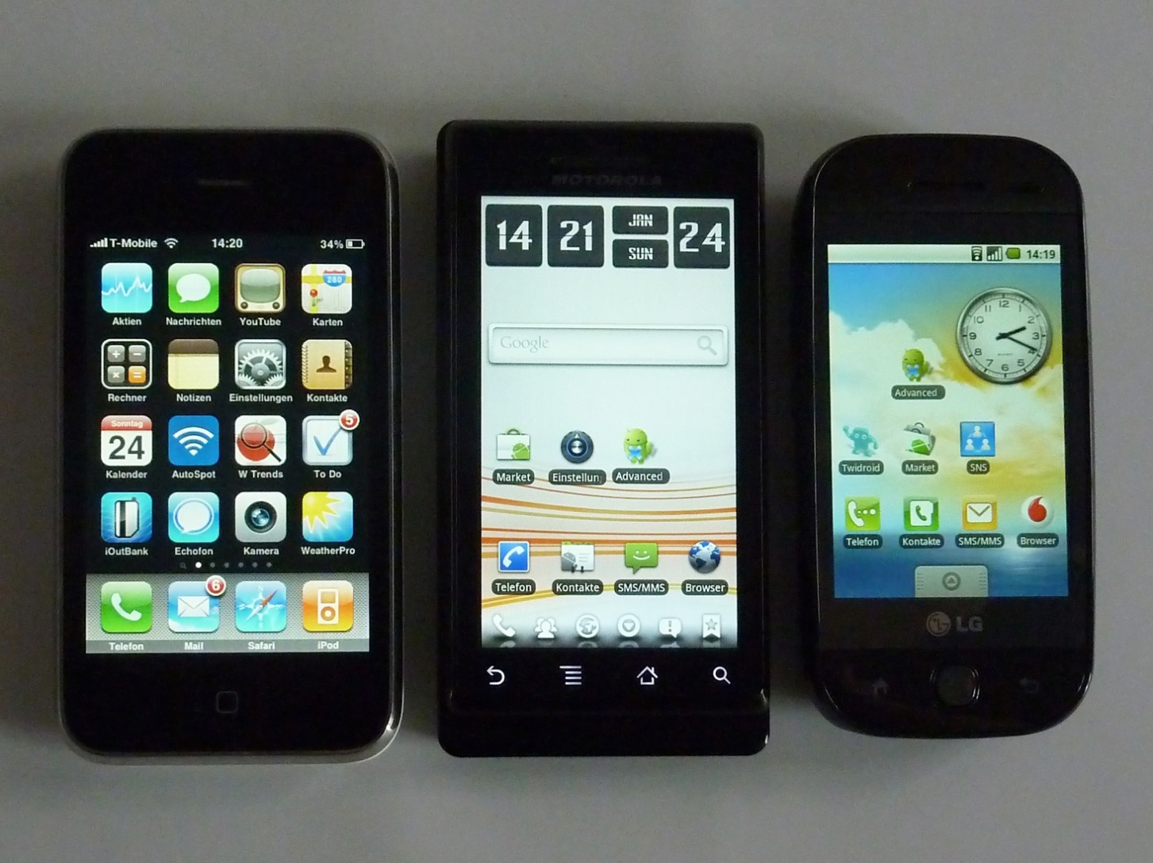
For Smartphone Use

Slide 5
App Features
Instant updates involving CUNY First account
Updated class enrollment made with each passing semester
Blackboard access installed in the program
Emails and notifications are directly sent to your phone keeping the user up to date with any last minute changes
No excuses! Instant reminders appear on your phone until the user has checked the latest update made
Instant messaging available for quick communication with classmates and Professors

Slide 6
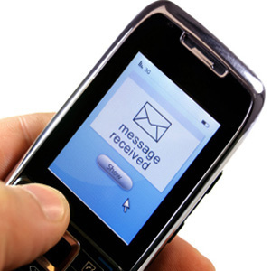
No More “I didn’t know”

Slide 7
The Qwicky App
No more excuses
No more “I didn’t know”
Any and every update sent directly to your phone via The Qwicky App
Be up to date with no surprises

Slide 8
Image Sources
Download App. Digital image. CreativeCommonsSearch. N.p., n.d. Web. 18 May 2013.
Mobile App Use. Digital image. CreativeCommonsSearch. N.p., n.d. Web. 18 May 2013.
Smartphones. Digital image. CreativeCommonsSearch. N.p., n.d. Web. 18 May 2013.

