Slide 1
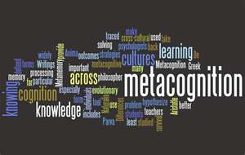
Get Students to Focus on Learning Instead of Grades:
Metacognition is the Key!
Saundra Yancy McGuire, Ph.D.
Asst. Vice Chancellor & Professor of Chemistry
Professor, Department of Chemistry
Past Director, Center for Academic Success

Slide 2

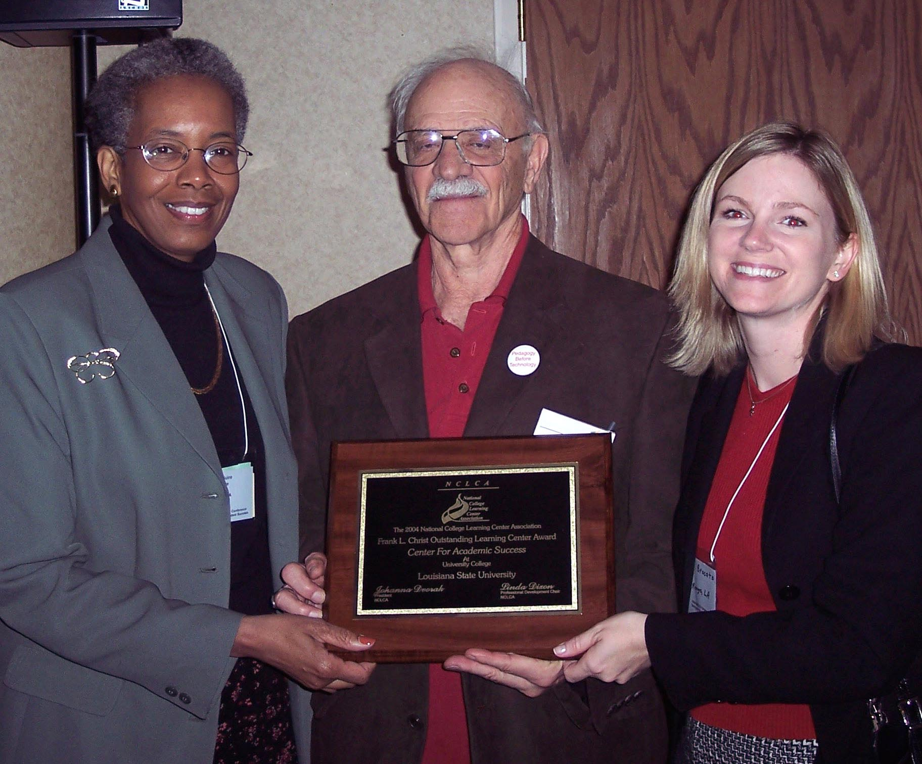
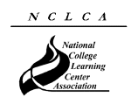
2004-2005 National College Learning Center Association
Frank L. Christ Outstanding Learning Center Award

Slide 3
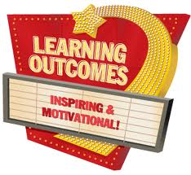
Desired outcomes
We will understand why many students spend little time studying and do not know how to learn
We will have concrete learning strategies that faculty can teach students to increase learning, and we will be committed to trying them
We will have more resources for our students
We will view our students differently
We will see positive changes in our students’ performance and self-perception
We will spend time reflecting on improving our teaching and our students’ learning

Slide 4
Metacognition
The ability to:
think about one’s own thinking
be consciously aware of oneself as a problem solver
monitor, plan, and control one’s mental processing (e.g. “Am I understanding this material, or just memorizing it?”)
accurately judge one’s level of learning
Flavell, J. H. (1976). Metacognitive aspects of problem solving. In L. B. Resnick (Ed.), The nature of intelligence (pp.231-236). Hillsdale, NJ: Erlbaum

Slide 5

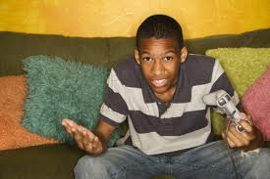
Why don’t most students know how to learn or how to study?

Slide 6
According to data from the entering class of 2011...*
It wasn’t necessary in high school
- 60.5% of 2011 (down from 63% in 2010) entering first year students spent less than six hours per week doing homework in 12th grade.
- 49.7% of these students said they graduated from high school with an “A” average.*
Students’ confidence level is high
- 70.9 % believe their academic ability is above average or in the highest 10 percent among people their age
*2011 Higher Education Research Institute Study

Slide 7
What did most of your teachers in high school do the day before the test?
How do you think most students would answer the following?
What did they do during this activity?
What grade would you have made on the test if you had gone to class only
on the day before the test?

Slide 8

Faculty Must Help Students
Make the Transition to College
Help students identify and close “the gap”
current behavior current grades
productive behavior desired grades

Slide 9
Reflection Questions
What’s the difference, if any, between studying and learning?
For which task would you study more?
A. Make an A on the test
B. Teach the material to the class

Slide 10

Turn Students into Expert Learners:
Teach Them Metacognitive
Learning Strategies!

Slide 11
The Story of Three Students
Travis, junior psychology student
47, 52, 82, 86 B in course
Maryam, first year art student
57, 87 B in course
Dana, first year physics student
80, 54, 91, 97, 90 (final) A in course

Slide 12
How’d They Do It?
They used metacognitive strategies
They began thinking about their thinking
They focused on learning instead of grades

Slide 13
Travis, junior psychology student
47, 52, 82, 86
Problem: Reading Comprehension
Solution: Preview text before reading
Develop questions
Read one paragraph at a time
and paraphrase information

Slide 14
Maryam, freshman art student
57, 87
Problem: Not seeing the underlying structure of different types of art
Solution: Focus on characteristics of different artists’ work in order to indentify the painter of an unfamiliar piece of art

Slide 15
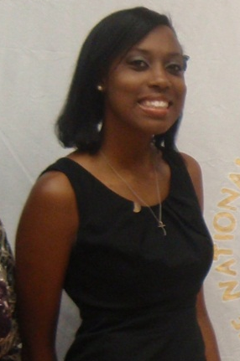
Dana, first year physics student
80, 54, 91, 97, 90 (final)
Problem: Memorizing formulas and using www.cramster.com
Solution: Solve problems with no external aids and test mastery of concepts

Slide 16



Why the Fast and Dramatic Increase?
It’s all about the strategies, and getting them to engage their brains!

Slide 17
Email from a Spring 2011 Chem 1201 student
“…Personally, I am not so good at chemistry and unfortunately, at this point my grade for that class is reflecting exactly that. I am emailing you inquiring about a possibility of you tutoring me.”
April 6, 2011
-------------------------------------------------------------------------------------
“I made a 68, 50, (50), 87, 87, and a 97 on my final. I ended up earning a 90 (A) in the course, but I started with a 60 (D). I think what I did different was make sidenotes in each chapter and as I progressed onto the next chapter I was able to refer to these notes. I would say that in chemistry everything builds from the previous topic.
May 13, 2011
  Semester GPA: 3.8

Slide 18
Counting Vowels in 45 seconds
How accurate are you?
Count all the vowels
in the words on the next slide.

Slide 19
Dollar Bill
Dice
Tricycle
Four-leaf Clover
Hand
Six-Pack
Seven-Up
Octopus
Cat Lives
Bowling Pins
Football Team
Dozen Eggs
Unlucky Friday
Valentine’s Day
Quarter Hour

Slide 20

How many words or phrases from the list do you remember?

Slide 21
Let’s look at the words again…
What are they arranged
according to?

Slide 22
Dollar Bill
Dice
Tricycle
Four-leaf Clover
Hand
Six-Pack
Seven-Up
Octopus
Cat Lives
Bowling Pins
Football Team
Dozen Eggs
Unlucky Friday
Valentine’s Day
Quarter Hour

Slide 23
Now how many words or phrases do you remember?

Slide 24
1. We knew what the task was
2. We knew how the information was organized
What were two major differences
between the two attempts?

Slide 25

Bransford, J.D., Brown, A.L., Cocking, R.R. (Eds.), 2000. How people learn: Brain, Mind, Experience, and School. Washington, DC: National Academy Press.

Slide 26
What we know about learning
Active learning is more lasting than passive learning
-- Passive learning is an oxymoron*
Thinking about thinking is important
  Metacognition**
The level at which learning occurs is important
  Bloom’s Taxonomy***
  *Cross, Patricia, “Opening Windows on Learning” League for Innovation in the Community College, June 1998, p. 21.
** Flavell, John, “Metacognition and cognitive monitoring: A new area of cognitive–developmental inquiry.” American Psychologist, Vol 34(10), Oct 1979, 906-911.
*** Bloom Benjamin. S. (1956). Taxonomy of Educational Objectives, Handbook I: The Cognitive Domain. New York: David McKay Co Inc.

Slide 27
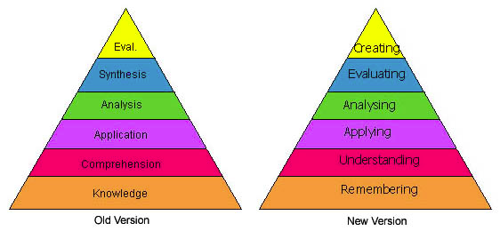
Bloom’s Taxonomy
Anderson & Krathwohl, 2001
http://projects.coe.uga.edu/epltt/index.php?title=Bloom's_Taxonomy

Slide 28
This pyramid depicts the different levels of thinking we use when learning. Notice how each level builds on the foundation that precedes it. It is required that we learn the lower levels before we can effectively use the skills above.
Bloom’s Taxonomy
Creating
Putting elements together to form a coherent or functional whole; reorganizing elements into a new pattern or structure through generating,
planning, or producing.
Graduate School
Making judgments based on criteria and standards through checking and critiquing.
Evaluating
Breaking material into constituent parts, determining how the parts relate to one another and to an overall structure .
Analyzing
Undergraduate
Carrying out or using a procedure through executing, or implementing.
Applying
Constructing meaning from oral, written, and graphic messages through interpreting, exemplifying, classifying, summarizing, inferring, comparing, and explaining.
Understanding
High School
Retrieving, recognizing, and recalling relevant knowledge from
long-term memory.
Remembering
http://www.odu.edu/educ/llschult/blooms_taxonomy.htm

Slide 29
When we teach students about Bloom’s Taxonomy…
They GET it!

Slide 30
How students answered
At what level of Bloom’s did you have to operate to make A’s or B’s in high school?
Knowledge
Comprehension
Application
Analysis
Synthesis
Evaluation

Slide 31
How students answered
At what level of Bloom’s do you think you’ll need to be to make an A in Chem 1201?
Knowledge
Comprehension
Application
Analysis
Synthesis
Evaluation

Slide 32
How do we teach students to move higher on Bloom’s Taxonomy?
Teach them the Study Cycle*
*adapted from Frank Christ’s PLRS system

Slide 33

The Study Cycle
4
Reflect
3
Review
4
Reflect
Preview
Preview before class – Skim the chapter, note headings and boldface words, review summaries and chapter objectives, and come up with questions you’d like the lecture to answer for you.
Attend
Attend class – GO TO CLASS! Answer and ask questions and take meaningful notes.
Review
Review after class – As soon after class as possible, read notes, fill in gaps and note any questions.
Study
Study – Repetition is the key. Ask questions such as ‘why’, ‘how’, and ‘what if’.
Intense Study Sessions* - 3-5 short study sessions per day
Weekend Review – Read notes and material from the week to make connections
Assess
Assess your Learning – Periodically perform reality checks
Am I using study methods that are effective?
Do I understand the material enough to teach it to others?
Intense Study Sessions
1 | Set a Goal | 1-2 min | Decide what you want to accomplish in your study session
2 | Study with Focus | 30-50 min | Interact with material- organize, concept map, summarize, process, re-read, fill-in notes, reflect, etc.
3 | Reward Yourself | 10-15 min | Take a break– call a friend, play a short game, get a snack
4 | Review | 5 min | Go over what you just studied
Center for Academic Success
B-31 Coates Hall ▪ 225.578.2872 ▪www.cas.lsu.edu

Slide 34
Effective Metacognitive Strategies
Always ask why, how, and what if
Use SQ5R for reading assignments
(survey, question, read, recite, review,
wRite, reflect)
Test understanding by giving “mini lectures” on concepts
Always solve problems without looking at an example or the solution
Use the Study Cycle with Intense Study Sessions

Slide 35
Metacognitive Get Acquainted Activity*
What do you believe is important to understand and learn in _____________________?
What do you believe to be critical characteristics of successful students in ___________?
How will you study and prepare for exams in ______________________________?
*Simpson, M. & Rush, L. (2012) in Teaching Study Strategies in Developmental Education, Hodges, Simpson, Stahl eds. New York: Bedford/St. Martin’s

Slide 36

Hodges, Simpson, Stahl eds. (2012) Teaching Study Strategies in Developmental Education, New York: Bedford/St. Martin’s
Historical Background on Study Strategies
Developmental Education and Learning Assistance Today
Diverse Populations in the Classroom
Students’ Beliefs about Study Strategies
Theory, Research, and Best Practices
Assessment and Evaluation

Slide 37
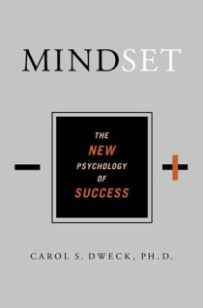

Help Students Develop the Right Mindset
Shenk, David, 2010. The Genius in All of Us: Why Everything You've Been Told About Genetics, Talent, and IQ Is Wrong. New York: Doubleday
Dweck, Carol, 2006.
Mindset: The New Psychology
of Success. New York:
Random House Publishing

Slide 38
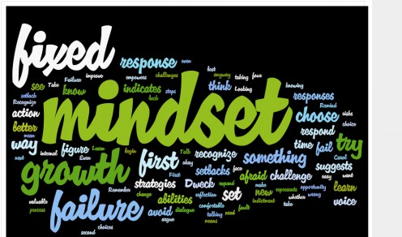
Mindset* is Important!
Fixed Intelligence Mindset
Intelligence is static
You have a certain amount of it
Growth Intelligence Mindset
Intelligence can be developed
You can grow it with actions
Dweck, Carol (2006) Mindset: The New Psychology of Success.
New York: Random House Publishing

Slide 39
Responses to Many Situations are Based on Mindset
 | Fixed Intelligence Mindset Response | Growth Intelligence Mindset Response
Challenges | Avoid | Embrace
Obstacles | Give up easily | Persist
Tasks requiring effort | Fruitless to Try | Path to mastery
Criticism | Ignore it | Learn from it
Success of Others | Threatening | Inspirational

Slide 40
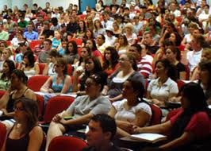
Ace Dr. Cook’s Chem 1201: Metacognition is the Key!
What happens when we teach metacognitive learning strategies, Bloom’s Taxonomy, and the Study Cycle to an entire class, not just individuals?

Slide 41
Performance in Gen Chem I Based on One Learning Strategies Session
Attended Absent
Exam 1 Avg.: 72.35% 70.11%
Exam 2 Avg.: 76.01% 68.74%
Final course Avg*.: 82.48% 72.61%
Final Course Grade: B C
Even one 50-min presentation on study and learning strategies may mean an improvement of one full letter grade!

Slide 42
Performance in Gen Chem I in 2011 Based on One Learning Strategies Session
Attended Absent
Exam 1 Avg.: 71.65% 70.45%
Exam 2 Avg.: 77.18% 68.90%
Final course Avg*.: 81.60% 70.43%
Final Course Grade: B C
The one 50-min presentation on study and learning strategies again resulted in an improvement of one full letter grade!

Slide 43
Intro Chem Results Spring 2007
Test 1 Test 2 Final Total points
Attended lecture 156 109 214 801 (B) on metacog. 3/2*
Did not attend 154 93 153 563 (D)
Class average 153 100 176 662 (C)
*Approximately 80 attendees out of 200 students because session was on a Friday afternoon. Exam 1 was Wednesday, March 7.

Slide 44
LSU Analytical Chemistry Graduate Student’s Cumulative Exam Record
2004 – 2005
9/04 Failed
10/04 Failed
11/04 Failed
12/04 Failed
1/05 Passed
2/05 Failed
3/05 Failed
4/05 Failed
2005 – 2006
10/05 Passed
11/05 Failed
12/05 Passed best in group
1/06 Passed
2/06 Passed
3/06 Failed
4/06 Passed last one!
5/06 N/A
Began work with CAS and the Writing Center in October 2005

Slide 45

Dr. Algernon Kelley, December 2009

Slide 46
Email from a faculty member who learned metacognitive strategies as a graduate student
“…I am happy to report to you that many of my students are using the study cycle and all of the outcomes are positive.
In summary, students who were failing all of their classes, including my course and in their final semester before being removed from the university are now the top students in their respective classes.
I am so proud of these students. Many of the students stated to me that they will continue to use the study cycle.....”
October 15, 2010
Algernon Kelley, Xavier University Chemistry Instructor

Slide 47
From a Xavier University student to Dr. Kelley in Fall 2011
Oct. 17, 2011
Hello Dr. Kelley. … I am struggling at Xavier and I REALLY want to succeed, but everything I've tried seems to end with a "decent" grade. I’m not the type of person that settles for decent. What you preached during the time you were in Dr. Privett's class last week is still ringing in my head. I really want to know how you were able to do really well even despite your circumstances growing up. I was hoping you could mentor me and guide me down the path that will help me realize my true potential while here at Xavier. Honestly I want to do what you did, but I seriously can't find a way how to. Can I please set up a meeting with you as soon as you’re available so I can learn how to get a handle grades and classes?
Oct. 24, 2011
Hey Dr. Kelley, I made an 84 on my chemistry exam (compared to the 56 on my first one) using your method for 2 days (without prior intense studying). Thanks for pointing me in the right direction. I’ll come by your office Friday and talk to you about the test.
Nov 3, 2011
Hey Dr. Kelley! I have increased my Bio exam grade from a 76% to a 91.5% using your system. Ever since I started your study cycle program, my grades have significantly improved. I have honestly gained a sense of hope and confidence here at Xavier. My family and I are really grateful that you have taken time to get me back on track.

Slide 48
We can significantly increase student learning!
We must teach students the learning process and provide specific strategies
We must not judge student potential on initial performance
We must encourage students to persist in the face of initial failure
We must encourage the use of metacognitive tools

Slide 49

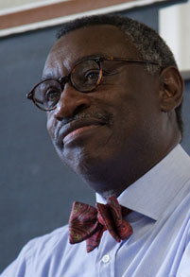
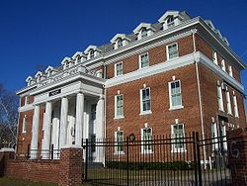
Who would you say is primarily responsible for student learning?
A) the student
B) the instructor
C) the institution

Slide 50
Who do you think students say is primarily responsible for student learning?
a) the student
b) the instructor
c) the institution

Slide 51

The reality is that…
when all three of these entities take full responsibility for student learning,
we will experience a significant increase in student learning, retention, and graduation rates!

Slide 52
Useful Websites
www.cas.lsu.edu
www.howtostudy.org
www.vark-learn.com
www.drearlbloch.com
www.khanacademy.org
Searches on www.google.com

Slide 53
Additional References
Bruer, John T. , 2000. Schools For Thought: A Science of Learning in the Classroom. MIT Press.
Bransford, J.D., Brown, A.L., Cocking, R.R. (Eds.), 2000. How people learn: Brain, Mind, Experience, and School. Washington, DC: National Academy Press.
Christ, F. L., 1997. Seven Steps to Better Management of Your Study Time. Clearwater, FL: H & H Publishing
Cromley, Jennifer, 2000. Learning to Think, Learning to Learn: What the Science of Thinking and Learning Has to Offer Adult Education. Washington, DC: National Institute for Literacy.
Ellis, David, 2006. Becoming a Master Student*. New York: Houghton-Mifflin.
Hoffman, Roald and Saundra Y. McGuire. (2010). Learning and Teaching Strategies. American Scientist , vol. 98, pp. 378-382.
Nilson, Linda, 2004. Teaching at It’s Best: A Research-Based Resource for College Instructors. Bolton, MA: Anker Publishing Company.
Pierce, William, 2004. Metacognition: Study Strategies, Monitoring, and Motivation.
http://academic.pg.cc.md.us/~wpeirce/MCCCTR/metacognition.htm
*Excellent student reference

