Slide 1
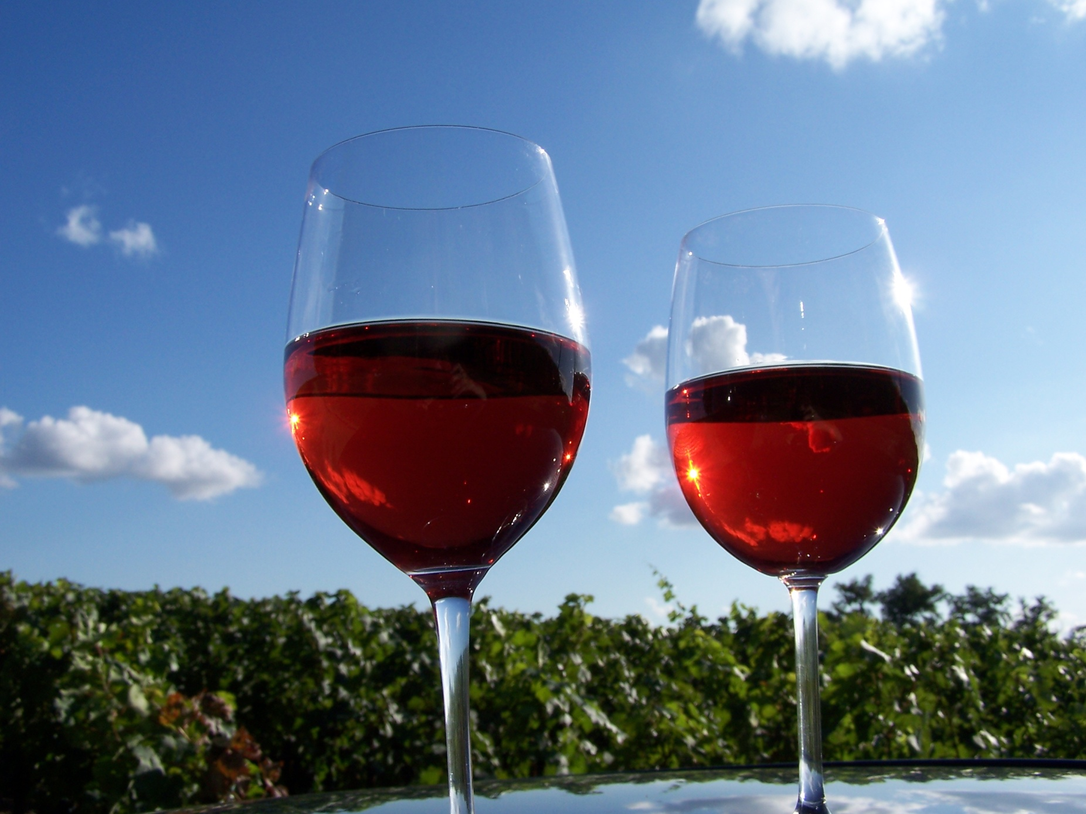
HMGT 2402 Wine & Beverage Management
Prof. Karen Goodlad
Red Wines of France Spring 2013

Slide 2
Overview
Collaborative Wine List
Review of Winery Assignment
Objectives:
Discuss the laws of French wine regions
Match appellations with the regions where they are located and their principal grapes and wine styles
Discuss wine making methods used to make red wine in various regions of France
Explain the factors that affect the taste of red wines of France
Tasting

Slide 3
European Union Wine Regulations
Protected Designation of Origin (PDO)
Produced from grapes grown in the specific territory listed on the label
Names are registered
Delimited boundaries
Defined Viticulture practices
Max. yields, permitted grape varieties…
Defined Vinification practices
Defined wine characteristics
Can be identified by the traditional terms of the country
Typically do not include grape variety on label
Protected Geographical Indication (PGI)
85% of grapes come from a registered geographical region
Viticulture and Vinification are defined but less strict than PDO
Grapes listed on the label will be listed in descending order.
May list grape variety on label
Wine/Table Wine
Least strict

Slide 4
French Wine Regulations
European Union Influence
Protected Designation of Origin (PDO)
Regulate the following
Grape varieties
Maximum yield
Row spacing, vine training, trellising…
Minimum ripeness/date of harvest
Typicity
Protected Geographical Indication (PGI)
Vin de Pays

Slide 5
Appellation Contrôlée Appellation Protégée
“Controlled Place-Name of Origin”
High Demand + Constant Supply
= Fraud
1935 – Institut National des Appellations d’Origine des Vins et Eauz-de-Vie (INAO)
2010 EU Laws
“Protected Naming of Origin”
Notes:
Fraud: 1991 Champagne, 1923 Chateauneuf-du-Pape, Negociants,
1935 – Legally defined appellation boundaries
2010 – changes affected by European Union regulations for foods associated with places

Slide 6
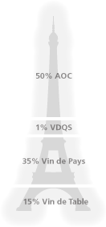
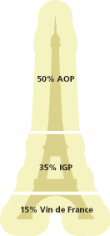
Before the EU Changes
After the EU Changes →
Image Source: Society of Wine Educators

Slide 7
Appellation Contrôlée Appellation Protégée
Appellation d’Origine Contrôlée (AOC)
Protected Designation of Origin (PDO)
Vin de Pays
Protected Geographical Indication (PGI)
Vin de Table Wine
~ 55%
~ 35%
~ 10%
Notes:
AOC (AOP)-- 100% from the appellation (region, district, village, vineyard),
--minimum sugar level, --defined viticulture methods (pruning, training)
-- minimum alc. level --designated maximum yields,
-- bottled with in appellation --taste by INAO --viniculture methods
Vin de Pays (IGP)– 152 regions and zonesmore freedom, changes for international sales…chard, cab, merlot viognier, syrah, defined regions, tasting panels, 85% of varietal on label say (IGP)
Vin de Table (Vin) – distilled into spirits, no regulations beyond health codes

Slide 8
Major Wine Regions of France
White Wine Regions
Bordeaux
Burgundy
Alsace
Loire Valley
Minimal White: The Rhone Valley
Regionally Unique Wines
Red Wine Regions
Bordeaux
Burgundy
Beaujolais
The Rhone Valley
The South
Minimal Red: Alsace, Loire Valley
Explore this topic Further
The Future of French Wine
Notes:
Bordeaux: Cabernet Sauvignon, Merlot, Cab Franc (petit verdot (haute medoc), malbec and carmenere (almost none)
Burgundy: Pinot Noir
Beaujolais: Gamay
Rhone: Syrah, Grenache,

Slide 9
Bordeaux
Climate
Maritime
Soil
Gravel & Limestone (Left Bank)
Clay (Right Bank)
Viticulture
Vinification
Cru System
Red Grape
Varieties
Cabernet Sauvignon
Merlot
Cabernet Franc
Petit Verdot
Malbec
Notes:
The Left Bank. The soil on the left bank of the Garonne and Gironde Rivers is primarily gravel, and the predominant red grape varietal is Cabernet Sauvignon. The wineries in the left bank generally produce full, elegant, and very tannic red wines that may require years to soften and develop.
Entre-Deux-Mers. This area is better known for its white wines than for its reds. But in recent years, it has become a principal source of light-bodied red wines that are made from Merlot and Cabernet Sauvignon and sold as Appellation Bordeaux Contrôlée.
The Right Bank. In the area on the right bank of the Dordogne River the soil is primarily clay. On the right bank, the wineries rely more heavily on the early-ripening Merlot grape. They generally produce softer, scented red wines.

Slide 10
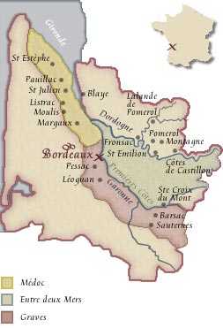
Bordeaux
Medoc & Haut Medoc
Saint Estephe
Pauillac
Saint Julian
Moulis
Listrac
Margaux
Grave
Pessac-Leognan
Saint-Emilion
Fronsac
Pomerol
Notes:
It is autumn that makes the red wines of Bordeaux so great, the weather otherwise is very maritime with a lot of rain and generally uneven growing conditions.
Gravel contributes as well: Good drainage, good air circulation, concentrates heat
Following are the sub-appellations of the region
Medoc: Mouth of Gironde estuary south to city of Bordeaux
“The best vineyards see the river”
St. Estephe: Most North of appellations Gravel, rocks, sand deep gravel clay
merlot, softer tannins that in past, richer fruit, all are dark, earthy/oaky, cassis
Paulliac: iron rich gravel over clay and limestone…good drainage 3 of five premier cru, mostly cabernet, then merlot, cab franc, petit verdot
St. Julien: gravel soil, layers of clay and limestone, Cab Sauv., Merlot, Cab Franc,
Margaux: Gravelly soil, pebble, sand, limestone
Graves: South east of Bordeaux city, Fine red wines
Pessac-Leognan: All Grave Classification are here
gravely rolling hills, big wines, mineral, floral, smote, red fruit
St. Emillion: very respected region, only reds, bordered by Dordogne and Isle Rivers
all about the limestone
Pomeral: full smooth wines with ripe fruit merlot, then cab franccan be drunk young due to merlot

Slide 11
Classification of the Bordeaux Cru
Medoc Classification of 1855 (revised 1973)
Premiers Crus
Deuxiemes Crus
Troisiemes Crus
Quatriemes Crus
Cizuimes Crus
Notes:
Paris Exposition Universaelle – All the best that France had to offer.

Slide 12
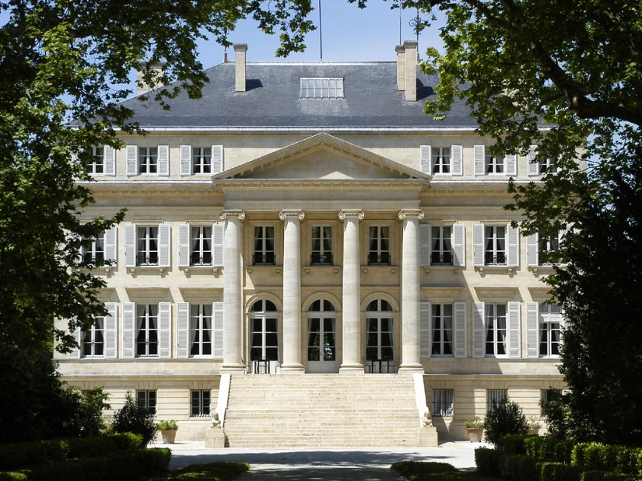
Premiers Crus
Chateau Lafite-Rothschild (Pauillac)
Chateau Latour (Pauillac)
Chateau Margaux (Margaux)
Chateau Mouton Rothschild (Pauillac)
Chateau Haut-Brion (Graves)
Notes:
Mouton Rothschild, 1973
60 total chateaux + 1 graves

Slide 13
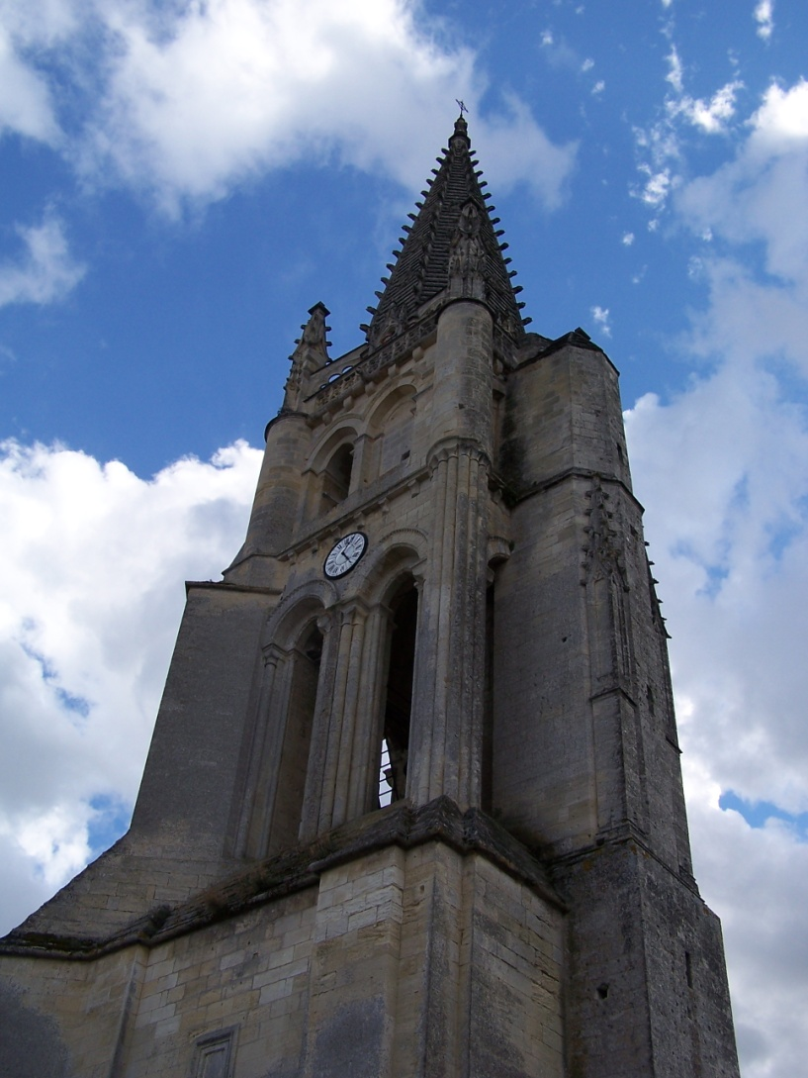
St. Emilion, Cru System 1958
Revised 2006, currently suspended
Premier Grand Cru Classé, Class A
Premier Grand Cru Classé, Class B
Grand Cru Classé
Grand Cru**

Slide 14
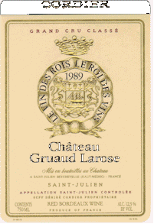
The Bordeaux Wine Label

Slide 15
Burgundy
Côte d’Or, 9.7% of all production
Côte de Nuits
Côte de Beaune: Both Red and White
Côte Chalonnaise, 2.8% of all production
Chablis: White Wines, 9.7% of all production
Maconnais: Mostly White, 12.4% of all prod.
Beaujolais: 47% of production
Fro More Information: The NYTimes on Burgundy
Notes:
Burgundy, all Pinot Nior
Many Small Vineyards (at times 1/3 of an acres) (55,000 acres over 10 growers)
Negociant driven
Soil and Climate: many Micro Climates that help with wine definition.
some negotiants use wood, others do not.
AOC Levels: Regional (15 appelations), high elevations
Village name place on label, stricter regulations, lower yields, higher alc
Premier Crus single vineyard in Cote d’Or village name + vineyard name
Grand Crus (31 vineyards) name of vineyard only due to superior quality
Cote de Nuits: (north)
red berry/cherry flavors
Cote Chalonnaise

Slide 16
Burgundy
Côte de Nuits
climate
Pinot Noir, almost exclusively
Limestone & Marl
Aspect Highly Important
Côte de Beaune
climate
Pinot Noir, both red and white varietals do well
Limestone
Aspect Highly Important

Slide 17
Burgundy, Cru System, established 1861
30 vineyards, all in Côte d’Or
Near hill tops
All reds come from Côte de Nuits
~1% of wine, age 20-30 years
Grands Crus
Premiers Crus
Regional
Village AOC
Mid range of hills
Label includes vineyard name as well as village name
More complex, more intense
~10% of all Burgundy Wine
Along low slopes & hill tops
All wine sourced from village
Lower yields, higher alc.
53 villages, 23% of all Burgundy Wine
General large areas, 65% of all wine from Burgundy
Notes:
Varying climate and soils add to the complex Cru system

Slide 18
Beaujolais
Larger that all areas in Burgundy
Climate is influenced by maritime, continental and Mediterranean conditions

Slide 19
Beaujolais
Beaujolais Crus
Moulin-A-Vent, St. Amour, Julienas, Chenas, Fleurie, Cheroubles, Morgon, Regnie, Brouilly, Lyonnais
Beaujolais-Village
Beaujolais
Beaujolais Nouveau
A marketing success story
Fro More Information: The NYTimes on Beaujolais
Notes:
Carbonic Maceration: fermentation of grape is due to pressure of top grapes
Pruning Technique: Goblet = 12 buds per plant aloud
Nouveau, Burgundian vinteners were strapped for $$ and had excess inventory after WWII, November 15 is release date of newly fermented and bottled wine, “Must have” for many, quaffing wine

Slide 20
The Rhône Valley/North
Climate
Moderate rain, little fear of drought
Moderate to high heat
Soil
Granite sand
Notes:
Red Grape: Syrah only
87% of the Rhone Valley AOC wines are red wines
Rosés make up another 9%
whites 4% of total production.
As for the regional Côtes du Rhône appellation, 95% of the wines produced are red, and for Villages the figure goes up to 99%.

Slide 21
The Rhône Valley/North
Chateau Grillet
Cote Rôtie
Condrieu
Hermitage & Crozes-Hermitage
Saint-Joseph
Cornas
Notes:
Red Grape: Syrah only
87% of the Rhone Valley AOC wines are red wines
Rosés make up another 9%
whites 4% of total production.
As for the regional Côtes du Rhône appellation, 95% of the wines produced are red, and for Villages the figure goes up to 99%.

Slide 22
The Rhône Valley/South
Climate
Dry, April –September
Some severe storms
Subject to drought
Intense wind
Soil
Clay with sand sandstone pebbles creates local terroir that add to differing tastes
Notes:
Grape: More 23 allowed grape varietals
Dominate varietals
Grenache
Syrah
Mourvedre are

Slide 23
The Rhône Valley/South
Gigondas
Chateauneuf-du-Pape
Lirac and Tavel
Notes:
Grape: More 23 allowed grape varietals
Dominate varietals
Grenache
Syrah
Mourvedre are

Slide 24
Loire Valley
Touraine: Gamay (60%), Cabernet Franc for a Rosé
Upper Loire: Pinot Noir, Gamay
Only 25% of production is red

Slide 25
The South
Provence
Languedoc & Roussillon

Slide 26
Next Week
Champagne and Sparkling Wine Lecture

