Slide 1
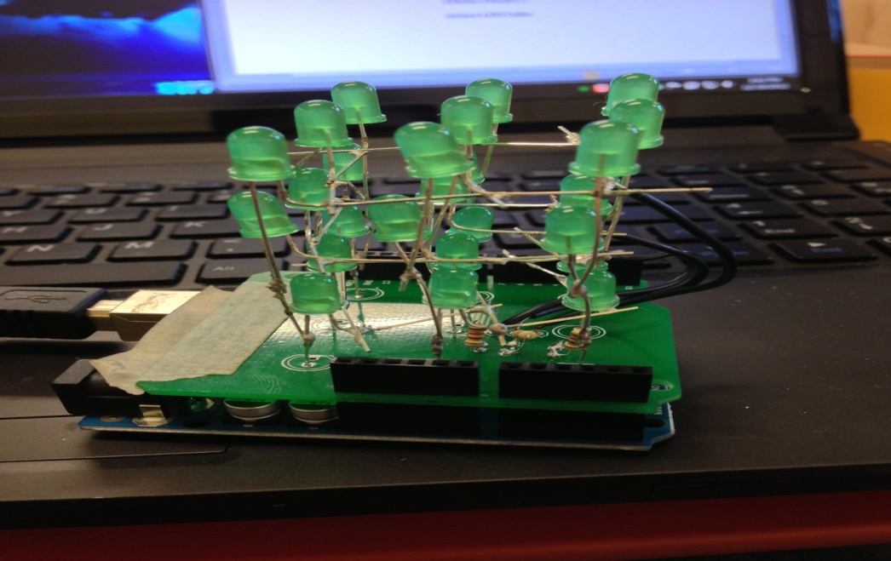
3X3X3 LED CUBE
By JASON WU CET4711 FINAL PROJECT

Slide 2
Main purpose for this project is to control the led by sending the signal from the Arduino to the led to make light show.

Slide 3
Project Management
Who are your teammates?
-Myself JASON WU
Who did the Project?
-ME
Who Pay the parts?
-ME
Who did everything?
-Me

Slide 4
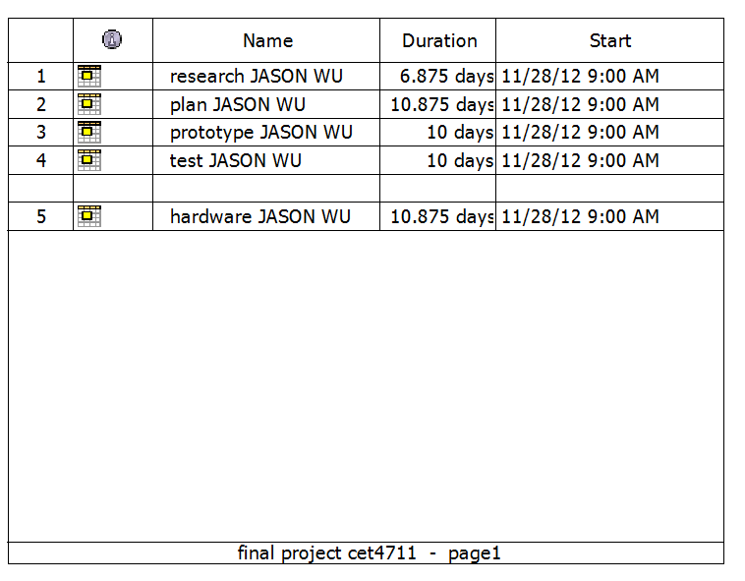
PROJECT MANAGMENT LIRBRE

Slide 5
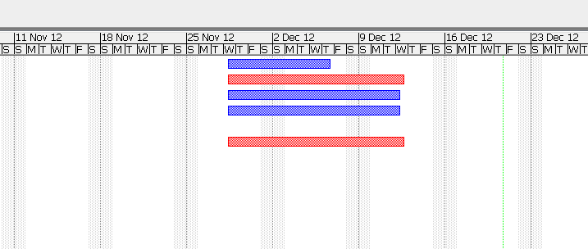
Time of the PROJECT

Slide 6
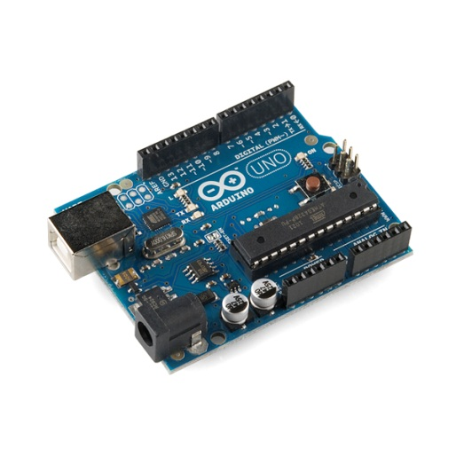
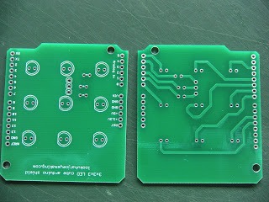
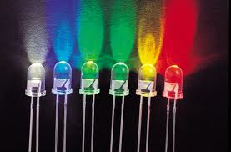
The Cost
ARDUINO KIT = $80
PCB = $10
LED 24 pieces = $2
SHIPPING COST = $10
TOTAL COST = $102

Slide 7
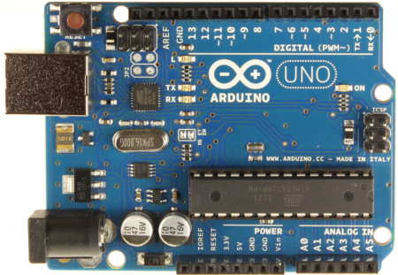
What is an Arduino?
Arduino is an open source single board microcontroller

Slide 8
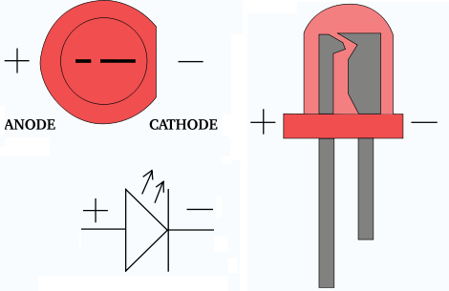
What is an LED? (light-emitting diode)
An LED is a special type of diode that emits light when current is run through it.
The positive is the Anode and the negative side is the Cathode.

Slide 9
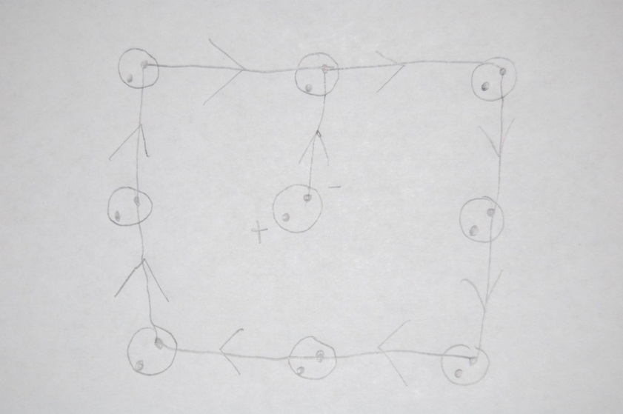
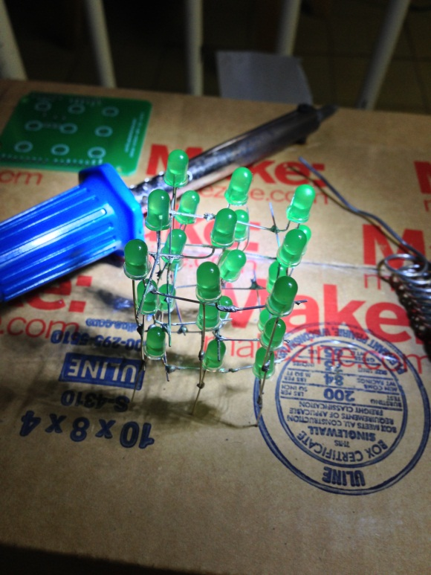
To build it
All positive connect together and all negative are connect together too.

Slide 10
The CUBE
The cube itself is made up of 27 LED arranged in a specific pattern so I can control which lights light up and which ones stay off. The idea behind the cube is that I want to be able to control the LEDs individually.

Slide 11
TESTING MODE
http://www.youtube.com/watch?v=AmV1qRw4V-E&feature=youtu.be

Slide 12
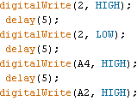
Change the Speed
To change the speed of the LED by change the number in the delay()
FOR Example it set in 5
http://www.youtube.com/watch?v=3dflBk21hS8&feature=youtu.be

Slide 13
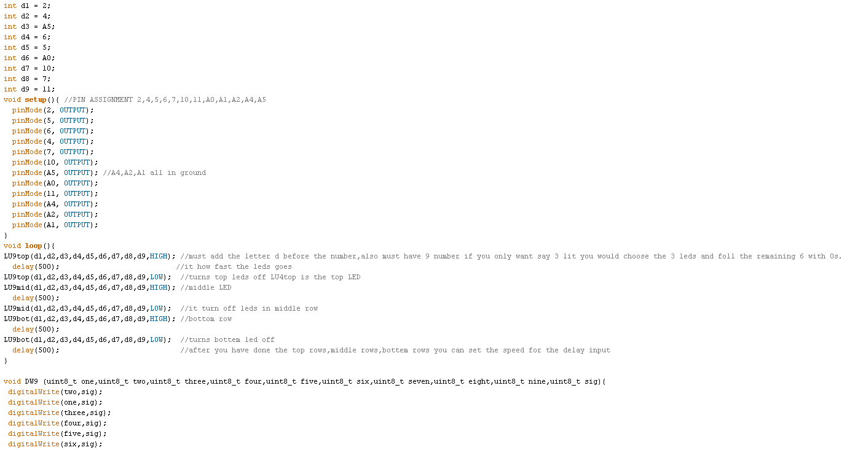
Full code

Slide 14
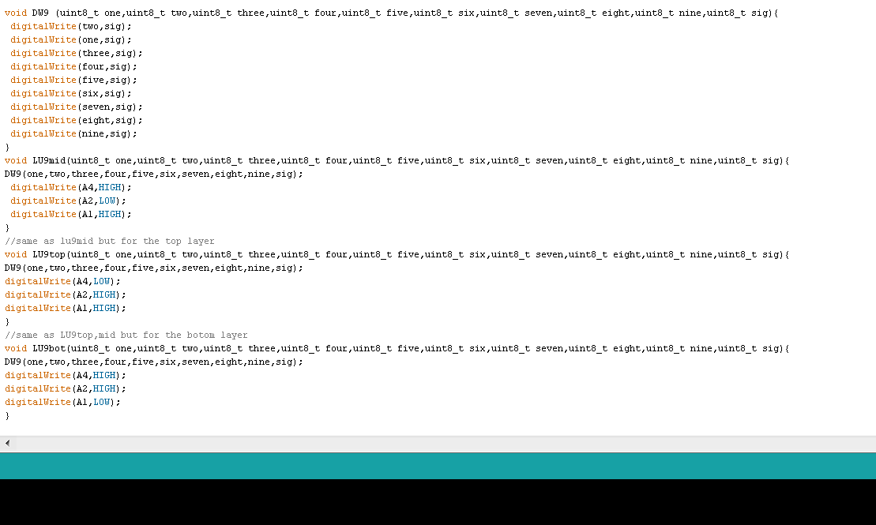

Slide 15
TROUBLESHOOT
IF I PUT TO MUCH SEQUENCE THE ARDUINO CAN’T HOLD THAT MUCH MEMORY
THE ARDUINO DRIVER DIDN’T WORK ON MY COMPUTER SO I SPEND ALL DAY FIX IT
I USE TOO MUCH SOLDERING THEREFORE SOME PINS ARE STUCK TOGETHER IT SHORTAGE
I HAVE TROUBLE SOLDERING LED TOGETHER IT LOT BETTER IF YOU HAVE EXTRA HAND

Slide 16
FINAL
http://www.youtube.com/watch?v=WEMNC6FaoQE&feature=youtu.be
TURN OFF THE SOUND WHEN WATCH THE VIDEO

