Slide 1
RFID TED BEAR
Partners: Zayira Vasquez
Frantz St Valliere
Lucy Lin

Slide 2
What is this about???
Our project is based on a bear which talks when it is near an object. The way this will work is by using an RFID reader, Arduino and a windshield. When the RFID reader in the bear is near an object, which has an RFID tag, it will talk. We programmed the Arduino to identify each tag differently using an RFID reader, so that the bear has something specific to say.

Slide 3
Roles
Lucy Lin – Report and Project Management
Zayira Vasquez – Report and PowerPoint
Frantz St Valliere – He did nothing 0_0 <- Just kidding!

Slide 4
Project Planning
Beware, changes were made…

Slide 5
Project Planning pt.2
Beware, changes were made…

Slide 6
Tools and Parts
Computer Marking pen
Phillips screwdriver SD memory card adapter
SD slot Scissors
Sewing needle Solder
Soldering iron USB programming cable
Wire cutter/stripper Stuffed toy
Arduino microcontroller Wave Shield
Parallax RFID Reader RFID tags
Speaker Connector header
Velcro

Slide 7
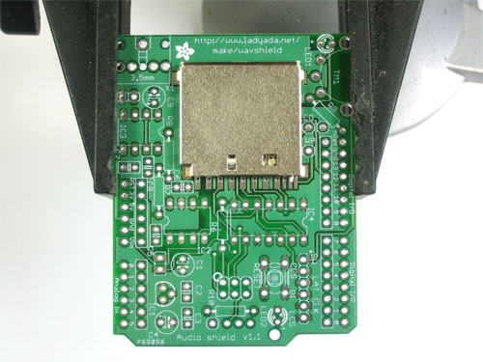
Soldering the WaveShield
The holder snaps right into place on the waveshield
http://ladyada.net/make/waveshield

Slide 8
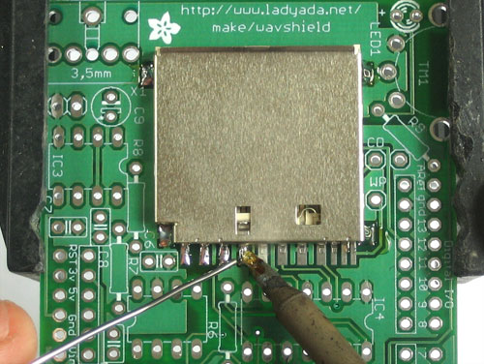
Solder the four corners and the eight leftmost pins on the bottom.
Make sure that there are no solder bridges.

Slide 9
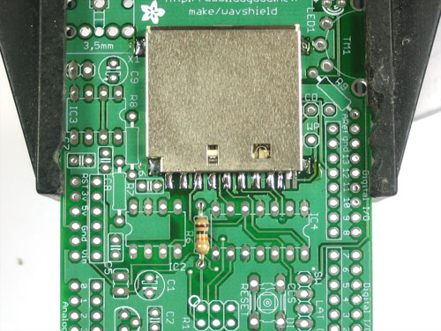
Place a 10k resistor to R6 on the board. The resistor leads should go through the holes of R6.

Slide 10
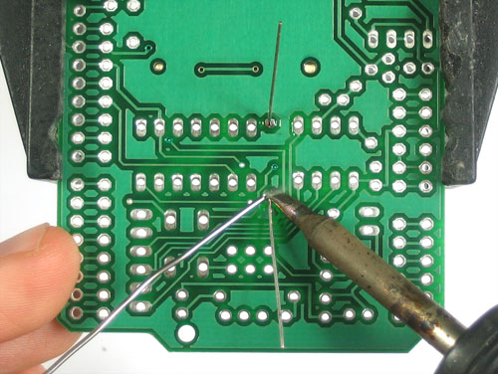
Bend the leads outward so it doesn’t fall out. Solder the leads to the pad and clip the leads off with cutters.
Finish soldering resistors by placing R8 (100k) and R7 (1.5k)

Slide 11
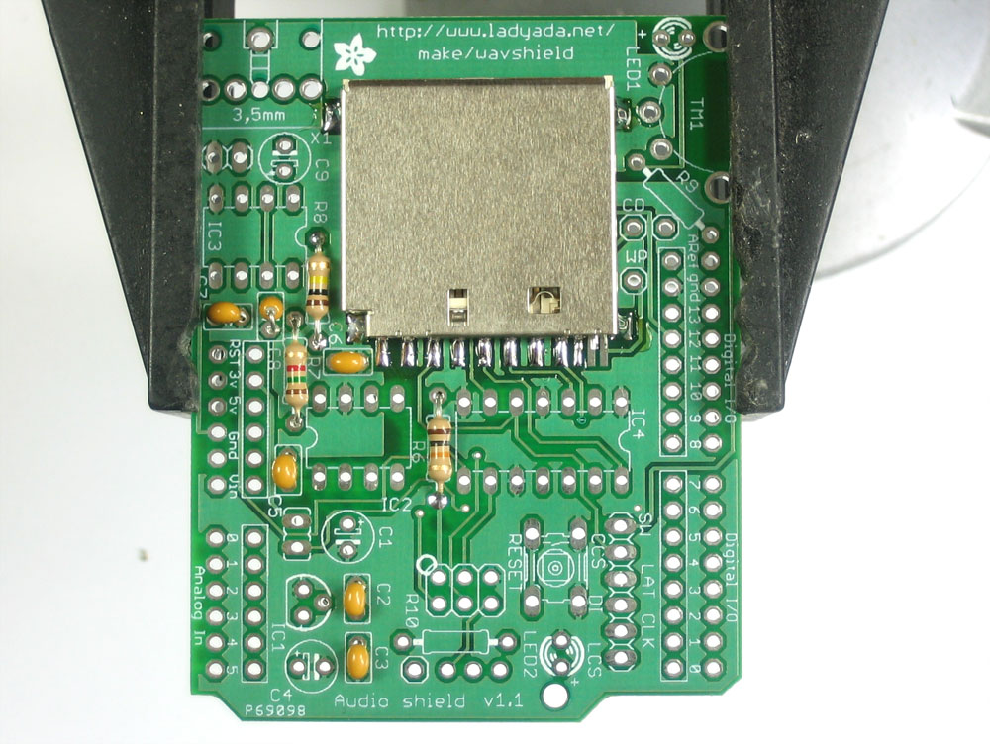
Place the 104 capacitor next to R7 and solder. Continue soldering remaining capacitors as shown on image.

Slide 12
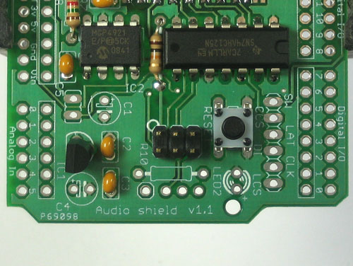
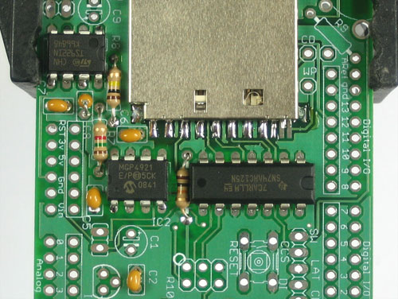
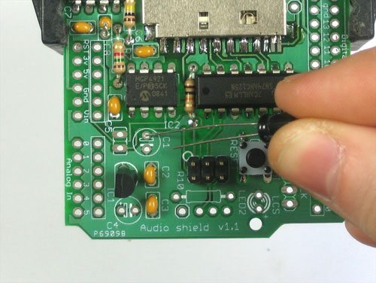
Solder the IC chips (IC2, IC3, IC4), ICSP header, regulator (IC1)and Polarized capacitor (in C1,C4, and C9) in the locations shown below.

Slide 13
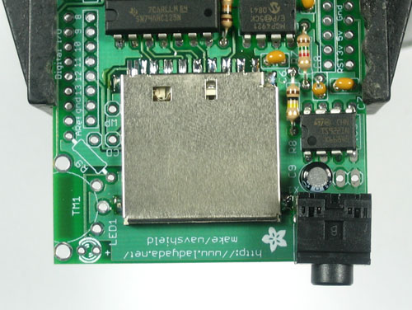
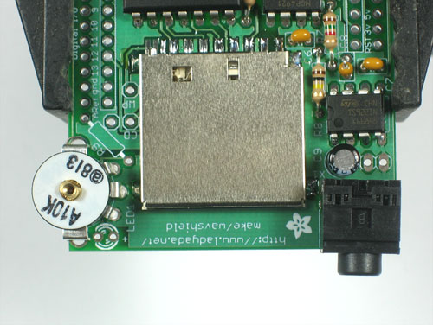
Snap in the headphone jack on the right edge of the board and solder.
Slip in The volume potentiometer (TM1)

Slide 14
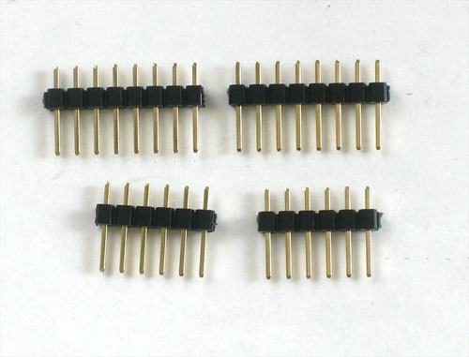
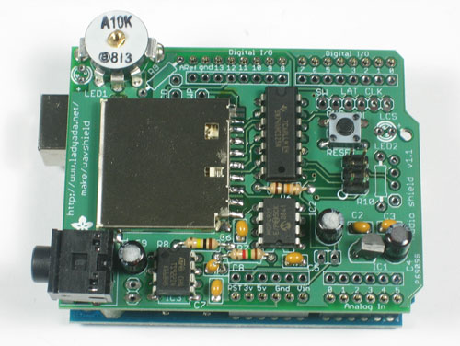
Clip off 2-6 pin and 2-8pin pieces. Place the 6 and 8 pin headers into the female sockets and place the shield onto the arduino so all the holes match up with the header. Solder in each and every pin of header

Slide 15
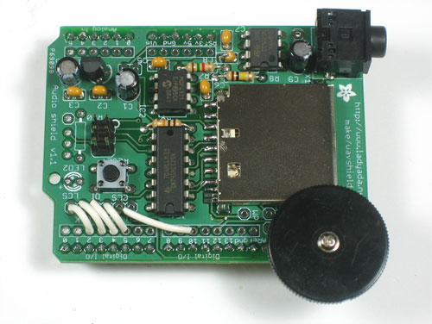
Screw in thumbwheel
Use jumper wires to connect:
2 -> LCS 3 -> CLK 4 -> DI 5 -> LAT 10 -> CCS

Slide 16
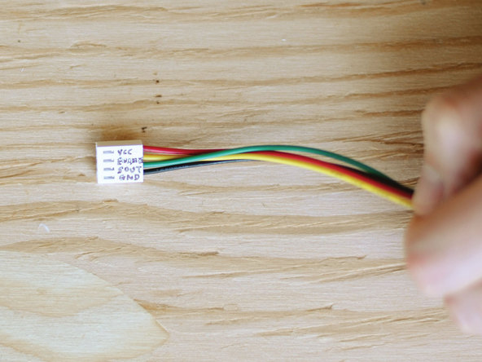
Mark the 4-pin connector positions Vcc, Enable, SOut, and GND, to match the RFID reader’s serial header, and connect red and black wires to voltage and ground, respectively.

Slide 17
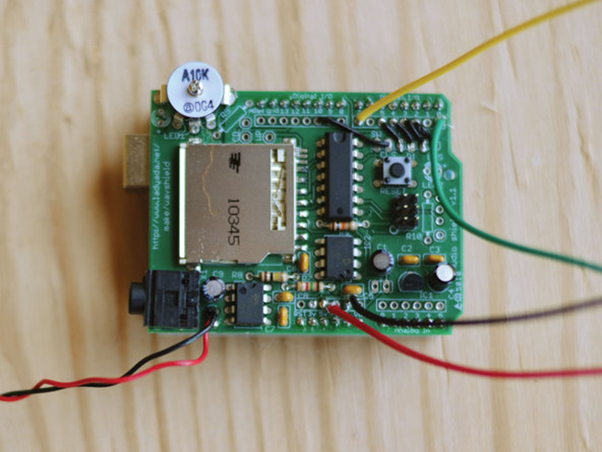
From your 4-wire RFID connector cable
Gnd -> Gnd
Enable -> Pin7
SOut -> pin0
Vin -> +5v
Solder the speaker wires to the 2 holes on the Wave Shield right next to capacitor C9, behind the headphone jack

Slide 18
To complete the electronics:
Just plug the Wave Shield onto the Arduino, connect the 4-wire cable to the RFID reader and plug the battery power plug into the Arduino.

Slide 19
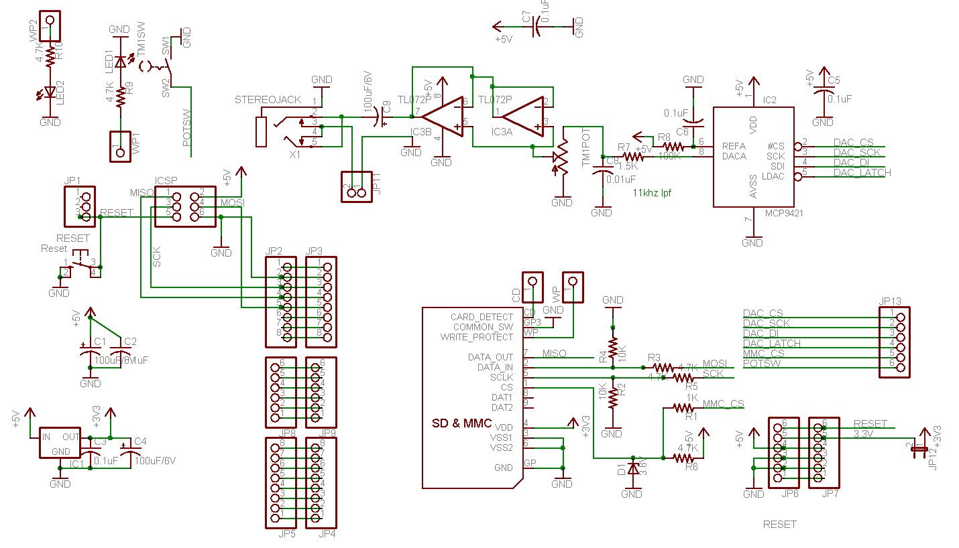
Schematic
… looks crazy…

Slide 20
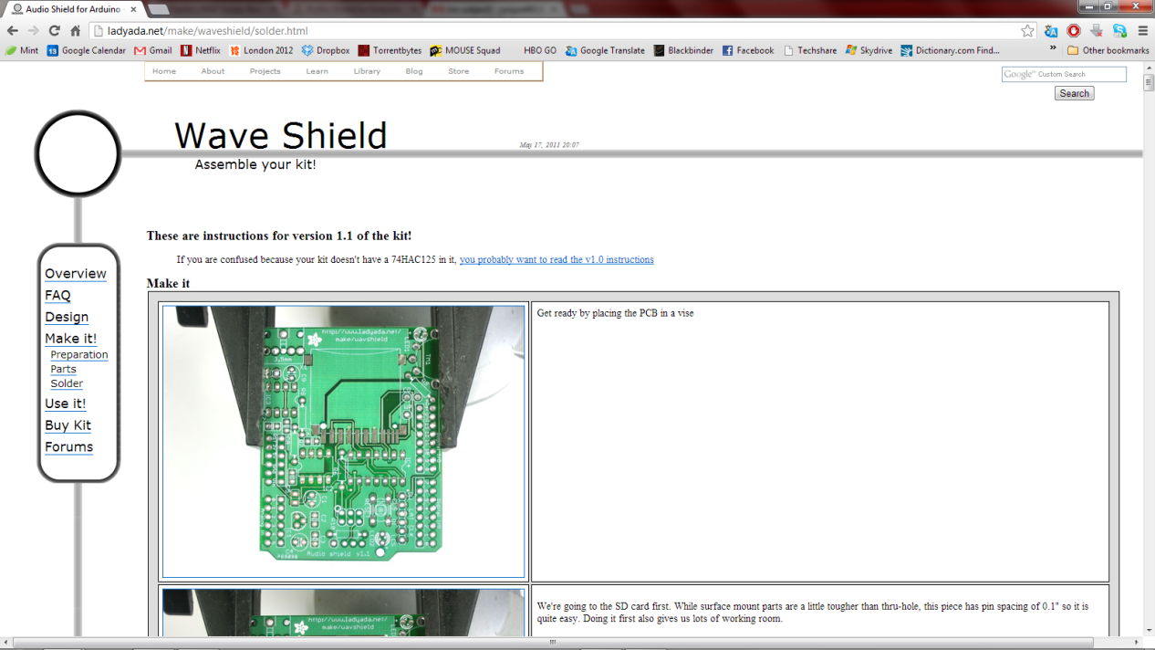
Ok so the schemtic looks hard…
No worries! The steps to make the wave shield are online here!

Slide 21
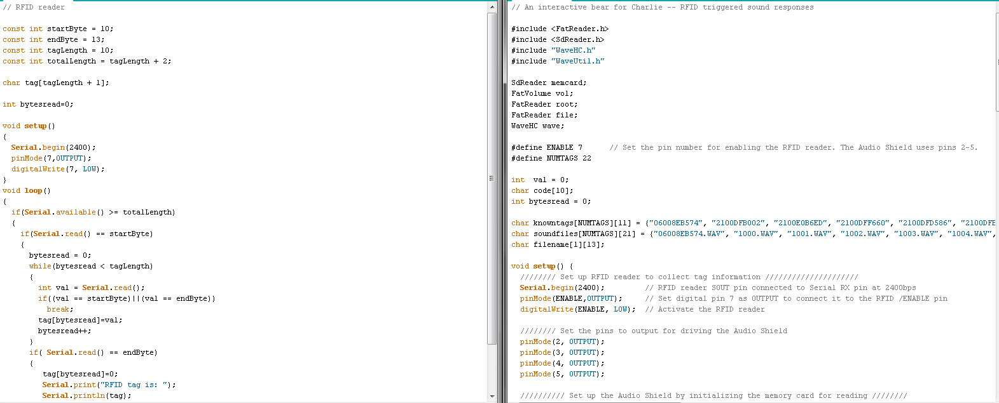
Two Codes for one Success!
Test Code for RFID tags
The Real Deal….

Slide 22
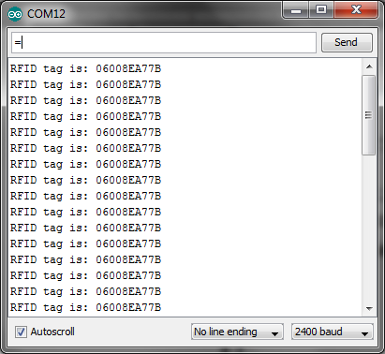
Test the RFID tags
In order to know what the hex value of the tags, you must run the test program to identify the tags and then you can mark it.
One of our results!

Slide 23
Encoding the Audio
Record your audio for each tag; detect tags through Serial Monitor. Download Audacity ; Following the Wave Shield’s “Converting audio to the proper format” tutorial, use Audacity to convert your audio files into the correct format: 16-bit sample size, PCM encoding, and a sample rate of 22kHz or less.
Copy the sound files in the root directory of the SD memory card.

Slide 24
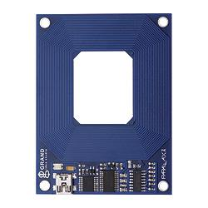
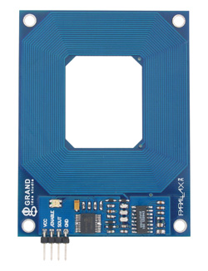
Problems
We brought this:
Was supposed to get this:

Slide 25
Configure and test the code
Unplug the RFID reader and load tedbear.pde sketch into the Arduino.
Plug the RFID reader back in, and see if bringing a tag near starts a sound playing.
Hear what the bear says!!!

