Slide 1
Tourism and the Military Industrial Complex
HMGT 3502 – Hospitality Research Seminar

Slide 2
An Odd Relationship
Military Industrial Complex
Tourism
Capitalism
Tourism
Military Industrial Complex

Slide 3
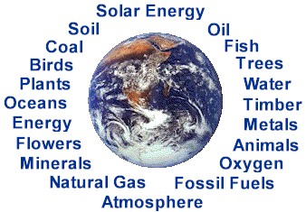
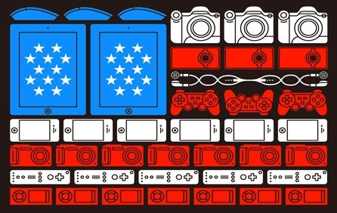
Economics
New Resources
New Technology

Slide 4
Military Industrial Complex and Technology
Air Travel
G.P.S.
Ship Defense
Wireless Technology
Internet
All used by tourism

Slide 5
Advantage of Tourism
Tourism
New Business Opportunities
Reenactments
New Attractions

Slide 6
Overview
Good for Tourism and the U.S. as a whole
The only flaw is that it is controlled by people

Slide 7
Fin
Benjamin Mendoza III

