Slide 1
Steve Jobs
Life of a innovator

Slide 2
Early life
February 24, 1955 in San Francisco Steve Paul was born, and left for adoption by his parents Abdulfattah Jandali and Joanne Schieble, and gets adopted by Paul and Ciara Jobs.
At the age of 13 Steve Jobs gets a summer job at the HP factory.
The year after Steve Jobs meets Steve Wozniak who is 5 years older then him and they have a lot in common including their love for electronics.

Slide 3
College Experience
1973 Steve jobs attended a semester at Reed College, and then drops out because he felt no drive to stay. Even though he drop out he stayed on campus at a friends dorm and attended classes that captured his interest.
After Jobs left college he got a job at the video game company Atari, and after decides to go to India with his friend Dan Kottke to seek enlightenment.

Slide 4
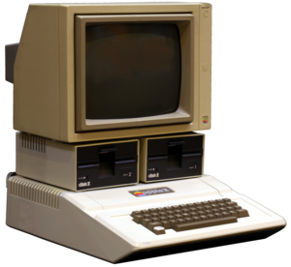
Enter Apple
April 1, 1976 Apple computer inc. is created by Steve Jobs, Steve Wozniak, and Ron Wayne.
April 17, 1977 the apple 2 prototype is unveiled t the West Coast Computer Faire.

Slide 5
NeXT & Apple
1986 Jobs creates NeXT inc. a company that makes more advanced computers.
In 1986 Jobs also purchased Pixar from George Lucas.
1996 Apple announces its going to purchase NeXT for its operating system, and Jobs is appointed as an advisor of apple.

Slide 6
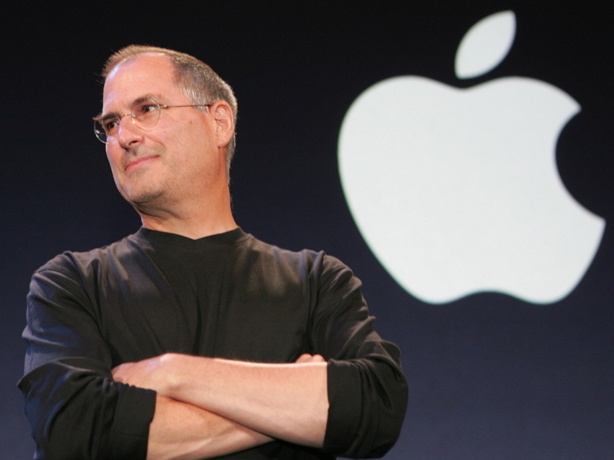
iCEO
1997 Steve Jobs becomes the “interim” CEO of Apple calling himself “iCEO”.
2000, Apple makes Steve Jobs the official CEO of Apple.

Slide 7
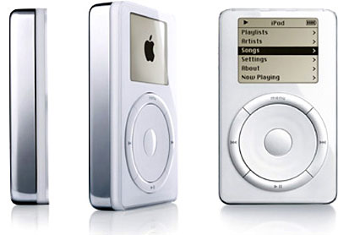
IPod & ITunes
2001, the apple iPod and iTunes is released, as well as the Mac operating system OS X.
2003, the iTunes music store is released.

Slide 8
Illness in an innovators life
2004, Steve Job undergoes surgery to remove a pancreatic tumor.
January 5, 2009 Steve Jobs announces he will not speak at Macworld 2009 because of his health and that he will be on medical leave.

Slide 9
Death of an innovater
October 5, 2011, Steve Jobs died at the age of 56.

Slide 10
Bibliography
http://allaboutstevejobs.com/bio/timeline.php
http://www.telegraph.co.uk/technology/steve-jobs/8810045/Steve-Jobs-timeline.html
www.Google.com

