Slide 1
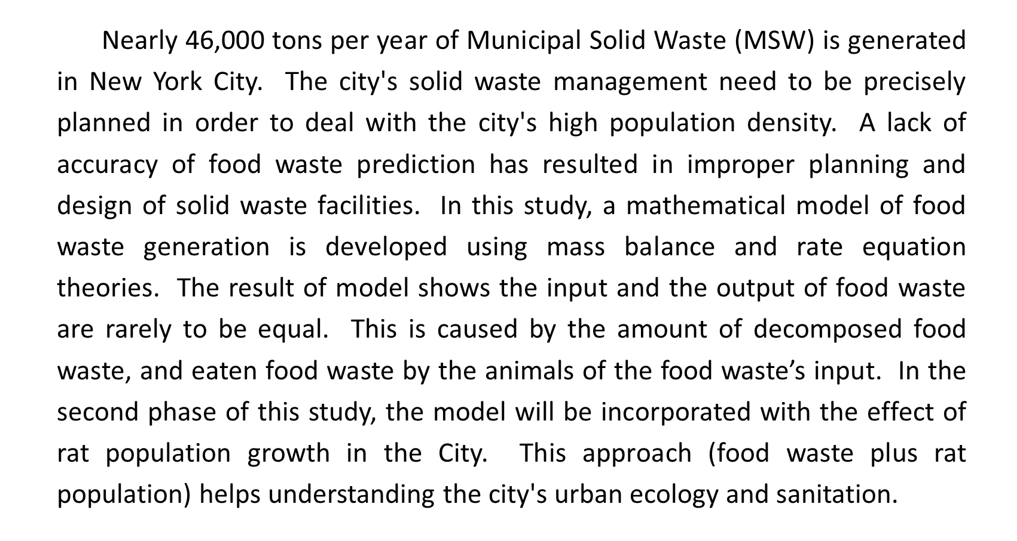
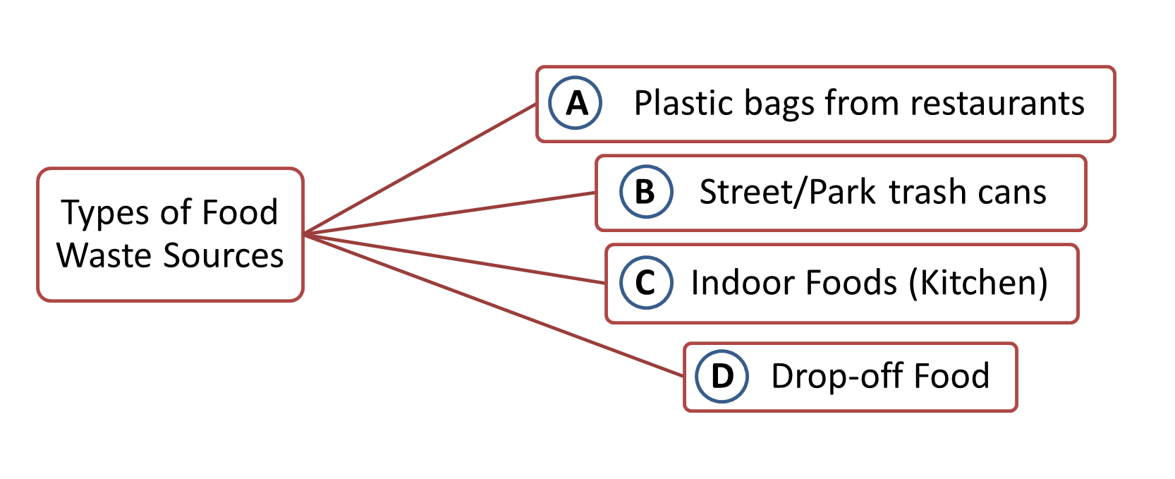
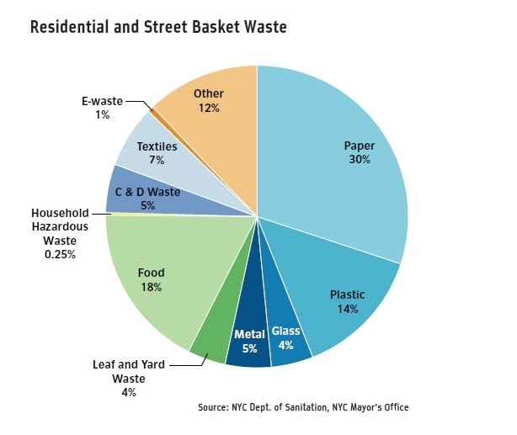
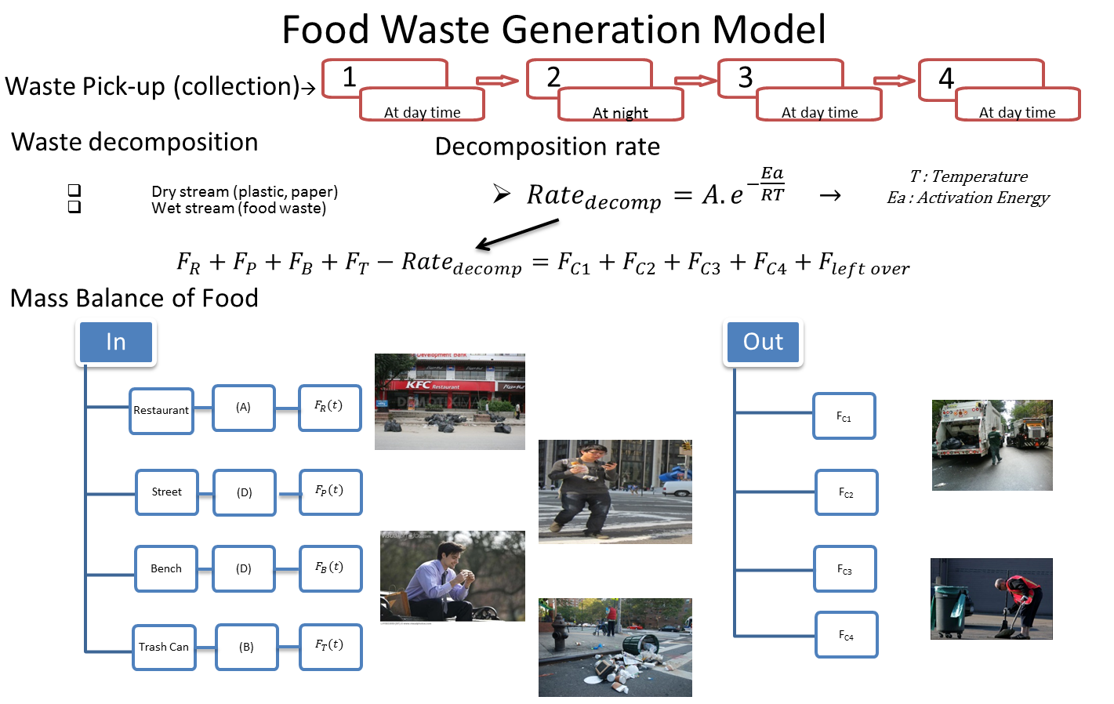
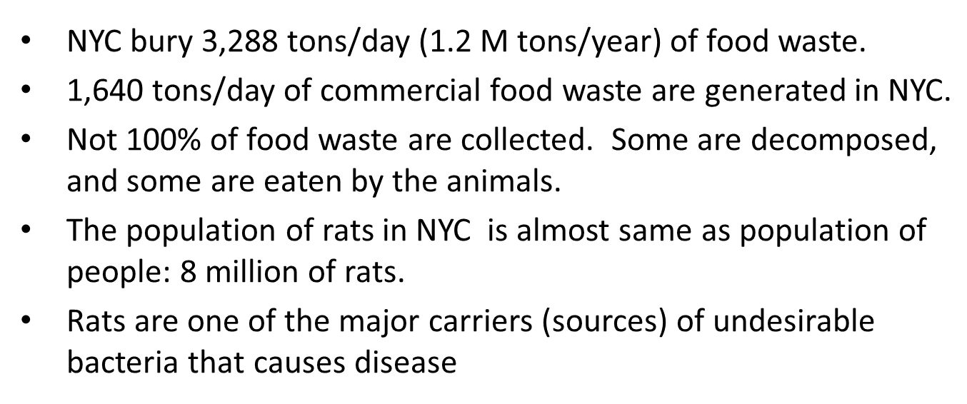
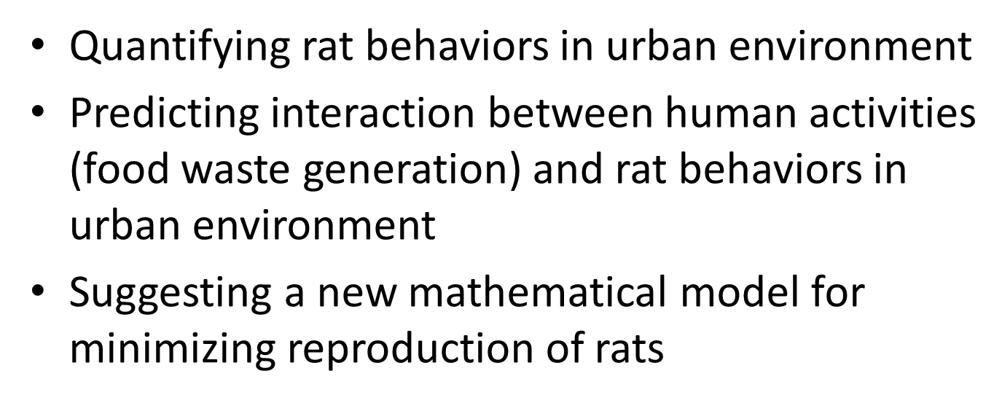
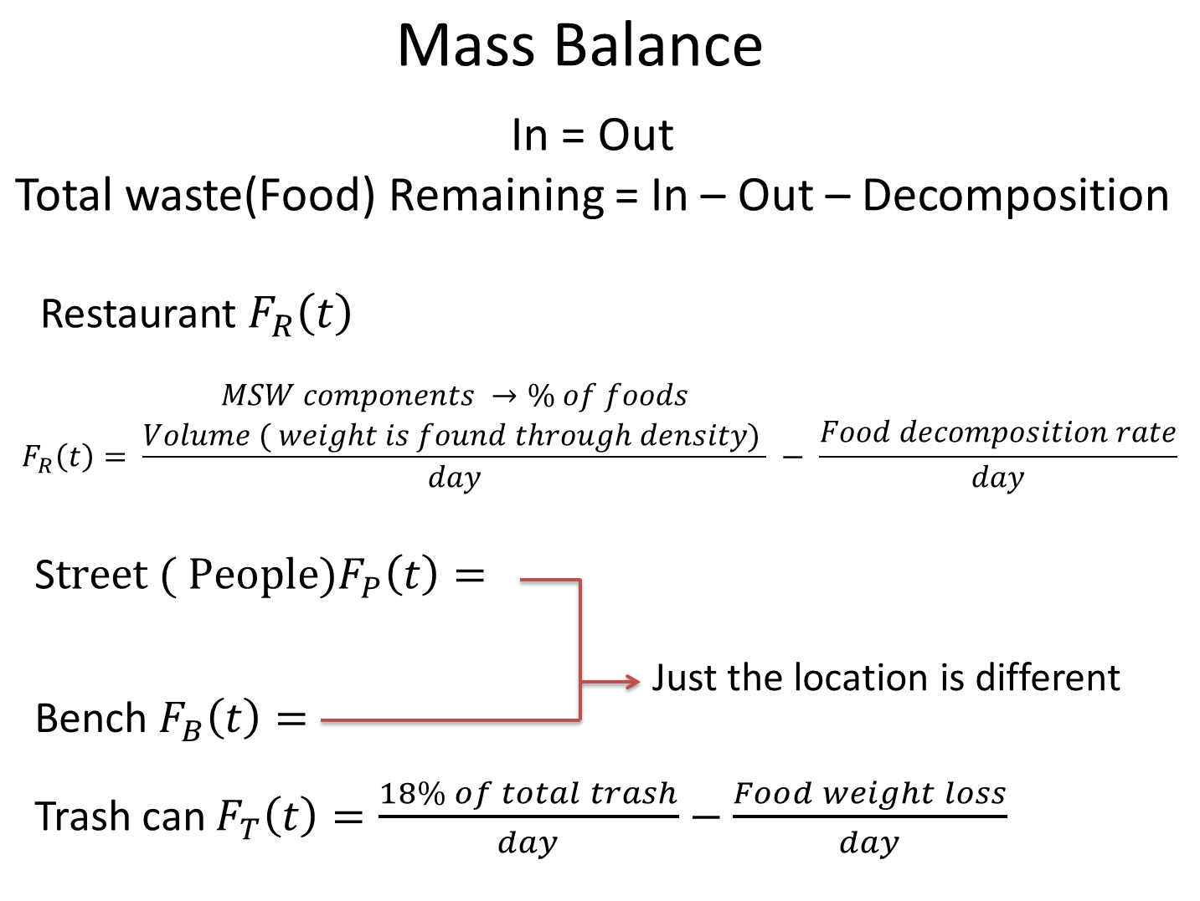
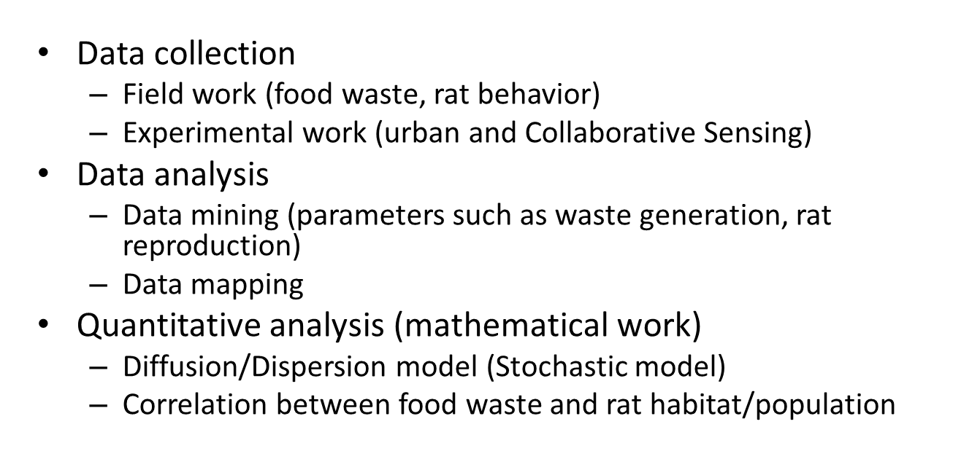
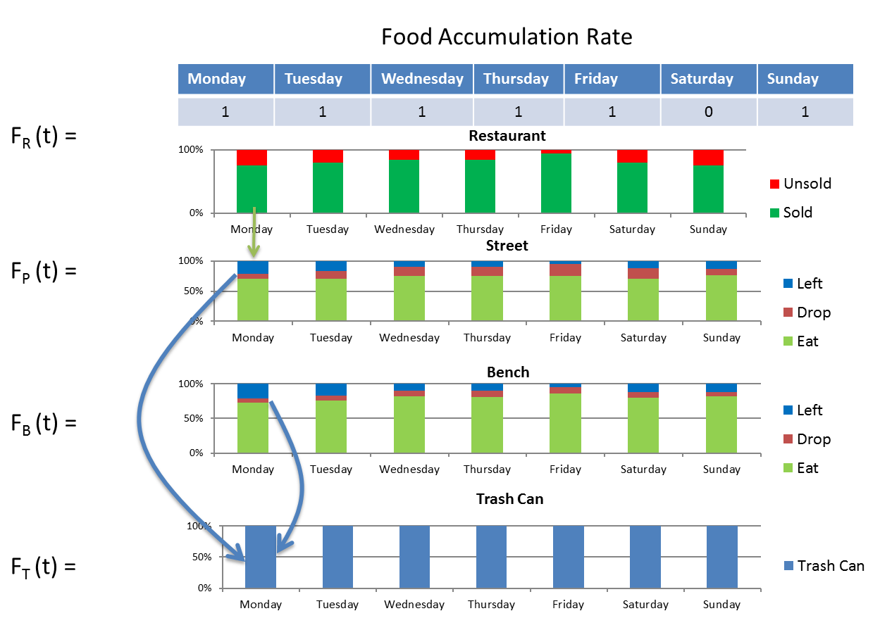
Mathematical Modeling of Food Waste Generation and Urban Ecology in New York City
Abraham Setiawan, and Masato R. Nakamura Department of Mechanical Engineering and Industrial Design Technology, New York City College of Technology (City Tech), City University of New York (CUNY), Brooklyn, NY 11201
Abstract
Food Waste Generation Model
Solid waste management in New York State
Summary
Objectives
Future Work
Methodology
References
New York Times, http://www.nytimes.com/2013/06/17/nyregion/bloombergs-final-recycling-frontier-food-waste.html?pagewanted=all&_r=0
N.Burant, A. McCornack, and H. Menten-Weil “Managing Food Waste in New York City: A Development Framework for Organic Waste Facilities”. Report from SIPA, Columbia University. (2012)
Columbia University WASTE MAP, http://www.seas.columbia.edu/earth/recycle/
N. J. Themelis “INTEGRATED MANAGEMENT OF SOLID WASTES FOR NEW YORK CITY” NAWTEC 2002

