Slide 1
Mathematical Modeling of Food Waste Generation and Urban Ecology in New York City
Abraham Setiawan and Masato R. Nakamura
Energy and Environmental Simulation Lab
Department of Mechanical Engineering and Industrial Design Technology New York City College of Technology (City Tech) City University of New York (CUNY)
Brooklyn, NY 11201

Slide 2
Abstract
Nearly 46,000 tons per year of Municipal Solid Waste (MSW) is generated in New York City. The city's solid waste management need to be precisely planned in order to deal with the city's high population density. A lack of accuracy of food waste prediction has resulted in improper planning and design of solid waste facilities. In this study, a mathematical model of food waste generation is developed using socioeconomic data. The result of model shows *******. In the second phase of this study, the model will be incorporated with the effect of rat population growth in the City. This approach (food waste plus rat population) helps understanding the city's urban ecology and sanitation.
have to be incorporated with rat.
Have to say something for the New York City’s composting stream program.
Experimental data that will be used for comparing this theoretical work.

Slide 3
Solid waste management in New York State
Columbia University WASTE MAP, http://www.seas.columbia.edu/earth/recycle/

Slide 4
Urban ecology in New York City
Hawks, pigeons, raccoons, rats, mice, squirrels etc.
Also NYC has large areas of waterfront (Fish)

Slide 5
New York City’s Sanitation
NYC bury 3,288 tons/day (1.2 M tons/year) of food waste [1]
1,640 tons/day of commercial food waste are generated in NYC [2]
The population of rats in NYC is almost same as population of people: 8 million of rats.
Rats are one of the major carriers (sources) of undesirable bacteria that causes disease
Sanitation is important especially in urban areas (high population density)
[1] New York Times, http://www.nytimes.com/2013/06/17/nyregion/bloombergs-final-recycling-frontier-food-waste.html?pagewanted=all&_r=0
[2] N.Burant, A. McCornack, and H. Menten-Weil “Managing Food Waste in New York City: A Development Framework for Organic Waste Facilities”. Report from SIPA, Columbia University. (2012)

Slide 6
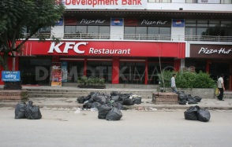
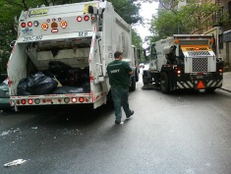
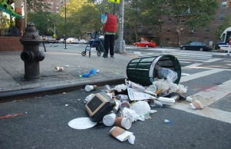
T : Temperature Ea : Activation Energy
Food Waste Generation Model
Waste Pick-up (collection)→
1
2
3
4
At day time
At night
At day time
At day time
Waste decomposition
Dry stream (plastic, paper)
Wet stream (food waste)
Decomposition rate
${Rate}_{decomp}=A.e^{−\frac{Ea}{RT}} →$
$$F_{R}+F_{P}+F_{B}+F_{T}−{Rate}_{decomp}=F_{C1}+F_{C2}+F_{C3}+F_{C4}+F_{left over}$$
Mass Balance of Food
In
Out
Restaurant
(A)
$$F_{R}(t)$$
F_{C1}
Street
(D)
$$F_{P}(t)$$
F_{C2}
Bench
(D)
$$F_{B}(t)$$
F_{C3}
Trash Can
(B)
$$F_{T}(t)$$
F_{C4}

Slide 7
Food Accumulation Rate
Monday | Tuesday | Wednesday | Thursday | Friday | Saturday | Sunday
1 | 1 | 1 | 1 | 1 | 0 | 1
F_{R} (t) =
F_{P} (t) =
F_{B} (t) =
F_{T} (t) =

Slide 8
Visitors to New York City

Slide 9
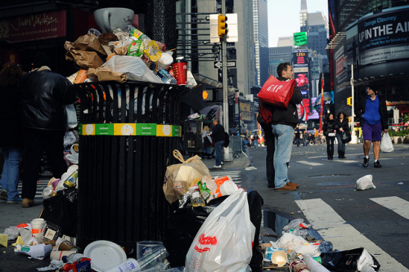
Solid waste management in New York City
Classification of NYC MSW
N. J. Themelis “INTEGRATED MANAGEMENT OF SOLID WASTES FOR NEW YORK CITY” NAWTEC 2002

Slide 10
Solid waste management in New York City (cont.)
Disposition of NYC-MSW
Distribution of landfills of NYC-MSW
N. J. Themelis “INTEGRATED MANAGEMENT OF SOLID WASTES FOR NEW YORK CITY” NAWTEC 2002

Slide 11
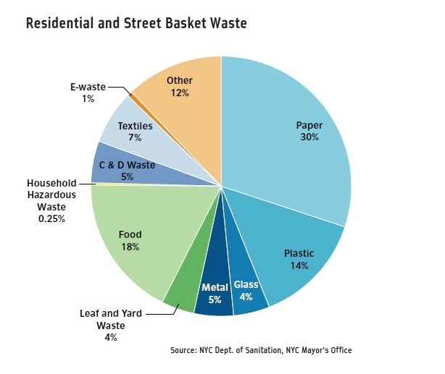
NYC residential and Street Basket Waste

Slide 12
New York Times: Food Composting in NYC

Slide 13
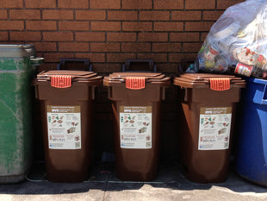
Bloomberg called food waste “New York City’s final recycling frontier.”
“We bury 1.2 million tons of food waste in landfills every year at a cost of nearly $80 per ton”

Slide 14
Project objectives
Quantifying rat behaviors in urban environment
Predicting interaction between human activities (food waste generation) and rat behaviors in urban environment
Suggesting a new mathematical model for minimizing reproduction of rats

Slide 15
Methodology
Data collection
Field work (food waste, rat behavior)
Experimental work (urban and Collaborative Sensing)
Data analysis
Data mining (parameters such as waste generation, rat reproduction)
Data mapping
Quantitative analysis (mathematical work)
Diffusion/Dispersion model (Stochastic model)
Correlation between food waste and rat habitat/population

Slide 16
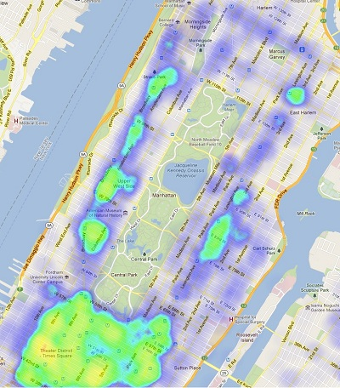
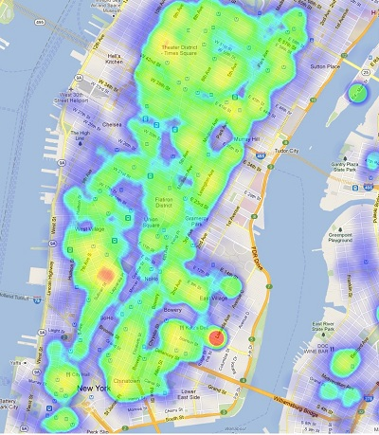
Stochastic model (Environmental Simulation)
Food waste generation data
Geographic Information Systems (GIS)
Quantified rat
behavior
http://nycopendata.tumblr.com/post/15622444237/visualization-submission-heatmap-of-restaurants-in-new

Slide 17
Raccoon behavior
http://www.pbs.org/wnet/nature/lessons/observing-the-secret-lives-of-raccoons/enhanced-video-resource/7945/

Slide 18
Cat behavior research using GPS
BBC news: http://www.bbc.co.uk/news/science-environment-22567526

Slide 19
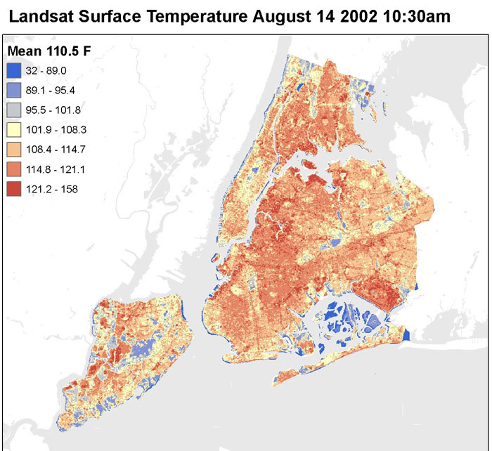
Surface Temperature of NYC

Slide 20
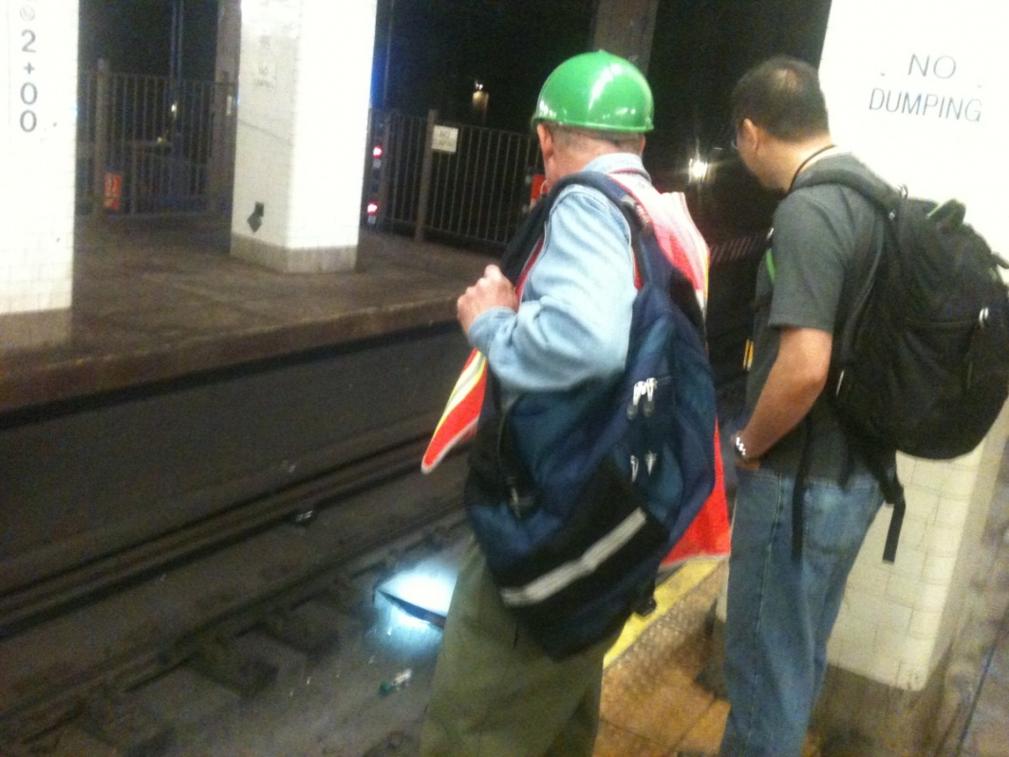
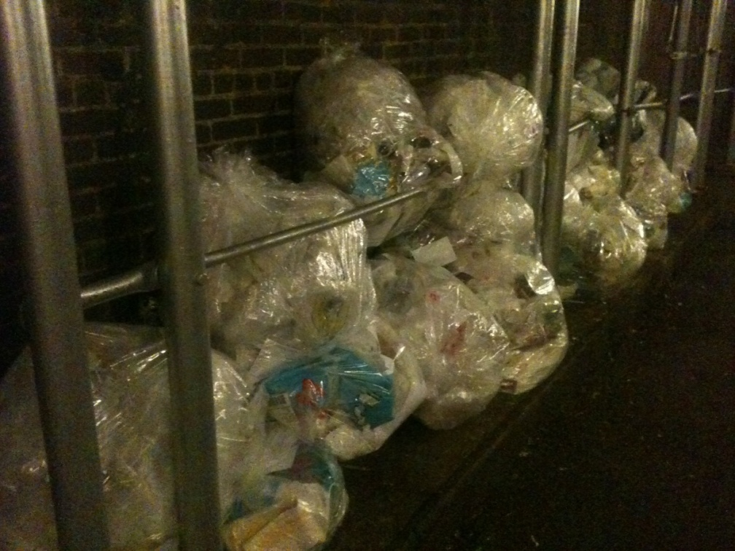
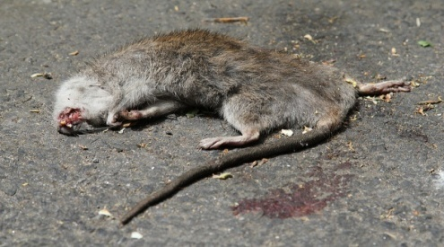
Field Work - Rat safari -

Slide 21
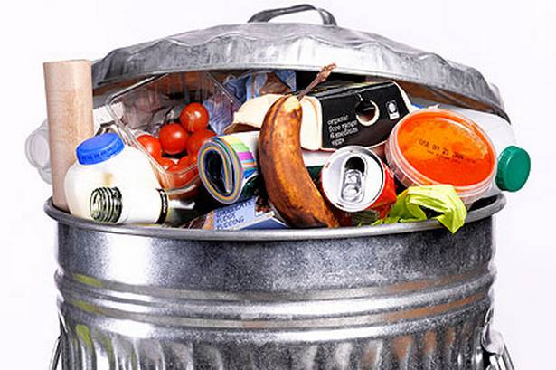
Food waste is very attractive for rats & mice

