Slide 1
Food Accumulation Rate
Monday | Tuesday | Wednesday | Thursday | Friday | Saturday | Sunday
1 | 1 | 1 | 1 | 1 | 0 | 1
F_{R} (t) =
F_{P} (t) =
F_{B} (t) =
F_{T} (t) =

Slide 2
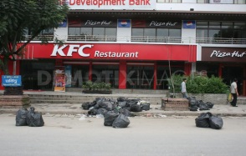
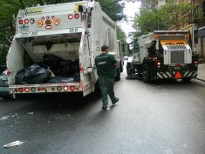
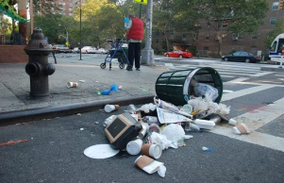
T : Temperature Ea : Activation Energy
1
2
3
4
Waste Pick-up (collection)→
At day time
At night
At day time
At day time
Waste decomposition
Dry stream (plastic, paper)
Wet stream (food waste)
Decomposition rate
${Rate}_{decomp}=A.e^{−\frac{Ea}{RT}} →$
$$F_{R}+F_{P}+F_{B}+F_{T}−{Rate}_{decomp}=F_{C1}+F_{C2}+F_{C3}+F_{C4}+F_{left over}$$
Mass Balance of Food
In
Out
Restaurant
(A)
$$F_{R}(t)$$
F_{C1}
Street
(D)
$$F_{P}(t)$$
F_{C2}
Bench
(D)
$$F_{B}(t)$$
F_{C3}
Trash Can
(B)
$$F_{T}(t)$$
F_{C4}

