Slide 1
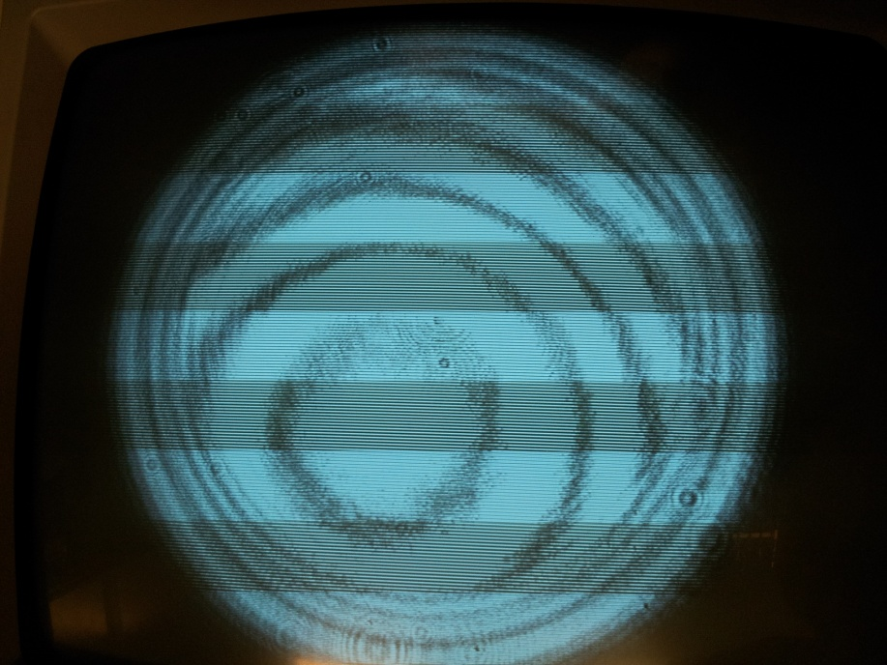
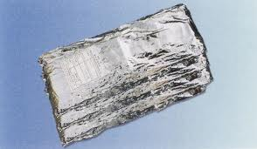
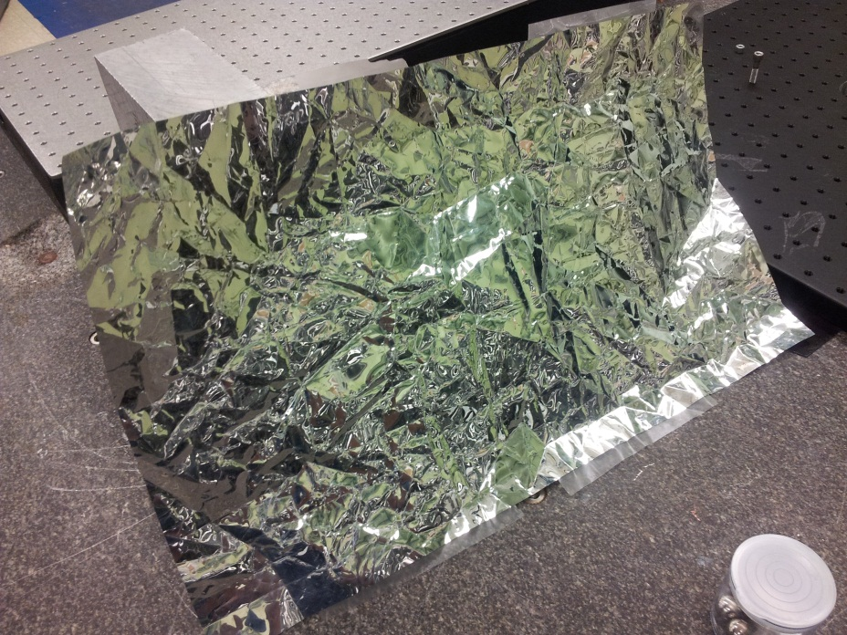
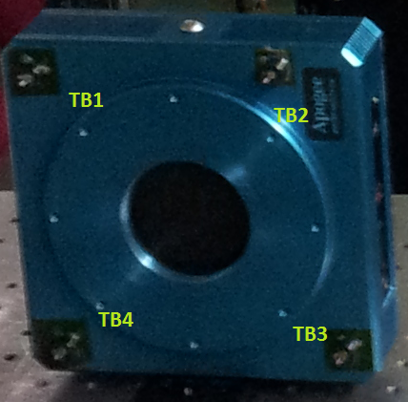
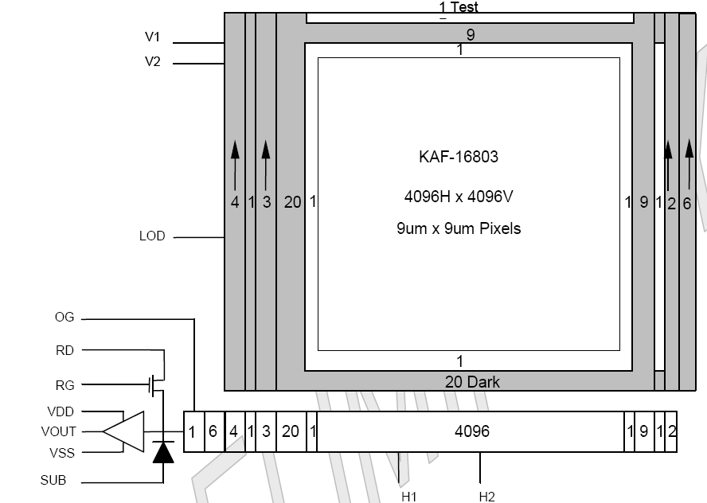
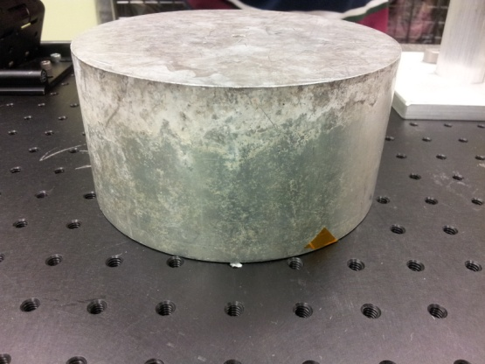
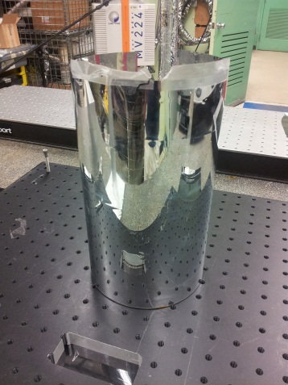
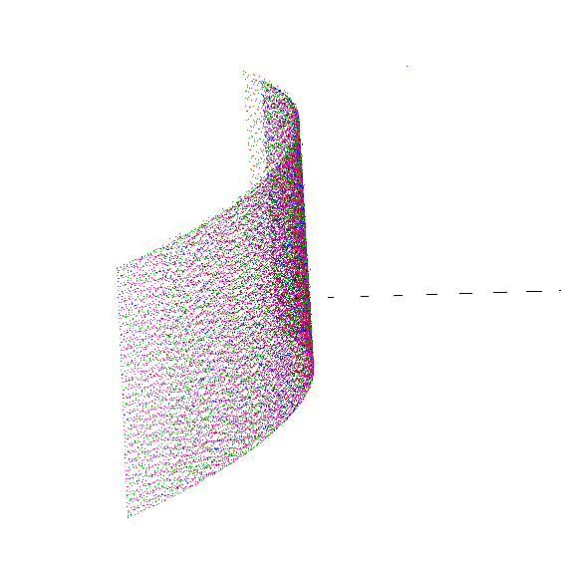
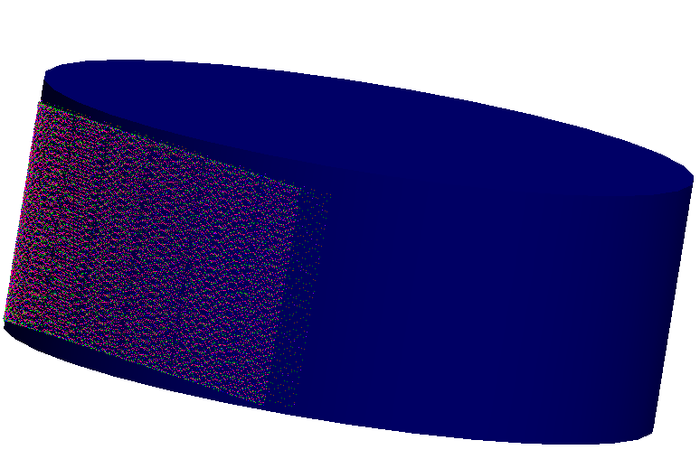
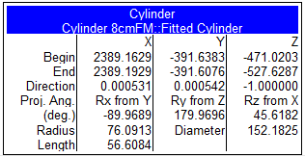
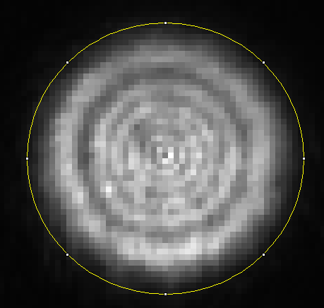
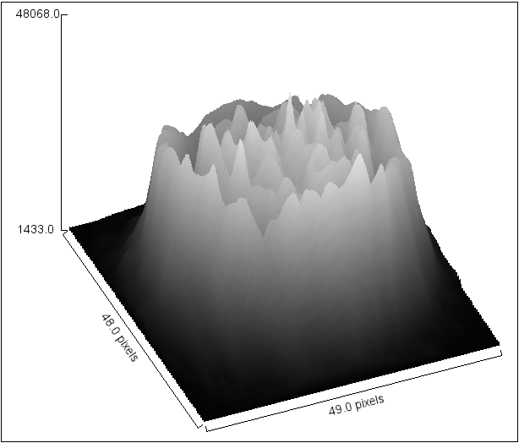
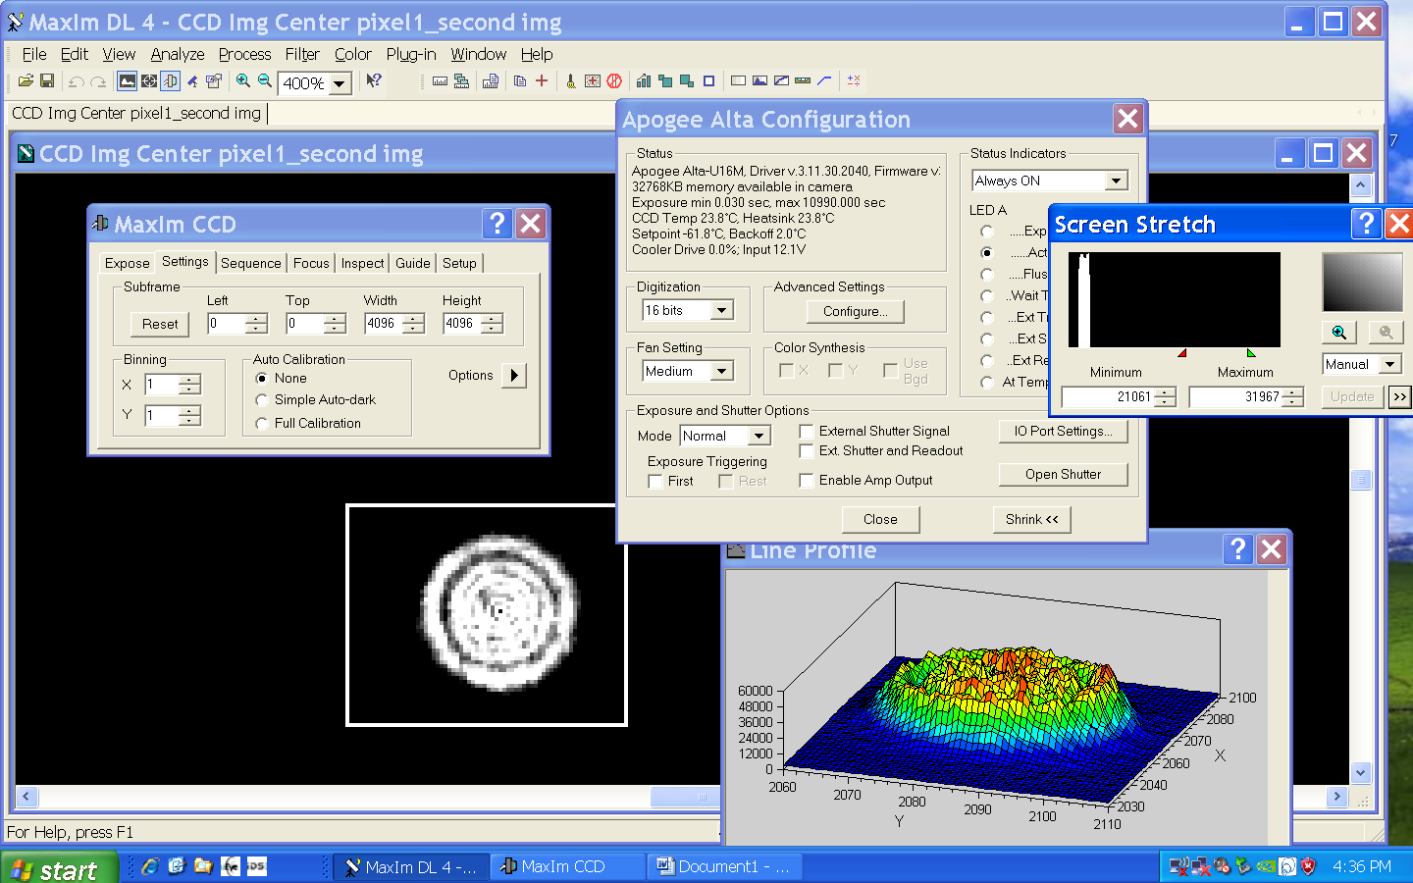
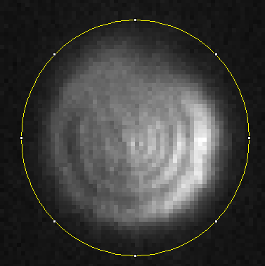
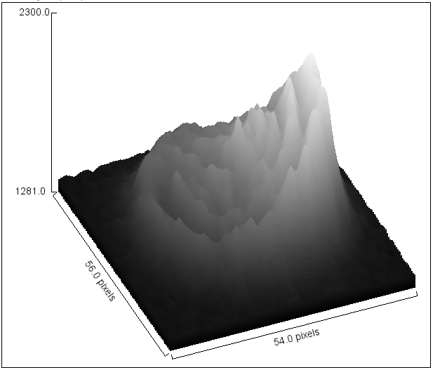
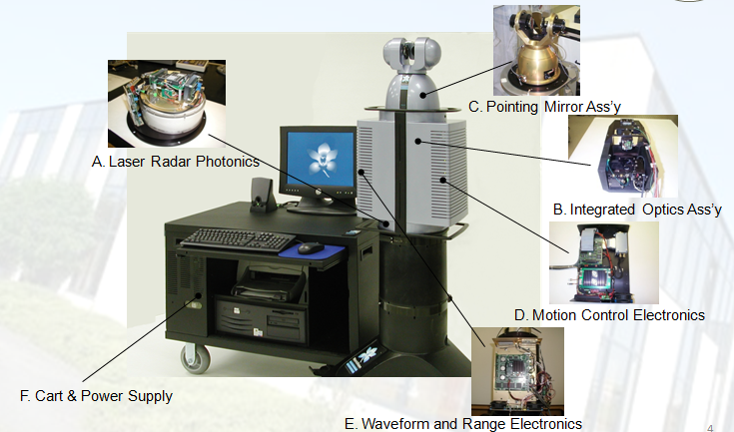
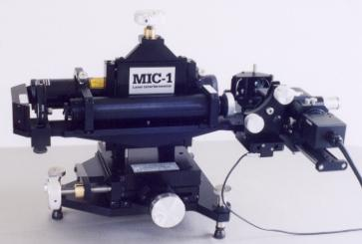
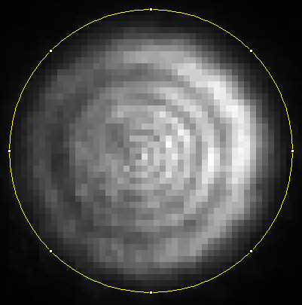
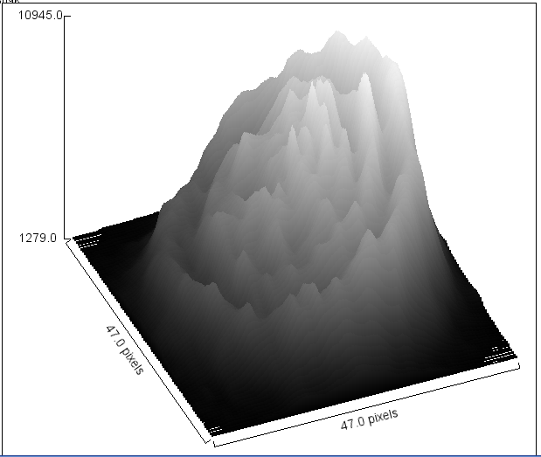
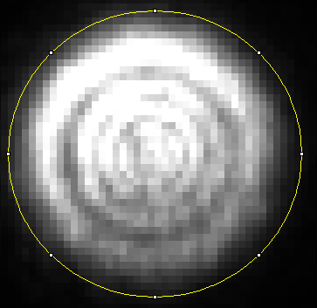
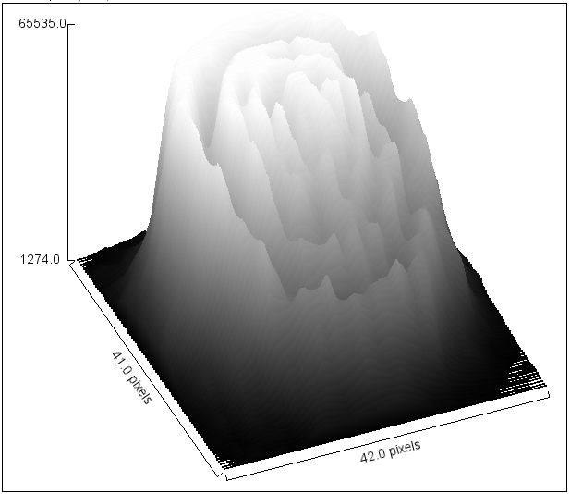
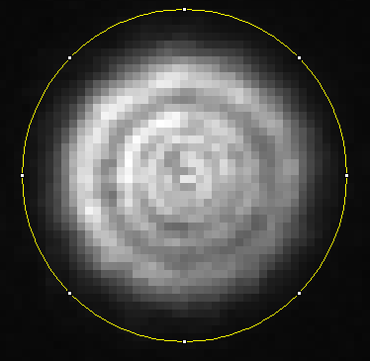
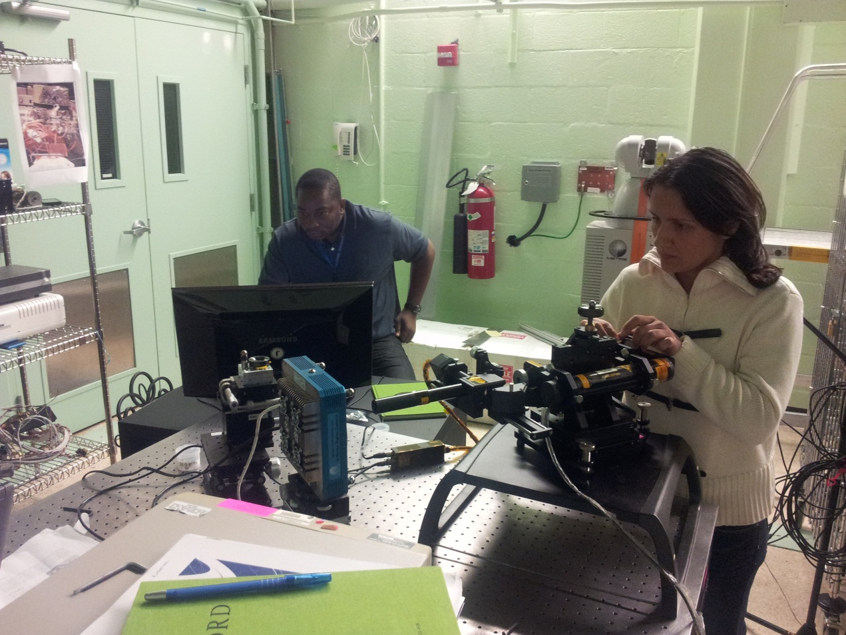
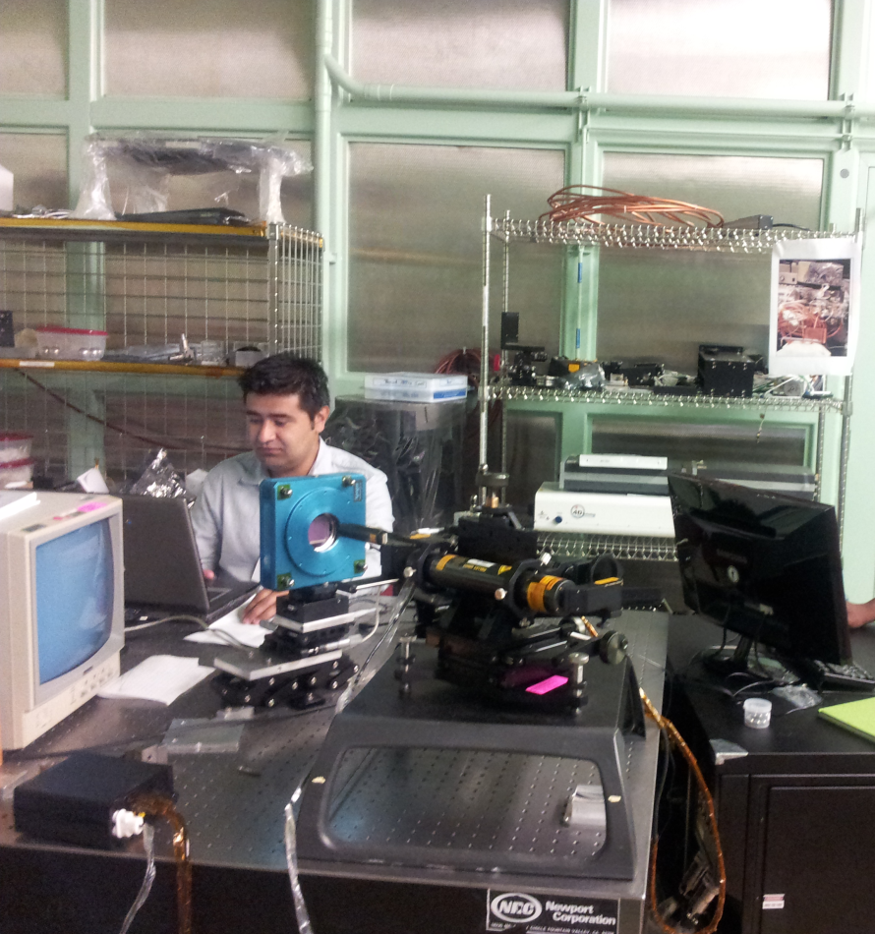
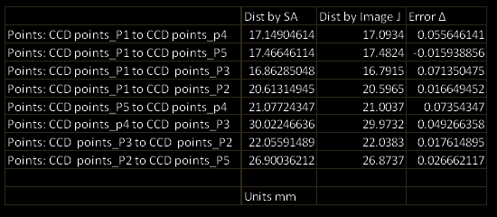
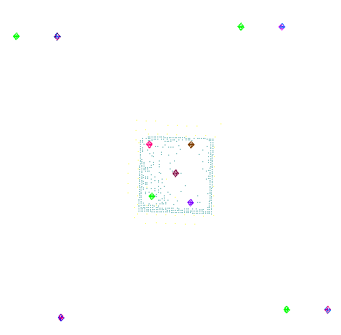
Non-contact measurement of large format detectors and thermal blanket
material surrounding the flight instruments of JWST
Edwin Olaya¹, Agossa Segla¹, Viviana Vladutescu¹ Phillip Coulter², Theo Hadjimichael² , Raymond Ohl²
¹Department of Electrical and Telecommunications Engineering Technology, NYCCT/CUNY ² NASA Goddard Space Flight Center, Instrument System and Technology Division, Optics (GSFC 5510)
Abstract
Project 1 CCD Measurement Procedure
Project 2 Thermal Blanket Scanning
Hubble successor, the James Webb Space Telescope (JWST) is an infrared-optimized space telescope to be launched in 2018. The goal of JWST is to see first galaxies that formed in the early Universe, connecting the Big Bang to our own Milky Way Galaxy. In the first project, our goal is to Calibrate a CCD Detector array’s alignment such that each pixel is mapped into the coordinate system used by JWST at ambient. This procedure is to ensure proper alignment of the optical telescope with the space instrument sensor. This is done by verifying the relative positions of the PAR (Pupil Alignment Reference) at the entrance pupil with respect to the exit pupil. The instruments used in this non contact measurement procedure are the Laser Unequal Path Interferometer and the laser radar. The second project is to find the differences of scanning an object with a smooth blanket, wrinkle blanket and without the blanket by using the Laser Radar and the software Spatial Analyzer.
1. Setup the MIC -1 interferometer
2. Install a polarizer or ND filter to reduce beam power
3. Position a 0.5 inch tooling ball (TB) at the focus of the interferometer. Use an objective with a longer focus distance (at least an inch or so).
4. Fine adjust TB position until the interferogram indicates focus.
5. Open a new collection in SA.
6. Measure the TB with the laser radar using “tooling ball 0.5 inch” mode.
Name the group detector face and name the point appropriately.
Note the tooling ball are installed in the frame of the CCD. The CCD
has 4 TB’s in each corner.
7. Remove the TB and place the detector at the focus.
The detector will be aligned so that the beam hits the center of the CCD array.
8. Power on detector and computer and obtain an image.
9. Adjust the detector (on stages) so that the beam is at best focus.
10. Remove interferometer objective and align the detector in angle.
11. Repeat steps 8-10 iteratively until alignment is achieved within reason.
12. Take an image of the laser spot. Settings are necessary
so that none of the pixels are saturated.
13. Scan the detector surface using vision scan.
14. Scan the detector surface with fast metrology scan.
-Scan the detector surface with metrology scan.
15. Measure the TB tie points on the detector.
16. Remove CCD and realign 0.5 inch TB to interferometer.
17. Measure the 0.5 inch TB again with LR.
18. Move CCD in plane to the next spot
19. Repeat steps 9-18 (skip steps 13-16). Open a new collection and instrument for each spot.
In this project we used the VDA-2 Aluminized blanket. The thermal blanket is part of the Thermal Control sub-system. The blanket is a thin foil material that covers the entire satellite, and it does just what you would think a blanket would do: it keeps the satellite warm in the cold and cool in the heat. Satellites are exposed to both very cold and very warm temperatures (-120 to +180 degrees). Without the thermal blanket, the delicate electronics would be damaged.
VDA-2 Aluminized
(Thermal blanket)
Introduction
Fringes from MIC-1
Interferometer
Project 2 Blanket Procedure
Non-contact measurement is an innovation that include 3D Scanning, 3D laser scanning software, 3D inspection, photogrammetric, surface modeling and digitizing. This technology was initially available only to the government. In the last few years this technology has become available to general commercial institutions. One of the devices use for both projects is called Laser Radar. It is an optical measurement system that provides fully automated, non-contact measurement without any offset . The laser radar use TBs (tooling balls) as a reference points. Laser Radar is able to measure 500 points for second and able to measure extremely hot or cold surface. For both projects we used the laser radar with the Software SA (Spatial Analyzer).
.
In this project we scan 4 types of objects (Three Cylinders and one Rectangular Block). First we scan the 6 inch cylinder (Figure 1). In figure 2 we can see the scanning clouds on SA(Spatial Analyzer). After scanning the surface of the cylinder, we create a geometry fitting in SA(Figure 3). The steps above are repeated with first a smooth blanket around the object (Figure 5) and then with a wrinkled blanket. The types of scans used in this measurement are Visual Scan, Metrology Scan and Fast metrology scan In the end the data is analyzed using SA. The fitting of the cylinder cloud points is shown in Figure 4. The model created in SA based on the observations is shown in fig 6.
Instrumentation
CCD Camera System ALTA U16M
with the tooling balls
Figure 1. Cylinder 6 Inch Diameter
Figure 5. Cylinder 6 Inch with the VDA-2 blanket
Figure 2. SA scan
(Metrology Scan)
Figure 3 Cylinder obtained after used geometry by fitting in SA.
For this project, we use the Laser Radar (Nikon Metris MV224), a pc with the software Spatial Analyzer, CCD Camera System ALTA U16M, it uses a very large format 16-megapixel full frame sensor (4096 x 4096 array, 9 x 9 micron pixels) and the Tooling Balls. The TBs are positioned in four corners of the CCD and are used to determine the position of the CCD with respect to the reference frame. The software used for the CCD, called Maxim DL 4 allowed us to visualize the laser beams on the CCD and improve the alignment. The diameter of the tooling balls used in this non contact measurements is 0.5” (figure 6), however other sizes can be used too. The measurements were performed on a highly stable optical breadboard table.
.
 | Without blanket | With smooth blanket | With wrinkled blanket
Scanning Type | Vision Scan | Metrology Scan | Metrology Scan
Diameter (mm) | 152.1825 | 151.4842 | 151.1903
Scan Points | 28206 | 5350 | 5942
Points used | 24795 | 660 | 713
Project 1 Data Analysis
Data of the Cylinder obtained by SA.
Data collection with Maxim DL 4 Software
These preliminary analysis yield 1mm error in the measured radius of the unwrapped scanned object in comparison with the measurements of the same object wrapped in smooth and wrinkled blanket , however the 1mm is much smaller than the 12 mm clearance for blanket.
Group 1-
center of CCD
Group 2
Conclusion
For project 1 we compared the data from two different sources, one is the SA and the other one is Image J. You can see the good agreement between the two software packages. We compare both measurements and obtained a maximum difference between retrievals of 0.071 mm and the minimum of 0.015 mm. The tie points (positions of TBs in SA) for the TB’s on the plane of the CCD and the ones on the frame of the CCD, we were able to fit all the pixels in the same coordinate system and determine the distance between each TB and each pixel.
Group 3
Pixel Position in Image J
Group 4
Group 5
Laser Radar and PC Station with SA(Spatial Analyzer)
MIC-1 Laser Interferometer
References
Laser Radar
MIC-1 laser Screen
Maxim DL 4 software
Pixel Position on SA(Spatial Analyzer)
- SA Training Manual, New River Kinematics inc. 11-14-2004
-User Manual SA (Spatial Analyzer)2011-12-22
-Introduction to Large Scale Portable Metrology, Metris.
-NASA - NASA Goddard Engineers Testing Webb Telescope's OSIM
www.nasa.gov/topics/technology/features/webb_osim.html
-Alta U16M - Apogee Instruments, Incwww.ccd.com/alta_u16m.html
-James Webb Space Telescope, Fine Guidance Sensor Engineering Test Unit Metrology Procedure, November 3, 2011, Goddard Space Flight Center.
-MIC-1 Laser Interferometer User Guide, Buccini Instrument Company
SA software
TBs and CCD
SA and Image J Comparison
Pixel 2
TB1
TB2
Pixel 3
CCD
MIC-1 Laser Interferometer
(476.41A, 3731.12)
(2925.09, 3741.41)
Center point 1
TBs on the Fame of the CCD
SA software
Pixel 5
(2066.32, 2085.09)
TB3
Pixel 4
(654.896, 750.494)
TB4
(2963.85, 411.28)

