Slide 1
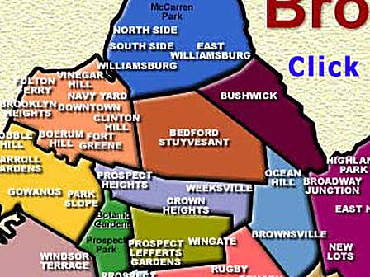
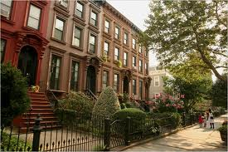
Community Assessment: Bedford Stuyvesant
By: Shakima Wiggins, Sandra Isaacs, Ahlam Alrubayai, Jeannie Mathieu and Rashida Johnson

Slide 2
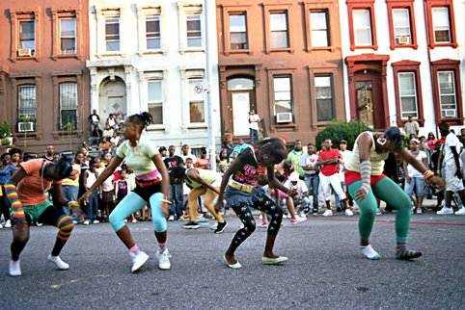
Bedford Stuyvesant
We assessed the Bedford Stuyvesant community in Brooklyn, New York. Commonly abbreviated as Bed-Stuy, this area was formed in 1930 and is located in the middle of the borough. Its bordering neighborhoods include Williamsburg located to the north, Crown Heights located to the south, along with Bushwick and Clinton Hill located to the east and west respectively. This neighborhood is primarily residential and has been noted for its distinctive brownstone style houses, lining many of blocks.

Slide 3
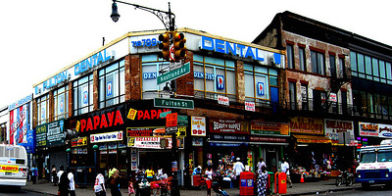
Community Development
There aren't many factory or industrial structures found within this area of Brooklyn and the majority of the non- residential buildings existing are in the form of retail stores and restaurants which are open to the public.

Slide 4

Since 2002, Albert Vann who is native to the area, has served as city councilman of the entire district 36 of which Bedford Stuyvesant belongs. His office is located within the neighborhood on Throop Avenue. During the summer of his election, Councilman Vann formed a neighborhood taskforce comprised of leaders and community organizations, united to improve the physical, social and economic needs of this community. Other community groups include Project Regeneration whose services include educational assistance for teens and the Brooklyn movement center whose focus is community improvement and safety.

Slide 5
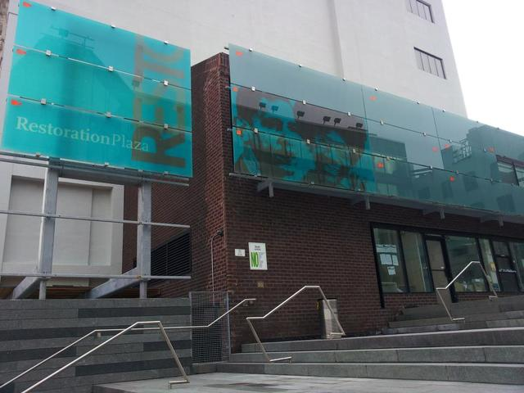
There are 22 public elementary schools that service Bed-Stuy and its district. There are five public junior high schools and four public high schools including the well known Boys and Girls and Paul Robeson high schools. There are also more than a dozen private/ parochial schools and at least four charter elementary schools available to the residents of this area. Another staple of this neighborhood is the Restoration Plaza which offers adult education (GED) classes as well as employment, financial, fitness and health services to area residents.

Slide 6
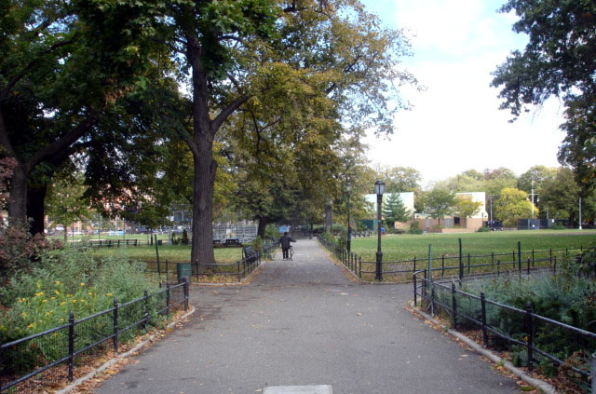
Environment
There doesn’t appear to be any extraneous threats to the air quality of this community, not found within the overall city and the area is actively monitored by the New York State Department of Environmental Conservation who issues advisories as needed.
Aiding in the efforts to preserve the air quality while providing recreational space for the area are the many community gardens and parks found throughout the neighborhood. These include Stuyvesant Park, Goodwin Gardens, Fulton Park and Herbert Von King Park. People gather at Fulton Park for their annual summer art fairs and Halloween parades while the Herbert Von King Park offers area residents outdoor concerts during the summer and various indoor activities throughout the year within the cultural art center.

Slide 7
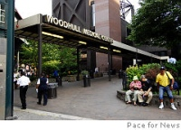
Health
Other health services available to the residents of Bed-Stuy include those found at the Bedford Stuyvesant family health center which offers a full range of treatment and prevention services like, pediatric, women’s health, gastroenterology and dentistry. There are other small clinics found throughout the area and a host of private medical doctor’s offices as well. Two local hospitals are easily accessible to residents and they are Interfaith medical center and Woodhull hospital and Mental health center. Both offer outpatient clinic services as well as acute care and emergency services to both children and adults.
Despite the beauty of the neighborhood and the abundance of things being done to improve the quality of life for its residents, there are still indications that there is room for improvement. There is the presence of drug activity in public spaces and a substantial amount of buildings which have become desolate. Rebuilding of the community needs to continue. Obesity also seems to be a cause for concern for both adult and child members of the community. This suggests the need for more community outreach to make them aware of the health care programs and services that are currently available.

Slide 8
Health Disparities
Hypertension 24.8%
Asthma 19.9%
Diabetes 15.7%
Hearing or vision problem 15.2%
People in this community who have health issues are given an opportunity to make healthier food choices. By consuming a diet rich in fruits and vegetables, preventative measures are also encouraged. Thus preventing diseases such as diabetes, obesity, and hypertension .

Slide 9
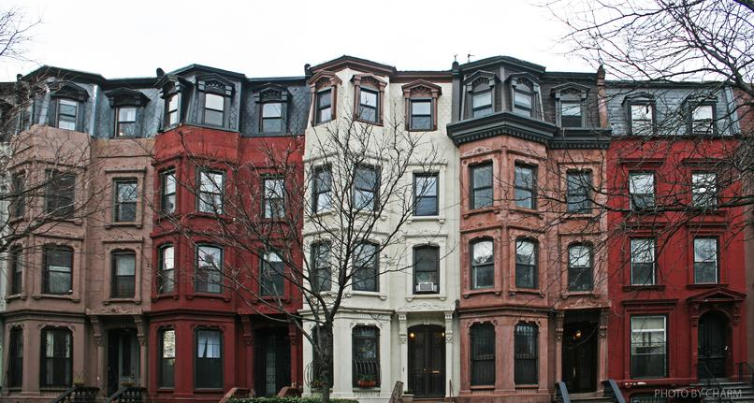
Housing
Bedford-Stuyvesant consists of rows of brownstones from the 1800s. The houses are solidly built and durable.

Slide 10
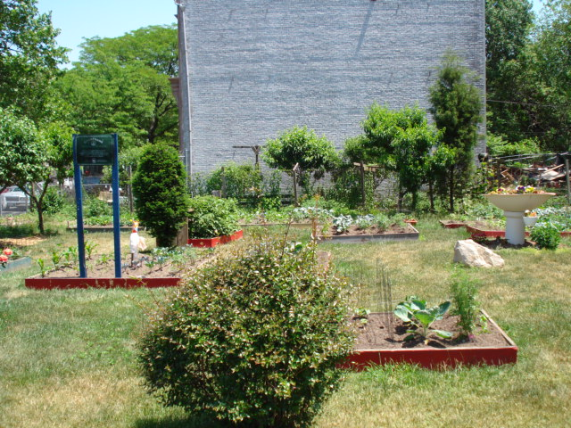
Garden
Located in the Bedford-Stuyvesant section of Brooklyn, 3,200 square feet.
Has long been known for the large quantities of fruits and vegetables including collard greens, tomatoes, okra, and pole and bush beans. They were cultivated there for many years by local gardeners and shared with senior citizens and others in the community.
Generous contributions were made by Dr. Leslie Dae Johnson.
Serves a neighborhood comprised primarily of single and multi-family homes and is within walking distances of several public schools.

Slide 11


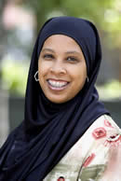

People in this community are predominantly African American, white, and recently a high concentration of African Muslims.
The Muslims usually dress in their habit and others casual.

Slide 12
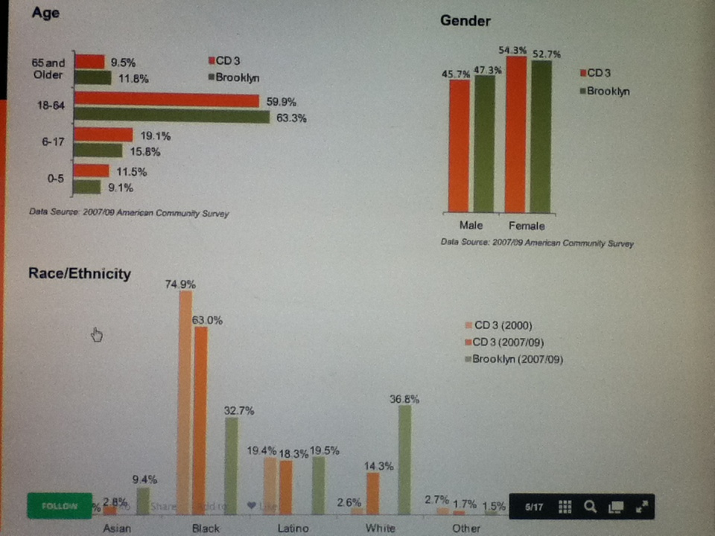
Age/ Gender/ Race statistics

Slide 13
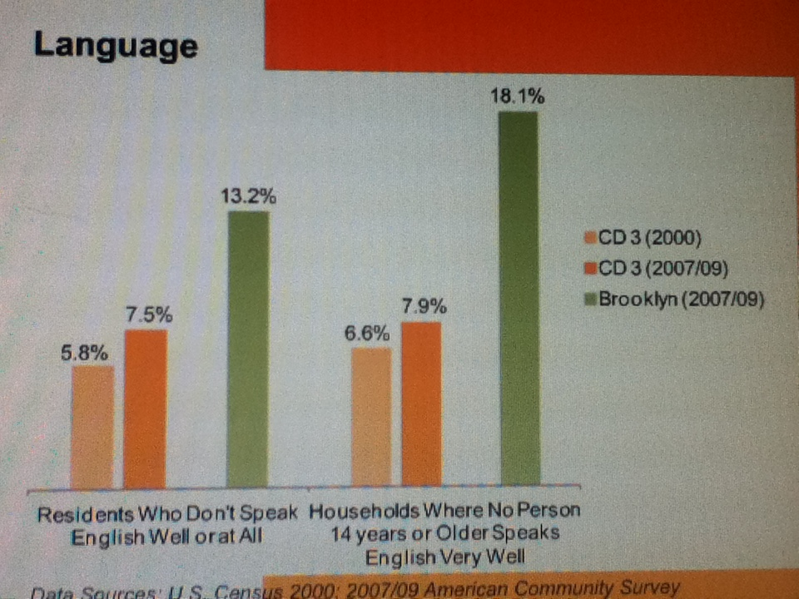
Language statistics

Slide 14
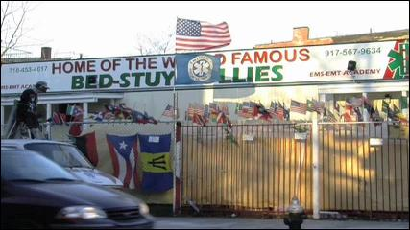
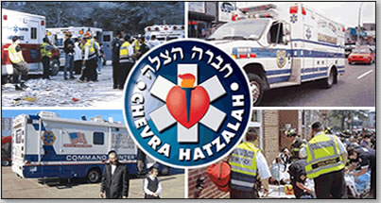
Safety services
There are two EMS centers located in Bedford-Stuyvesant:
EMS
  The Bedford-Stuyvesant Volunteer Ambulance Corps
    727 Greene Ave, Brooklyn, NY
  Cherva Hatzalah
    518 Park , Brooklyn, NY

Slide 15
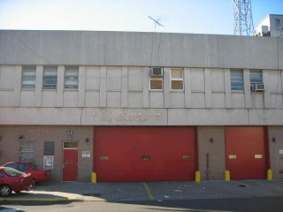
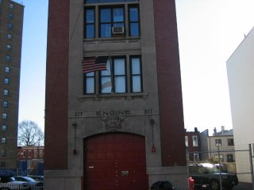
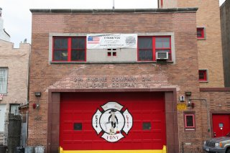
Fire Departments:
  Engine 222/Battalion 37 32 Ralph Avenue
  Engine 214/Ladder 111 495 Hancock Street
  Engine 217
  940 Dekalb Avenue

Slide 16
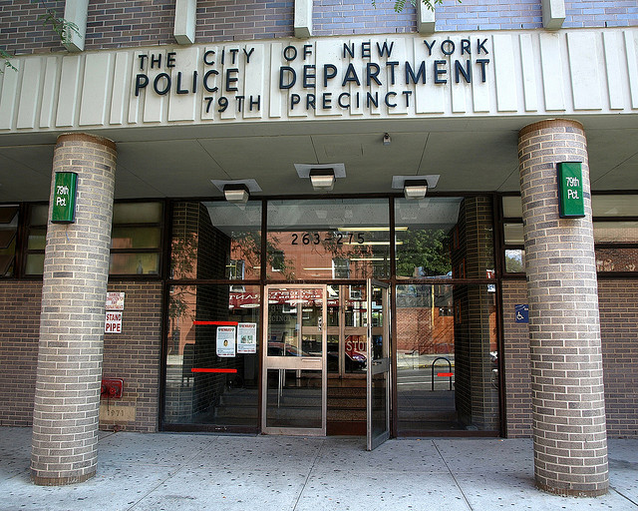
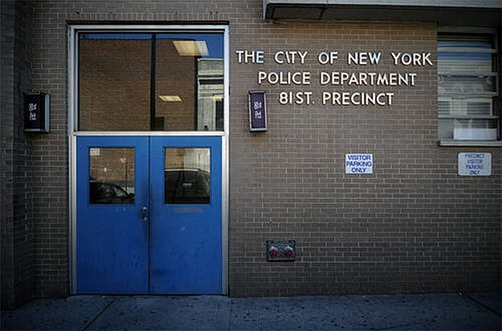
Police:
  79th Precinct 263 Tompkins Avenue
  81st Precinct 30 Ralph Avenue

Slide 17
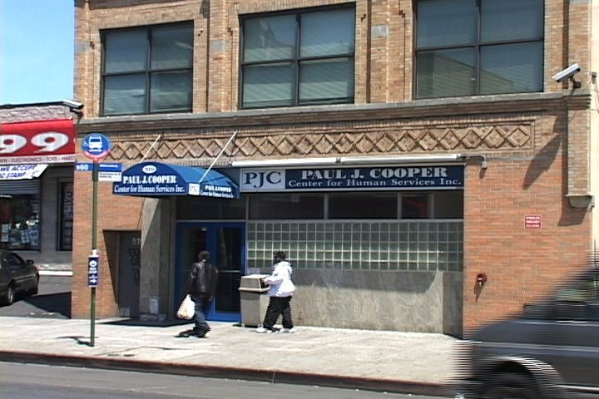
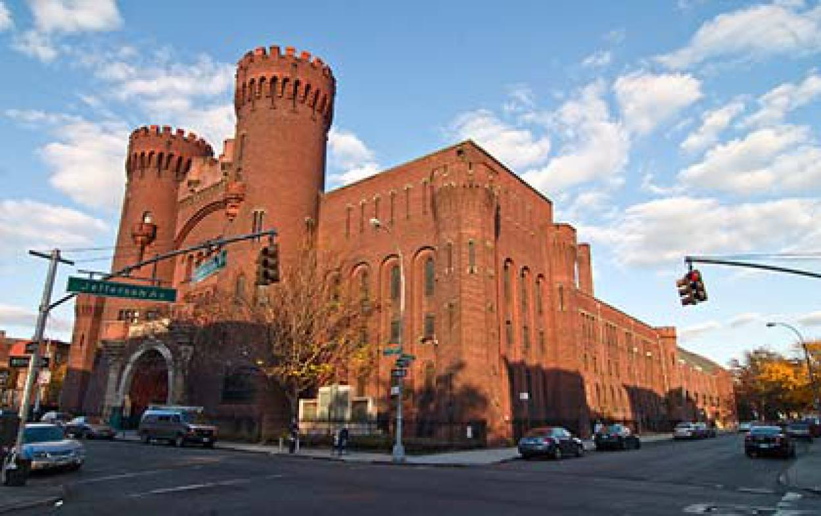
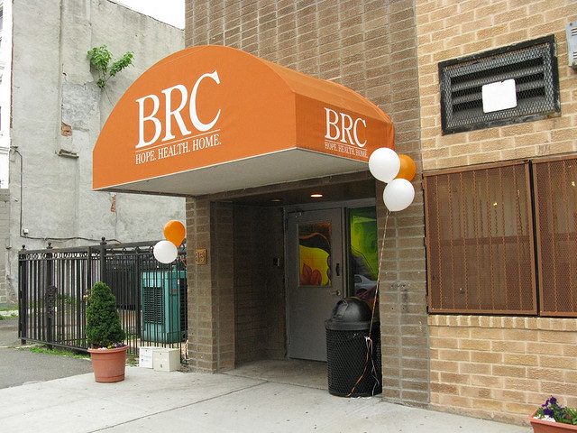
Shelters:
  Paul J. Cooper Center for Human Services 510 Gates Ave
  Wayside Macdonough Residence 771 MacDonough St
  Healthy Living Housing 398 Bainbridge St
  Lexington Ave Womans Shelter 85 Lexington Ave

Slide 18
Shopping/common areas
Types of eateries/restaurants:
  Bedford-Stuyvesant has an arrangement of eclectic restaurants that cater to different palates from southern soul to French style. In this neighborhood there is also fast-food, Chinese food, pizza shops, and coffee cafes. Prices for the foods listed are reasonable and cheap. Bedford-Stuyvesant include a thriving donut shop called Dough and an organic ice-cream shop called Frozen Social. Bed-Stuy really has something to offer for
Stores and theatres:
  Bedford Stuyvesant has a high number of corner deli’s for everyday groceries. Also supermarkets are readily available in the neighborhood. There are clothing stores popular on Fulton St. Unfortunately there are no movie theaters located here. Access to these stores are easily obtained by bus, train and car. Prices are also very reasonable.

Slide 19
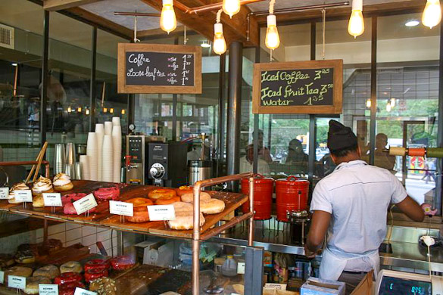
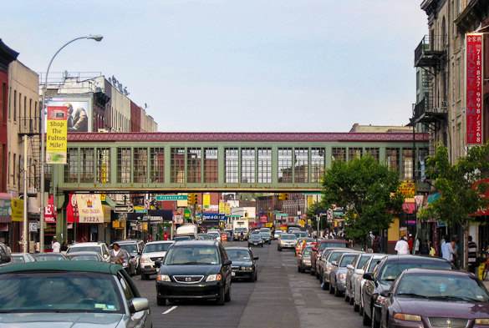
The donut shop, Dough in Bed-Stuy
Shops along Fulton Street in Bedford-Stuyvesant, Brooklyn

Slide 20
Transportation
Availability:
  The A and C trains run along Fulton Street and take you straight to Lower Manhattan, while the G train goes to Queens, and the J & M trains take you through Williamsburg to Lower and Midtown Manhattan. Bedford-Stuyvesant also has two LIRR stations, Nostrand Avenue and East New York, where you can catch a train to Long Island to visit one of the many great beaches there and the bus system B26 15,43,52,47,46,54, 44,48,38. There are also hailing cabs and $1 cabs. These modes of transportation are fast and can take anyone to anywhere else in New York.
Avenues/Highways:
  Avenues: Bedford, Dekalb, Nostrand, Lewis, Atlantic, Park, Flushing.
  Highways: There are no highways running through Bedford Stuyvesant

Slide 21
Status of the Community
30% of adults in Bedford-Stuyvesant are obese, compared with 20% in New York City as whole.
About 12% of adults in Bedford-Stuyvesant have diabetes, compared with 9% citywide.
The reason for more obesity in low-income neighborhoods may be twofold: fewer safe places to exercise, such as parks, and less access to healthy food, including fresh fruits and vegetables.

Slide 22
Based on a community assessment that was conducted Bedford-Stuyvesant has approximately 373 food stores, and Bodegas are the most common in the neighborhood.
They offer convenient locations and hours, but are more expensive and have a much narrower product selection than most other stores.
Supermarkets have lower prices and a wider selection of food, but are less conveniently located.

Slide 23
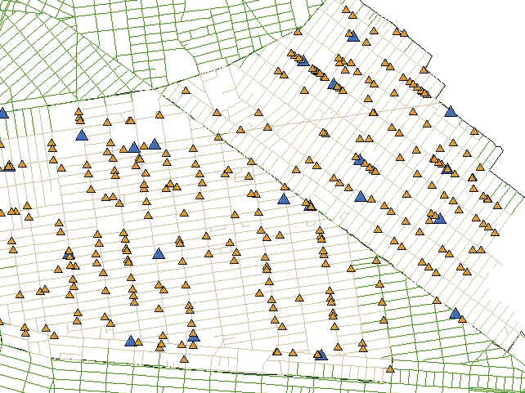
Bodegas far outnumber supermarkets in Bedford-Stuyvesant and Bushwick.
Blue triangles represent Supermarkets.
Orange triangles represent Bodegas.

Slide 24
Community Status cont’d
Most storefronts in Bedford-Stuyvesant (about 90%) feature ads. The most common are for less-healthy, sugar-added juices, energy drinks, and sodas.
More than half advertise alcoholic beverages, especially beer, but ads for water and diet soda are rare.
In Bedford-Stuyvesant, 44% of stores display cigarette ads.

Slide 25
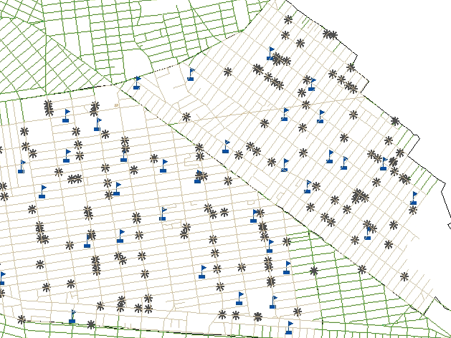
Stores advertising cigarettes are located near every elementary school
*Food stores with cigarette ads.
Flags: Elementary schools.

Slide 26
Community Status cont’d
Most restaurants (73%) offer only take-out service.
There are 94 restaurants in Bedford-Stuyvesant and the most common foods served are Chinese, Latin American, and pizza.
National fast-food chains, such as McDonald’s and Kentucky Fried Chicken, represent 13% of restaurants in the community.
New Yorkers eat out and take out frequently. Any strategy for healthy eating should take local restaurants into account.

Slide 27

Strength and Weaknesses
Bed Stuy has many strengths and weaknesses. Some of the weaknesses include the existence of gun violence within the community, deterioration of police-community relations, struggling schools and some high negative health outcomes.
Strengths aside from the rich culture, beautiful brownstones and abundance of parks, Bed Stuy’s ability for residents to organize in order to address community issues. One of the main organizations is the Coalition for the Improvement of Bedford Stuyvesant. Their main goals are to maintain and enhance an equitable, healthy and sustainable community that produces economic and social progress.

Slide 28
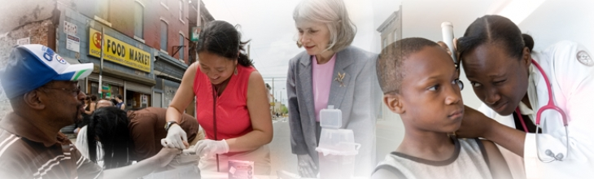
Role of the Community Nurse
One way in which the community nurse can maximize the health of the Bedford Stuyvesant community is by providing education on nutrition and healthy choices for residents within the community.
The community nurse can also collaborate with the community hospitals to start drives that monitor hypertension, diabetes and obesity within the community. Teaching should also revolve around preventing and controlling hypertension and diabetes.

Slide 29

THANK YOU !!

